Slide 1

Zero-ID
zero
Knowledge
proof
based
identity
verification

Slide 2
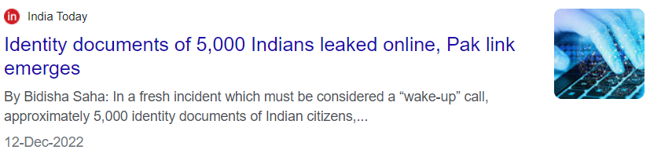
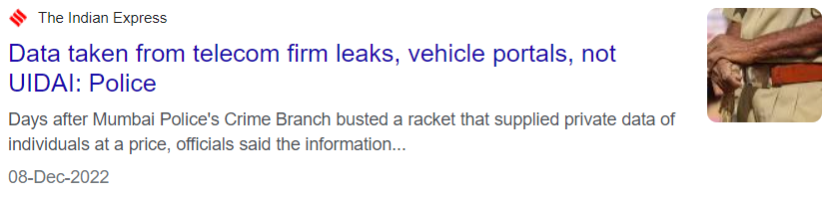
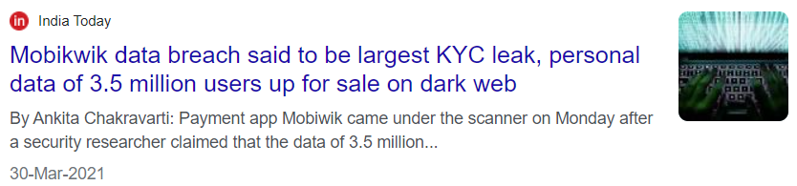
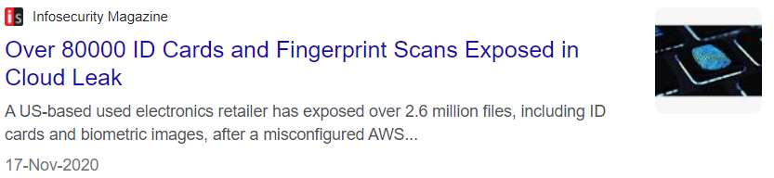
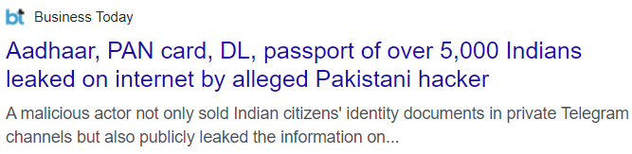
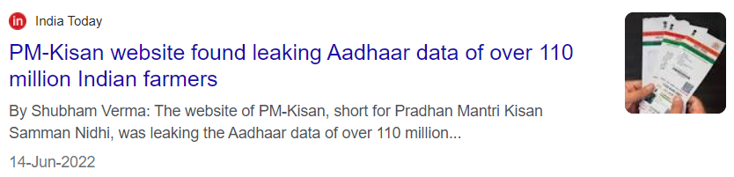
Zero-ID
NEWS

Slide 3
Zero-ID
PROBLEM
To prove identity one need to show their identity document, or may be required to submit a copy of same to the vendor. Here is a high chance that that document can be misused by vendor. And sometimes our documents are found in data breaches.

Slide 4

Zero-ID
UNIQUE
VALUE PROPOSITION
So to stop this, we can have zero-knowledge-proof based identification system where people won't have to show original document of proof all the time and still verifier will understand that he/she is the genuine person.

Slide 5
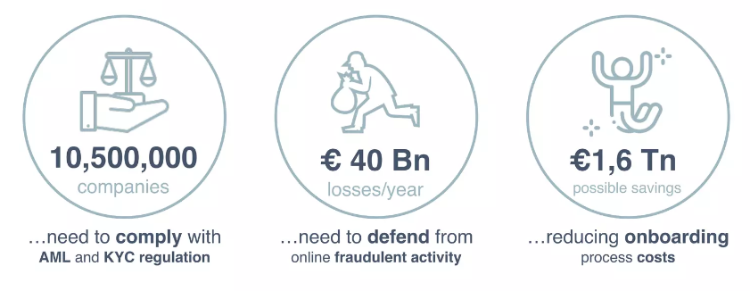
Zero-ID
UNIQUE
VALUE PROPOSITION
As per report by government of United Kindom

Slide 6
Zero-ID
SOLLUTION
One need to show id proof to centralized authority only once. Based on zero-knowledge-proof algorithm a badge will be generated which can be later used instead of id as a proof. This way original document is not revealed and identity is also proved. The badge cannot be decoded in anyway to retrieve the original id.

Slide 7
Zero-ID
TECHNOLOGY
STRENGTH
Fully Automated
Easy & Fast API and SDK integration
Unique addons for d2c companies
Personalized service
Economies of scale

Slide 8








Zero-ID
ENTERPRISE
PIPELINE
BANKING, FINANCE, GOVERNMENT, TELECOM etc…

Slide 9
Zero-ID
MARKET
CAP
Total Available Market
$1.2 Bn
Servicable Available Market
$406 Mn
Servicable Obtainable Market
$18 Mn
REVENUE MODEL B2B with per successful id verification basis
The global blockchain identity management market size was valued at $107.00 million in 2018, and is projected to reach $11.46 billion by 2026.
Global KYC spending projected to total $1.6 billion in 2022.
According to a report by MarketsandMarkets, the global KYC market is expected to grow from USD 467.2 million in 2019 to USD 1,105.4 million by 2024, at a compound annual growth rate (CAGR) of 18.9% during the forecast period. The report also highlights the increasing adoption of advanced technologies such as artificial intelligence, blockchain, and ZKP in KYC solutions.

Slide 10
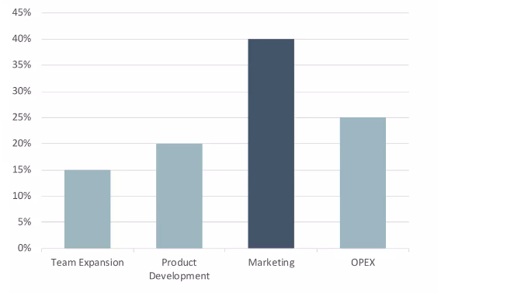
Zero-ID
INVESTMENT
ALLOCATION

Slide 11


Zero-ID
Team
Cipher Force
Contact Us:
sharma_ashu@outlook.in
ASHU
SHARMA
Tech
DIPTI
MISHRA
Sales & Marketing

Slide 12
Zero-ID
ThankYou
QnA

