Slide 1

NARRATIVE DESIGN · MOTION STORYBOARD
The Turning Point
A Fitness App User Journey — Maya's Story
A 10-panel storyboard that follows one user from avoidance to real, lasting progress — built for onboarding, an ad, or an in-app ‘your journey’ moment.
Format 10 panels · 60–90 sec animatic Prepared for Portfolio Review · Narrative Design
Cover
The Turning Point
Notes:
Open warm, not corporate. This is a working case study, not a pitch deck. The one thing to land here: fitness is not the story, Maya's relationship with herself is.

Slide 2
OBJECTIVE
A real story, not a workout montage
This is about how Maya feels, step by step — not whether she finishes a run.
A
B
C
D
E
Show Her Emotions
Show a Real Setback
Show Support, Twice
Write With Meaning
See Through Her Eyes
Every panel shows a different feeling. The mood keeps changing.
She hits a bad day, then chooses on her own to keep going.
A coach shows up before the setback, and again after — never fixing it for her.
Every message connects to who she is, not just what to do next.
Two shots put the viewer directly in Maya's shoes.
Assignment Overview
The Turning Point
Notes:
Walk the five points quickly — don't dwell. The point is to show we understood the assignment before touching a single panel. Flag B and C out loud: those are the two things people usually get wrong — letting the app solve the problem, or only showing the mentor once.

Slide 3

CHARACTER & STRUCTURE
Meet Maya, and her 10-step journey
This is not really about fitness. It's about Maya learning to trust herself again.
HER GOAL
HER FEAR
Get back into a simple habit of moving her body — not win a race or hit a number.
She's tried twice before and quit both times. Now she worries that's just who she is.
WHAT SUCCESS FEELS LIKE
HER CONFLICT
Not a finish line — just proof, to herself, that she can follow through.
She wants help, but hates feeling watched or judged.
MAYA, 29 · lapsed runner
HER 10-STEP JOURNEY
01
02
03
04
05
06
07
08
09
10
Ordinary
Struggle
Trigger
First
Attempt
Mentor
Shows Up
Momentum
The
Setback
Her
Choice
Mentor
Returns
Return
Quiet
Confidence
Character Brief & Story Map
The Turning Point
Notes:
Say the wound out loud plainly: she's internalized two failed attempts as an identity claim, not a scheduling problem. That's what makes every later panel legible — it's either feeding or challenging that belief. The ten-beat strip is the map for the two panel slides that follow — point at it once here so the audience is oriented before the detail arrives.

Slide 4
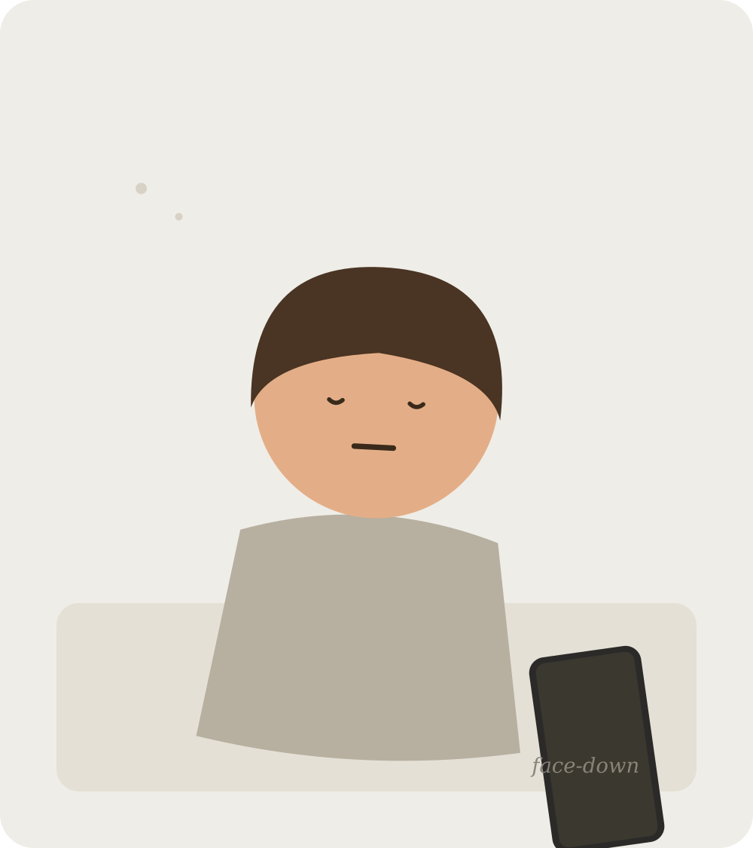

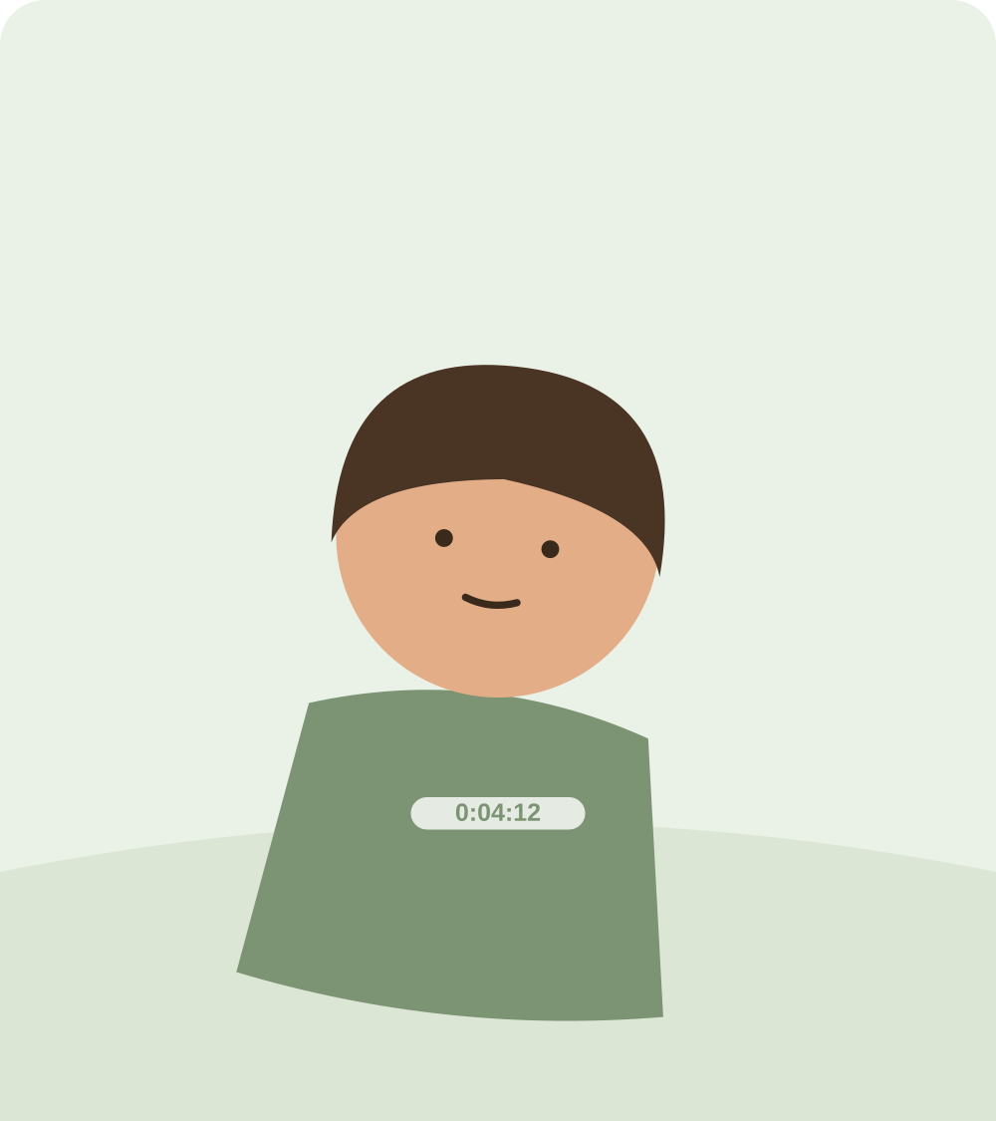
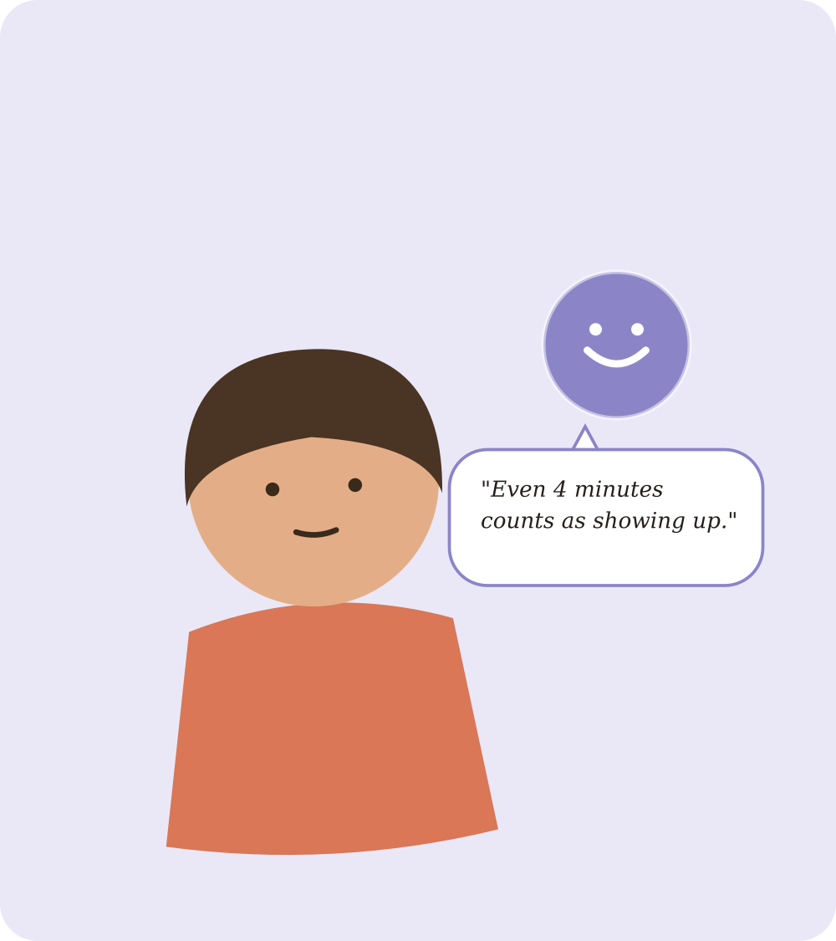
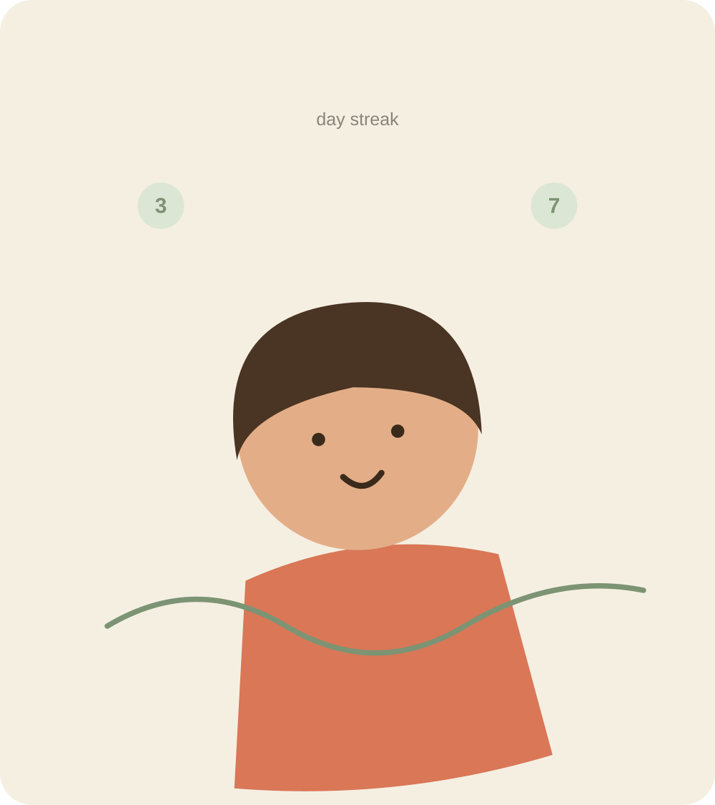
STORYBOARD · PART 1
From avoidance to momentum
Panels 1–5: she notices the app, tries once, and starts to build a habit.
01 Ordinary Struggle
02 The Trigger
03 First Attempt
04 Mentor Shows Up
05 Momentum
THROUGH HER EYES
MESSAGE 1
Four awkward minutes. She does it anyway.
COACH CHECK-IN 1
A few days become a week. Small wins add up.
Her phone sits face-down. She's not ready to try yet.
A gentle notification catches her attention.
Her coach notices the effort, not the result.
“No pressure today — even opening the app counts as showing up.”
“Even 4 minutes counts as showing up.”
BEAT Avoidance
BEAT Resistance
BEAT A Little Hope
BEAT Building Momentum
BEAT Momentum
Wide, Eye-Level
Close, High Angle
Low Angle
Over-the-Shoulder
Wide Pan
Storyboard · Panels 1–5
The Turning Point
Notes:
Panel 1: hold the shot still, nothing moves — that stillness is the point. Panel 2: notification slides in with a soft chime, warm light as she reaches for the phone. Panel 3: slight handheld shake, just breathing and footsteps, no music yet. Panel 4 (first coach appearance): message appears gently, warm tone, notices effort not achievement. Panel 5: streak counter ticks up, first bit of music enters. Roughly the first 35 seconds of the animatic.

Slide 5
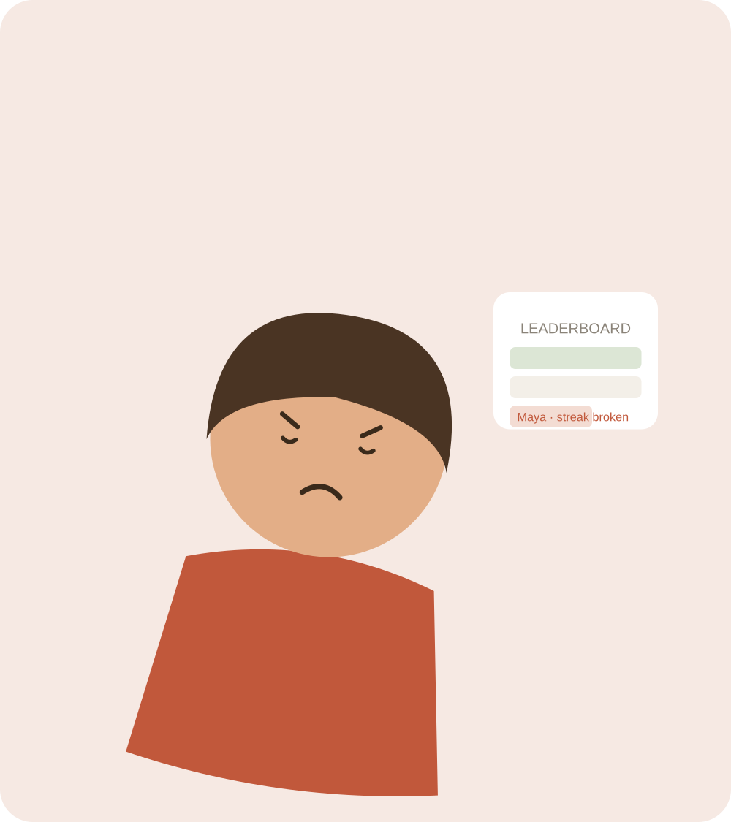
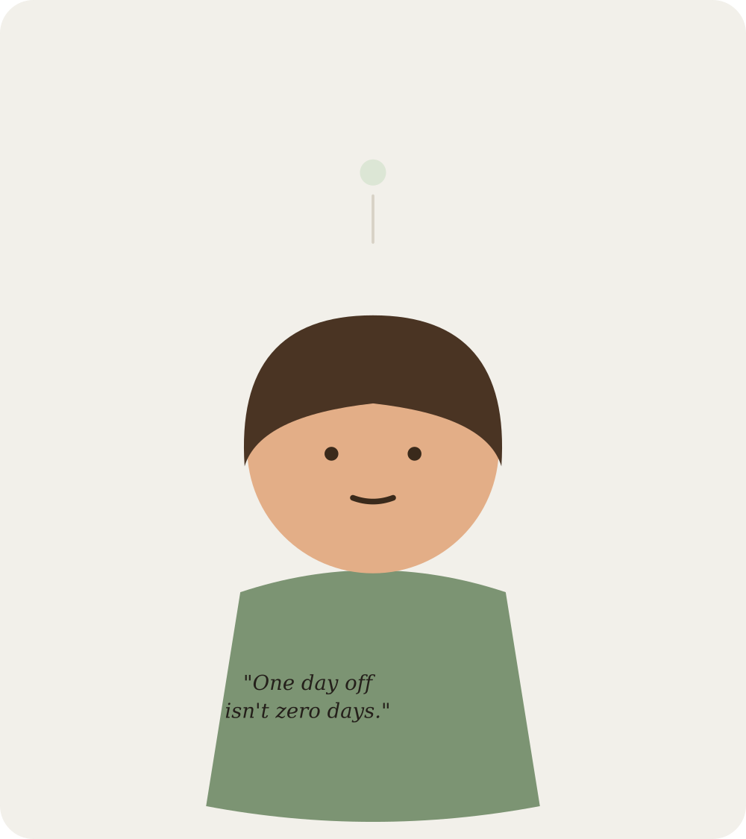
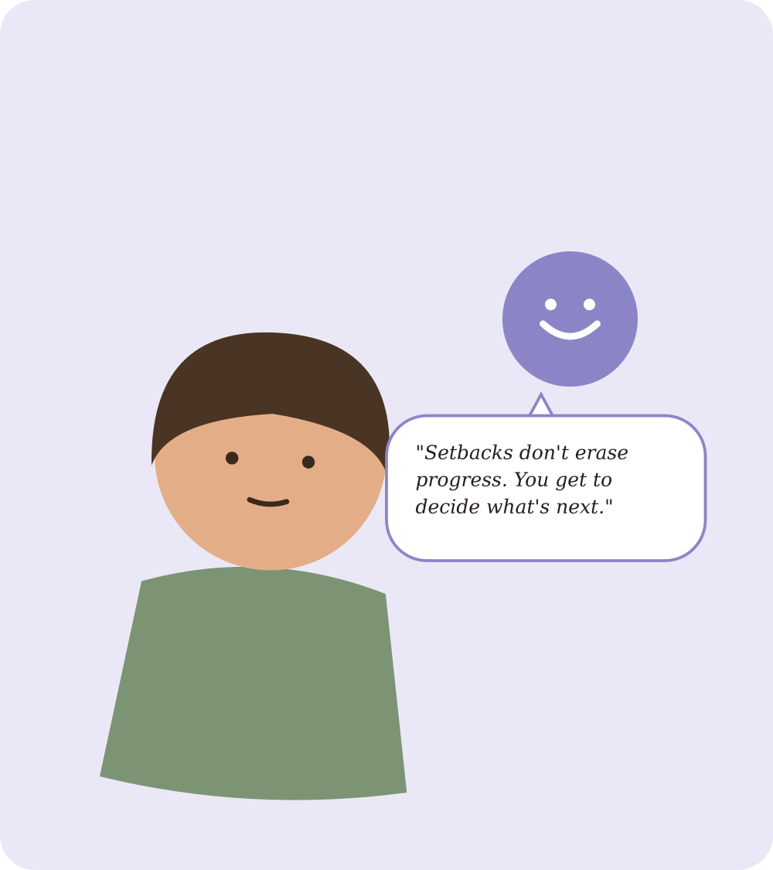
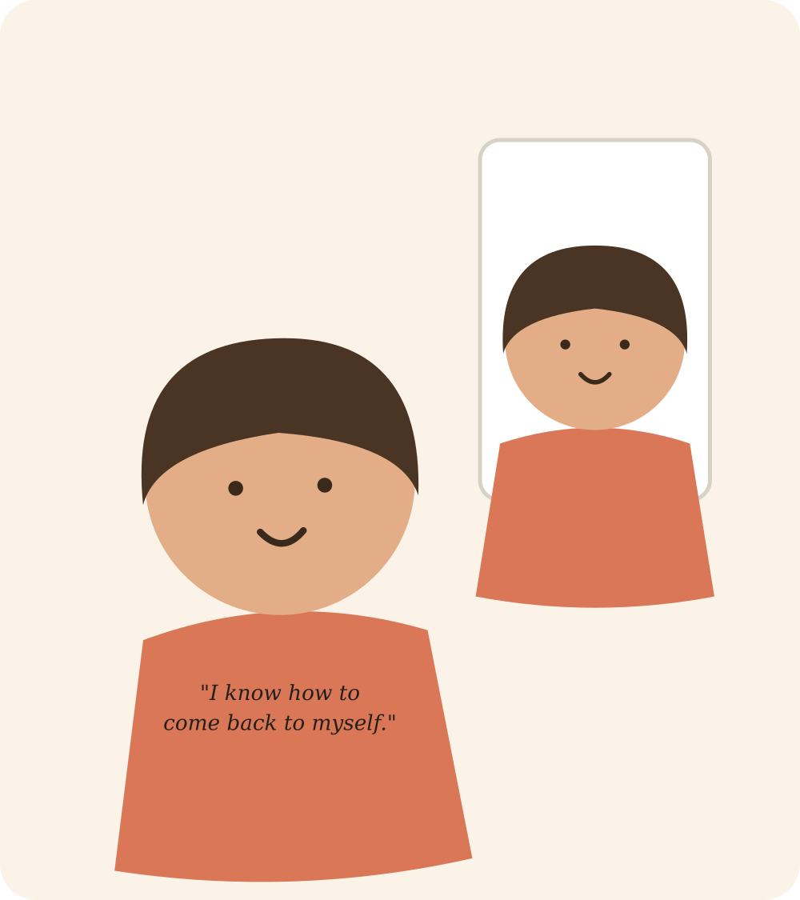
STORYBOARD · PART 2
From setback to quiet confidence
Panels 6–10: she slips, chooses to come back, and finishes changed.
06 The Setback
07 Her Choice
08 Mentor Returns
09 Return
10 Quiet Confidence
Her streak breaks overnight. The app says nothing — on purpose.
HER OWN CHOICE
COACH CHECK-IN 2
THROUGH HER EYES
She stands taller. Same Maya, a little less afraid.
No app, no coach — just Maya, deciding for herself.
Her coach checks in — without fixing it for her.
A quiet mirror moment. She hears herself think it.
“One day off isn't zero days.”
“Setbacks don't erase progress. You decide what's next.”
“I know how to come back to myself.”
BEAT The Setback
BEAT Quiet Resolve
BEAT Finding Resolve
BEAT Coming Back
BEAT Quiet Confidence
Close, Tilted
Close, Eye-Level
Two-Shot
Mirror View
Wide, Slow Zoom Out
Storyboard · Panels 6–10
The Turning Point
Notes:
Panel 6 (the setback): the app does nothing here on purpose — no pep talk, no notification. That silence is what makes Panel 7 hers. Panel 7 (her choice): no app on screen at all — this is the most important panel in the whole deck; keep it simple, just her and one breath. Panel 8 (second coach appearance): quieter than the first one, no celebration, doesn't undo the setback. Panel 9: mirror shot, viewer reads the line with her. Panel 10: end quiet, not triumphant — a slow zoom out, nothing flashy. Roughly the last 45 seconds of the animatic.

Slide 6
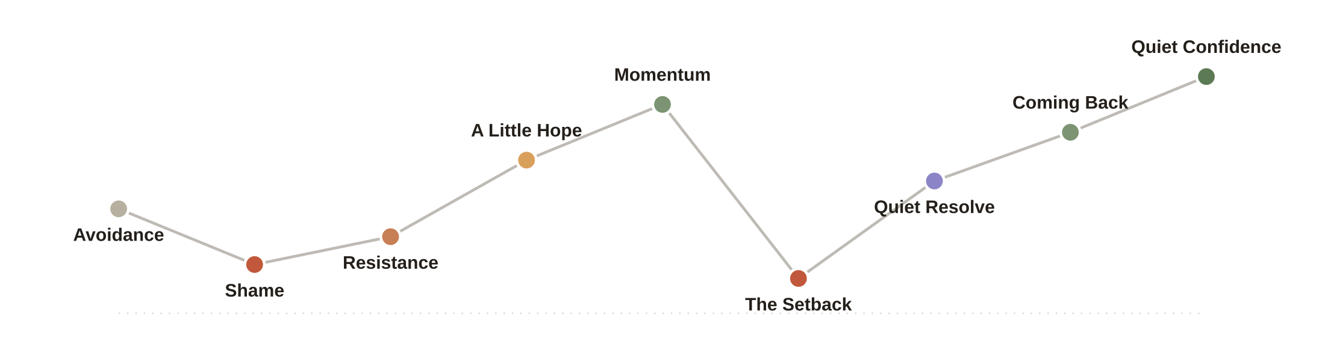
COMPETENCY A
How Maya Feels, Step by Step
No two panels feel the same — her mood keeps moving, even during the dip.
The dip at the setback is on purpose. Real progress isn't a straight line up — it dips, then slowly climbs back. That's more honest, and more relatable, than a story where nothing ever goes wrong.
Emotional Beat Line
The Turning Point
Notes:
Trace the line left to right rather than reading labels off — the shape is the argument. Pause at the dip: this is where people usually either skip the setback or make it too dramatic. Ours is balanced — one dip, and a believable recovery, not a straight drop.

Slide 7
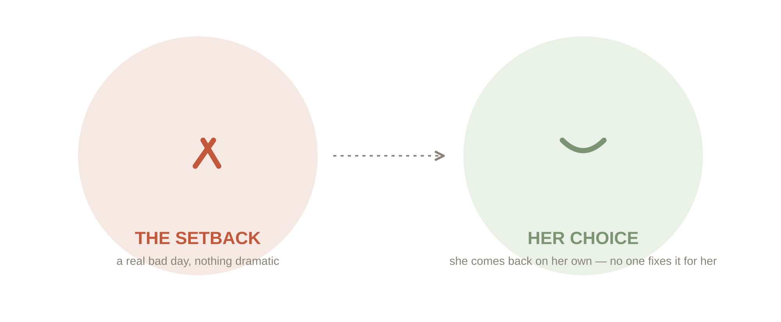
COMPETENCY C + B
Support & Setback
The same coach shows up twice. The setback, Maya solves on her own.
THE COACH'S TWO APPEARANCES
THE SETBACK, HANDLED HER WAY
CHECK-IN 1 · PANEL 04
Before the setback
“Even 4 minutes counts as showing up.” — a small, early boost that builds trust.
CHECK-IN 2 · PANEL 08
After the setback
“Setbacks don't erase progress. You decide what's next.” — support, not a fix.
Notice: Panel 7 has no app on screen. That's the whole point — if the coach fixed things for her here, it wouldn't feel like her win. The second check-in just confirms a decision she already made.
Support & Setback
The Turning Point
Notes:
This pairing carries the most weight in the rubric — resilience and mentor support together are worth 35 of the 100 points. Spend real time on the callout: a good test is whether deleting the coach's second message would change the outcome. Here it wouldn't, because the choice already happened in Panel 7 without them.

Slide 8

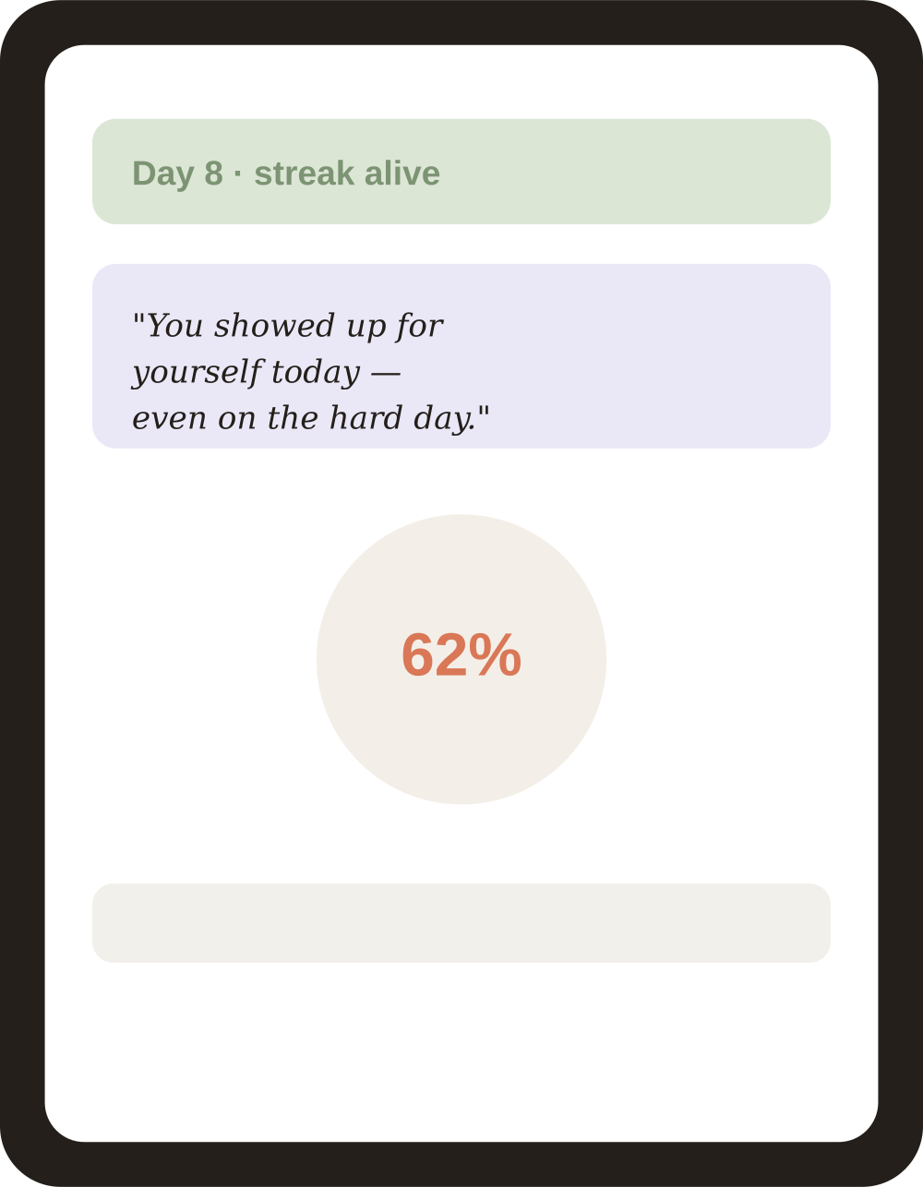
COMPETENCY E + D
Her Eyes, Her Words
Two shots put you in her shoes. Three messages speak to who she is.
SEEN THROUGH HER EYES
THREE MESSAGES THAT MEAN SOMETHING
PANEL 1 · HER SHOES
NOTIFICATION · PANEL 2
Before a run she doesn't want to take
“No pressure today — even opening the app counts as showing up.”
You see what she sees, right before she almost quits.
COACH MESSAGE · PANEL 4
“Even 4 minutes counts as showing up.”
HER OWN THOUGHT · PANEL 7
PANEL 9 · HER PHONE
“One day off isn't zero days.”
Her screen, exactly as she sees it
You read the message at the same moment she does.
We avoided: “You completed your workout!” — that just states a fact, it doesn't mean anything to her.
Her Eyes & Her Words
The Turning Point
Notes:
Simple test for POV shots: does it make you feel a specific feeling Maya is having, or is it just a POV shot for its own sake? Both of ours pass that test. On the messages: read all three out loud in order — the notification lowers the bar, the coach message says a small effort is enough, and by panel 7 Maya is saying it to herself. That shift from someone else's words to her own is the whole idea.

Slide 9
REFLECTION
EVERYTHING THIS COVERS
The hardest part to get right
Final Checklist
The hardest part was showing the setback without fixing it too fast. It's easy to draw a bad day — a broken streak reads instantly. It's much harder to draw someone quietly deciding to keep going, with nothing else happening on screen.
My first version had the coach step in right after the setback, because an empty panel felt incomplete. Taking that out was the right call, but it felt risky — now that panel relies only on Maya's face and one quiet thought.
That's when it clicked: a setback story falls apart the moment someone else solves it for the main character, even with good intentions. The empty space around Maya in that panel says more than any message could.
✓
Character brief
Slide 3
✓
10 storyboard panels
Slides 4–5
✓
Feelings that keep changing
Slide 6
✓
A real setback + her own recovery
Panels 6–7 + Slide 7
✓
Coach appears twice
Panels 4, 8 + Slide 7
✓
3 messages that mean something
Panels 2, 4, 7 + Slide 8
✓
2 shots through her eyes
Panels 1, 9 + Slide 8
✓
Reflection
This slide
Reflection & Checklist
Thank you — now go tell your app's story.
The Turning Point
Notes:
Read the reflection out loud rather than paraphrasing it — the last line is worth landing exactly as written. Use the checklist on the right to confirm everything is covered if time is short. One suggestion before final submission: record the actual 60–90 second animatic — the storyboard proves the idea works, but it will land even stronger with real motion, even a rough pass.

