Slide 1
EY TRAINING 2026
Credit Risk
Intelligence Platform
AI-Powered Credit Risk Assessment & Financial Document Analysis
Akash Chaurasiya
Ashu Sharma
🌐 creditriskplatform.azurewebsites.net
Notes:
Title slide. Introduce the team and the platform. Mention it is live on Azure.

Slide 2

A CREDIT RISK STORY
What Rohan Needed
Was an Answer.
Rohan applied for a business loan and heard nothing for four days. Here's what happened next.
IN ONE SENTENCE A loan decision that once took days — and still felt unfair — now takes minutes and comes with a clear reason.
Cover
Rohan's Story

Slide 3
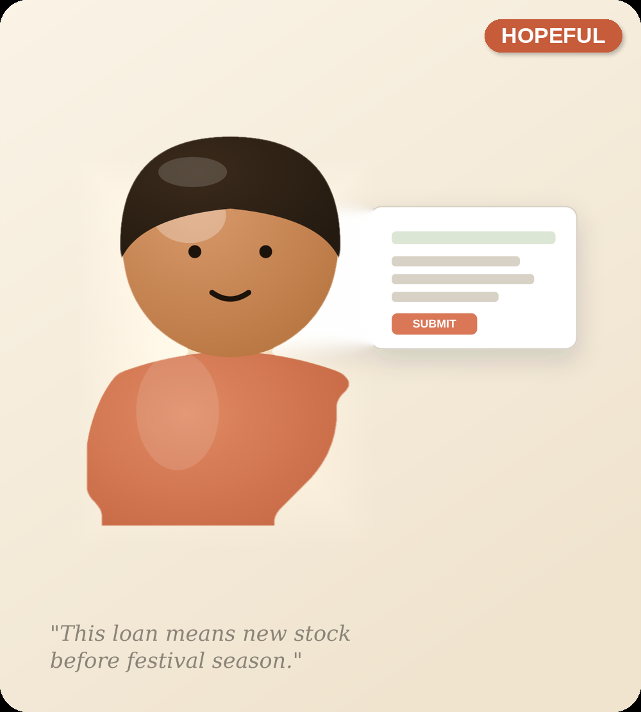
THE OLD WAY
MEET ROHAN
Rohan owns a shop and is applying for a loan to grow his business
Rohan runs a small electronics shop. Festival season is six weeks away, and he needs a loan to buy new products to sell before demand goes up. He applies for the loan and waits — hopeful, not worried yet.
THE OLD WAY
Rohan's Story

Slide 4
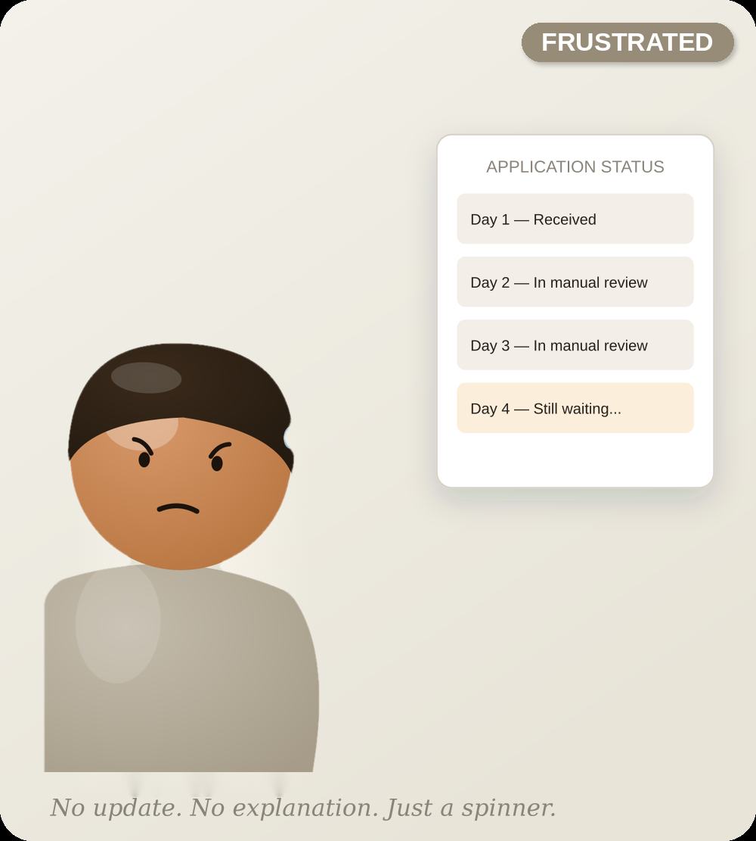
THE OLD WAY
THE WAIT
Someone at the bank is reviewing his loan application
At the bank, a loan officer is reviewing his file. Day one turns into day four, with no explanation — the officer is still working through a stack of paperwork. Rohan has no idea where he stands.
THE OLD WAY
Rohan's Story

Slide 5
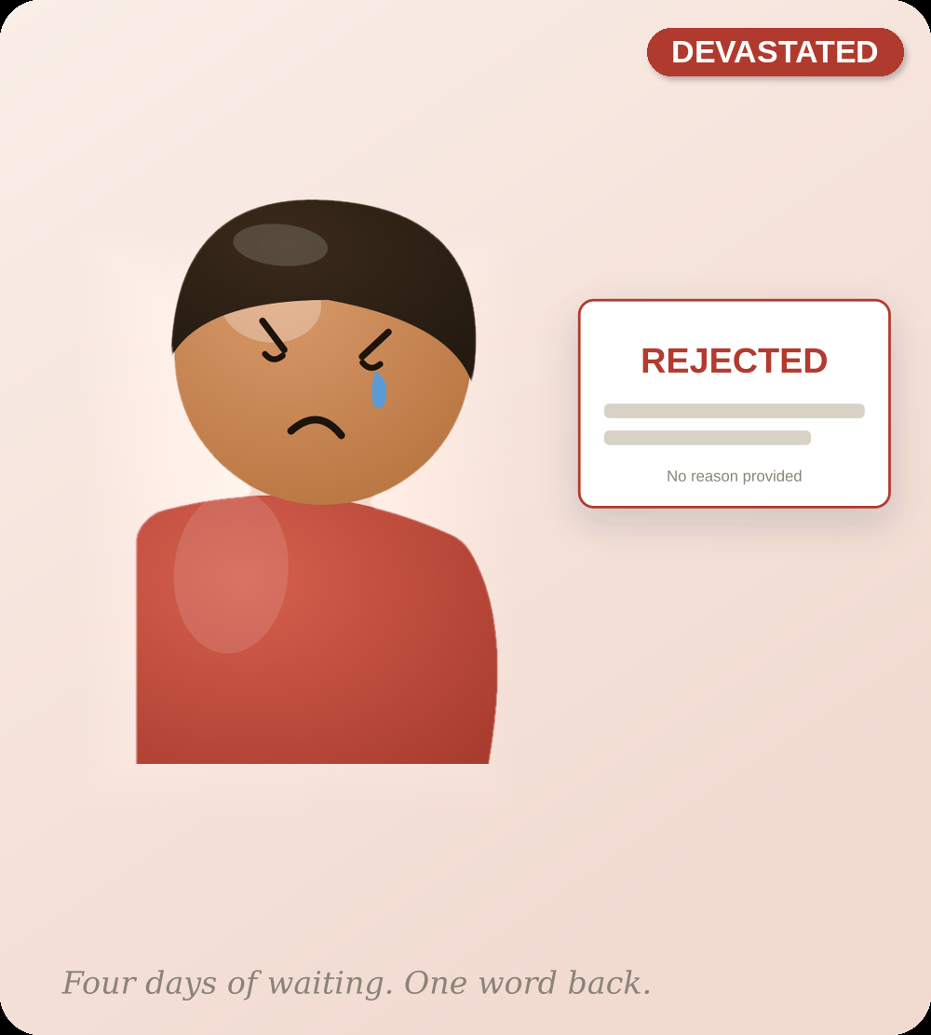
WHERE IT BROKE
THE ANSWER HE GOT
Loan Application Rejected — No Reason Given by the Bank
Four days of waiting ends in one word: rejected. No explanation — not what went wrong, not what to fix, not whether to try again. Just a decision he doesn't understand.
WHERE IT BROKE
Rohan's Story

Slide 6

WHERE IT BROKE
WHAT IT COST HIM
The Shop That Couldn't Restock
Festival season doesn't wait for anyone. Rohan couldn't order the products he needed because his loan never came through. A slow, unexplained 'no' didn't just cost him an application — it cost him his season.
WHERE IT BROKE
Rohan's Story

Slide 7
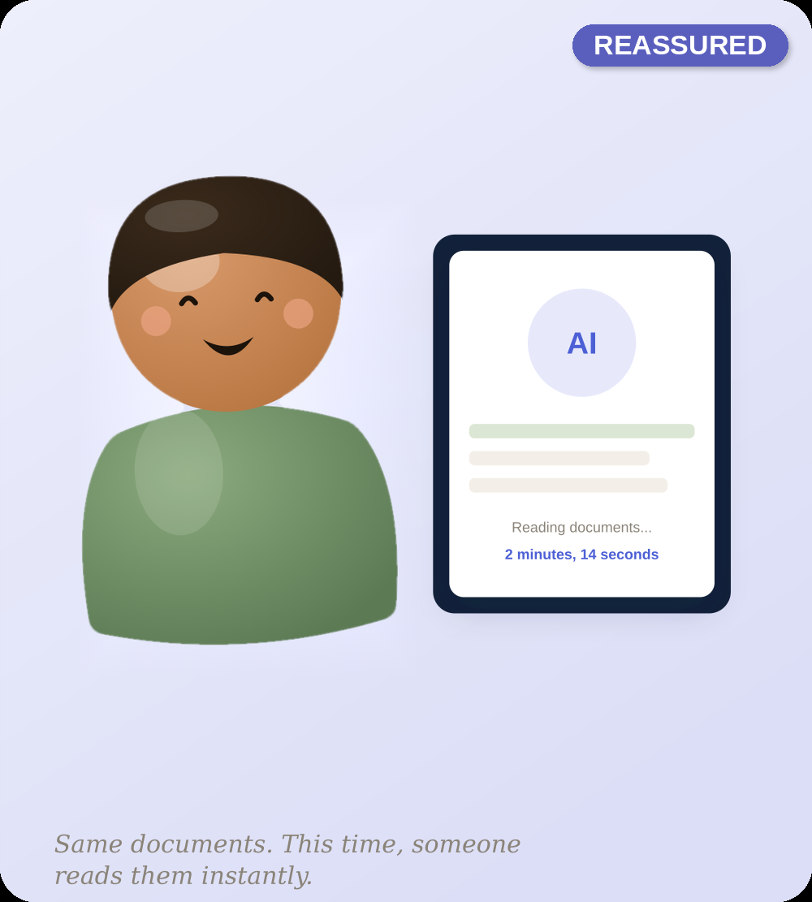
THE NEW WAY
THE TURNING POINT
The same documents. This time, read in minutes.
This time, Rohan checks his documents on the Credit Risk Intelligence Platform before applying. It shows him why he was rejected and what to fix. He fixes the issues, then applies for the loan again with confidence.
THE NEW WAY
Rohan's Story

Slide 8

THE NEW WAY
THE NEW NORMAL
Approved — and this time, he understood why
Rohan orders his inventory in time for the season. The bank keeps a loyal customer instead of losing him. Same documents were read properly, by both the bank and Rohan.
THE NEW WAY
Rohan's Story

Slide 9
IN ONE SENTENCE
A loan decision that used to take days
and still felt unfair now takes minutes —
and finally explains itself.
Rohan's story is one applicant. The platform behind it — built on real documents, real risk scoring, and a mandatory human sign-off — is built to give every applicant an answer, not just a stamp.
Credit Risk Intelligence Platform · Ashu Sharma & Akash Chaurasiya
Close
Rohan's Story

Slide 10
OVERVIEW
Why We Built It — And What We Built
THE PROBLEM
OUR SOLUTION
📄
Manual Review
An AI platform that extracts key financial data from uploaded PDFs, generates explainable credit risk scores, and gives AI-powered loan recommendations — for both individual customers and financial institutions.
Officers read 50-100 page PDFs by hand — 3-5 days per application.
❌
Human Error
Same applicant gets different risk ratings from different officers.
•
Automatic PDF data extraction
⏰
Slow Decisions
•
Explainable risk scores, not black-box numbers
Customers wait weeks while documents sit in a processing queue.
•
Safer loan amounts, better rates, next steps
💰
Revenue Loss
•
Full CI/CD deploy pipeline on Azure
Banks lose creditworthy customers to faster competitors.
Streamlit
LangChain
Pinecone
Docker
Azure
LangSmith
OpenAI
Notes:
Explain the manual bottleneck. Banks receive hundreds of loan applications. Human review is slow and inconsistent.

Slide 11
ARCHITECTURE
System Architecture
UI Layer
Orchestrator
AI / LLM
Data Layer
Cloud
Streamlit Web App
Chat Agent
OpenAI → Groq → Gemini
Pinecone Vector DB
Azure App Service
Auth (JWT + bcrypt)
Document Agent
3-tier fallback chain
BM25 Hybrid Search
GitHub Actions CI/CD
Customer + Institution Views
Retrieval Agent
LangSmith tracing
SQLite User Auth
← User uploads PDF → Chunks → Vectors → LLM → Risk Score + Recommendations →
Notes:
Show the five layers. PDF comes in at the top, risk decision comes out at the bottom.

Slide 12
FEATURES
Everything Inside The Platform
🔐
Secure Login
📤
Upload PDFs
📊
Risk Analysis
JWT + bcrypt auth
Salary slips, statements, ITR
AI credit score + red flags
💡
AI Recommendations
💬
AI Chat
🏙️
Retirement Planner
Urgency-sorted action plan
Ask about your own documents
40-city cost of living
👤 CUSTOMER SEES
🏦 BANK OFFICER SEES
•
Personal risk score (0-100)
•
NPA risk & CRAR indicators
•
Loan approval probability
•
Fraud detection flags
•
Safe borrowing amount
•
Applicant financial summary
•
Recommended banks & rates
•
Loan approve / reject decision
•
Debt-to-income ratio (DTI)
•
Capital adequacy assessment
•
Improvement action plan
•
Structured executive report
Notes:
Show the customer journey from login to recommendations. Mention loan gating feature.

Slide 13


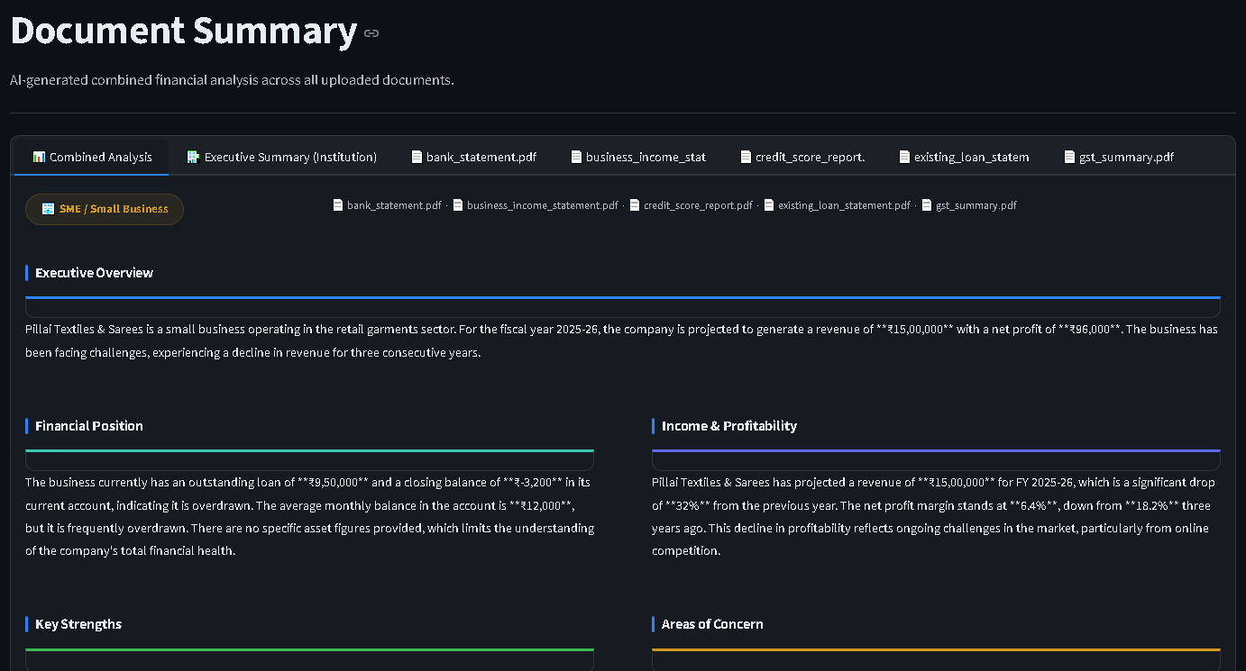
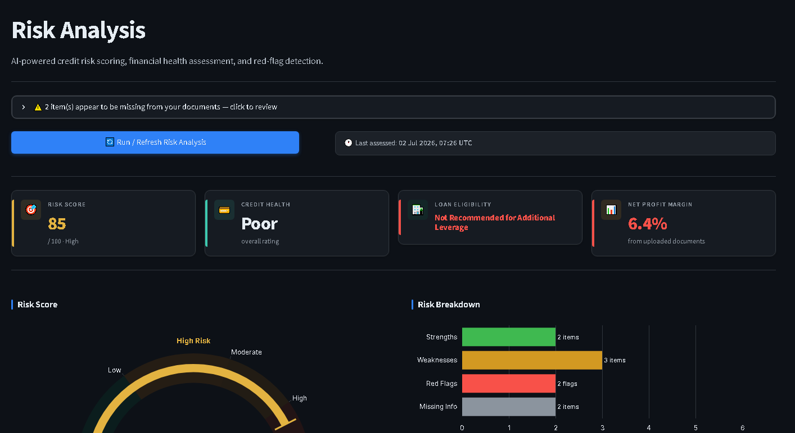

CORE FEATURE
Understanding the documents, then scoring the risk
Document Summary
Risk Analysis
The AI reads every uploaded PDF and pulls out the numbers that actually matter — income, expenses, existing loans, balances — and lays them out in plain language instead of raw pages.
From that summary, the app calculates a credit risk score out of 100, and explains it — what's working in the applicant's favor, what the red flags are, and how much of their income already goes toward debt.
Document Summary Screen
Risk Analysis Screen
Paste your screenshot here
Paste your screenshot here
Credit Risk Intelligence Platform
07

Slide 14
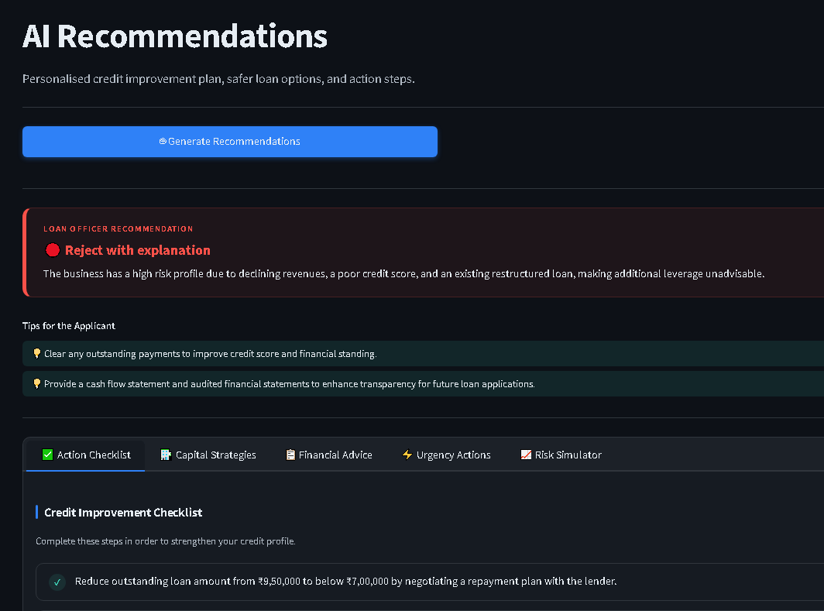
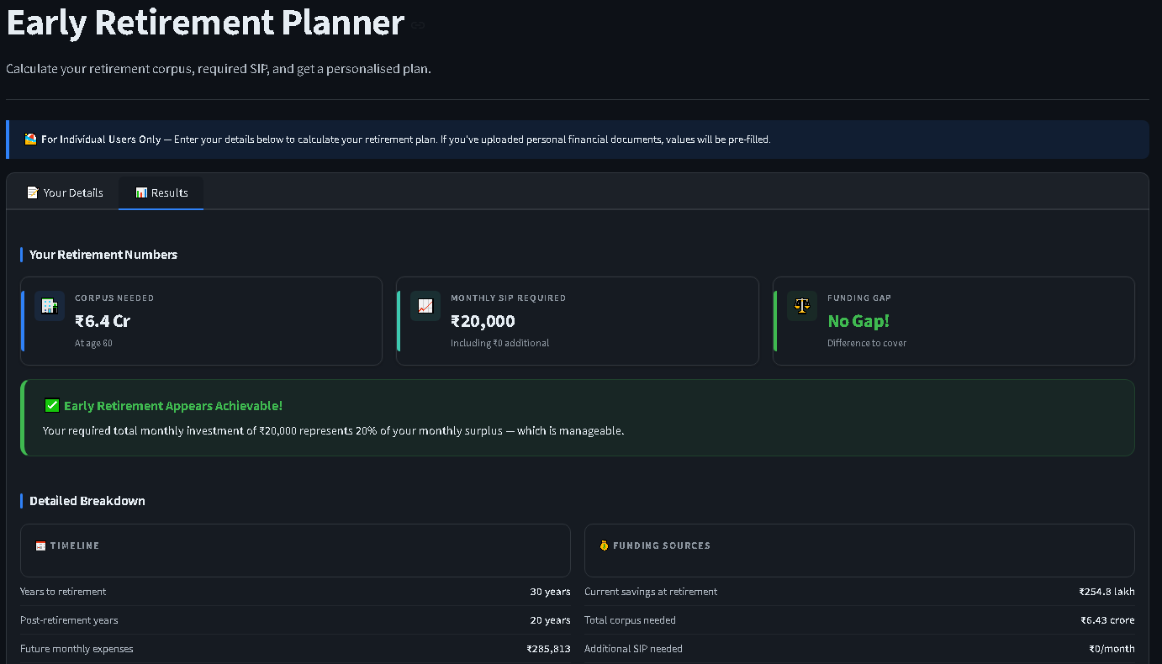
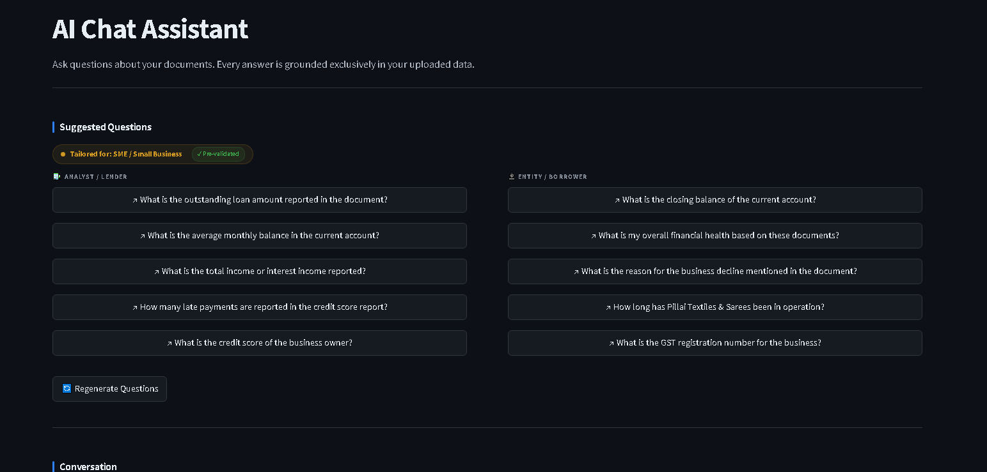
CORE FEATURES
Recommendations · Retirement · Chat
🎯 AI Recommendations
🏙️ Retirement Planner
💬 AI Chat
Personalised action plan from your risk profile.
City-aware corpus calculator, 40 Indian cities.
Ask questions about your own documents.
•
Approve / Review / Reject with reasons
•
Retirement corpus required
•
Answers grounded only in your documents
•
Alternative financing suggestions
•
Monthly SIP needed to close the gap
•
Hybrid BM25 + vector retrieval
•
Steps to improve approval odds
•
Feasibility check vs income
•
Year-aware re-ranking prevents mixups

Slide 15
HOW IT WORKS
The RAG Pipeline
1
2
3
4
5
Upload PDF
Extract Text
Chunk + Embed
Store Vectors
Retrieve
User uploads financial documents
PyMuPDF extracts content by page
Split into chunks, create vectors
Indexed in Pinecone cloud DB
BM25 + vector hybrid search
6
7
8
9
Re-rank
LLM Call
Validate
Display
Year-aware re-ranking removes stale data
OpenAI → Groq → Gemini fallback chain
DeepEval + RAGAS hallucination check
Risk score, recommendations, chat answer
Notes:
Walk through the 9-step pipeline. Emphasise the hybrid search and year-aware re-ranking as the key innovation for reducing hallucination.

Slide 16
AI QUALITY
Evaluation & Testing Coverage
DeepEval — Hallucination Detection
RAGAS — Faithfulness & Relevancy
0.22
0.88
avg. score, bad profile (under 0.5 = pass)
avg. faithfulness score
96 Unit Tests — Every Module Covered
13
test_auth.py
16
test_loan_workflow.py
19
test_entity_aware_fixes.py
14
test_reranker.py
13
test_city_and_validator.py
4
test_retirement_calc.py
5
test_sampling.py
6
test_schemas.py
All 96 tests run automatically in GitHub Actions on every push — in 6 seconds, no API keys required.
Notes:
62% reduction in hallucination. Explain that DeepEval gives us proof the AI is not making things up.

Slide 17
DEVOPS
CI/CD, Observability & Cloud Deployment
Automated CI/CD Pipeline
git push
96 tests
Docker build
Push to ACR
Deploy
Live on Azure
LangSmith — Full Request Tracing
auth.login_attempt
document_processing
run_risk_analysis
retrieval_agent.retrieve
chat_agent.answer_question
Live on Azure App Service
📦
⚙️
🌐
🔑
Container Registry
App Service Plan
Web App
Environment Vars
creditriskakash7272.azurecr.io
B2 — 2 CPU, 3.5GB RAM
creditriskplatform.azurewebsites.net
13 secure settings, never baked into image
Notes:
Two workflows run on every push. main.yml is the quality gate. The Azure workflow only runs if tests pass.

Slide 18
LESSONS
Challenges We Solved & What We Learned
HARDEST PROBLEMS
WHAT WORKED
Hallucination in RAG
•
Hybrid search dramatically cut hallucination
✅ Hybrid BM25 + vector search with year-aware re-ranking. 0.58 → 0.22.
•
LangSmith tracing made debugging fast
Python 3.11 vs Docker
•
Pydantic settings caught config errors early
✅ SyntaxError only in Docker's Python 3.11 — fixed, now tested inside Docker pre-deploy.
•
96 tests caught Docker/Python issues pre-deploy
Azure CI/CD permissions
WHAT WE'D DO DIFFERENTLY
✅ No Owner role for a service principal — used Deployment Center + system identity instead.
•
Use managed auth (Supabase/Auth0) from day one
LLM provider reliability
•
Pin all package versions from the start
✅ Gemini deprecations, OpenAI 401s, Groq limits — solved with a 3-tier fallback chain.
•
Set up LangSmith tracing from day one
•
Add a background job queue for large PDFs
Notes:
Pick the hardest one and explain it in depth. The hallucination problem is the most impressive technically.

Slide 19
EY GUIDELINES · IN PRACTICE
How Our Project Followed EY Coding Guidelines
Every EY coding principle mapped to what we actually built and shipped on the Credit Risk Intelligence Platform.
✎
Naming Conventions
🔀
Code Reviews
Modules named by responsibility — test_auth.py, test_loan_workflow.py, test_reranker.py, retrieval_agent, chat_agent — consistent across the codebase.
Every push is gated: GitHub Actions runs all 96 tests automatically before code can move forward — no merge without a passing check.
📄
Documentation
🛡
Security & Compliance
LangSmith traces every step by name (auth.login_attempt, document_processing, run_risk_analysis) — intent is visible, not just code.
JWT + bcrypt authentication; 13 secure environment settings kept out of the Docker image, never baked into the build.
✔
Testing Standards
📦
Version Control
96 unit tests across every module, plus DeepEval (0.22 hallucination score) and RAGAS (0.88 faithfulness) — all run in CI in 6 seconds.
Trunk-based flow: git push → tests → Docker build → push to ACR → deploy — a clean, atomic, automated pipeline to Azure.

Slide 20
SUBMITTED
Thank You
🌐 Live App
creditriskplatform.azurewebsites.net
💻 GitHub
github.com/Chaurasiyakash0136/EY-Training-2026
🔍 LangSmith
smith.langchain.com → credit-risk-platform
🏷️ Version
git tag v1.0 — main branch
Akash Chaurasiya · Ashu Sharma · EY Training 2026
Notes:
Thank the audience. Offer to show the live app and LangSmith traces. Invite questions.

