Slide 1

PROJECT RODY
Interactive Traffic & Road Simulation
Created by Ashutosh kr. singh

Slide 2
Secure Access with IBM Cloud App ID
01
Centralized Authentication
• Secure user access gateway.
• Central token management.
• Robust login security flow.
02
Multi-Factor Security
• Adaptive security layer.
• Restricts dashboard edits.
• Protects simulation settings.
03
Social Sign-In Providers
• Easy social ID integration.
• Supports Google/Facebook login.
• Streamlines user onboarding.

Slide 3
Core Frameworks & Backend Services
Node.js Runtime
• Asynchronous backend environment.
• Calculates real-time road vehicle flow.
• Dynamic dashboard API delivery.
IBM Cloud App ID
• Centralized security layer.
• Validates user identity tokens.
• Governs simulated user metadata.

Slide 4
Interactive Frontend Interface Tools
HTML5
• simulation viewport structures.
• Visual canvas layouts.
• Settings panel inputs.
CSS3
• Responsive dark-theme styling.
• Interactive control widgets.
• Adaptive visual metrics grid.
JavaScript
• Calculates simulation physics.
• Handles vehicle flow intervals.
• Directs active canvas rendering.

Slide 5
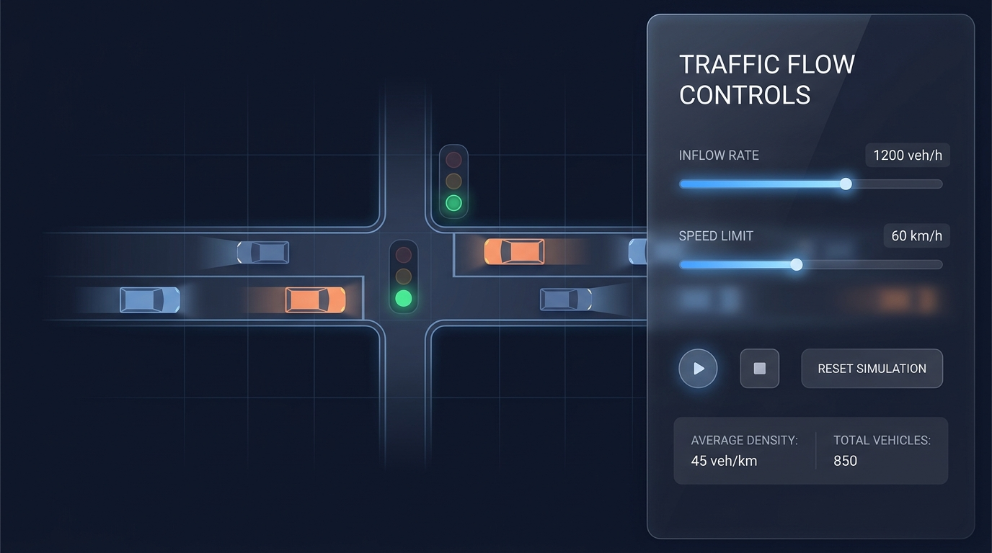
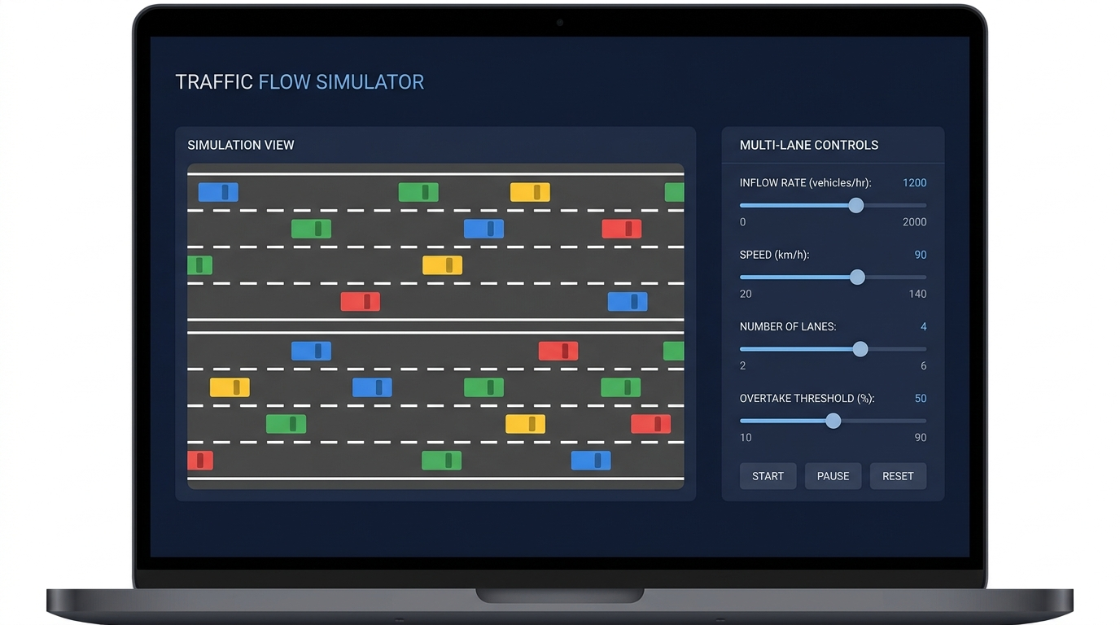
Single & Multi-Lane Road Simulations
Single-Lane Traffic Control
• Manual signal overrides.
• Adaptive automatic timers.
Multi-Lane Highway Mechanics
• Intelligent overtaking algorithms.
• Interactive multi-lane width setup.

Slide 6
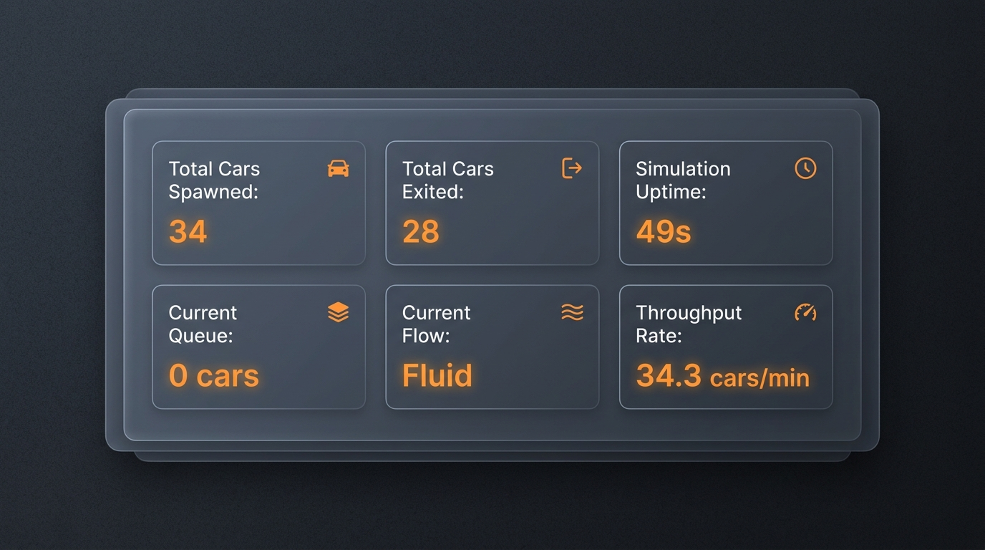
Simulation Performance Analytics
Analytics Panel Capabilities
• Tracks total car spawn/exit metrics.
• Monitors simulation uptime & congestion queue.
• Computes exact vehicle throughput per minute.
• Aggregates real-time telemetry datasets.

Slide 7
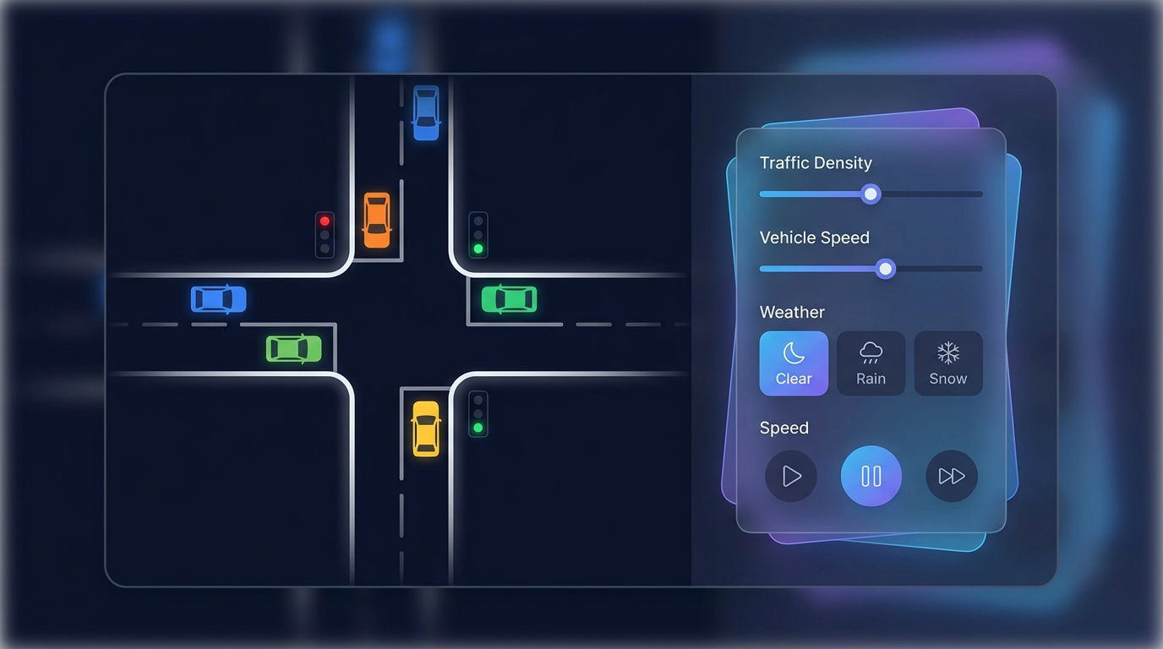
Crossroad Intersection Simulation
Perpendicular Intersections
• Schedules active 4-way signals.
• Deploys dynamic collision avoidance.
• Simulates driver behavior attributes.

Slide 8
THANK YOU
Project Rody — Simulation Completed
Presented by Ashutosh kr. singh

