Slide 1

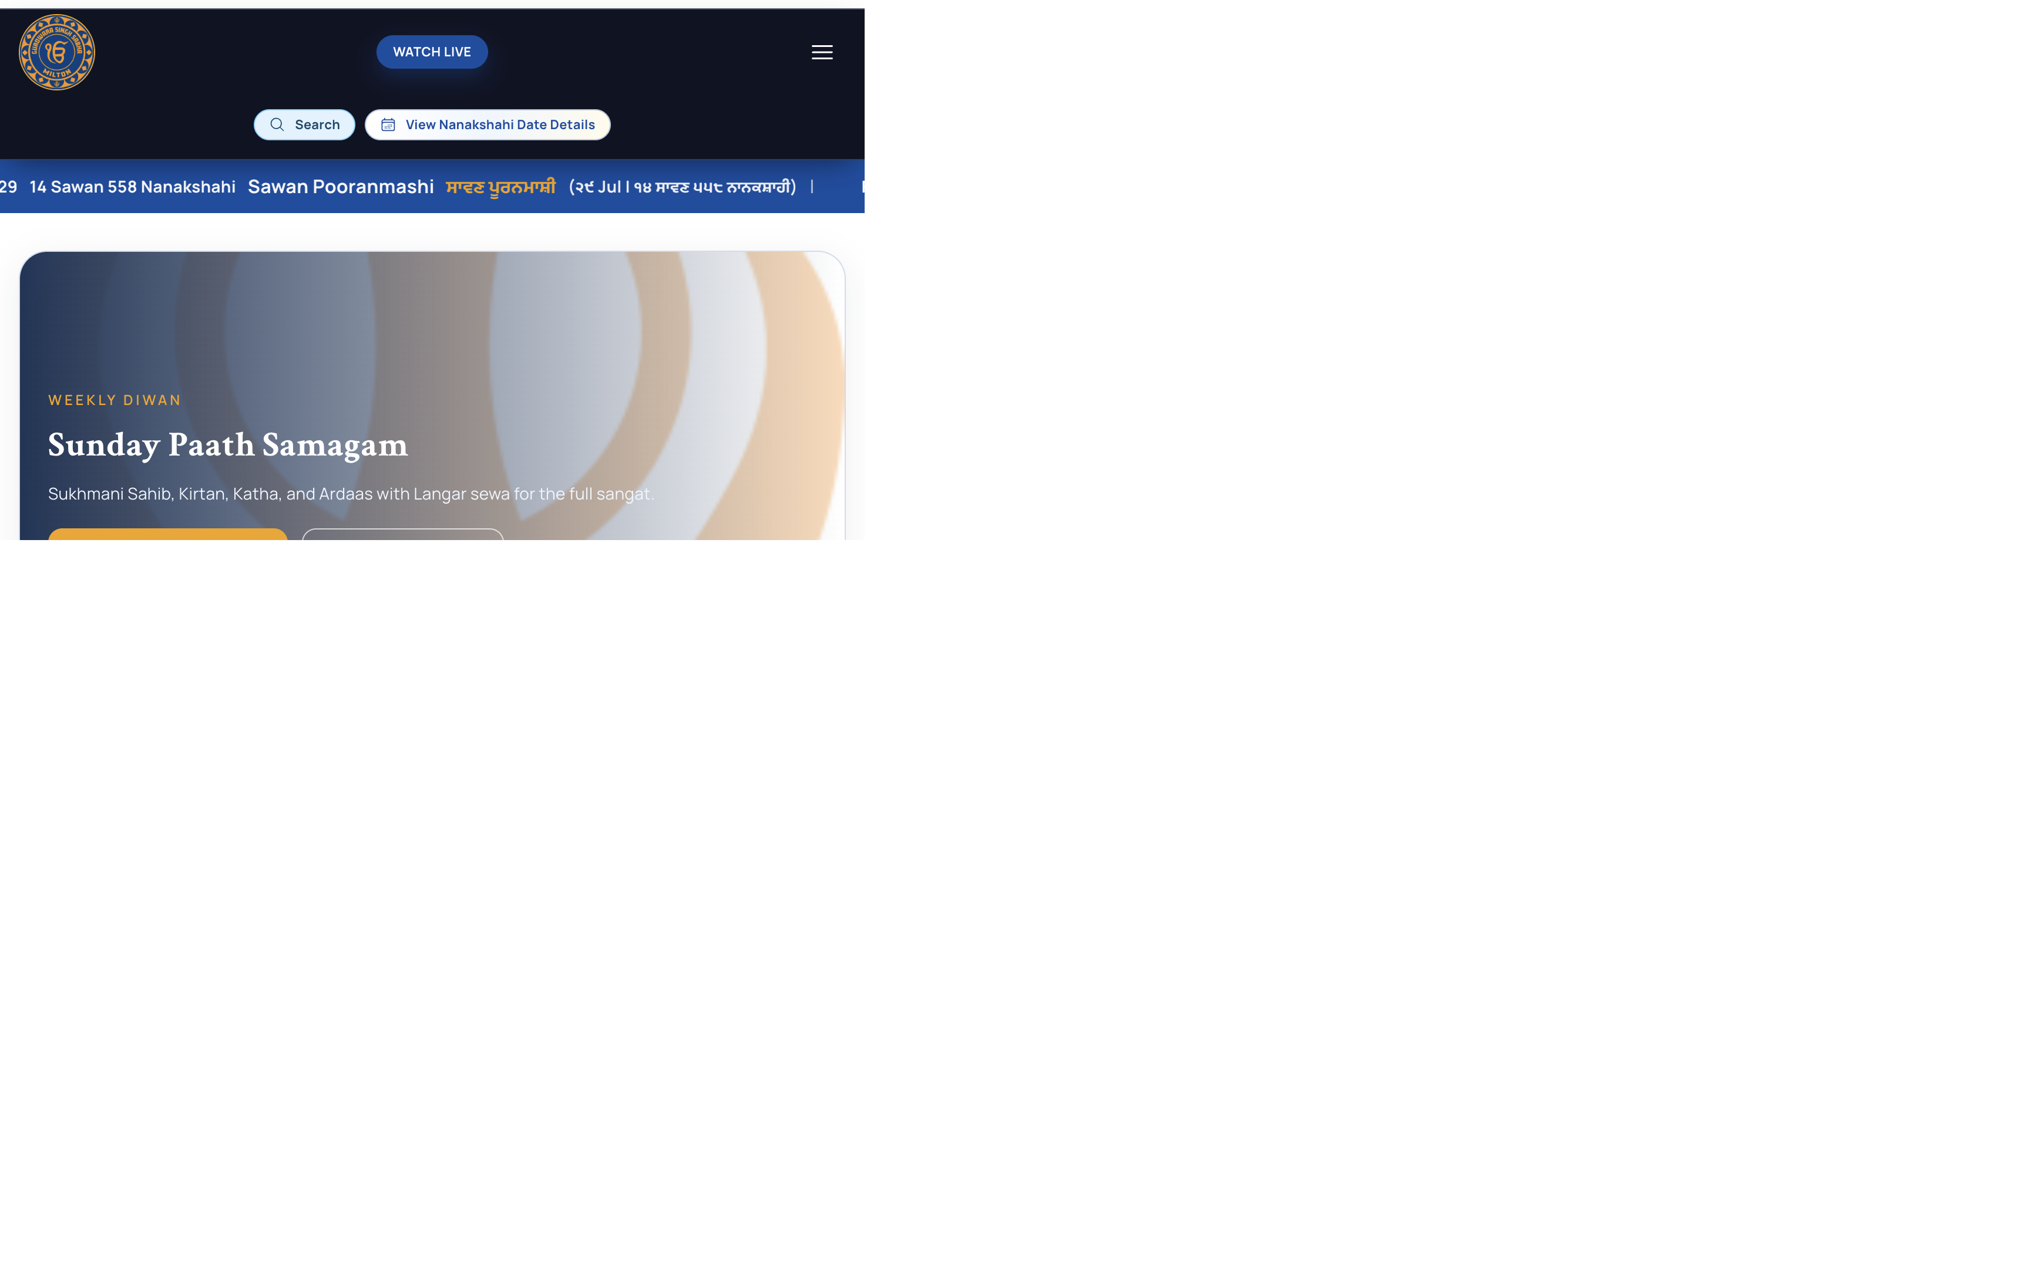
Singh Sabha Milton
Stakeholder Adoption Presentation
From information website to action-driven community platform
Clear case for business adoption and governance approval.
Measured improvements in engagement, participation, and efficiency.
Device-ready platform assurance for desktop, iPad, and mobile.
Practical 90-day execution model with KPI accountability.
SINGH SABHA MILTON
Introduction line: This platform helps sangat members move from interest to participation in a few trusted clicks.

Slide 2
Singh Sabha Milton
Executive Summary
Adoption business case for Singh Sabha Milton digital platform
Goal: approve the platform as the primary digital operating channel.
Approach: compare current-site experience to new platform capabilities.
Audience: non-technical stakeholders across committee and operations.
Method: use observable facts, measurable KPIs, and a clear 90-day plan.
Result: faster participation, fewer manual loops, and stronger visibility.
SINGH SABHA MILTON
Stakeholder Adoption Deck
2

Slide 3
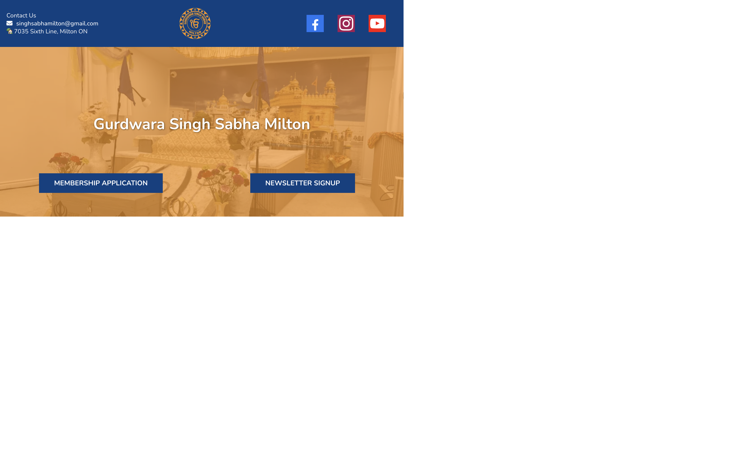
Singh Sabha Milton
Current State Baseline (Existing Site)
Observed snapshot from singhsabhamilton.com
Strong informational presence with schedule, Sunday details, and contact.
Main actions are membership application and newsletter signup links.
Event visibility exists through calendar embed and social channels.
Most workflows still require off-platform follow-up and coordination.
Leadership reporting requires manual interpretation and consolidation.
This model informs the community well, but scales operations slowly.
SINGH SABHA MILTON
Stakeholder Adoption Deck
3

Slide 4
Singh Sabha Milton
New Platform Snapshot (Desktop Web)
Full web experience as primary showcase
15 public sections organized for discover-to-action journeys.
20 admin modules accessible via role-aware controls.
Integrated flows for events, seva, donation, videos, news, and contact.
Single destination reduces dependence on disconnected external links.
Navigation, content, and calls-to-action are designed for conversion.
Desktop version is optimized for committee demos and stakeholder reviews.
SINGH SABHA MILTON
Stakeholder Adoption Deck
4

Slide 5
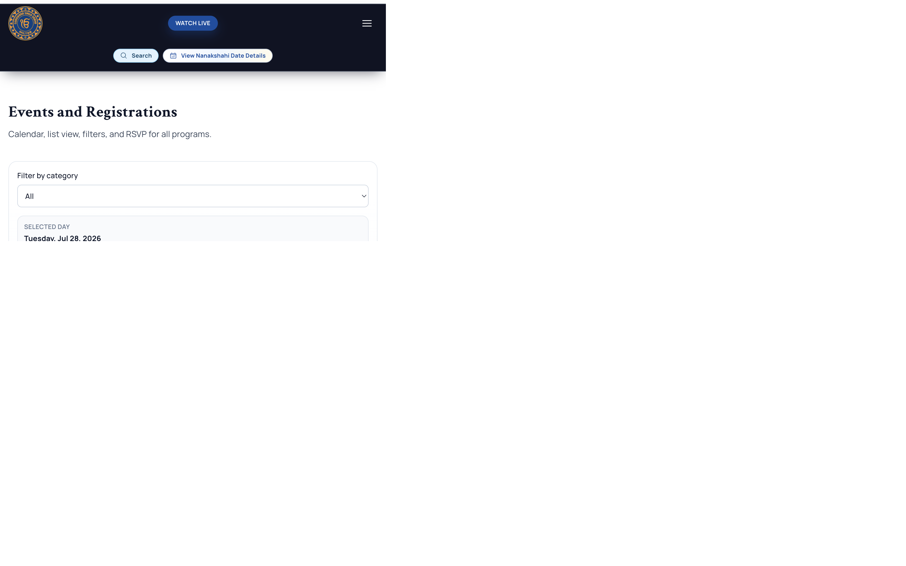
Singh Sabha Milton
Business Value Delivered
What changes for the organization
Participation value: more users can complete actions in-platform.
Operational value: fewer manual corrections and follow-up messages.
Governance value: role-based access reduces accidental changes.
Communication value: updates can be published and discovered faster.
Experience value: clearer action states increase user confidence.
Leadership value: stronger clarity on what is working each month.
SINGH SABHA MILTON
Stakeholder Adoption Deck
5

Slide 6

Singh Sabha Milton
Community Action Flows
Event, seva, and donation actions are now direct
Events flow supports registration with clean identity handoff.
Seva flow blocks duplicates and communicates status clearly.
Donation flow supports secure checkout with webhook reliability.
Action pages are designed to remove uncertainty at click time.
Users spend less time searching and more time participating.
This directly supports attendance, seva coverage, and campaign goals.
SINGH SABHA MILTON
Stakeholder Adoption Deck
6

Slide 7

Singh Sabha Milton
Operations and Communications
Admin-side capability in one platform
26 admin module areas support content and operations.
7 upload buckets support media workflows across modules.
News, videos, and CMS updates can be managed centrally.
Roles and access controls support safer delegation.
Reminders are configured for volunteer (10,5,2,1) and event (7,3,1) cadences.
This reduces dependence on ad-hoc communication channels.
SINGH SABHA MILTON
Stakeholder Adoption Deck
7

Slide 8
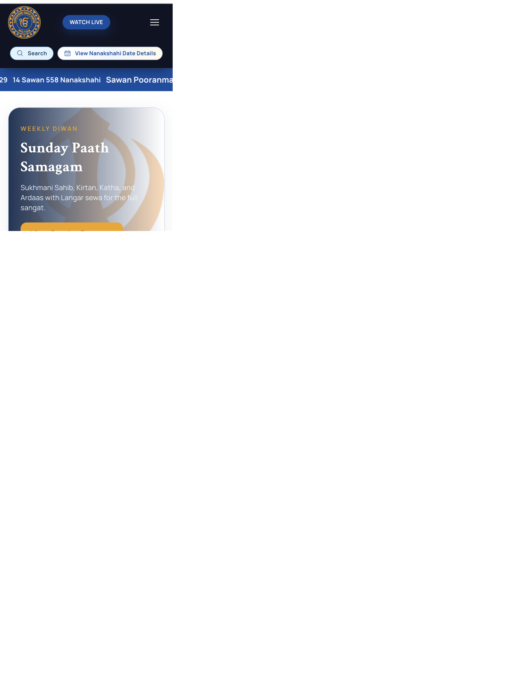
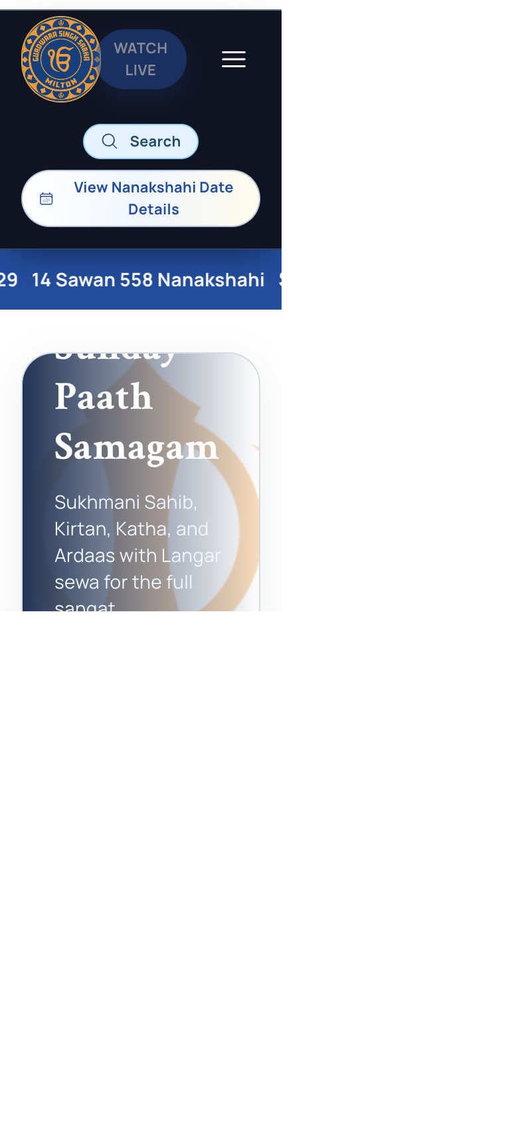
Singh Sabha Milton
Responsive Assurance: Home Page
Desktop, iPad, and mobile proof on the same platform
Desktop presents full-context navigation and discovery.
Tablet keeps interaction balanced with touch-first behavior.
Mobile preserves key actions with simplified layout.
Assurance: one platform is usable across all major device formats.
Outcome: accessibility and confidence for wider audience adoption.
SINGH SABHA MILTON
Desktop
Tablet (iPad)
Mobile
Stakeholder Adoption Deck
8

Slide 9
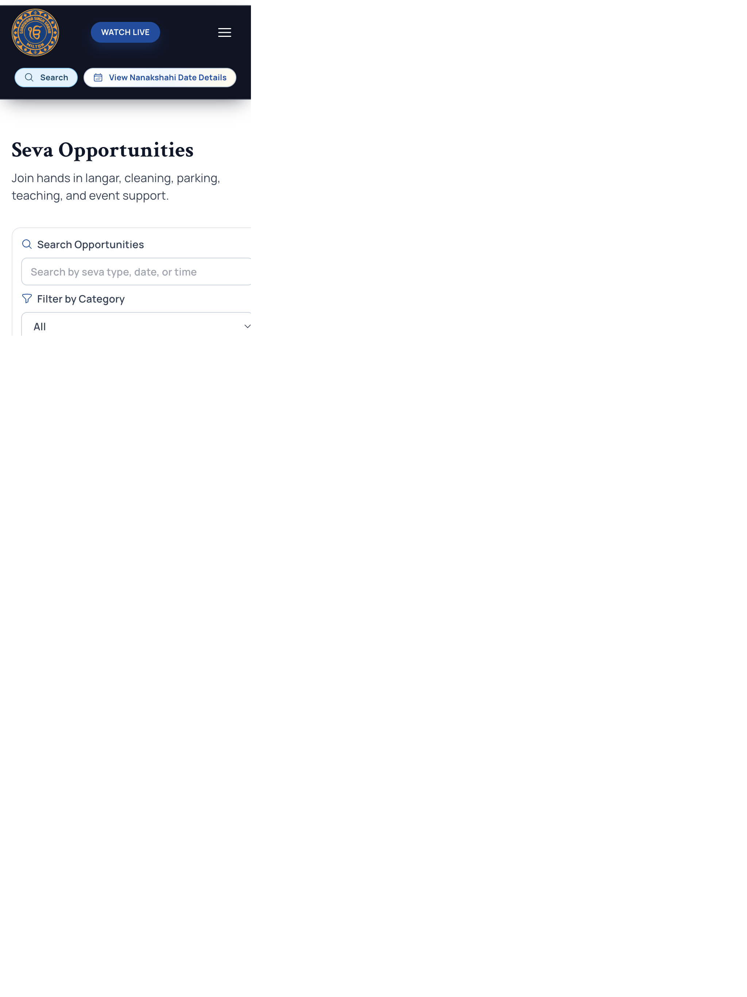
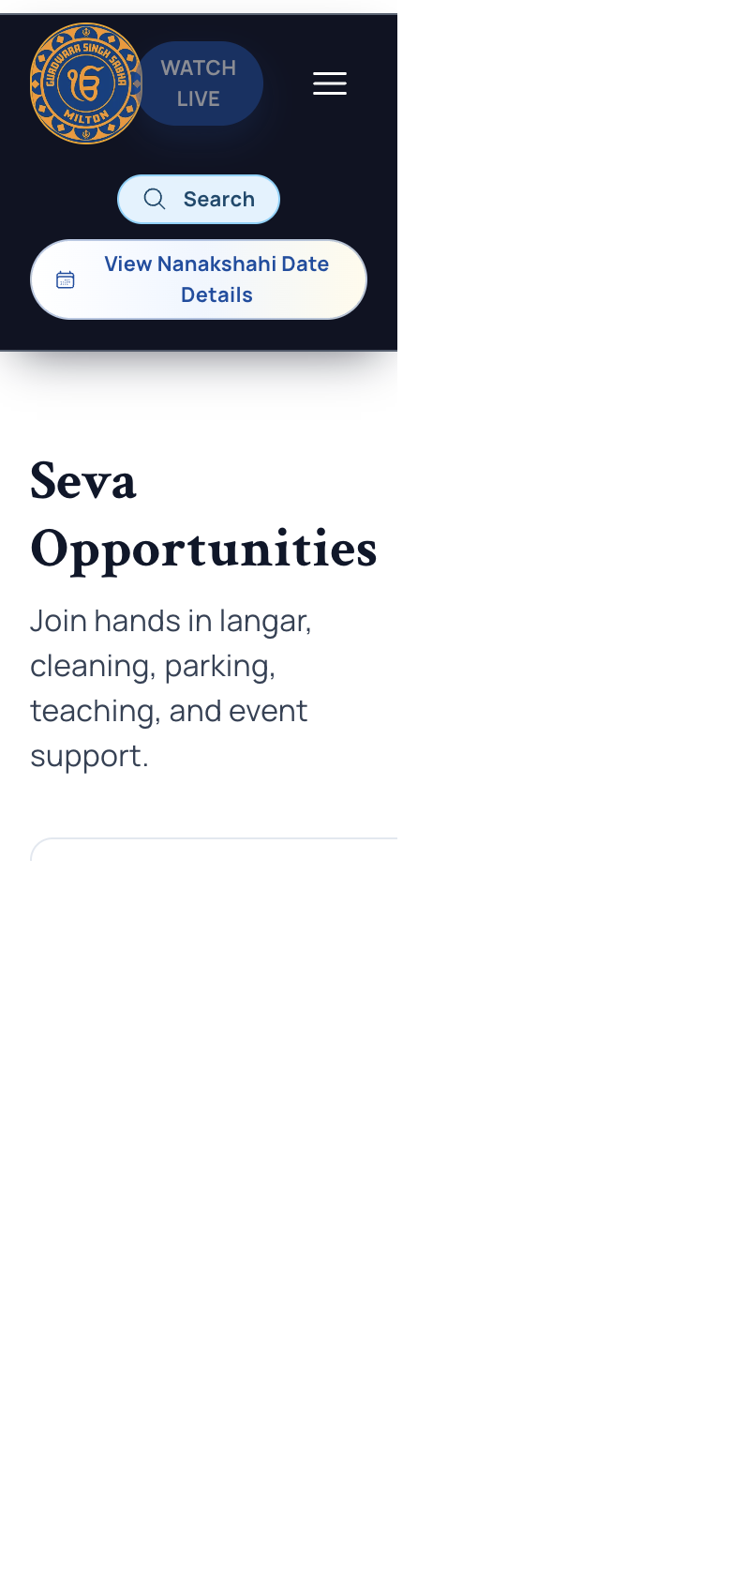
Singh Sabha Milton
Responsive Assurance: Seva Flow
Action journey consistency across device sizes
Desktop shows broader seva context and status visibility.
Tablet keeps action controls readable and scannable.
Mobile retains the complete registration journey.
Design keeps the same task outcomes, regardless of screen width.
Outcome: volunteer conversion is not device-dependent.
SINGH SABHA MILTON
Desktop
Tablet (iPad)
Mobile
Stakeholder Adoption Deck
9

Slide 10
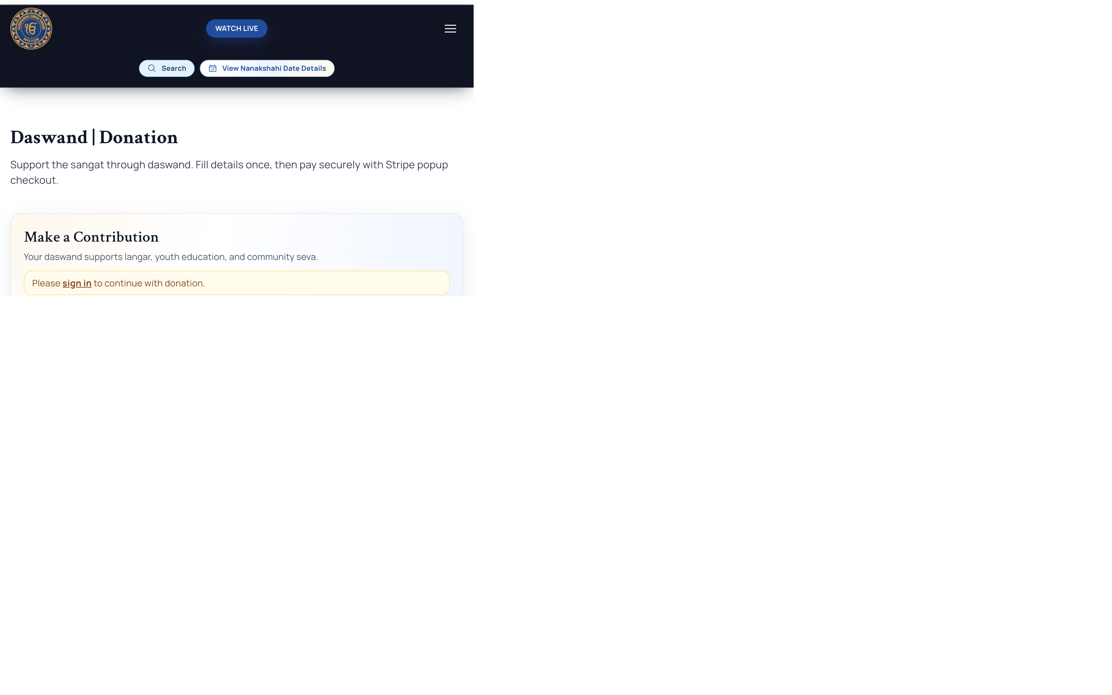
Singh Sabha Milton
KPI and Adoption Model
Simple scorecard for non-technical governance
Activation KPI: signed-in users completing at least one action.
Events KPI: event-page visitors converted to registrations.
Seva KPI: opportunity views converted to volunteer signups.
Donation KPI: intent-to-completed successful donation rate.
Communication KPI: update-page view-to-action click-through.
Service KPI: manual follow-up time reduction percentage.
SINGH SABHA MILTON
Stakeholder Adoption Deck
10

Slide 11
Singh Sabha Milton
90-Day Adoption Plan
Phased plan for sustained rollout
Weeks 1-2: baseline data setup, owners assigned, demo readiness.
Weeks 3-6: campaign-led adoption for events, seva, and donation.
Weeks 7-10: optimize pages with highest drop-off rates.
Weeks 11-13: leadership review and next-quarter scaling decisions.
Cadence: weekly KPI pulse and quick corrective iterations.
Output: measurable adoption, not just feature completion.
SINGH SABHA MILTON
Stakeholder Adoption Deck
11

Slide 12
Singh Sabha Milton
Decision and Ask
Approvals required from business stakeholders
Approve this platform as the primary digital service channel.
Approve KPI scorecard and monthly governance review.
Nominate module owners for operations continuity.
Approve 90-day rollout communication and training plan.
Authorize periodic stakeholder review using agreed business metrics.
SINGH SABHA MILTON
Stakeholder Adoption Deck
12

