Slide 1
Singh Sabha Milton Platform
Why People Use It | Who It Serves | What We Gain
This platform is the digital front door of the sangat. It helps people find events, offer seva, donate with confidence, and stay connected without friction.
Prepared: 2026-07-17

Slide 2
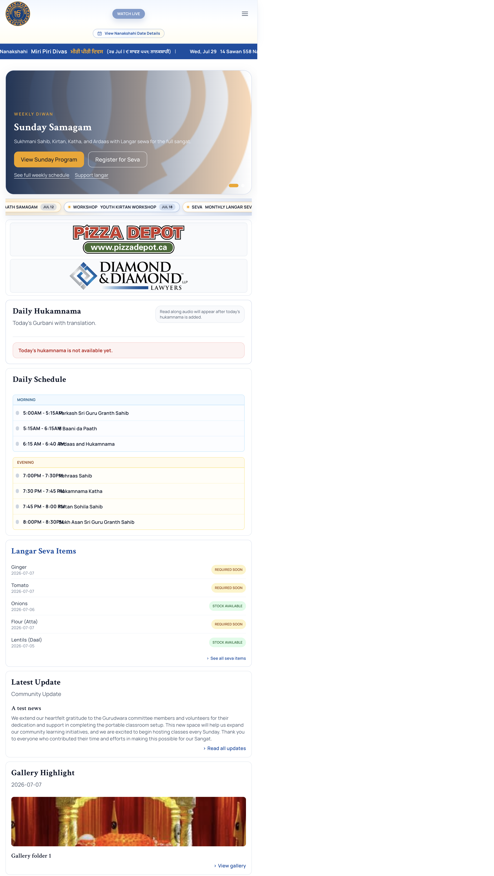
Who Uses This Website
From first-time visitors to full operations teams
Public Visitors - Explore the Gurdwara, programs, media, and updates Participants - Register for events, sign up for seva, and donate Families and Members - Track participation and manage profile details Admins and Leadership - Run content, approvals, campaigns, and operations in one place

Slide 3
Why People Keep Using It
Clear journeys, less confusion, better trust
- The site is simple to navigate from any starting point - Event and seva registration flows are straightforward - Already-registered users get clear messages instead of error loops - Families see relevant actions, admins see admin actions - The platform feels predictable, which builds confidence

Slide 4
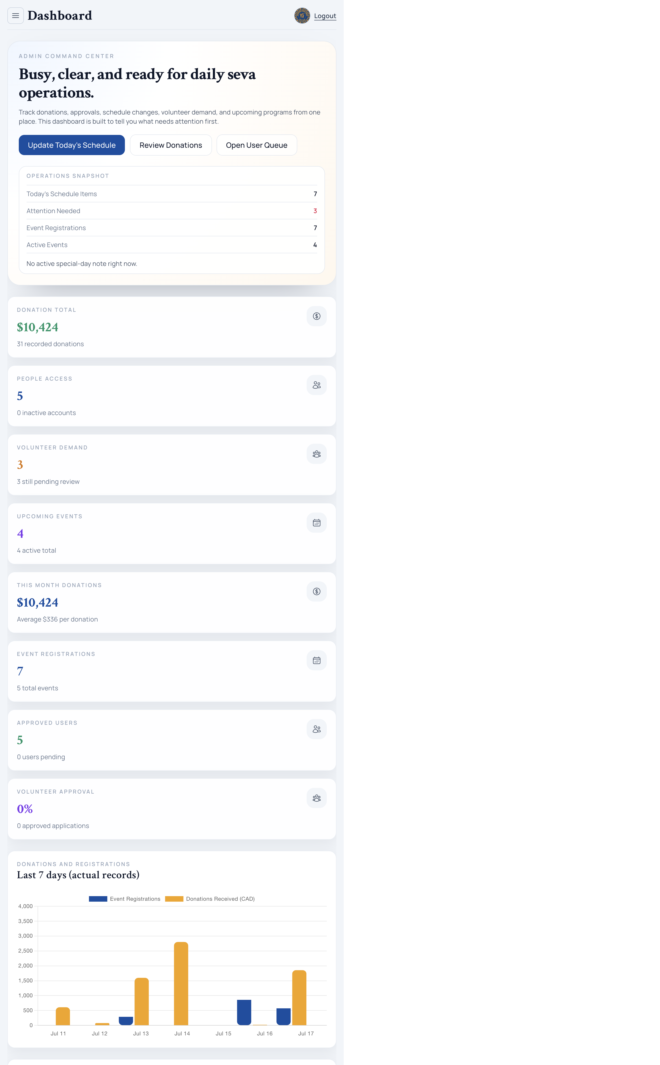
What We Gain
Real outcomes for community and operations
- Community Gain: More participation in events, seva, and learning - Operational Gain: Less manual follow-up and fewer duplicate records - Governance Gain: Role-aware access and cleaner approval flow - Communication Gain: Faster publishing across pages and channels

Slide 5
Trust and Data Integrity
Where user experience and admin reliability meet
- Duplicate registration is blocked for the same user and opportunity - Already registered users see disabled submit states with clear wording - This prevents accidental double entries and reporting noise - Teams spend less time fixing records and more time serving people

Slide 6
Why This Is Worth Investing In
The value is felt by families, sevadars, and leadership
Efficiency
Engagement
Governance
Operations teams can run updates and campaigns without scattered tools.
Sangat members can discover, join, and contribute with less effort.
Leadership gets clearer visibility with safer role and approval controls.

Slide 7
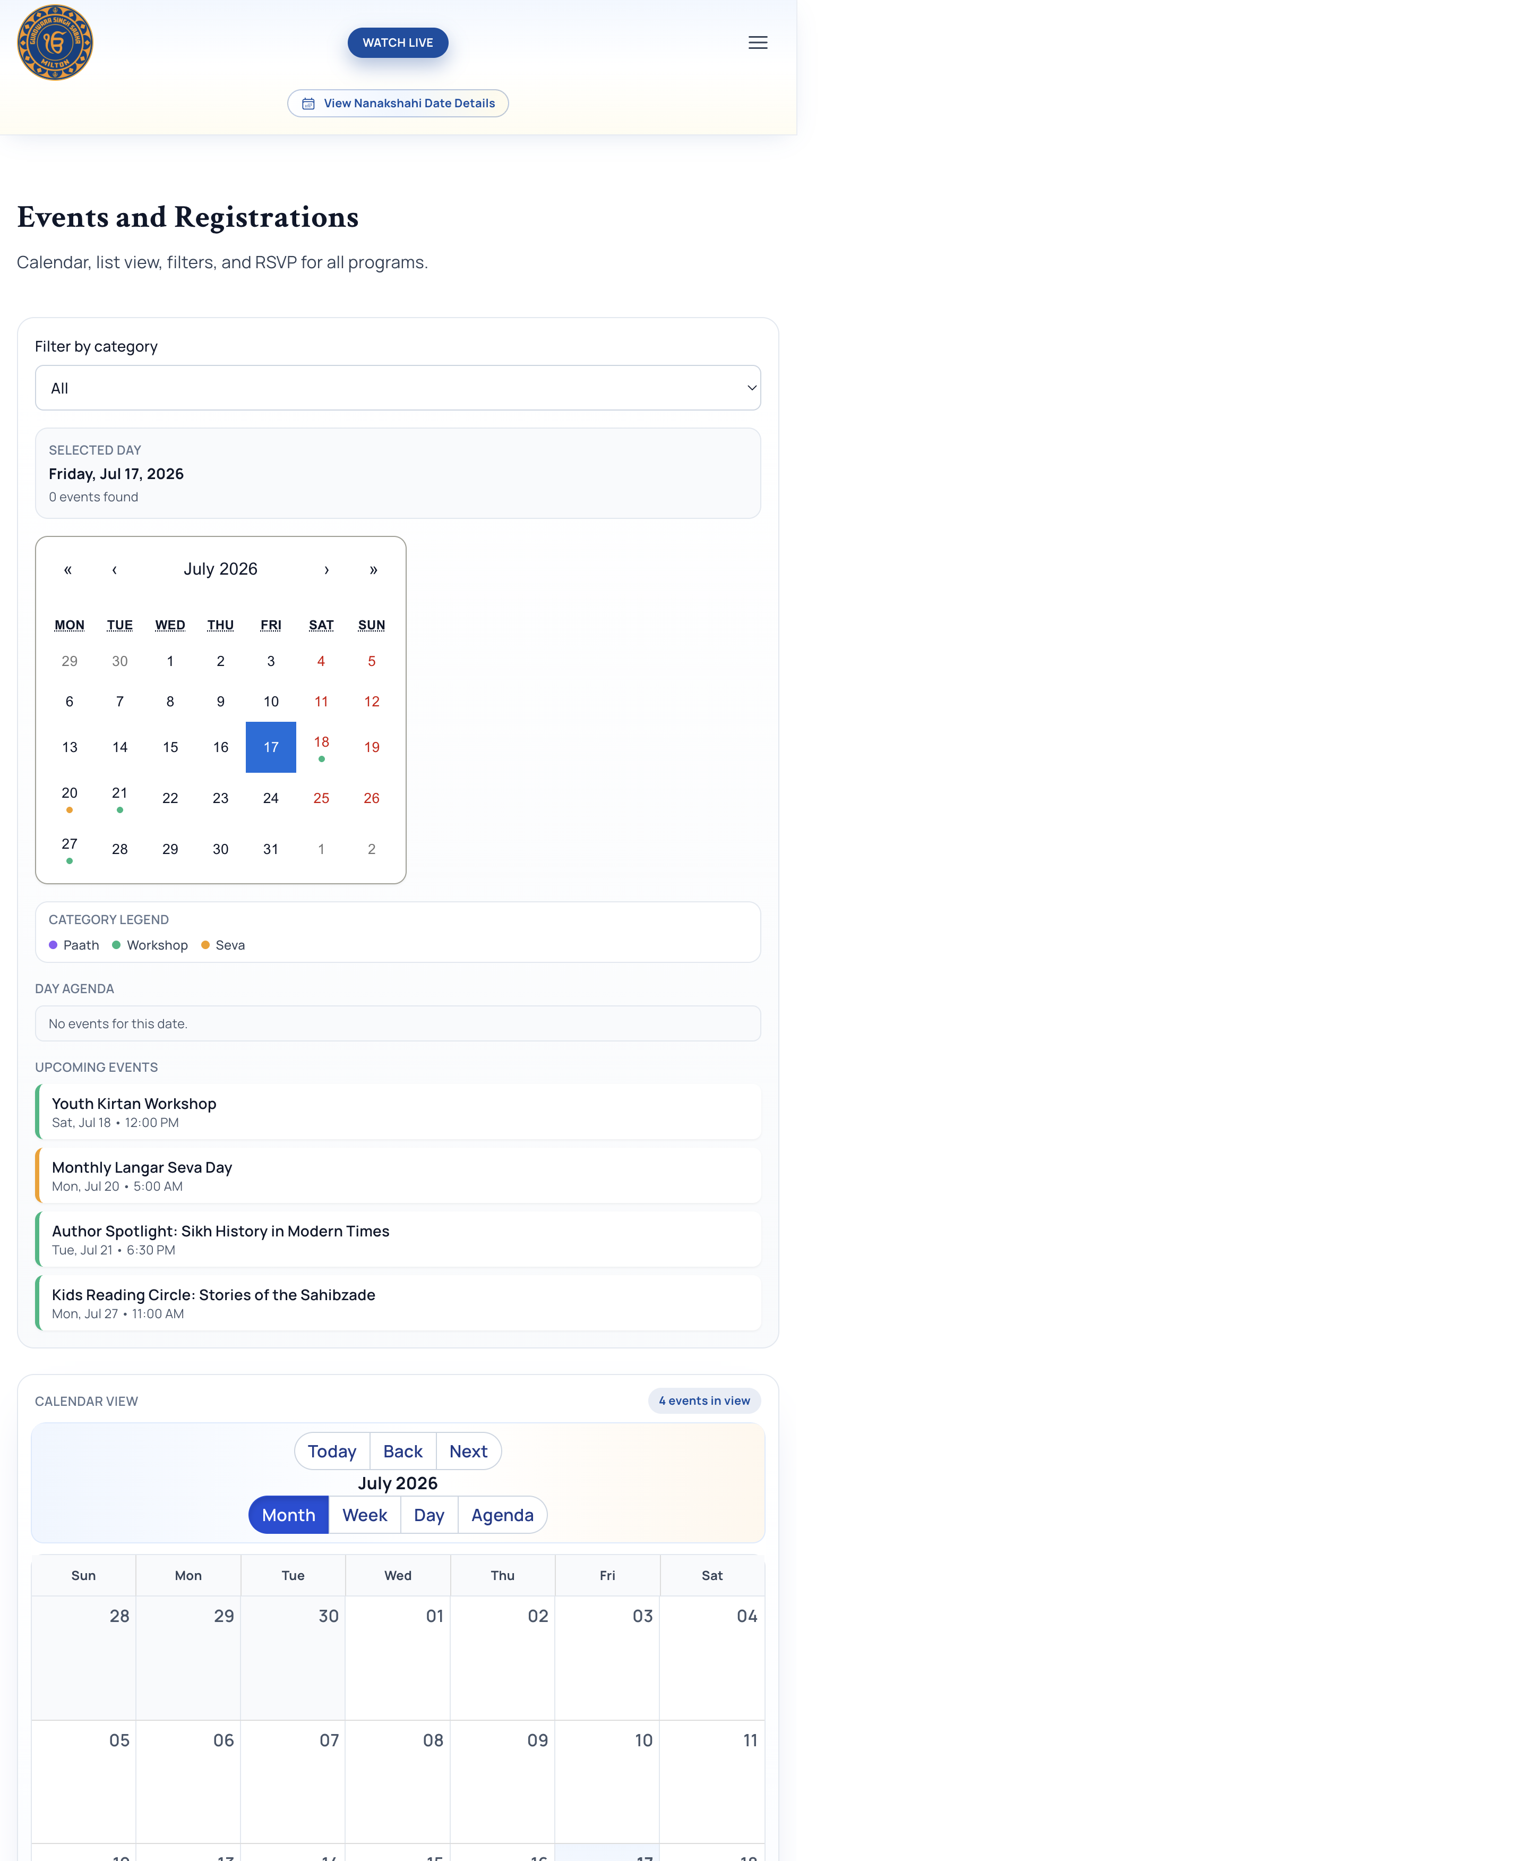
Public Journeys
Representative platform screen

Slide 8
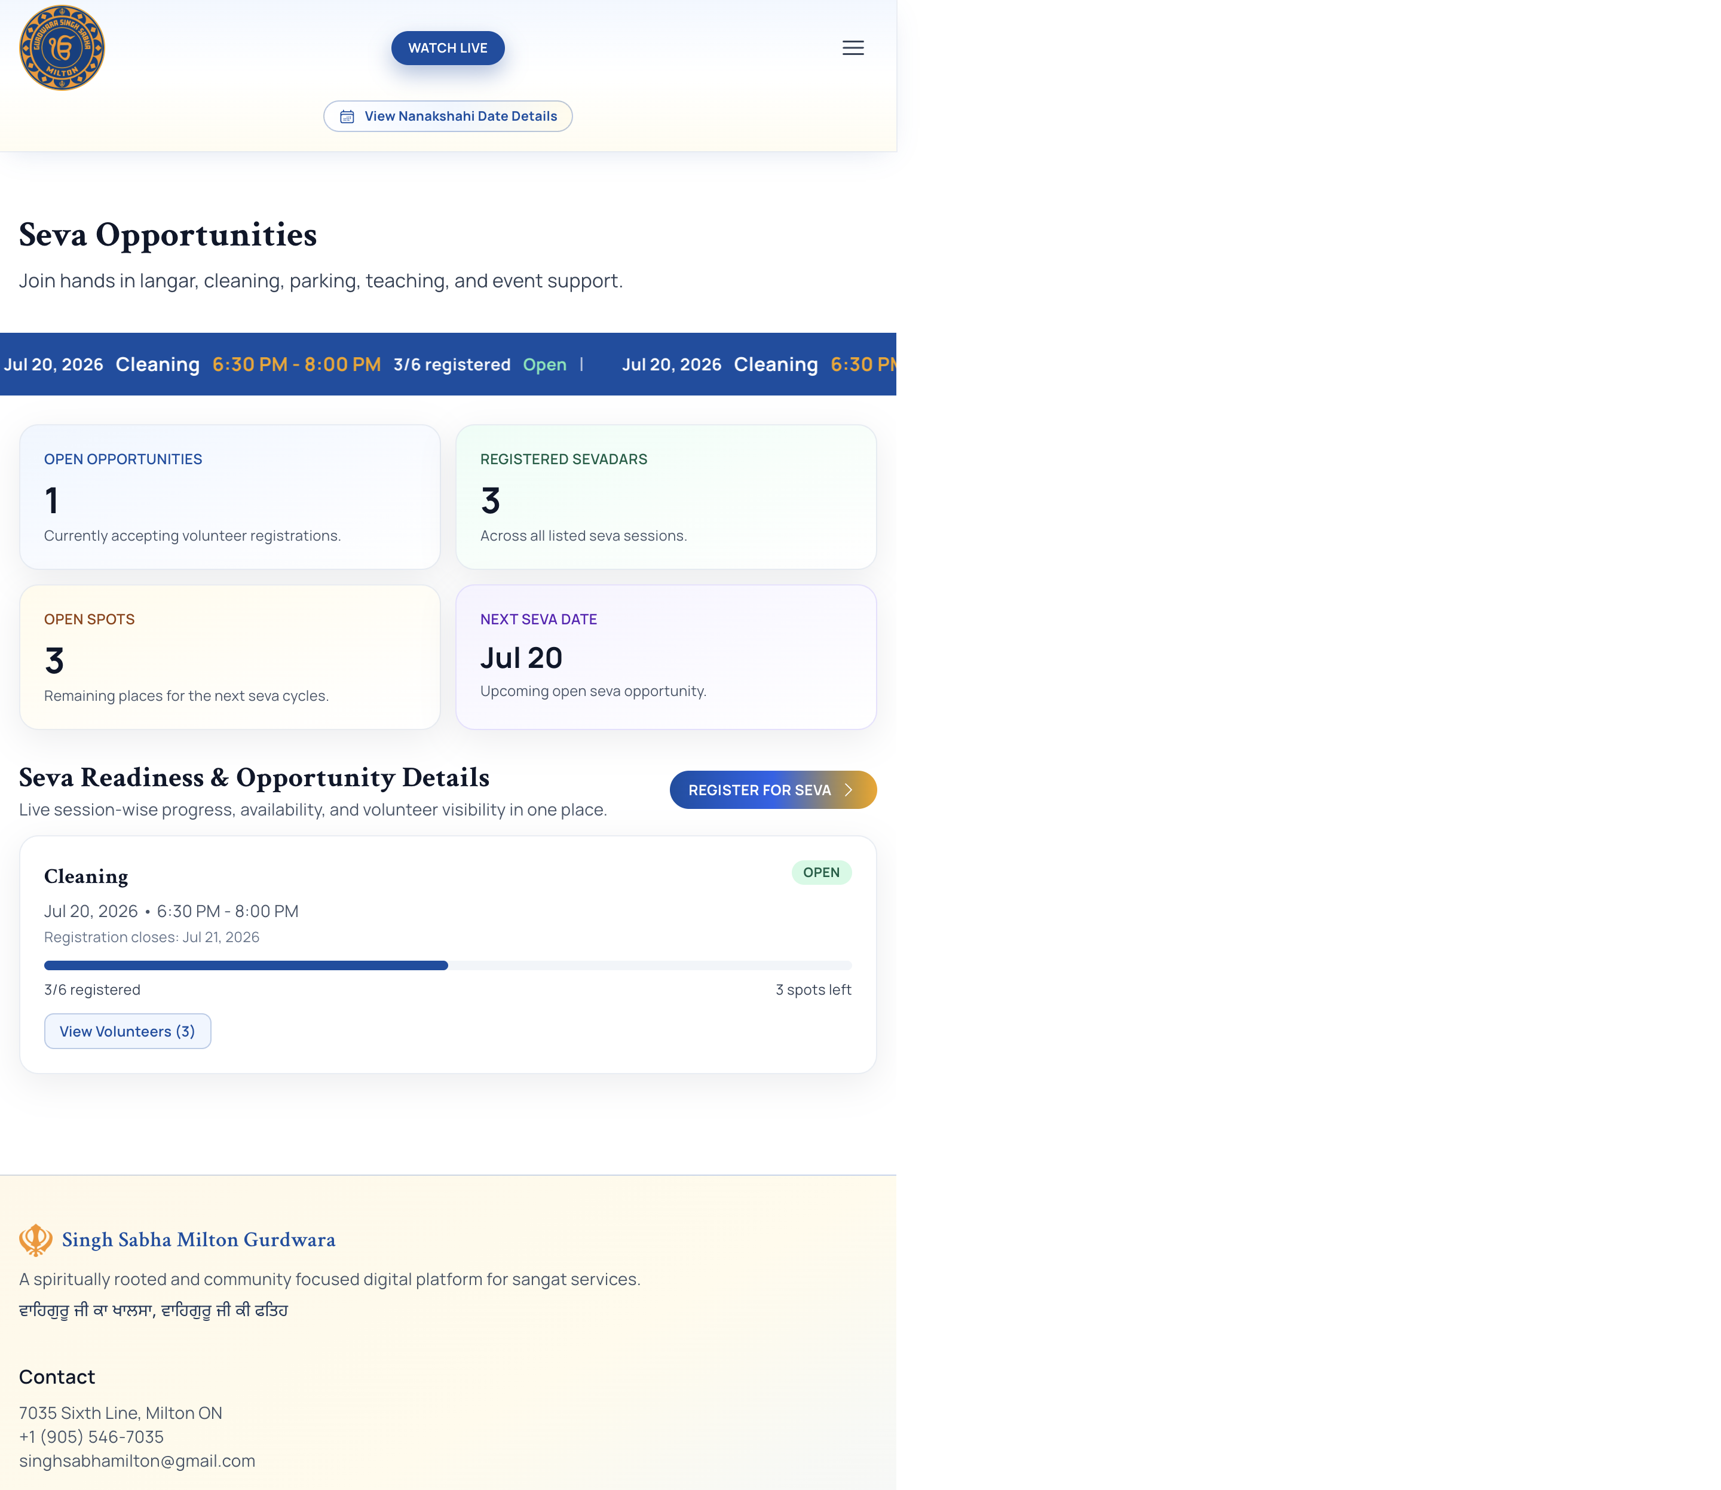
Seva Journeys
Representative platform screen

Slide 9
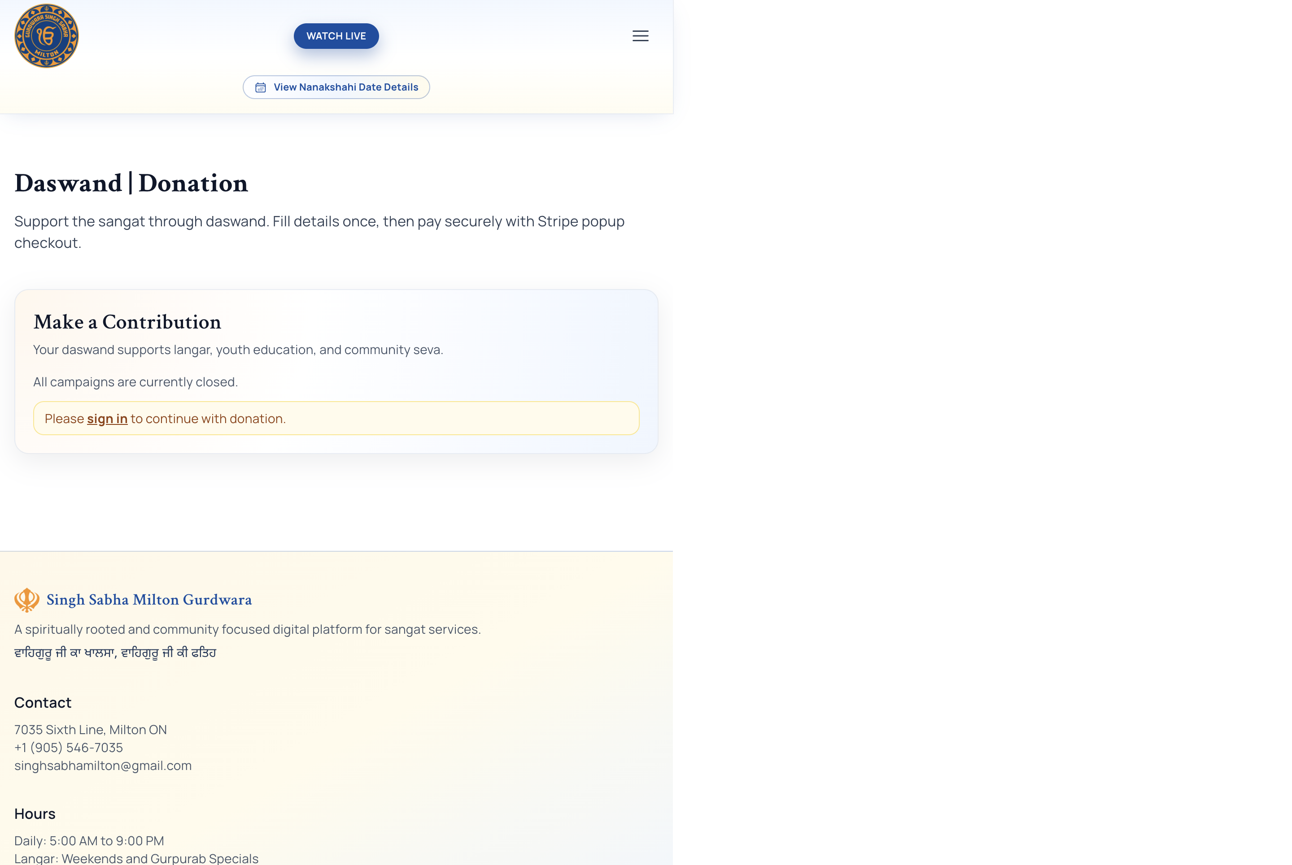
Donations
Representative platform screen

Slide 10
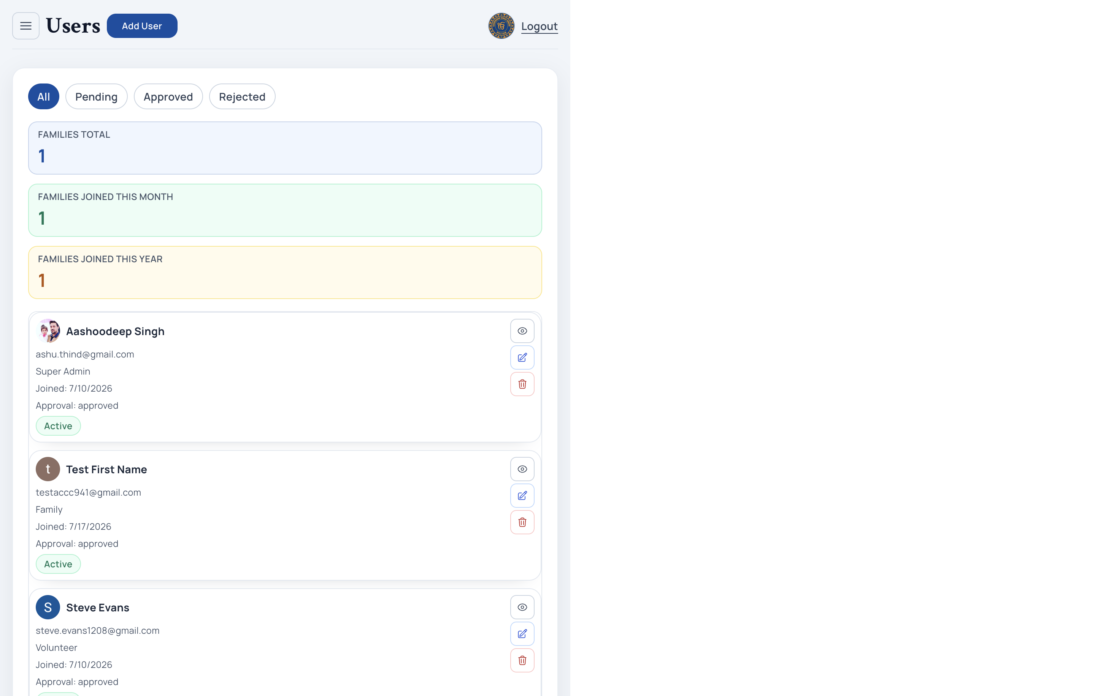
Users and Access
Representative platform screen

Slide 11
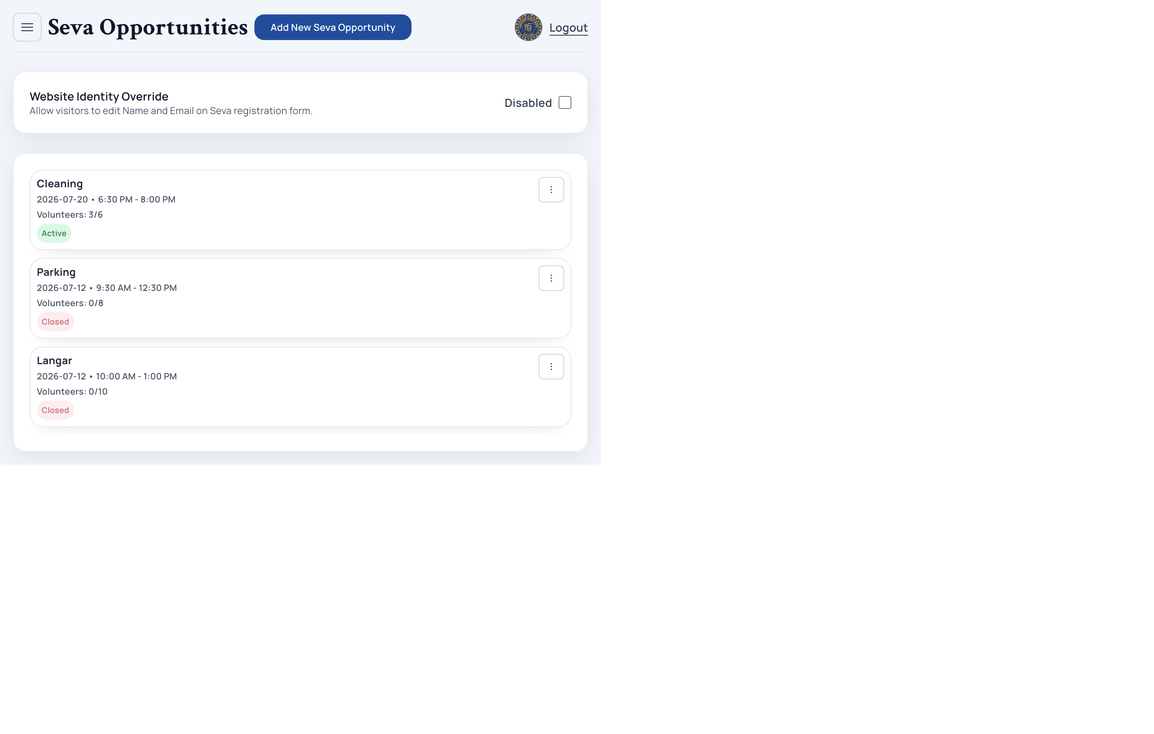
Operations
Representative platform screen

Slide 12
What To Do Next
Make the value visible in every rollout and demo
1. Keep demos people-first: start with who uses each page and why 2. Publish this runbook where admins can access it quickly 3. Train module owners with live flows (Users, Events, Seva, Donations) 4. Track KPIs: registrations, donation conversion, volunteer participation

