Slide 1
AI-Based Doctor Recommendation System
Ashutosh Srivastava | MCA (AI & DS)

Slide 2
INTRODUCTION
What Is This System?
An AI-powered tool that recommends the right doctor based on your symptoms — instantly.
Smart Matching
Saves Time
For Everyone
Analyzes symptoms to find the best specialist
No guessing, no confusion — quick results
Simple to use, no medical knowledge needed

Slide 3
PROBLEM STATEMENT
The Problem We're Solving
❓ Wrong Doctor Visits
⏳ Delayed Treatment
😕 Confusion & Stress
Patients consult the wrong specialist, wasting time and money
Not knowing where to go leads to dangerous delays in care
Too many specializations make the choice overwhelming

Slide 4
OBJECTIVES
What This System Aims to Do
1
2
Recommend the Right Doctor
Save Patient Time
Match symptoms to the most suitable medical specialization
Instant results — no long waits or multiple consultations
3
4
Improve Decisions
Easy Access for All
Data-driven suggestions reduce human error and guesswork
Designed to be simple for anyone, anywhere

Slide 5
TECHNOLOGIES USED
Built With These Tools
Python
Machine Learning
Core programming language for the entire system
Trains models to predict the right doctor
Dataset
Libraries
Symptoms & disease records used for training
Pandas, Scikit-learn, NumPy & more

Slide 6
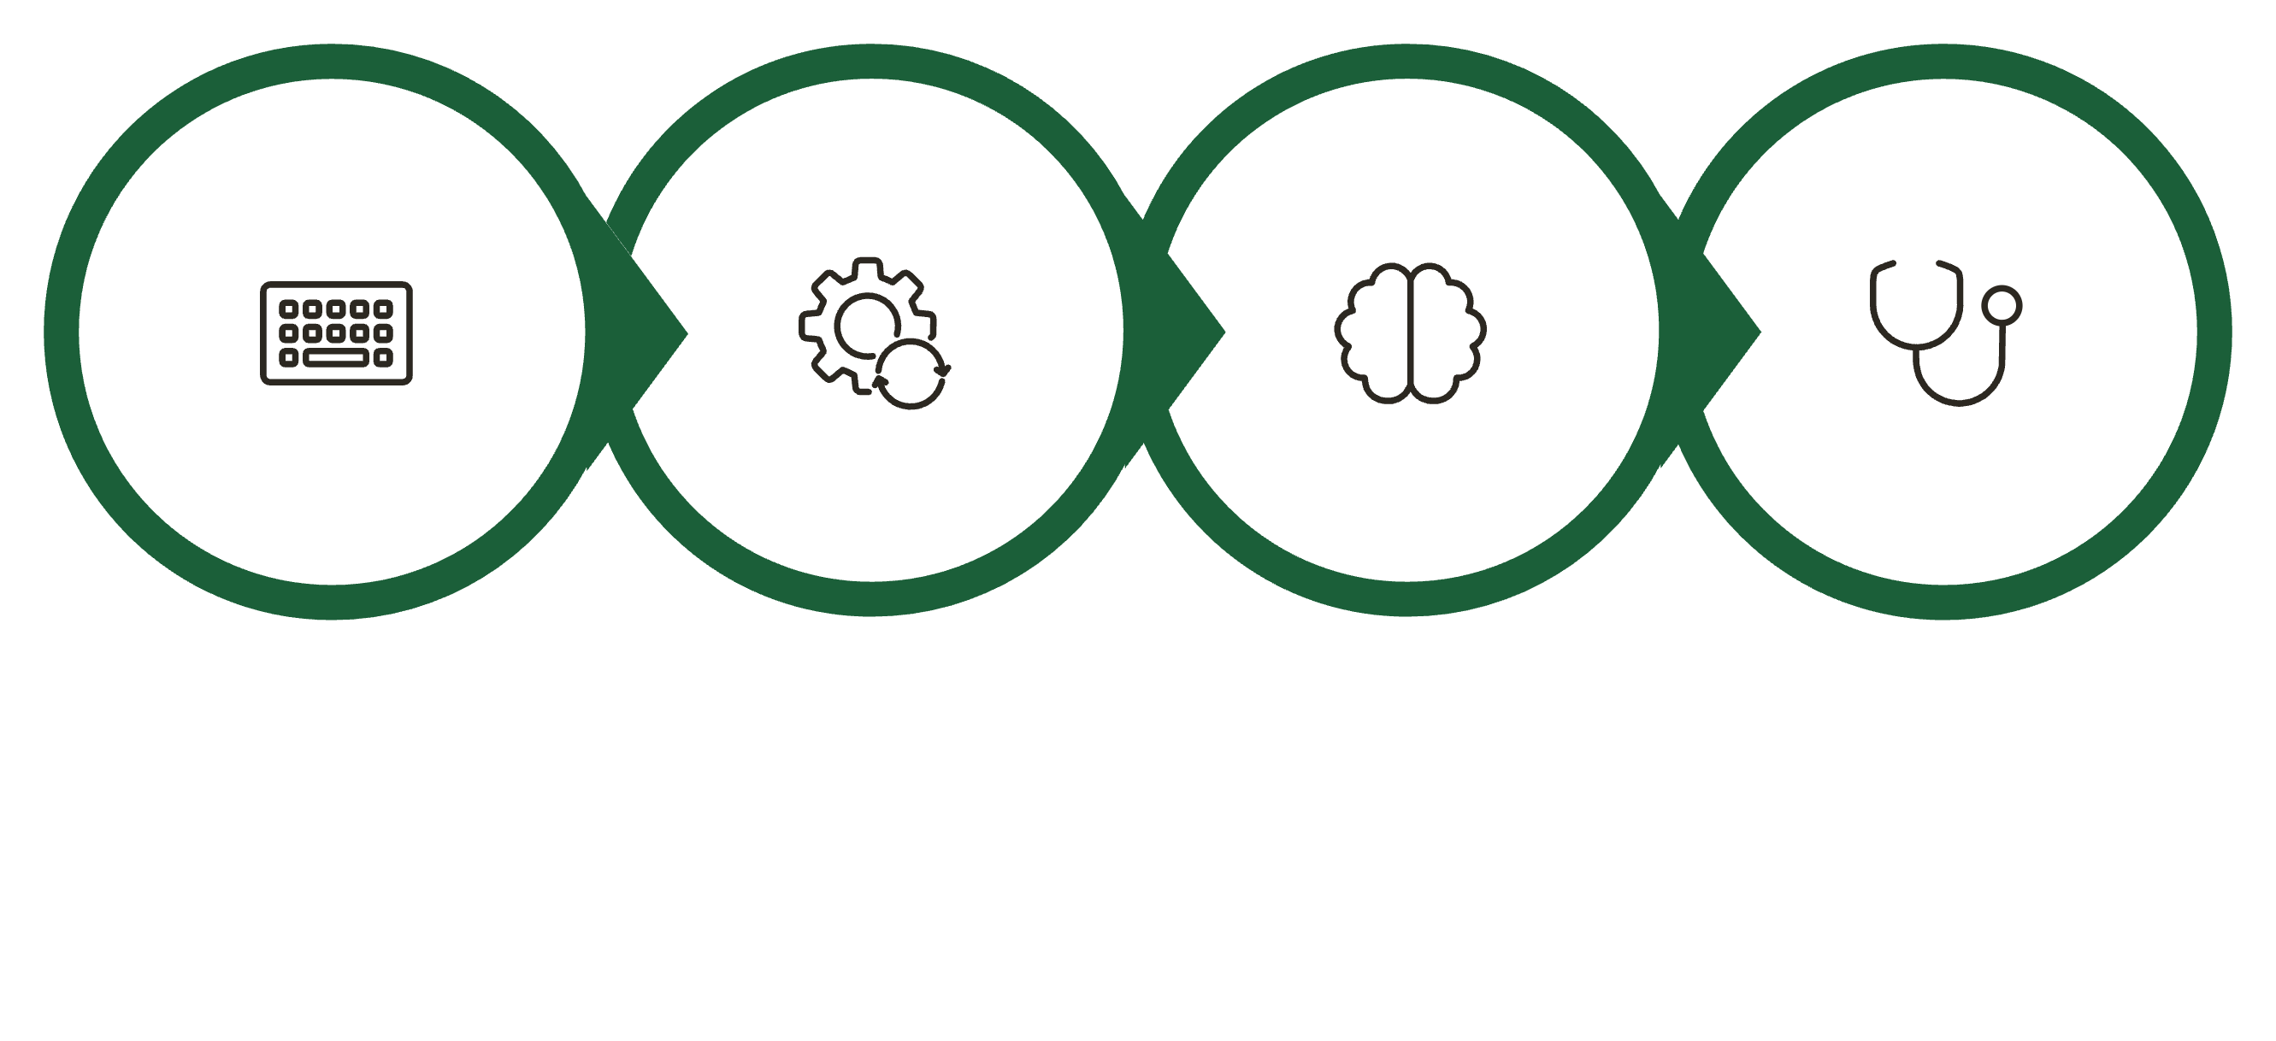
HOW IT WORKS
System Workflow
Enter Symptoms
Predict Disease
Recommend Doctor
Process Input
The entire process happens in seconds — from symptom input to doctor recommendation.

Slide 7
KEY FEATURES
Why Users Love It
Fast Results
Easy to Use
Accurate
Patient-Centered
Recommendations in seconds
No tech knowledge required
ML-trained for reliable output
Designed with real needs in mind

Slide 8


CONCLUSION & FUTURE SCOPE
What's Next?
Project Summary
Real-Time Data
A working AI system that recommends doctors from user symptoms — fast, simple, and accurate.
Integrate live hospital & patient records
Built with Python & ML. Trained on real symptom-disease data.
Mobile App
Launch as an Android or iOS application
Scan to View Project
📱 GitHub Repo QR Code — scan to explore the code
Web Platform
Deploy as a full web-based service

Slide 9
Thank You

