Slide 1
Numpy
Numerical Computing in Python

Slide 2
What is Numpy?
Stands for Numerical Python
Is the fundamental package required for high performance computing and data analysis
It provides:
ndarray for creating multiple dimensional arrays
Standard math functions for fast operations on entire arrays of data without having to write loops

Slide 3
Why do we need NumPy
Python does numerical computations slowly.
1000 x 1000 matrix multiplication
Python triple loop takes > 10 min.
Numpy takes ~0.03 seconds

Slide 4
NumPy Overview
Arrays
Shaping and transposition
Mathematical Operations
Indexing and slicing
Broadcasting

Slide 5

Arrays, Basic Properties
Arrays can have any number of dimensions, including zero (a scalar).
Arrays are typed: np.uint8, np.int64, np.float32, np.float64
Arrays are dense. Each element of the array exists and has the same type.

Slide 6
Arrays, creation
np.ones, np.zeros, np.empty, np.linspace
np.arange
np.concatenate
np.astype
np.random.random

Slide 7
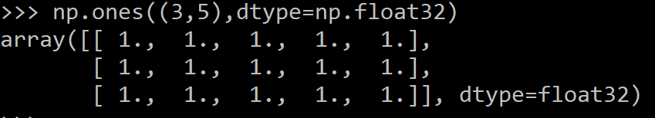
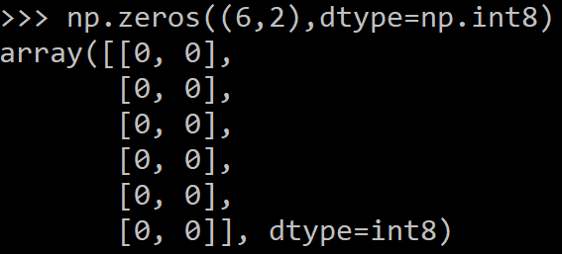
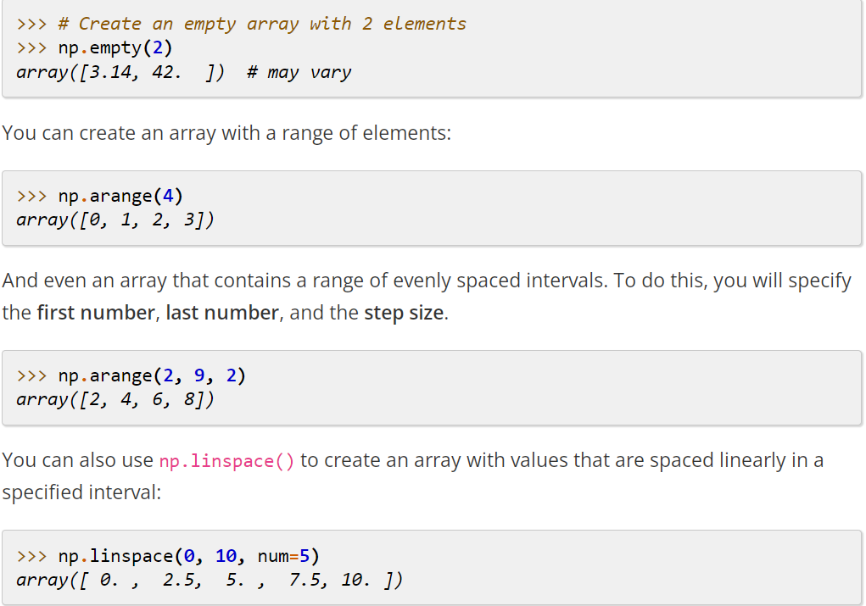
Arrays, creation
np.ones, np.zeros, np.empty, np.linspace
np.arange
np.concatenate
np.astype
np.random.random

Slide 8

Arrays, creation
np.ones, np.zeros, np.empty, np.linspace
np.arange
np.concatenate
np.astype
np.random.random

Slide 9
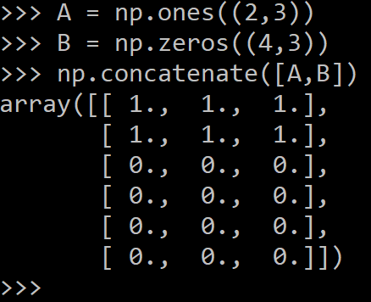
Arrays, creation
np.ones, np.zeros, np.empty, np.linspace
np.arange
np.concatenate
np.astype
np.random.random

Slide 10
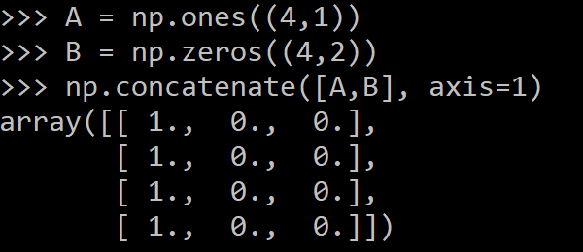
Arrays, creation
np.ones, np.zeros, np.empty, np.linspace
np.arange
np.concatenate
np.astype
np.random.random

Slide 11
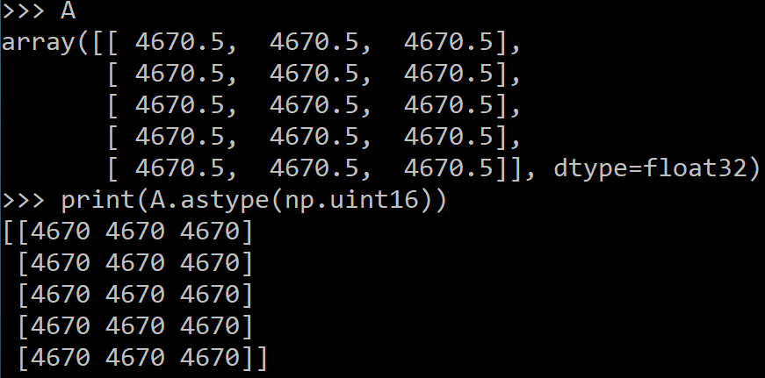
Arrays, creation
np.ones, np.zeros, np.empty, np.linspace
np.arange
np.concatenate
np.astype
np.random.random

Slide 12
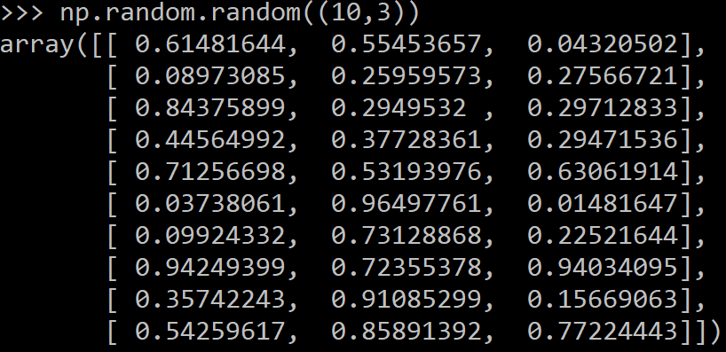
Arrays, creation
np.ones, np.zeros, np.empty, np.linspace
np.arange
np.concatenate
np.astype
np.random.random

Slide 13
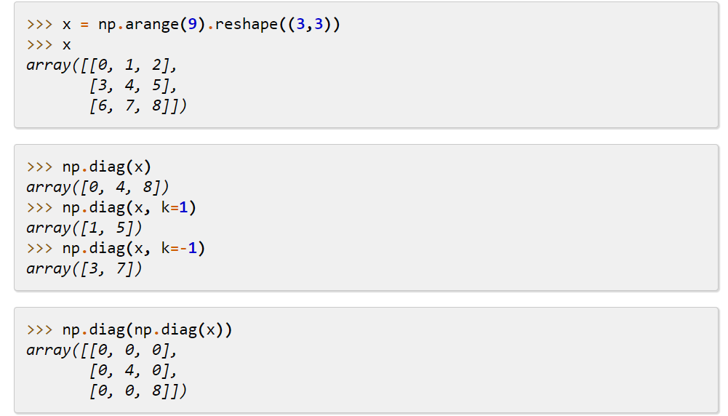
Diagonal array

Slide 14
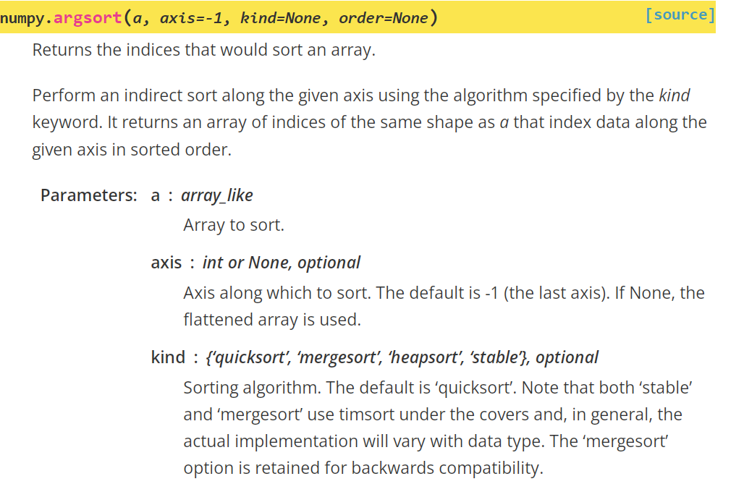
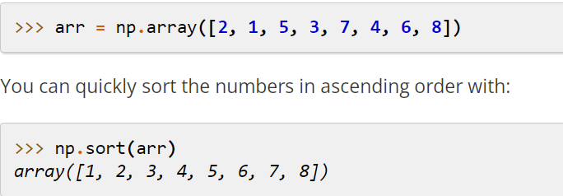
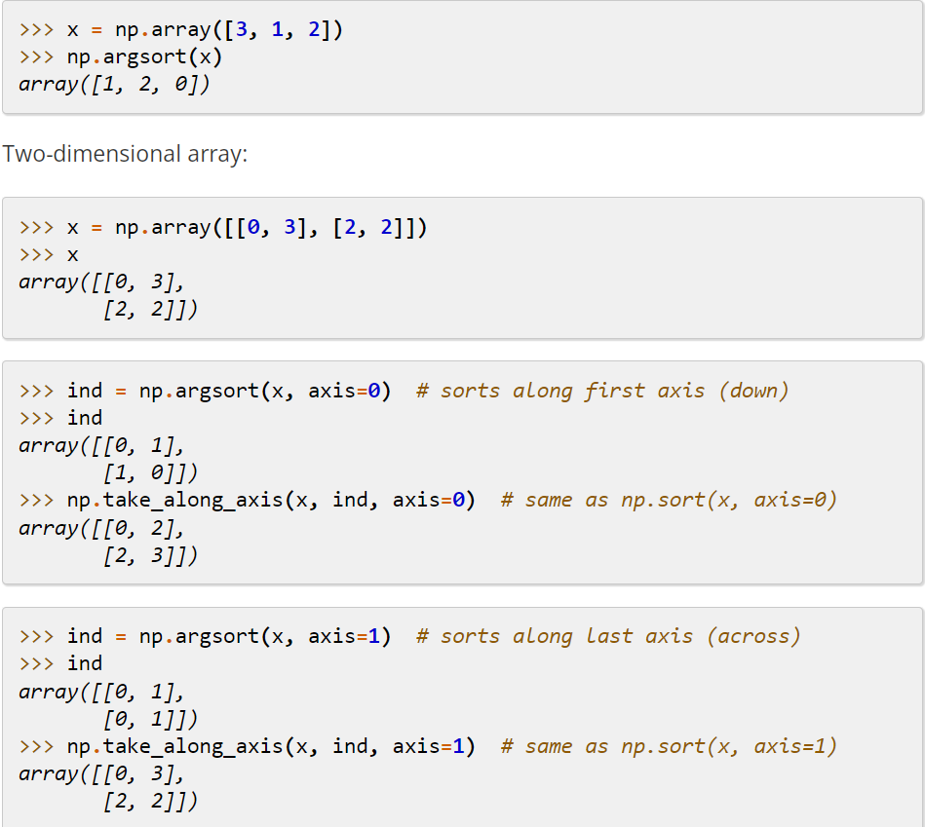
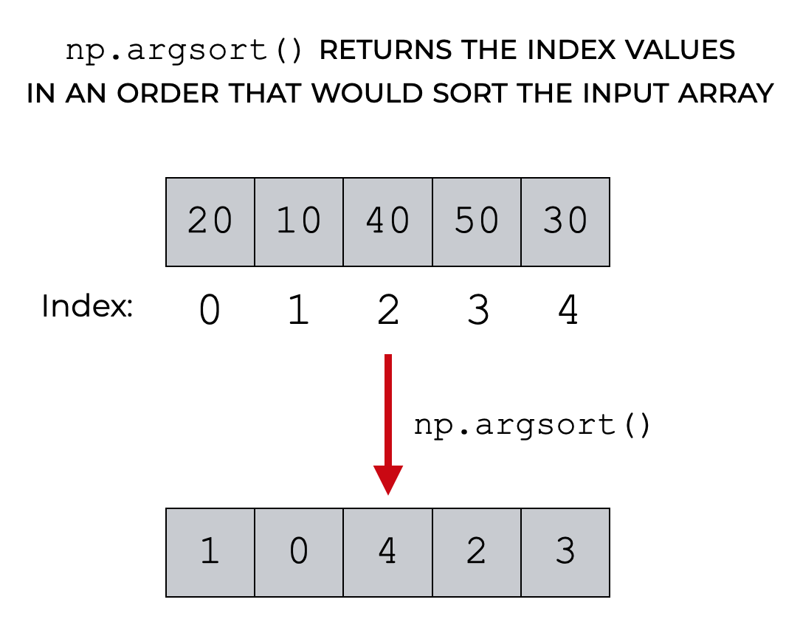
Sorting

Slide 15
Shaping
a = np.array([1,2,3,4,5,6])
a = a.reshape(3,2)
a = a.reshape(2,-1)
a = a.ravel()
Total number of elements cannot change.
Use -1 to infer axis shape
Row-major by default (MATLAB is column-major)

Slide 16
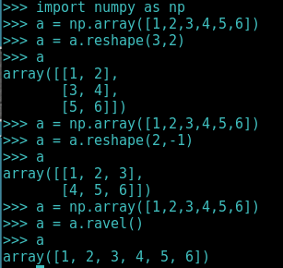
Shaping

Slide 17
Copy vs View
Numpy functions return either views or copies.
Views share data with the original array. Altering entries of a view, changes the same entries in the original.
Changes made to the original array are not reflected in the copy in case of copy command.

Slide 18
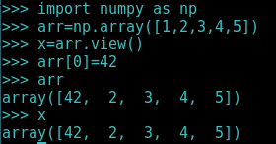
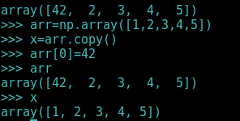
Copy vs View
View
Copy

Slide 19
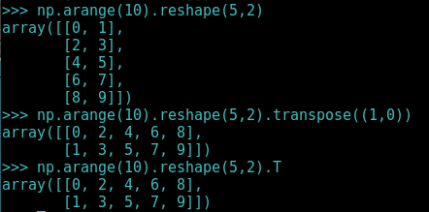
Transposition
a = np.arange(10).reshape(5,2)
a = a.T
a = a.transpose((1,0))
np.transpose permutes axes.
a.T transposes the first two axes.

Slide 20
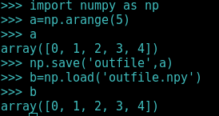
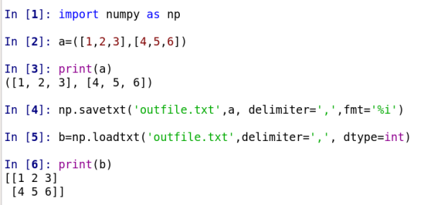
Saving and loading arrays

Slide 21
Mathematical operators
Arithmetic operations are element-wise
Logical operator returns a boolean array
In place operations modify the array

Slide 22
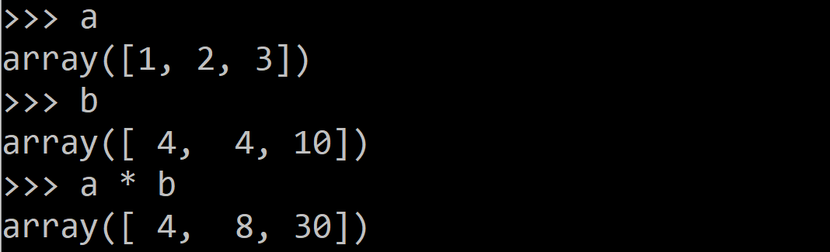
Mathematical operators
Arithmetic operations are element-wise
Logical operator return a bool array
In place operations modify the array

Slide 23
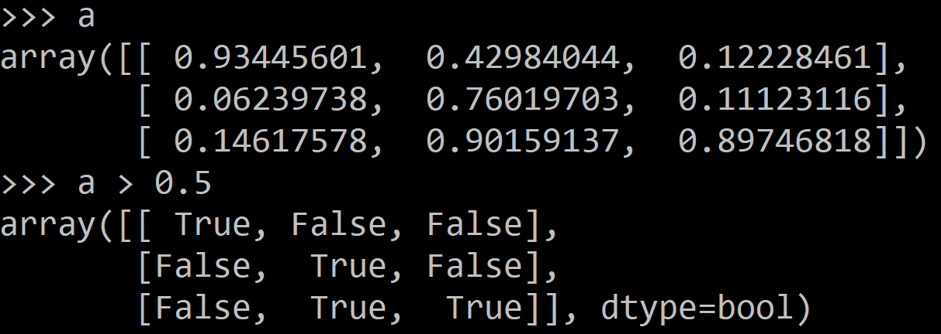
Mathematical operators
Arithmetic operations are element-wise
Logical operator return a bool array
In place operations modify the array

Slide 24
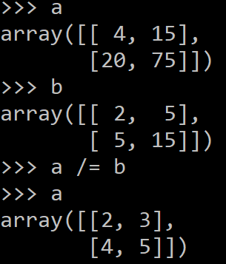
Mathematical operators
Arithmetic operations are element-wise
Logical operator return a bool array
In place operations modify the array

Slide 25
Math, upcasting
Just as in C++ and Java, the result of a math operator is cast to the more general or precise datatype.
uint64 + uint16 => uint64
float32 / int32 => float32
Warning: upcasting does not prevent overflow/underflow. You must manually cast first.
Use case: images often stored as uint8. You should convert to float32 or float64 before doing math.

Slide 26
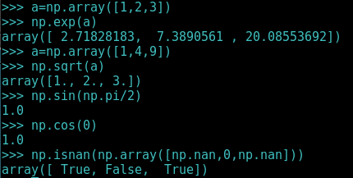
Math, universal functions
Also called ufuncs element-wise
Examples:
np.exp
np.sqrt
np.sin
np.cos
np.isnan

Slide 27
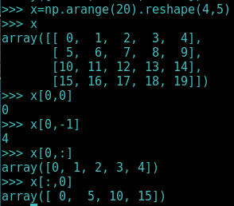
Indexing
x[0,0] # top-left element
x[0,-1] # first row, last column
x[0,:] # first row (many entries)
x[:,0] # first column (many entries)
Notes:
Zero-indexing
Multi-dimensional indices are comma-separated (i.e., a tuple)

Slide 28
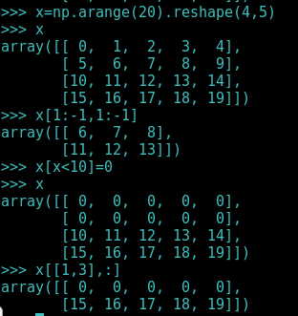
Indexing, slices and arrays
I[1:-1,1:-1]
# select all but one-pixel border
I[I<10] = 0
# set dark pixels to black
I[[1,3], :]
# select 2nd and 4th row

Slide 29
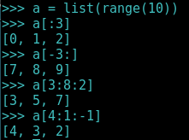
Python Slicing
Syntax: start:stop:step
a = list(range(10))
a[:3] # indices 0, 1, 2
a[-3:] # indices 7, 8, 9
a[3:8:2] # indices 3, 5, 7
a[4:1:-1] # indices 4, 3, 2

Slide 30
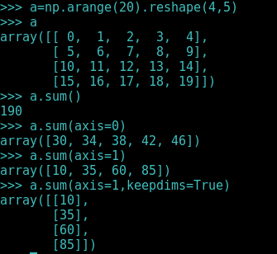
Axes
a.sum() # sum all entries
a.sum(axis=0) # sum over rows
a.sum(axis=1) # sum over columns
a.sum(axis=1, keepdims=True)
Use the axis parameter to control
which axis NumPy operates on
Typically, the axis specified will
disappear, keepdims keeps all dimensions.

Slide 31
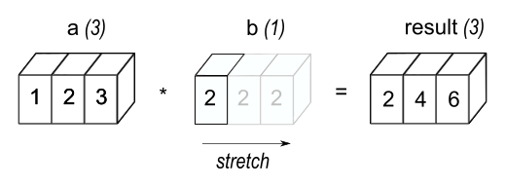
Broadcasting
a = a + 1 # add one to every element
When operating on multiple arrays, broadcasting rules are used.
Dimensions of size 1 will broadcast (as if the value was repeated).
Otherwise, the dimension must have the same shape.

Slide 32
Broadcasting example
Suppose we want to add a color value to an image
a.shape is 100, 200, 3
b.shape is 3
a + b will pad b with two extra dimensions so it has an effective shape of 1 x 1 x 3.
So, the addition will broadcast over the first and second dimensions.

Slide 33
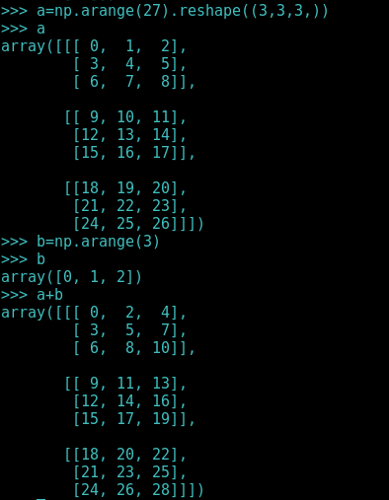
Broadcasting example

Slide 34
Broadcasting failures
If a.shape is 100, 200, 3 but b.shape is 4 then a + b will fail. The trailing dimensions must have the same shape (or be 1)

