Slide 1
Workshop on AI/ML using Python Topics Covered: 1. Concurrency in Python-Multithreading and Multiprocessing 2. Collections 3. Memory Mapped Files 4. Working with binary data Hemant Lalwani HRDPD/SIPG

Slide 2
Concurrency in Python Multithreading and Multiprocessing

Slide 3
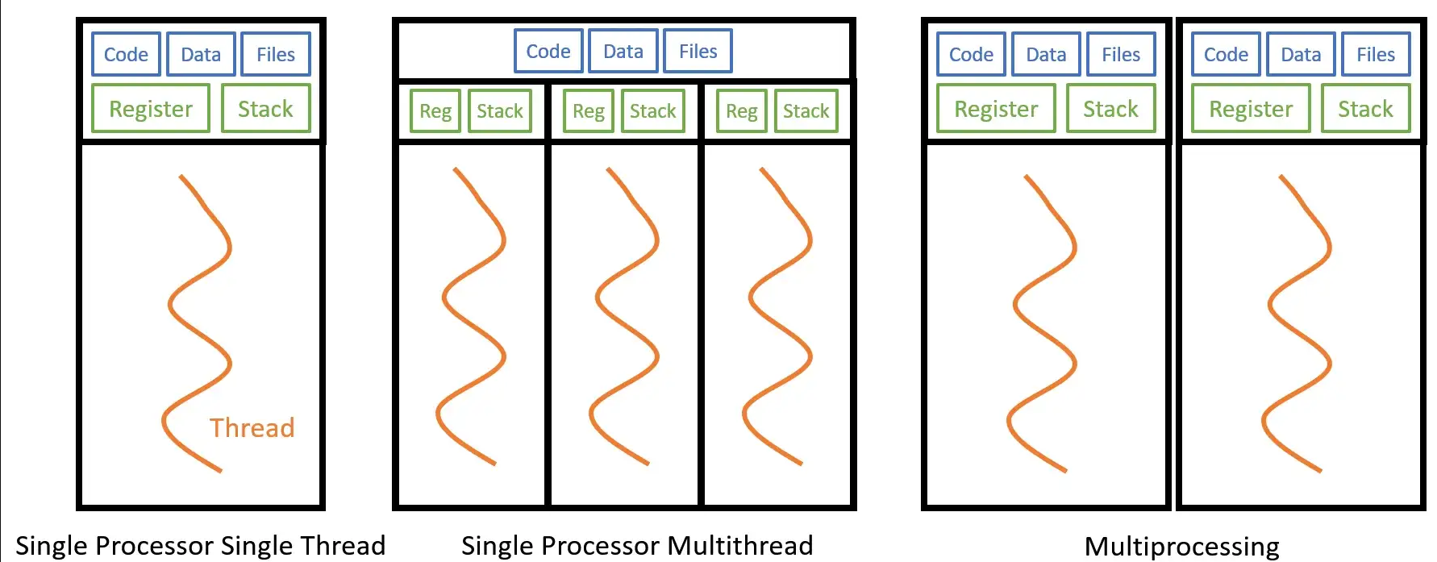
Introduction – Basic Terminology
Program : Is an executable file consisting of a set of instructions to perform some task.
Process : Is a program in execution (Loaded into main memory along with all the resources it needs to operate).
Thread : Is a unit of execution within a process or a lightweight process . (A process can have anywhere from one thread to many).

Slide 4
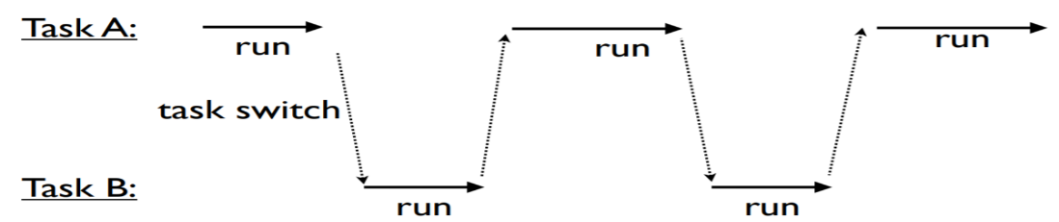
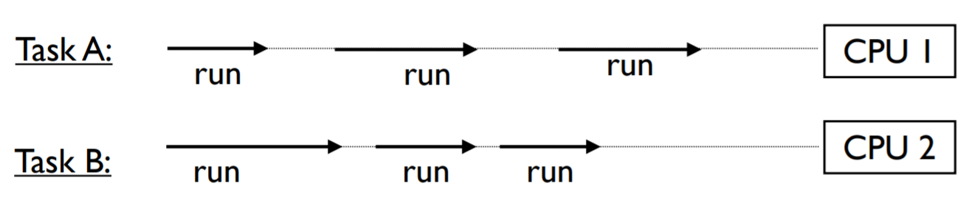
Concurrency vs Parallelism
Concurrent execution or concurrency | Parallel execution or parallelism
A condition when two or more tasks can start, execute and complete (making progress) in overlapping time periods. If only one CPU is available, the only way it can run multiple tasks is by rapidly switching between them. | A condition when two or more tasks are executing simultaneously ( run at the same time on multi-core processor).

Slide 5
Multitasking
Ability of operating system to perform multiple tasks (processes, programs, threads)at the same time.
utilize the CPU to reduce response time and improves performance.
Process-Based Multitasking(Multiprocessing) | Thread-Based Multitasking(Multithreading)
Executing multiple tasks simultaneously, where each task is separate independent process is called as process based multitasking. Example | Executing multiple tasks simultaneously, where each task is separate independent part of process (or) program. Multi-threading allows single process to have multiple code segments (threads) running concurrently within the context of process. Example

Slide 6
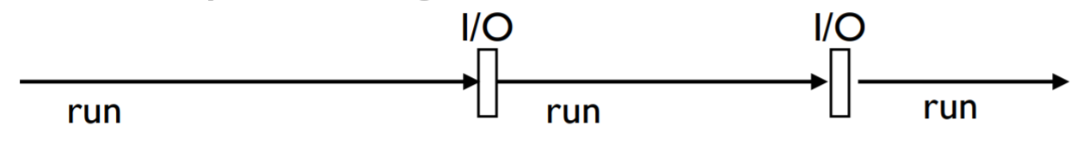
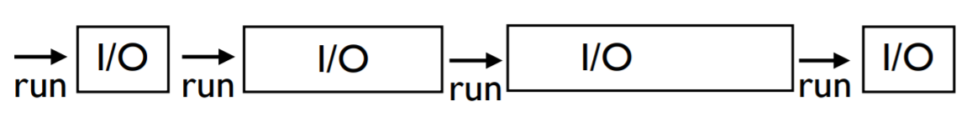
Task Execution – CPU Bound and I/O Bound Tasks
All tasks execute by alternating between CPU processing and I/O handling
For I/O, tasks must wait (sleep)
Behind the scenes, the underlying system will carry out the I/O operation and wake the task when it's finished.
CPU Bound Tasks | I/O Bound Tasks
A task is "CPU Bound" if it spends most of its time doing computation with little I/O Examples: Matrix multiplication Video Compression Image Processing | A task is “I/O Bound" if it spends most of its time doing I/O than doing computation. Examples: Reading input from user File processing Database connections, N/W Requests

Slide 7
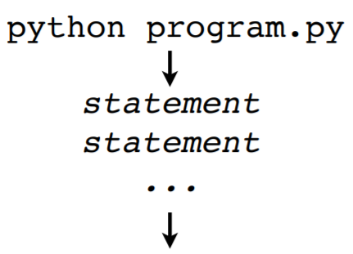
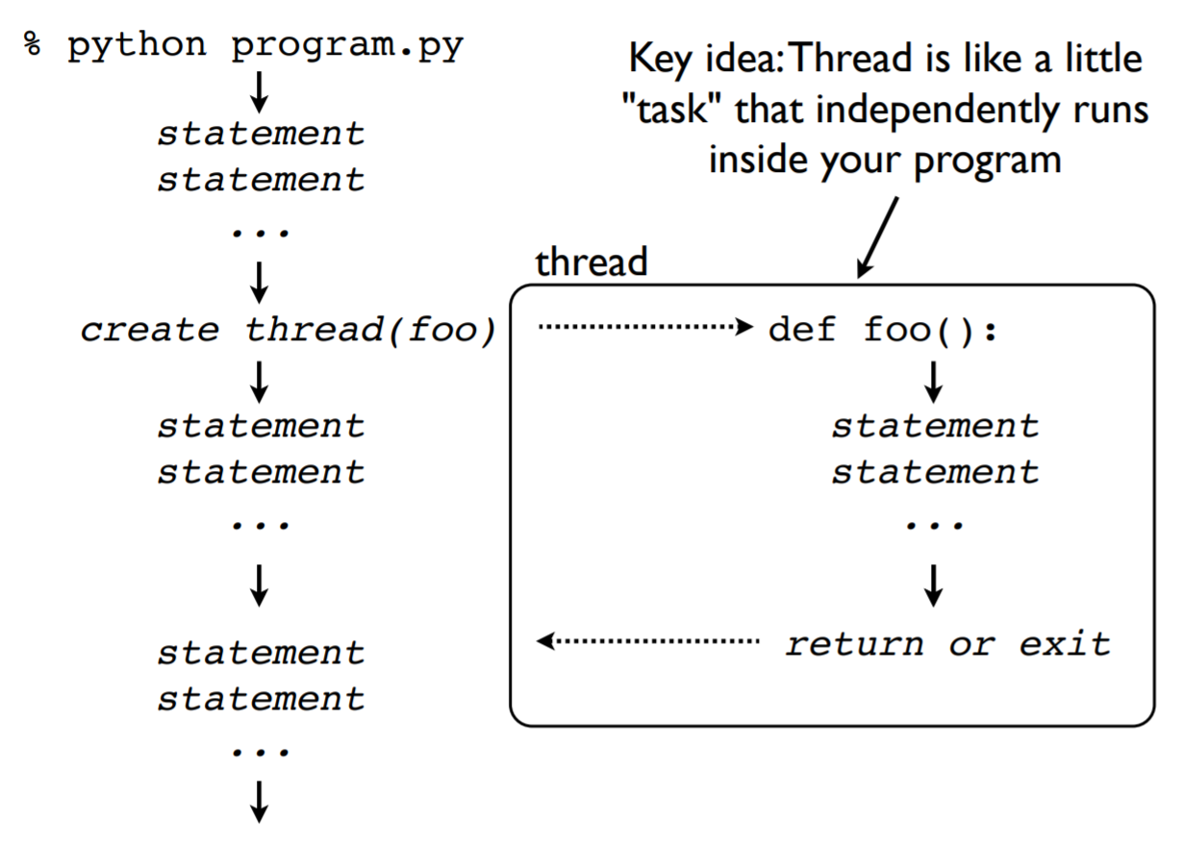
Thread Basics
Steps
Program Launch. Python loads a program and starts executing statements.
Creation of a thread. Launching of function
Concurrent execution of statements
Thread terminates on return or exit
Key Idea : Thread is like a little “task” that independently runs
inside program.

Slide 8
How to create threads in Python ?
Threading Module :
This Module provides Thread class, and this Thread class provide following methods
• start() − starts a thread by calling the run method.
• join()− waits for threads to terminate.
• isAlive() − checks whether a thread is still executing.
• getName() − returns the name of a thread.
• setName() − sets the name of a thread.
Creating Thread Using Threading Module
threading.Thread (target=None, name=None, args=())
• target is the callable function to be invoked by the run() method.
• name is the thread name.
• args is the argument tuple for the function invocation.

Slide 9
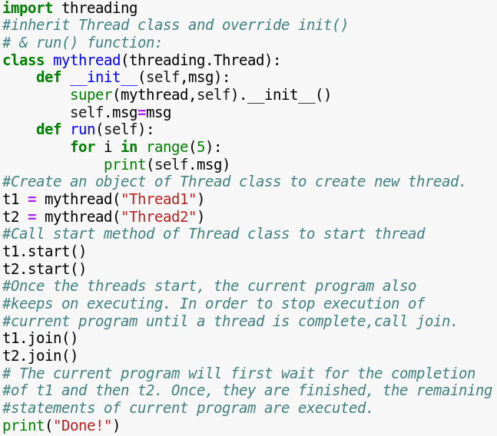
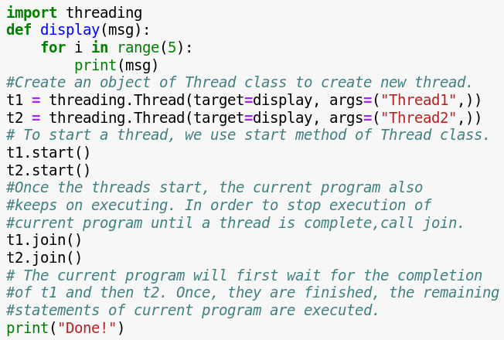
By Extending Thread Class
Without Extending Thread Class

Slide 10
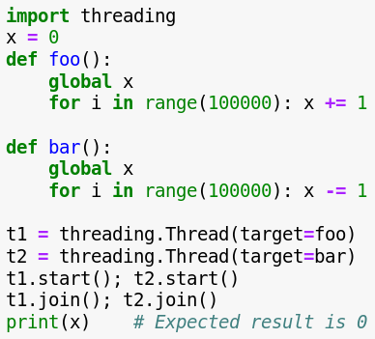
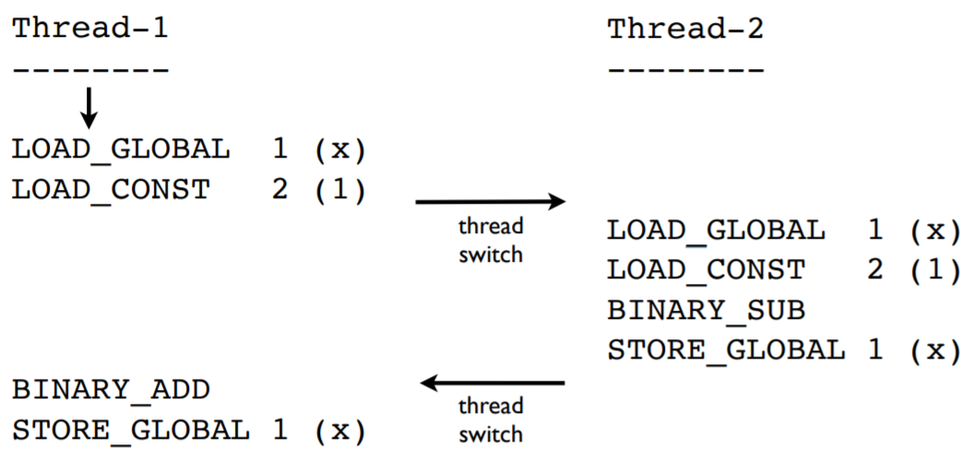
Shared Data Access
Thread share all of the data in program.
Thread scheduling is non-deterministic. Access to any kind of shared data is also non-deterministic.
Whenever two or more processes/threads manipulate a shared resource concurrently and the outcome depends on particular order in which access takes place ,a “Race Condition” occurs.
Thread Synchronization (Only one thread/process can make modification to shared data at any given time) - Using Lock , Semaphore

Slide 11
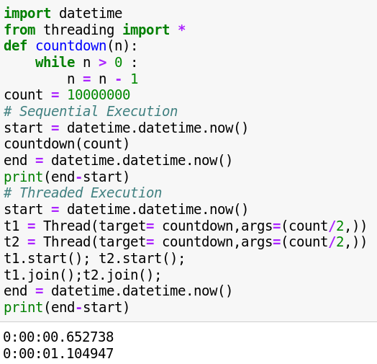
Whether Multithreading is useful or not ? A Performance Test
Now, you might expect two threads to run twice as fast on multiple CPU cores.
Sequential : 0.65 s
Threaded(2 threads) : 1.10 s
Threaded(4 threads) : 1.43 s
Why this happened ?

Slide 12
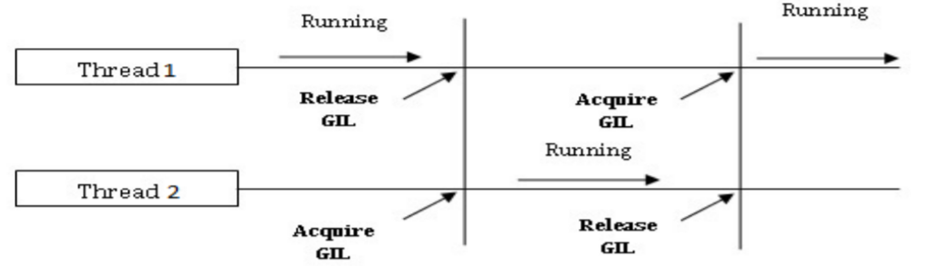
Global Interpreter Lock(GIL)
Python does not have a thread scheduler. Fully managed by the host operating system(All scheduling/thread switching)
Execution of Python code is controlled by the Python Virtual Machine.
Multiple threads may be "running" within the Python interpreter, only one thread is being executed by the interpreter at any given time.
Access to the Python Virtual Machine is controlled by the global interpreter lock (GIL). This lock ensures that exactly one thread is running in the interpreter at once.
Simplifies many low-level details (memory management, callouts to C extensions, etc.)
When a thread starts running, it acquires GIL and when it waits for I/O, it releases the GIL, so that other threads of that process can run.

Slide 13
Multiprocessing
An alternative to threads is to run multiple independent copies of the Python interpreter in separate processes. Each instance of Python is independent.
With multiprocessing, there are no shared memory address space. Every process is completely isolated/independent.
Different interpreters cooperate by sending messages to each other using Pipes/Sockets/Queues.
How to create processes in Python ?
Multiprocessing Module :
A module for writing concurrent Python programs based on communicating processes.
useful for concurrent CPU-bound processing.
Creating Process Using mulitprocessing Module
mulitprocessing.process(target=None, name=None, args=())
Note : Always launch process in main()

Slide 14
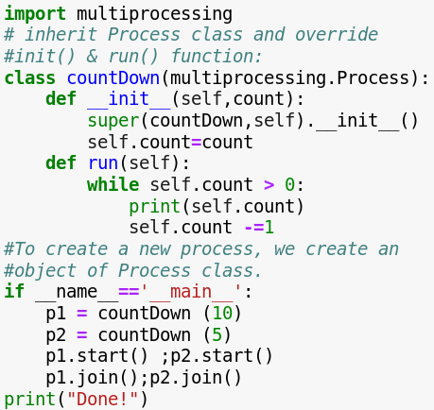
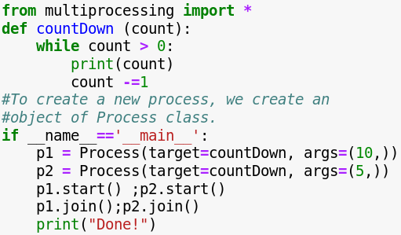
By Extending Process Class
Without Extending Process Class

Slide 15
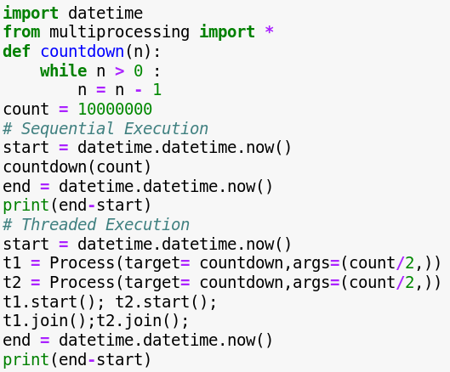
Whether Multiprocessing is useful or not ? A Performance Test
Sequential : 0.65 s
Parallel (2 processes) : 0.44 s
Parallel (4 processes) : 0.30 s

Slide 16
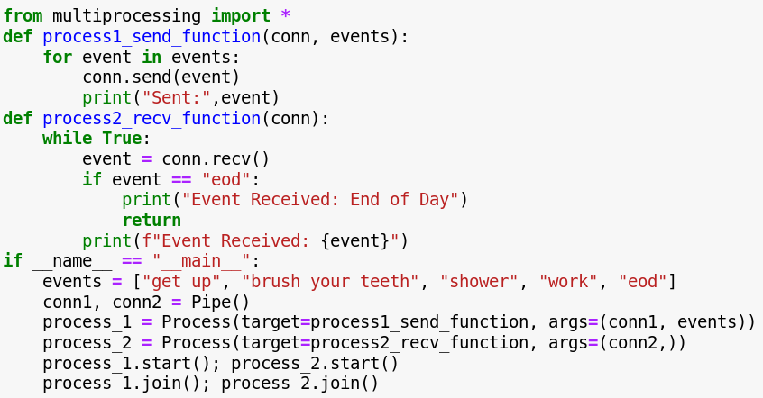
Process Communication Pipes
The Pipe() function returns a pair of connection objects connected by a pipe.
Each connection object has send() and recv() methods to send and receive messages

Slide 17
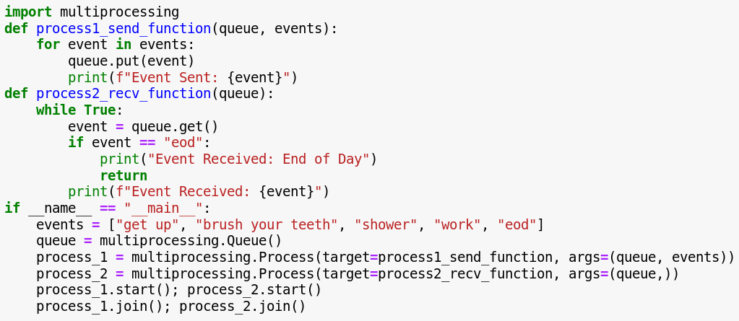
Process Communication Queues
A simple way to communicate between process with multiprocessing is to use a Queue to pass messages back and forth.

Slide 18
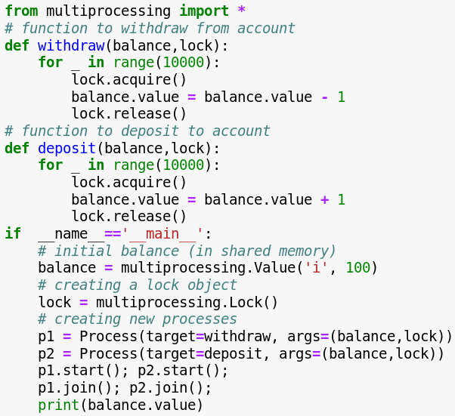
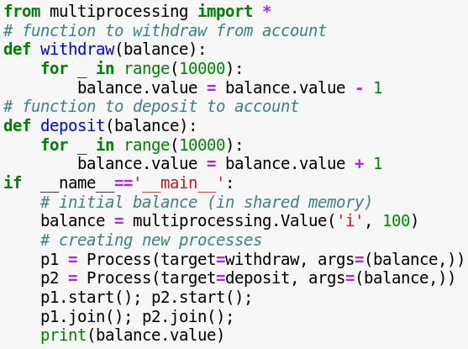
Process Synchronization Locks
Synchronization ensures that two or more concurrent processes/threads do not simultaneously execute some particular program segment where the shared resources are accessed known as critical section.

Slide 19
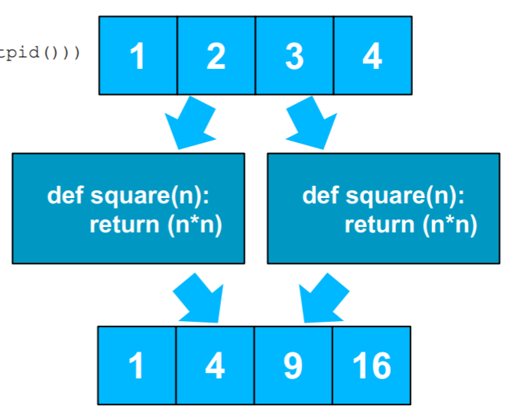
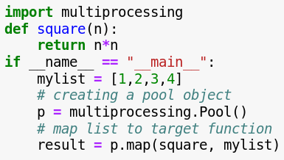
Work Distribution Pool
multiprocessing module provides a Pool class that represents a pool of worker processes. It has methods which allows tasks to be offloaded to the worker processes.

Slide 20
Pool Methods
When choosing one, you have to take multi-args, blocking, and ordering into account:
 | Multi-args | Blocking | Ordered-results
pool.map | no | yes | yes
pool.map_async | no | no | yes
pool.apply | yes | yes | yes
Pool.apply_async | yes | no | yes
TASK: Image Augmentation with multiprocessing.
Steps : 1. Read an Image ,
2. Segment image into small size chips,
3. perform flipping, rotation on chips using multiprocessing.

Slide 21
Collections

Slide 22
Container : A Container is a type of object that can be used to hold multiple items while simultaneously providing a way to access and iterate over them, such as a Tuple, list, dictionary.
Collections Module
Deque
OrderedDict
defaultdict
Collections
Counter
namedtuple
Chainmap

Slide 23
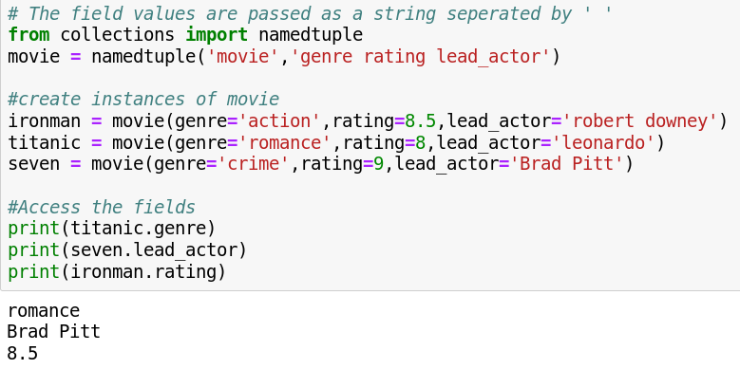
Namedtuple : Improving Code Readability
A function for creating subclasses of tuple that provides named fields that allow accessing items by name while keeping the ability to access items by index .

Slide 24
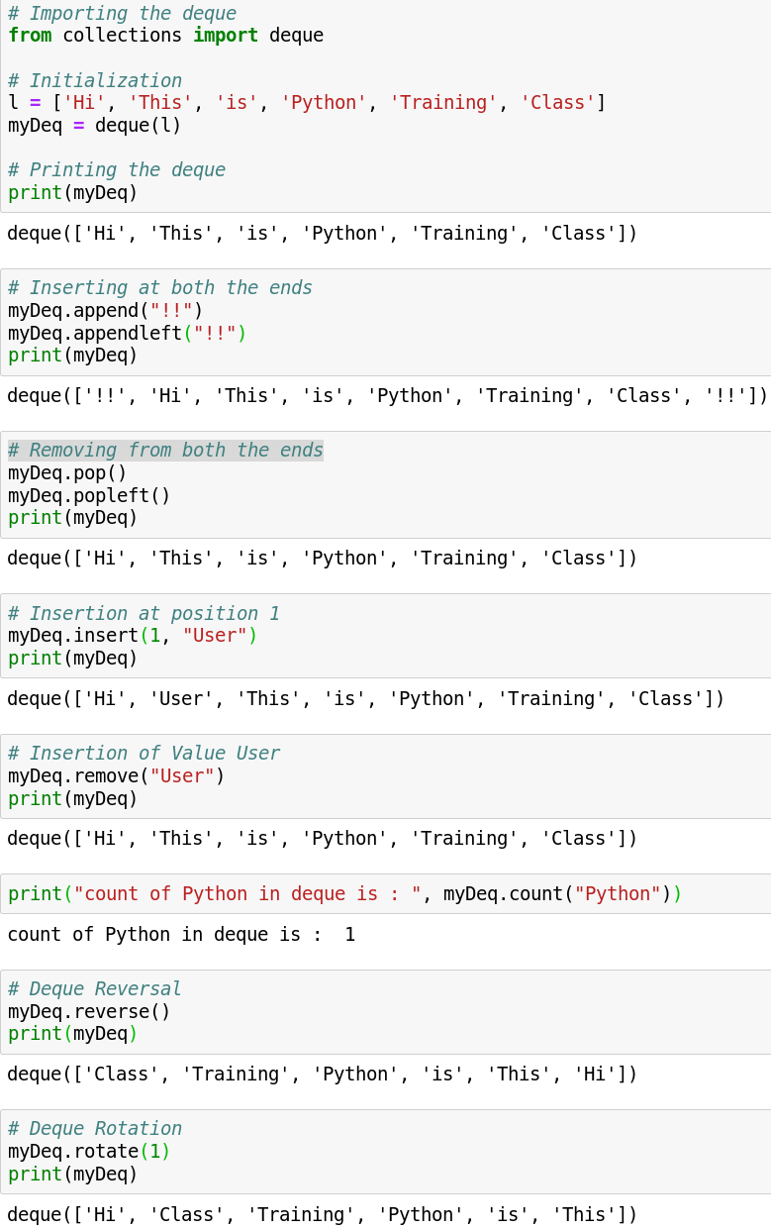
Deque : Building Efficient Queues and Stacks
A sequence-like collection that supports efficient addition and removal of items from either end of the sequence.

Slide 25
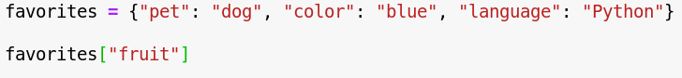
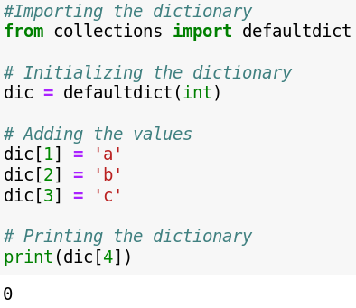
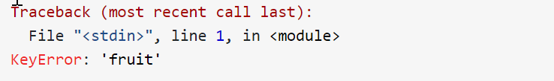
defaultdict : Handling Missing Keys
A dictionary subclass for constructing default values for missing keys and automatically adding them to the dictionary.

Slide 26
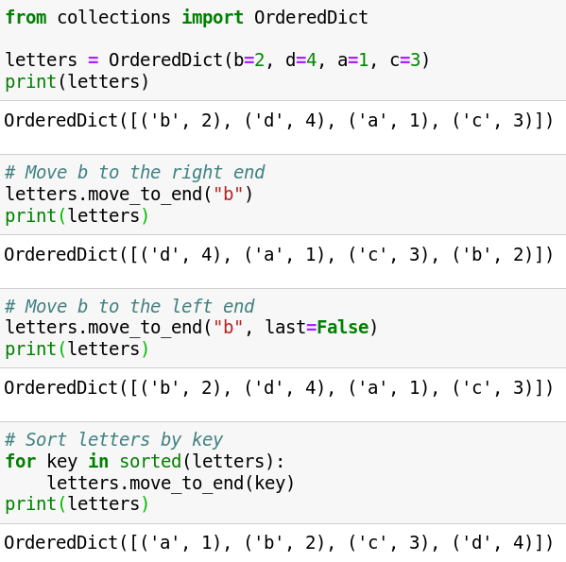
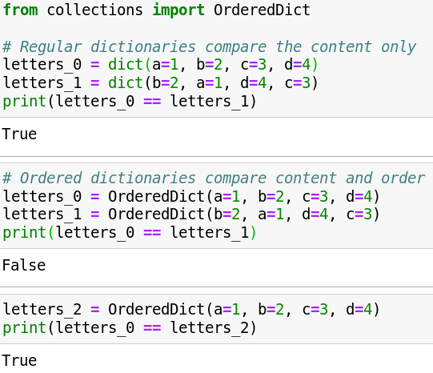
OrderedDict : Keeping Your Dictionaries Ordered
A dictionary subclass that keeps the key-value pairs ordered according to when the keys are inserted.

Slide 27
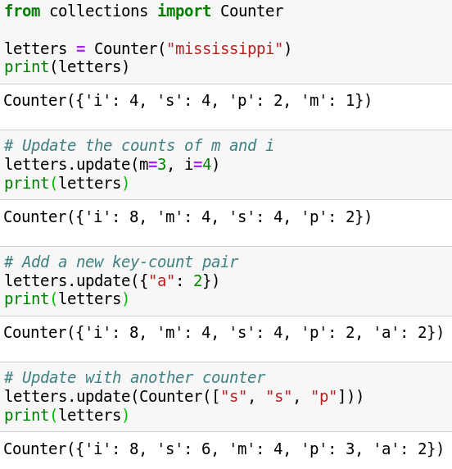
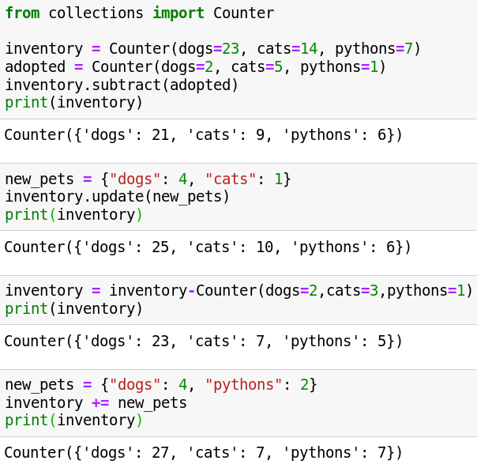
Counter: Counting Objects in One Go
A dictionary subclass that supports convenient counting of unique items in a sequence or iterable.

Slide 28
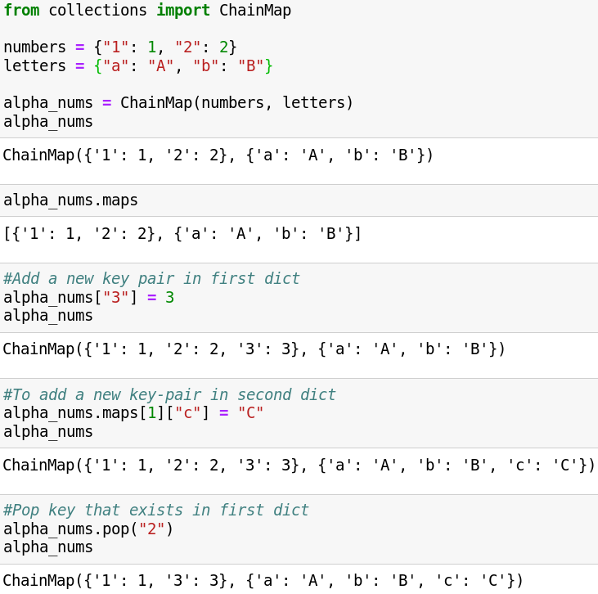
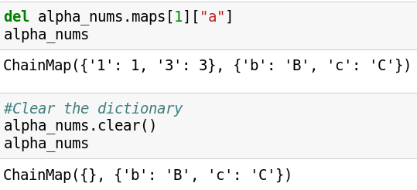
ChainMap: Chaining Dictionaries Together
A dictionary-like class that groups multiple dictionaries and other mappings together to create a single object. In other words, it takes several mappings and makes them logically appear as one.

Slide 29
Memory Mapped Files

Slide 30
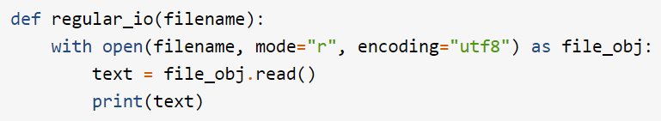
Regular File I/O
Reads file into physical memory and prints it to the screen
1. Transferring control to the kernel operating system code with system calls(System calls are the API that the operating system provides to allow your program to go from user space to kernel space)
2. Interacting with the physical disk where the file resides
3. Copying the data into different buffers between user space and kernel space
4. All these layers add latency and can slow down your program.
Solution : Memory Mapped Files

Slide 31
Memory Mapped Files
Memory-mapping typically improves I/O performance because it uses lower-level operating system APIs to store file contents directly in physical memory. It does not involve a separate system call for each access and does not require copying data between buffers – the memory is accessed directly.
Memory-mapping uses the concept of virtual memory to make it appear to the program that a large file has been loaded to main memory.
But in reality the file is only present on the disk. The operating system just maps the address of the file into the program’s address space so that program can access the file.

Slide 32
Python mmap: Improved File I/O With Memory Mapping
mmap Object Creation Syntax :
mmap.mmap(file_obj.fileno(), length=0, access=mmap.ACCESS_READ)
1. File discriptor, which comes from the fileno() method of a regular file object
2. length=0. This is the length in bytes of the memory map. 0 is a special value indicating that the system should create a memory map large enough to hold the entire file.
3. The access argument tells the operating system how you’re going to interact with the mapped memory. The options are ACCESS_READ, ACCESS_WRITE, ACCESS_COPY.
ACCESS_READ creates a read-only memory map.
ACCESS_WRITE specifies write-through semantics, meaning the data will be written through memory and persisted on disk.
ACCESS_COPY does not write the changes to disk.

Slide 33
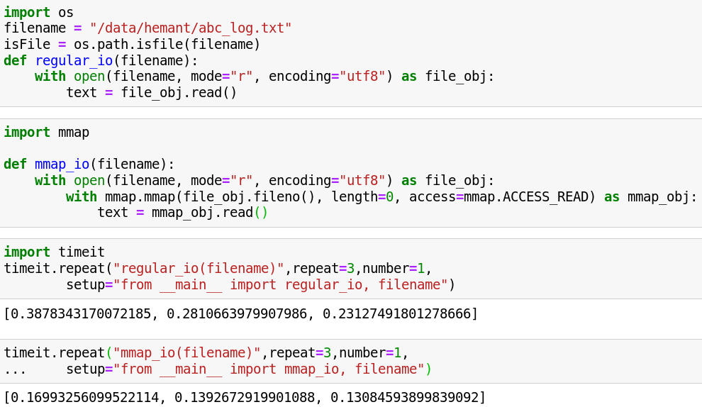
Python mmap: Improved File I/O With Memory Mapping

Slide 34
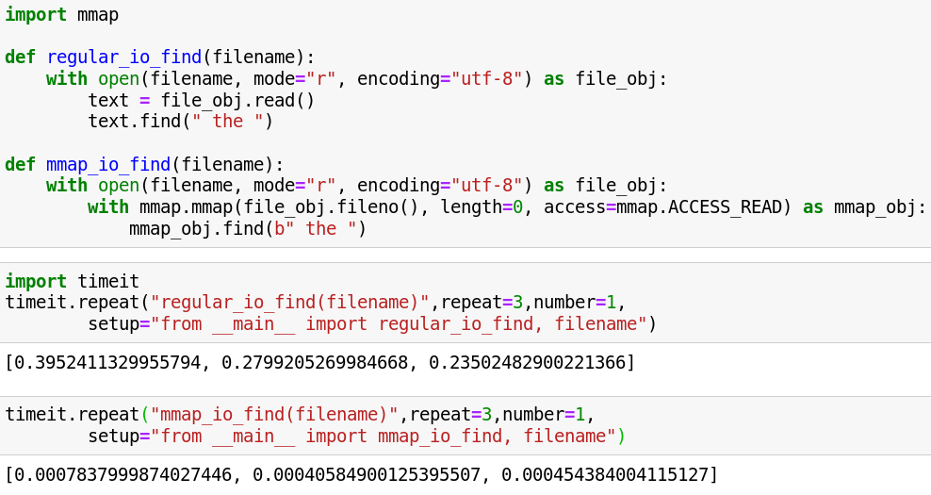
mmap Objects as Strings Search a Memory-Mapped File
Memory mapping transparently loads the file contents into memory as a string. So string operations can be performed on mmap objects like slicing , searching etc.

Slide 35
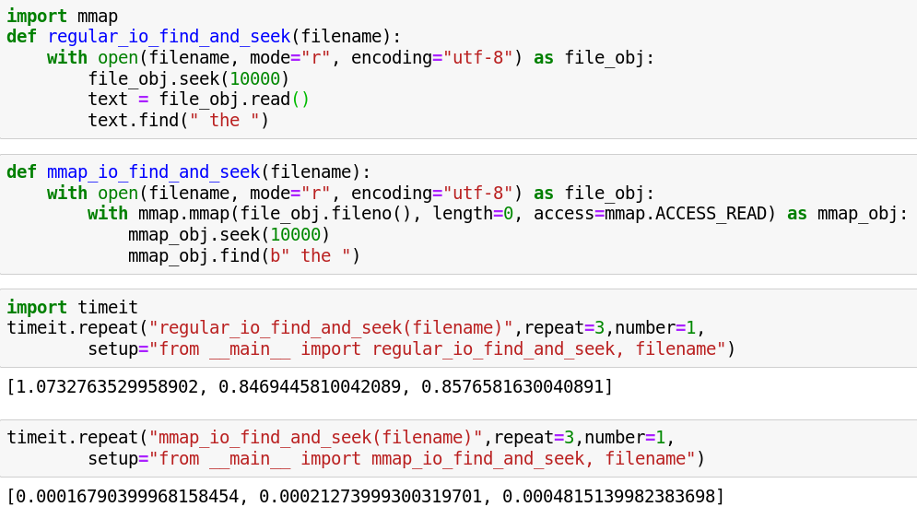
Memory-Mapped Objects as Files
A memory-mapped file is part string and part file, so mmap also allows
you to perform common file operations like seek(), tell(), and readline().

Slide 36
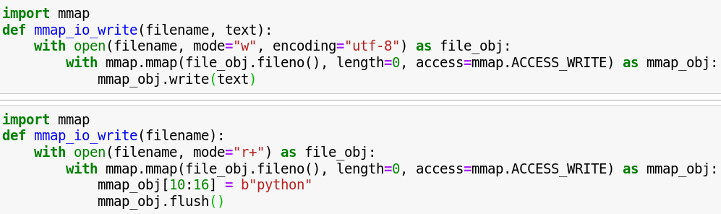
Writing a Memory-Mapped File With Python’s mmap
Memory mapping is most useful for reading files, but you can also use it to write files. The mmap API for writing files is very similar to regular file I/O except for a few differences.

Slide 37
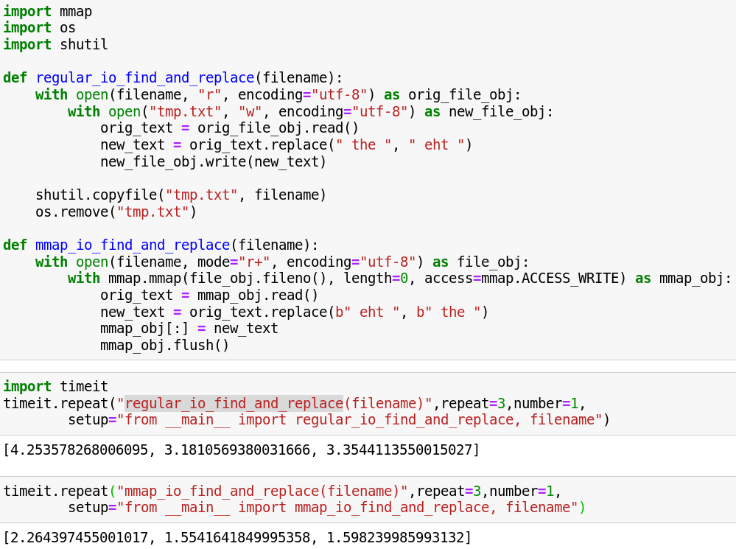
Search and Replace Text
Memory mapped file data is a string of mutable bytes. So it is much more straightforward and efficient to write code that searches and replaces data in a file.

Slide 38
Working with Binary Data

Slide 39
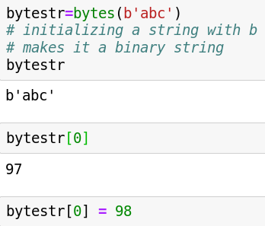
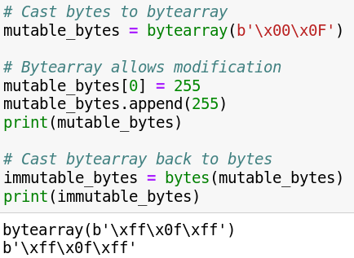
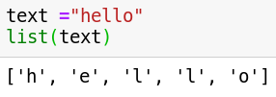
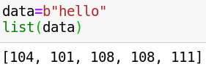
Working with binary data
Strings represent text, bytes objects represent binary data (i.e. images, video, or anything else you could represent on a computer).
The bytes type in Python is immutable and stores a sequence of values ranging from 0-255 (8-bits). You can get the value of a single byte by using an index like an array, but the values can not be modified.
To create a mutable object you need to use the bytearray type ( To modify a set of bytes).

Slide 40
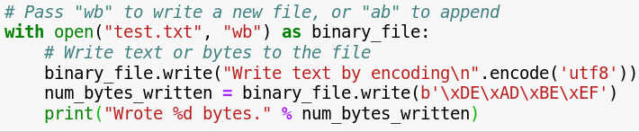
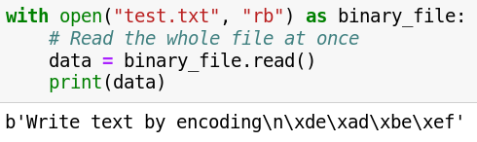
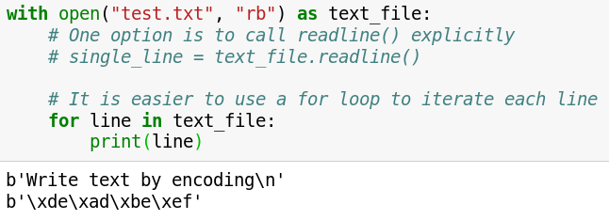
In Python, files are opened in text mode by default. To open files in binary mode, when specifying a mode, add 'b' to it.
Writing Bytes to a file
Reading Bytes from a file
Reading file line by line

Slide 41
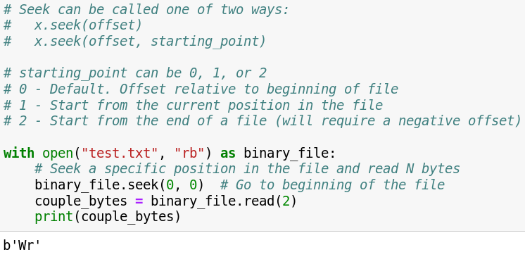
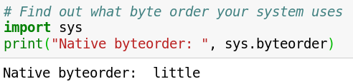
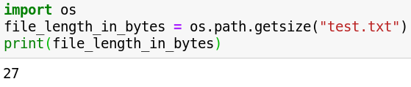
Seeking a specific position in a file
Getting the size of a file
Getting system byte order

Slide 42
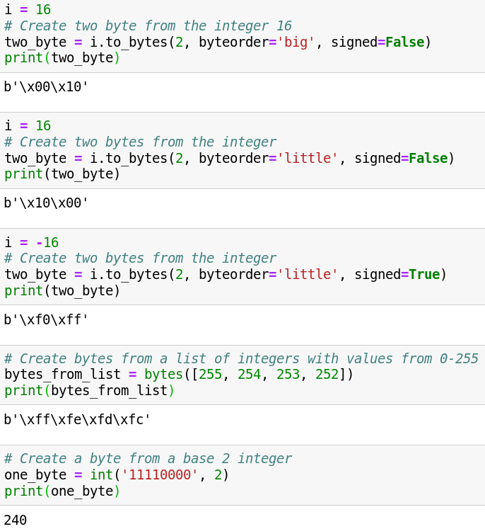

Integer to Bytes
Bytes to Integer
to_bytes – Returns an array of bytes representing an integer.
from_bytes – Returns integer represented by given array of bytes.
Byte Order : “big” – most significant byte at the beginning of the byte array.
“little” - most significant byte at the end of the byte array.
Signed – indicates whether 2’s complement is used to represent the integer.

Slide 43


Character Encoding
Format Strings
Character Encodings are a way to assign values to bytes that represent a certain character in that scheme. Some encodings are ASCII(probably the oldest), Latin, and UTF-8.
Format strings can be helpful to visualize or output byte values. Format strings require an integer value so the byte will have to be converted to an integer first.

Slide 44

Bitwise Operations
In Python, bitwise operators are used to perform bitwise calculations on integers. The integers are first converted into binary and then operations are performed on bit by bit, hence the name bitwise operators.

Slide 45

Struct Module
Struct module is used to convert the native data types of Python into string of bytes and vice versa. This module performs conversions between Python values and C structs represented as Python bytes objects.
The module’s functions and objects can be used for two largely distinct applications, data exchange with external sources (files or network connections), or data transfer between the Python application and the C layer.

Slide 46



struct.calcsize() :Return the size of the struct corresponding to the given format.
Struct Module

Slide 47
Thank You

Slide 48


Global Interpreter Lock(GIL)
I/O Bound Processing | CPU Bound Processing
Whenever a thread runs, it holds the GIL.However, the GIL is released on blocking I/O So, any time a thread is forced to wait, other "ready" threads get their chance to run Threads are useful for I/O-bound processing or Limit CPU-bound processing to C extensions (that release the GIL) | there is a global variable /* Python/ceval.c */ ... static volatile int gil_drop_request = 0; A thread runs until the value gets set to 1. At which point, the thread must drop the GIL. So, the timeout sequence happens over and over again as CPU-bound threads execute

Slide 49

Thread Synchronization Mutex Locks
Synchronization ensures that two or more concurrent processes/threads do not simultaneously execute some particular program segment where the shared resources are accessed known as critical section.
Mutex Locks
Mutual Exclusion Lock
m = threading.Lock()
• Primarily used to synchronize threads so that only one thread can make modifications to shared data at any given time
There are two basic operations
m.acquire() # Acquire the lock
m.release() # Release the lock
• Only one thread can successfully acquire the lock at any given time
• If another thread tries to acquire the lock when its already in use, it gets blocked until the lock is released
Use of Mutex Locks
Commonly used to enclose critical sections.

Slide 50
Thread Synchronization Semaphores
A counter-based synchronization primitive
sema= threading.Semaphore(n) # Create a semaphore
sema.acquire() # Acquire
sema.release() # Release
• acquire() - Waits if the count is 0, otherwise decrements the count and continues
• release() - Increments the count and signals waiting threads (if any)
Use of Semaphores
Using a semaphore to limit resources
sema = threading.Semaphore(5) # Max: 5-threads
def fetch_page(url):
sema.acquire()
try:
u = urllib.urlopen(url)
return u.read()
finally:
sema.release()
• In this example, only 5 threads can be executing the function at once (if there are more, they will have to wait)

