Slide 1
HACKATHON PROJECT
AEGIS
A changing floor plan, shown as a route graph
GROUND FLOOR · SIMULATED GRAPH
Every Second Counts.
Every Route Adapts.
EXIT
A local evacuation simulation that keeps people, hazards and route changes visible in one place.
Safe route
Closed passage
Occupant · selected person · exit
SEE THE INCIDENT · INSPECT THE ROUTE · REPLAY THE RUN
Synthetic building data · seeded scenarios · deterministic route planning
AEGIS · EVACUATION SIMULATION
01 / 07
Notes:
0:00–0:25 | Namaste. AEGIS ek local evacuation rehearsal hai. Yeh multi-floor building, occupants aur hazard simulate karta hai. Alarm ya passage band hote hi route dobara banta hai. Operator kisi ek person ka floor aur remaining path dekh sakta hai, phir same run replay kar sakta hai.

Slide 2
A route is only safe while its passages stay usable
An alarm, blockage or queue can invalidate yesterday’s shortest path.
A small change can affect the whole group
01
Detect
GROUND FLOOR · SIMULATED GRAPH
A simulated sensor alarm marks a room or passage.
02
Recalculate
The planner avoids closures and accounts for queues.
EXIT
One corridor closes; an alternate passage remains open.
03
Guide
A person’s route and next action update in the live view.
The question is not only “Which exit?” but also “Which safe route now?”
Use case: rehearse changing scenarios on generated buildings.
Buildings, sensor readings and incidents in the demo are synthetic.
AEGIS · EVACUATION SIMULATION
02 / 07
Notes:
0:25–0:55 | Fire, earthquake, blockage aur queues route badal sakte hain. Operator incident shuru karta hai ya monitored location par simulated alarm inject karta hai. Route engine blocked passages se bachkar paths update karta hai. Yeh hackathon rehearsal hai; building aur sensor data generated hain.

Slide 3
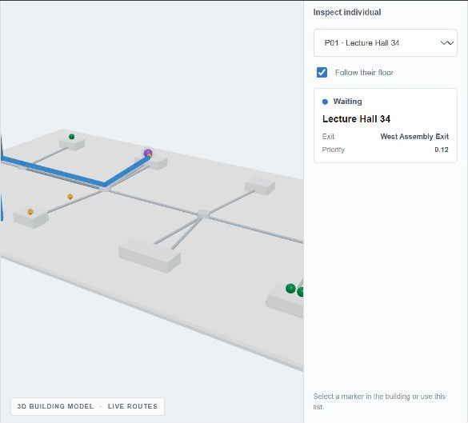
One seed creates a replayable building and incident
The same seed reproduces the generated layout, hazard and starting placements.
Seed 1,992,440,700
School · 4 floors · 5 rooms per wing · 15 people
Layout
Seeded floors, rooms, junctions, stairs and exits.
Incident
Chosen type; seeded random target location.
People
Safe rooms are shuffled and spread across floors.
Replay
Reuse the seed to reproduce the same setup.
“Random respawn” is initial placement; no in-run respawn.
AEGIS · EVACUATION SIMULATION
03 / 07
Notes:
0:55–1:35 | Seed random choices ko repeatable rakhta hai. Generator floors, rooms, corridors, stairs aur exits banata hai; seed incident target aur occupants ki safe starting rooms choose karta hai. Rooms floors mein spread hote hain. Yahan respawn ka matlab sirf initial placement hai; run ke beech log teleport ya respawn nahi hote. Same seed se wahi setup milta hai.

Slide 4
Separate roles keep the simulation explainable
Python computes the scenario; the web client shows it continuously; AI is optional.
Python
FastAPI
React / TS
Three.js
Simulation core
Local service layer
Operator interface
3D scene
→
→
→
Seeded random layouts
Graph state and movement
heapq-based Dijkstra
Pydantic request checks
REST commands
WebSocket snapshots
Scenario controls
Person selection
Live status and timeline
React Three Fiber
Drei helpers
Animated floor view
API dependencies: FastAPI, Pydantic, Uvicorn · Web: React, TypeScript, Vite, Three.js, React Three Fiber, Drei
Optional AI review
An optional Hugging Face model reads simulation facts and returns evidence-linked checks; routing stays deterministic. It uses Python’s standard-library HTTP client and is disabled here until HF_TOKEN and HF_MODEL are set.
AEGIS · EVACUATION SIMULATION
04 / 07
Notes:
1:35–2:20 | Python standard library seeded randomness, movement aur heapq Dijkstra chalati hai. FastAPI, Pydantic aur Uvicorn commands validate karke REST API serve karte hain; WebSocket live state bhejta hai. React aur TypeScript controls banate hain. Three.js building render karta hai; React Three Fiber aur Drei ise React screen se jodte hain. Optional Hugging Face review facts ko summarize karta hai, routes nahi chunta; is demo mein disabled hai. AI ko optional rakhne se route calculation repeatable rehti hai aur review readable ho sakta hai. Quick debrief mein model recorded hazards, blocked passages, queues aur route changes ko evidence ke saath summarize kar sakta hai. Sources: https://fastapi.tiangolo.com/advanced/websockets/ ; https://threejs.org/docs/pages/WebGLRenderer.html.

Slide 5
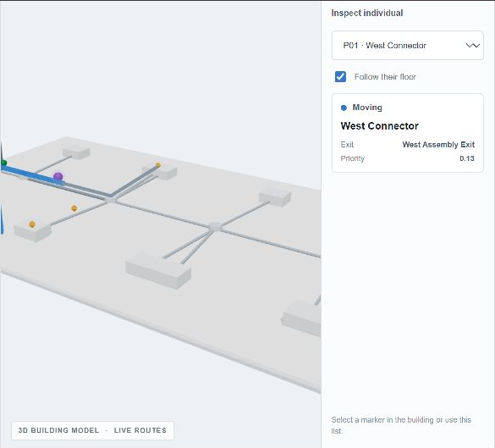
An injected alarm changes plans while people are moving
The local run below shows the selected person and route after a second sensor alarm.
OBSERVED IN THIS RUN
15
2
7
people active
hazards
routes changed
How the incident evolves
Initial hazard: random safe target; starts at 12–22/100 and grows by 2–4 per tick.
At intensity stages 35, 60 and 85, nearby areas gain caution and local passages may close.
An extra sensor alarm starts at 70/100; group routes are recalculated against closures, congestion and exit load.
Blue = remaining route · covered segments fade to grey
AEGIS · EVACUATION SIMULATION
05 / 07
Notes:
2:20–3:00 | Screenshot wale run mein 15 log active the; doosre alarm ke baad 2 hazards aur 7 route changes hue. Initial hazard random room ya passage par 12–22 intensity se shuru hokar har tick 2–4 badhta hai. Intensity 35, 60, 85 par caution aur paas ke synthetic closures aa sakte hain. Alarm route ko turant recalculate karata hai; passage capacity queues bana sakti hai. Saare occupants background mein move karte hain; selected person ka POV inspection ke liye hai. Yeh fire physics nahi.

Slide 6
AEGIS is a rapid rehearsal interface, not a compliance model
Its value is visible, replayable route change at hackathon scale.
Established egress tools
AEGIS hackathon prototype
Example: Pathfinder
Graph-based, interactive and seeded
Agent-based human movement and egress simulation
Detailed geometry-oriented analysis
Used for building design and evacuation studies
Generate a small multi-floor layout in seconds
Inject an alarm and inspect live reroutes
Switch to one person’s floor and remaining path
Replay the same setup with its seed
Different goals, different validation level
AEGIS is for transparent interaction and route-change demos. It is not certified guidance: no CFD fire or smoke physics, measured building geometry, live sensors, or real emergency calls.
AEGIS · EVACUATION SIMULATION
06 / 07
Notes:
3:00–3:40 | Pathfinder jaise tools detailed agent movement aur egress analysis ke liye bane hain. AEGIS ka scope rapid seeded rehearsal hai: layout generate karo, alarm inject karo, person-level reroute dekho, setup replay karo. Hum universally better hone ka claim nahi karte; purpose aur validation alag hain. AEGIS certified engineering guidance nahi. Sources: https://www.thunderheadeng.com/pathfinder/ ; https://files.thunderheadeng.com/support/documents/pathfinder-technical-reference-manual-2024-2.pdf.

Slide 7
Graph-based rerouting stays tractable at the demo’s scale
Time is driven by graph search per person; the current generated graphs are small.
Complexity
Current generator limits
One route search
Up to 5 floors
Up to 6 rooms per wing
Up to 20 people
O((V + E) log V)
Group replanning after an alarm
O(P (V + E) log V)
Maximum generated graph: about 107 nodes and 110 passages.
Working memory per search: O(V + E)
Stored person routes add up to O(PV); event history is capped at 200 entries.
Dijkstra uses positive travel, caution, congestion and exit-load costs. This is a graph heuristic, not a forecast of real evacuation time.
V nodes · E passages · P people
AEGIS · Every Second Counts. Every Route Adapts.
AEGIS · EVACUATION SIMULATION
07 / 07
Notes:
3:40–4:25 | V nodes, E passages, P people hain. Ek weighted Dijkstra route search O((V+E) log V) leta hai; sabke liye replanning O(P(V+E) log V) tak. Search memory O(V+E), saved routes worst case O(PV). Generator limit par graph lagbhag 107 nodes, 110 passages aur 20 people ka hai. Yeh algorithmic complexity hai, real evacuation-time forecast nahi. AEGIS decisions ko visible aur replayable banata hai, safety certify nahi karta.

