Slide 1


Real-Time Chat Application with NodeJS and Socket.IO
Welcome to the world of real-time chat applications, where you'll learn how to build an interactive and dynamic experience using the powerful combination of NodeJS and Socket.IO.
by Ashutosh Kumar
322101033

Slide 2
Overview of NodeJS and Socket.IO
NodeJS is a JavaScript runtime environment that excels in building server-side applications. Socket.IO is a library that facilitates real-time, bi-directional communication between client and server.
NodeJS
Socket.IO
Lightweight and efficient for handling concurrent connections.
Establishes persistent connections between client and server.
Enables real-time data exchange and broadcasting.
Event-driven architecture for responsiveness.

Slide 3

Setting up the Development Environment
Start by installing NodeJS and npm (Node Package Manager) on your system. Then, create a new project directory and initialize it with npm to manage dependencies. You'll also need to install Socket.IO using npm.
1
Install NodeJS and npm
Download and install NodeJS from the official website.
2
Create a project directory
Use the command line to create a new directory and navigate to it.
3
Initialize the project
Run 'npm init' to create a package.json file.
4
Install Socket.IO
Run 'npm install socket.io' to add Socket.IO to the project.

Slide 4

Implementing the Server-side Logic
Create a server file (e.g., 'server.js') to handle incoming connections, message events, and broadcasting. Utilize Socket.IO to establish websockets, listen for connection events, and emit messages to connected clients.
Establish WebSocket Connections
Handle Message Events
Manage User Connections and Disconnections
Listen for incoming messages from clients and broadcast them to all connected users.
Use Socket.IO to create a WebSocket server that listens for incoming connections.
Track users who join and leave the chat, and notify other clients about these changes.

Slide 5
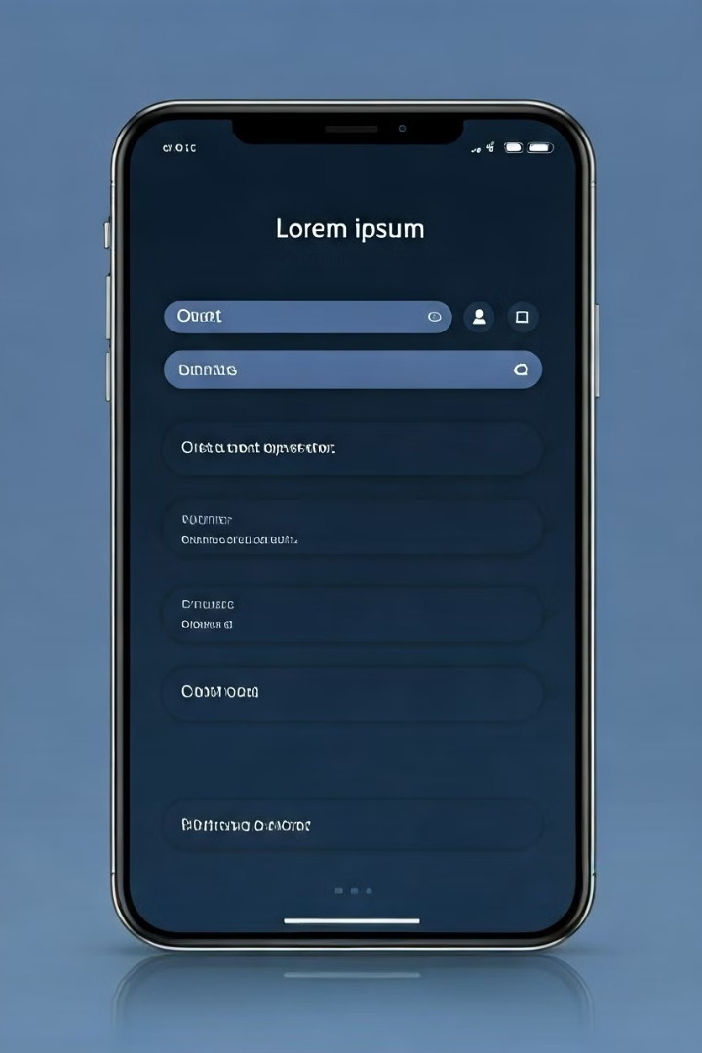
Designing the Client-side Interface
Use HTML, CSS, and JavaScript to build the client-side interface. Create elements for displaying messages, input fields for typing messages, and potentially a list of online users. Connect to the server using Socket.IO to receive and send messages.
1
Chat Window
2
Input Field
Displays all messages in a chronological order.
Allows users to type and send messages.
3
Online Users List
Displays the names or avatars of users currently connected.

Slide 6





Handling User Connections and Disconnections
When a client connects to the server, Socket.IO emits a 'connect' event. You can use this event to log the connection and potentially update the list of online users. Similarly, handle 'disconnect' events to remove users from the list and notify other clients.
Client Connects
Emits a 'connect' event on the server.
Server Handles Connection
Logs the connection and potentially updates the online users list.
Client Disconnects
Emits a 'disconnect' event on the server.
Server Handles Disconnection
Removes the user from the online users list and notifies other clients.

Slide 7
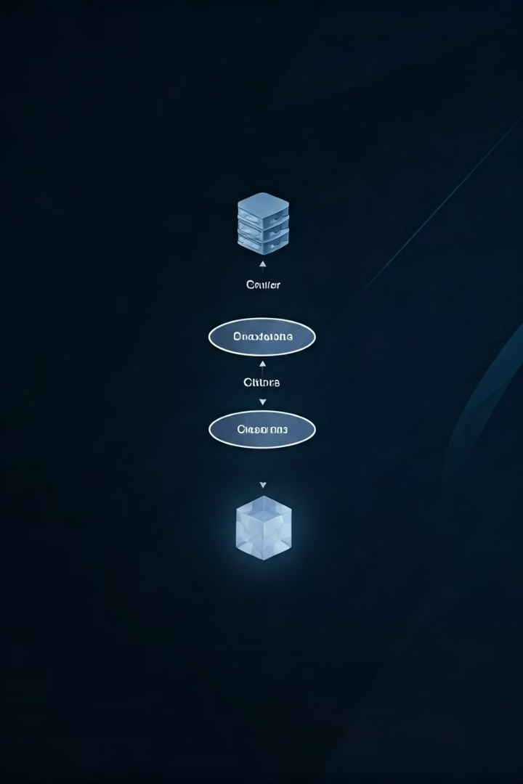
Implementing Realtime Message Broadcasting
On the client-side, handle the 'message' event emitted by the server to display new messages received from other users. On the server, when a client sends a message, emit a 'message' event with the message content to all connected clients.
Event
Description
'message'
Emitted by the server when a client sends a message.
'message'
Emitted by the server to all connected clients, containing the message content.

Slide 8





Conclusion and Next Steps
You've now created a fully functional real-time chat application using NodeJS and Socket.IO. Expand your application by adding features like user authentication, private messaging, file sharing, and more.
User Authentication
Private Messaging
Implement login and registration to secure user accounts.
Allow users to send direct messages to each other.
File Sharing
Group Chat
Enable users to share files and images within the chat.
Create channels or groups for multiple users to chat together.

Slide 9
Thank You.

