Slide 1


SCHOOL OF MANAGEMENT SCIENCES LUCKNOW
www.smslucknow.ac.in
Department of Artificial Intelligence & Data Science
A Project Synopsis Presentation on
“ScrapEase”
Under the Supervision of: Mr. Sanjay Kumar Singh Assistant Professor,
S. M. S., Lucknow
Presented by:
Danish Khan (2104231630015)
Roli(2104231630010)
Ashutosh Shukla(2104231630010)

Slide 2


Table of Contents
www.smslucknow.ac.in
✔ Introduction
✔ Problem Definition
✔ Objectives
✔ Methodology
✔ Modules / Implementation / Result & Discussion
✔ Diagram (DFD, Use Case, Schema Model, Gantt Chart)
✔ Applications/ Advantages / Limitations / Future Scope
✔ Conclusion
✔ References

Slide 3
Introduction of Scrap ease
www.smslucknow.ac.in
Purpose:
ScrapEase digitizes the scrap collection process for users and vendors.
Aims to bridge the gap between waste producers and collectors.
AI-powered system for efficient scheduling and vendor matching.
Encourages sustainability by promoting responsible recycling.
Need: Traditional methods are manual, inefficient, and unorganized.
Solution: A smart digital platform connecting users with scrap vendors seamlessly.

Slide 4
Problem Definition
www.smslucknow.ac.in
Limited Communication: Many people are unaware of how to contact local scrap vendors or dealers to sell their waste.
Highlight the lack of automation and public engagement in recycling.
No Centralized Platform: There is no unified system to connect citizens with nearby scrap vendors easily.
Inconsistent Availability: Scrap vendors often operate on irregular schedules, making it difficult to coordinate pickups.

Slide 5
Objective of Scrap ease
www.smslucknow.ac.in
Develop an AI-powered web platform for seamless scrap vendor booking.
Optimize scrap collection logistics with AI-driven recommendations and real-time tracking.
Digitize the informal scrap collection sector for improved vendor efficiency.
Enhance accessibility with a user-friendly interface for individuals and businesses.
Promote sustainable waste disposal and eco-friendly recycling practices.

Slide 6
Methodology
www.smslucknow.ac.in
Frontend: HTML, CSS, React.js for a user-friendly interface
Backend: Node.js, Express.js for robust functionality.
Database: MongoDB for secure and scalable data storage.
AI Algorithms: Optimize vendor selection and pickup routes.
Testing Tools: Exploratory Manual Testing.

Slide 7
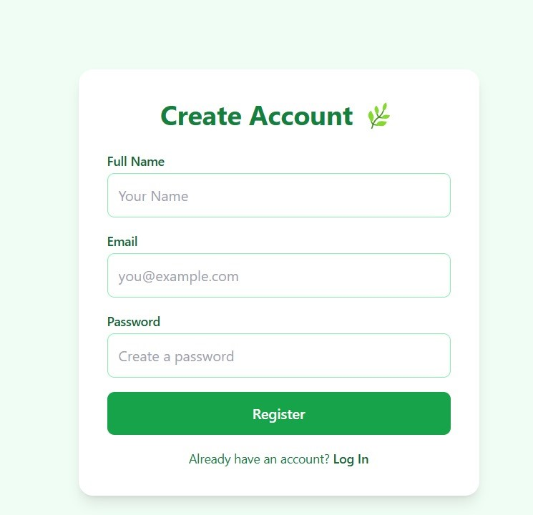
Project Modules
www.smslucknow.ac.in
User Registration & Authentication: Secure login and profile management
REGISTRAION
Fig 1.1 Registration Process

Slide 8
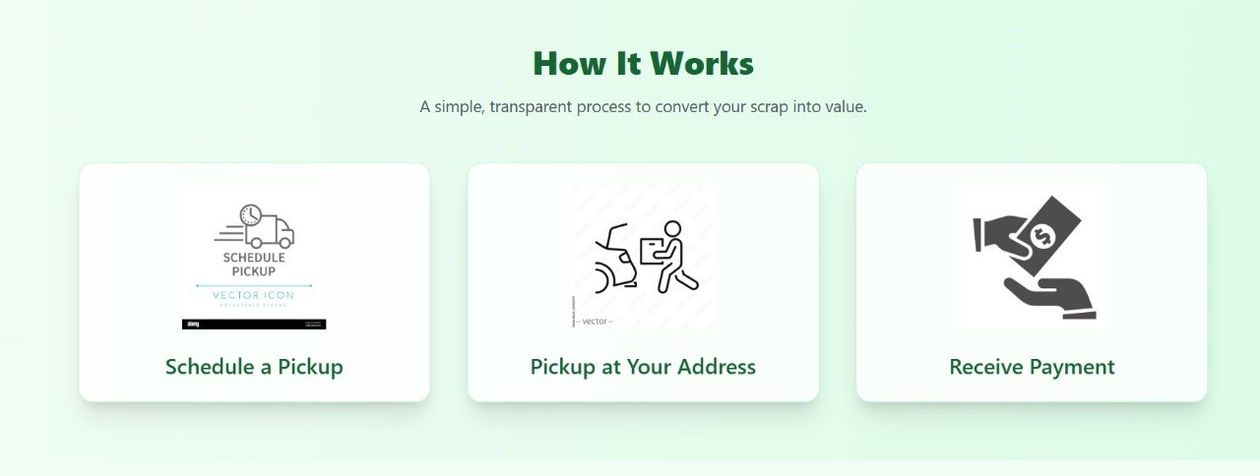
www.smslucknow.ac.in
Working Process
Fig 2.2 Working Process

Slide 9
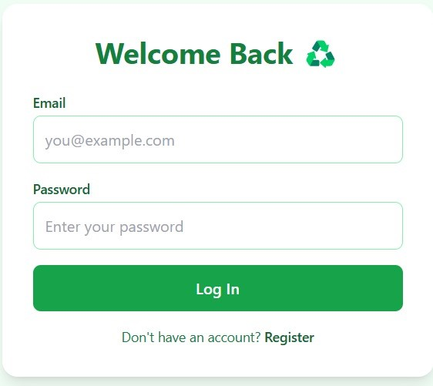
LOGIN
www.smslucknow.ac.in
Fig 1.2 Login using Email and Password

Slide 10
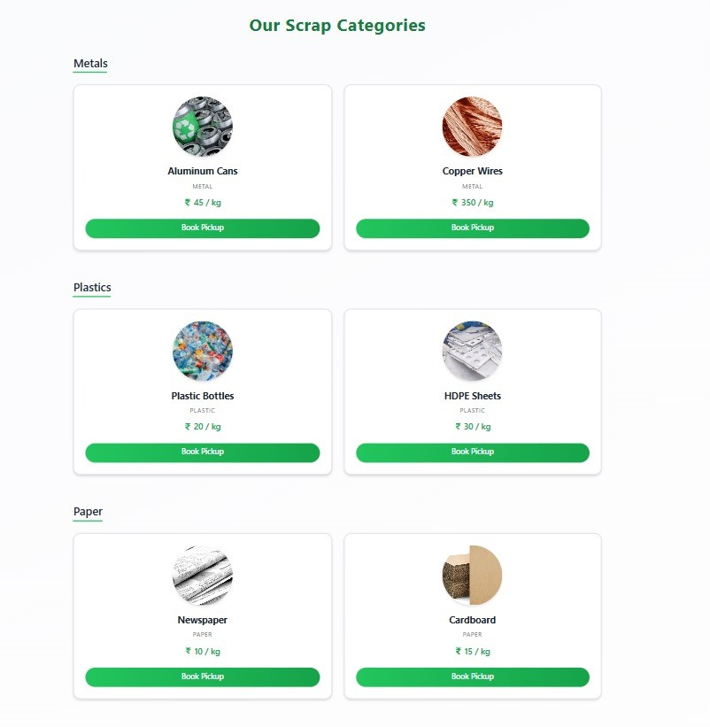
CATEGORIES
www.smslucknow.ac.in
Scrap Booking System: Select scrap type, schedule pickup
Fig 2.1 Categories of Scrap

Slide 11
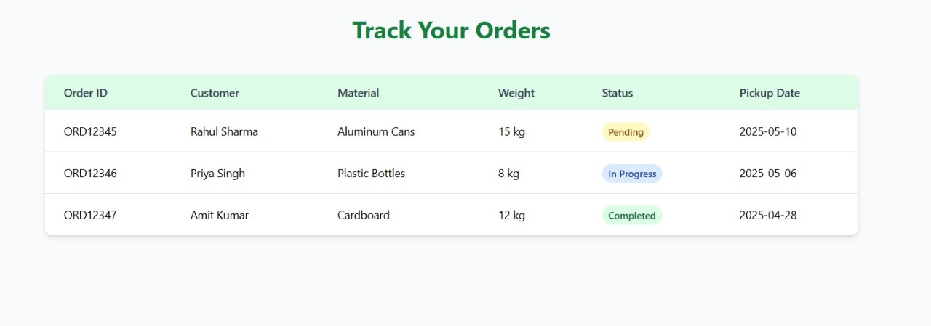
www.smslucknow.ac.in
ORDER Management: Availability tracking and request handling
Fig 3.1 TRACK ORDER

Slide 12
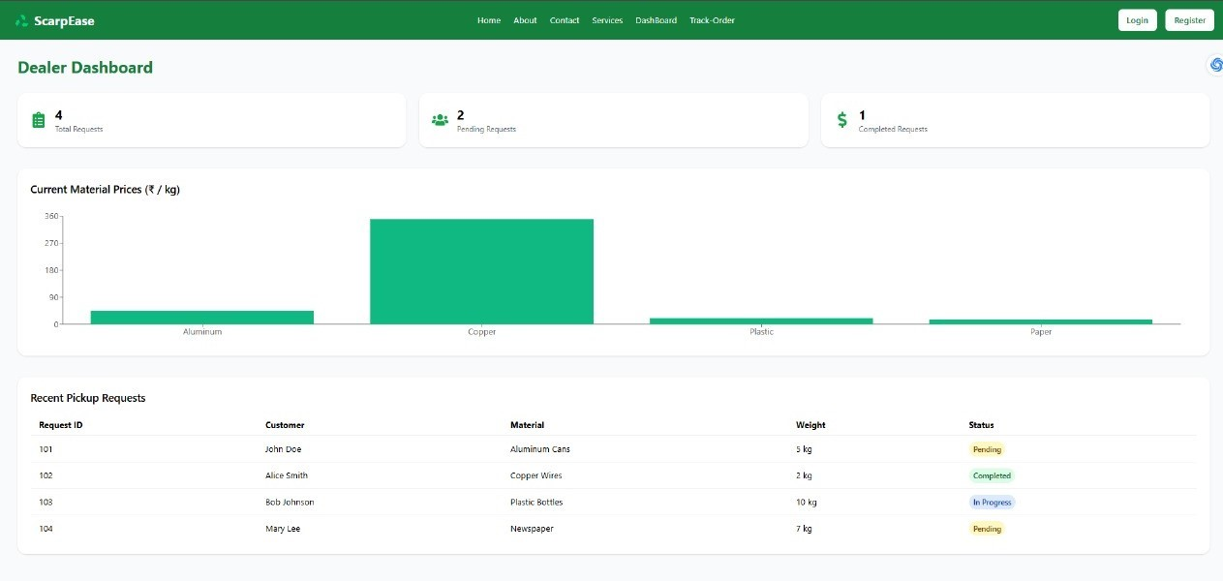
www.smslucknow.ac.in
DASHBOARD
Fig 3.2 DASHBORD(ADMIN)

Slide 13
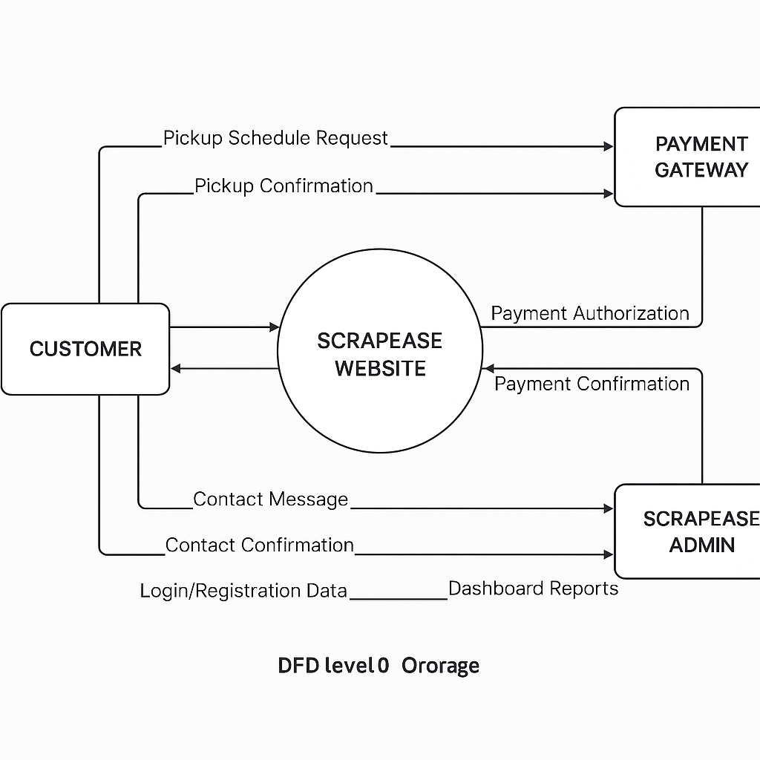
www.smslucknow.ac.in
Data flow Diaram of Scrap ease
LEVEL 0 DFD

Slide 14
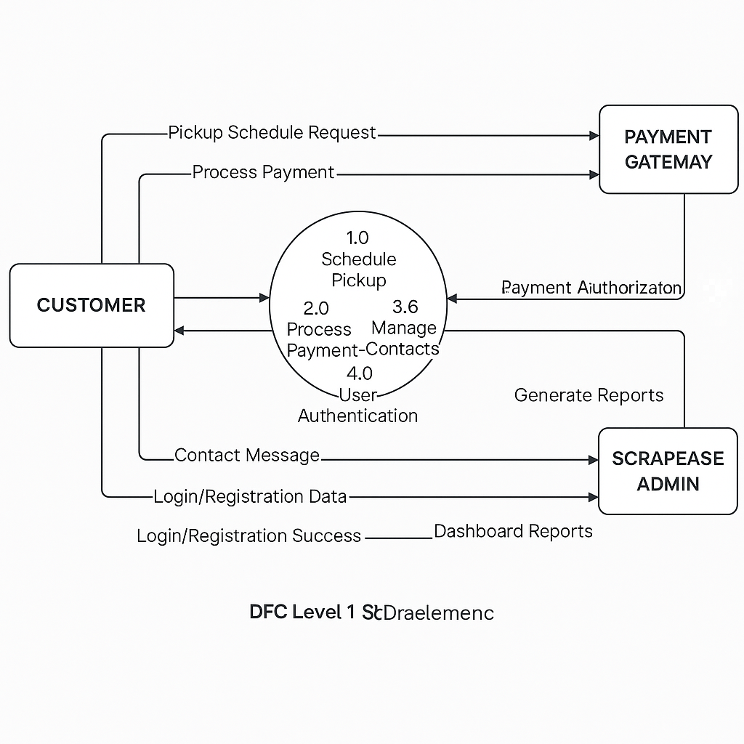
www.smslucknow.ac.in
LEVEL 1 DFD

Slide 15
Implementation Details
www.smslucknow.ac.in
React.js frontend ensures responsiveness and interactive UI.
Node.js backend for secure API handling and request processing.
AI integration enhances vendor matching accuracy.
Scalable MongoDB database efficiently stores bookings and user data.

Slide 16
Results & Discussion
www.smslucknow.ac.in
Connected users with verified scrap vendors seamlessly
Enabled real-time tracking and status updates
Reduced vendor search time and increased booking efficiency
Encouraged eco-friendly waste management and recycling

Slide 17
Applications & Use Cases
www.smslucknow.ac.in
Urban Waste Management: Digital solution for scrap pickup.
E-commerce Integration: Scrap trade made accessible.
Industrial Recycling: Helps businesses manage scrap efficiently.
Sustainability Initiatives: Encourages greener disposal practices.

Slide 18
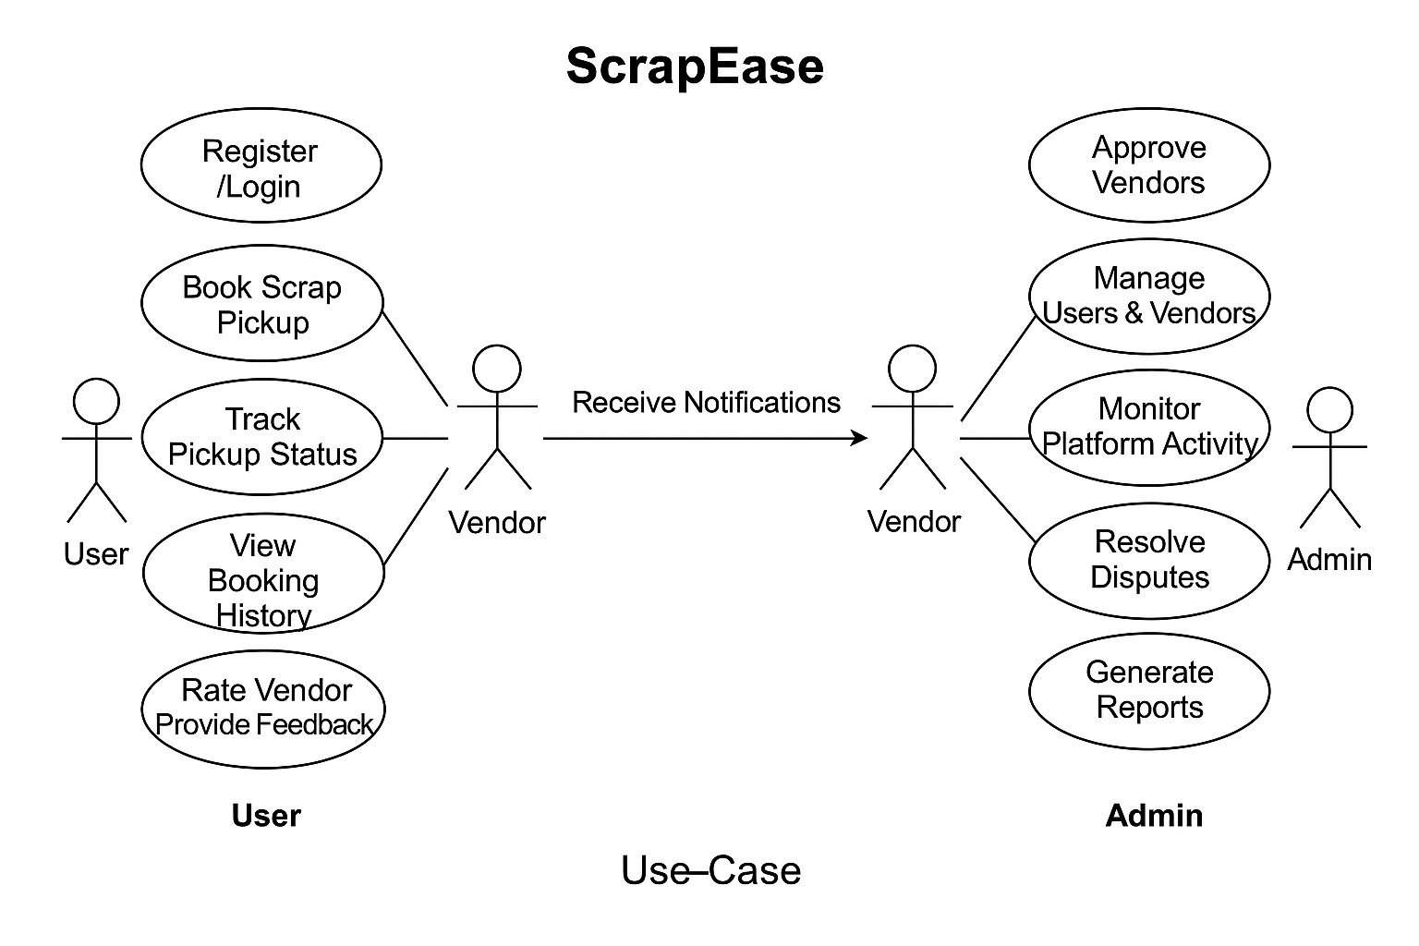
www.smslucknow.ac.in
Use case Diaram of Scrap ease

Slide 19
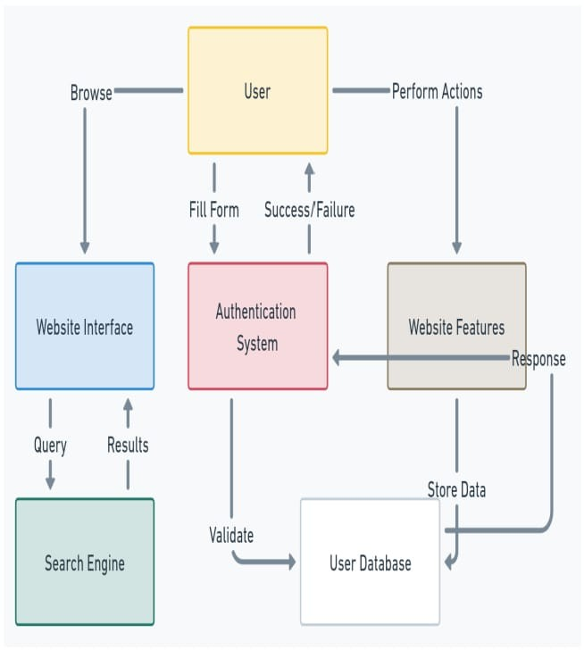
www.smslucknow.ac.in
Schema Model of Scrap ease

Slide 20
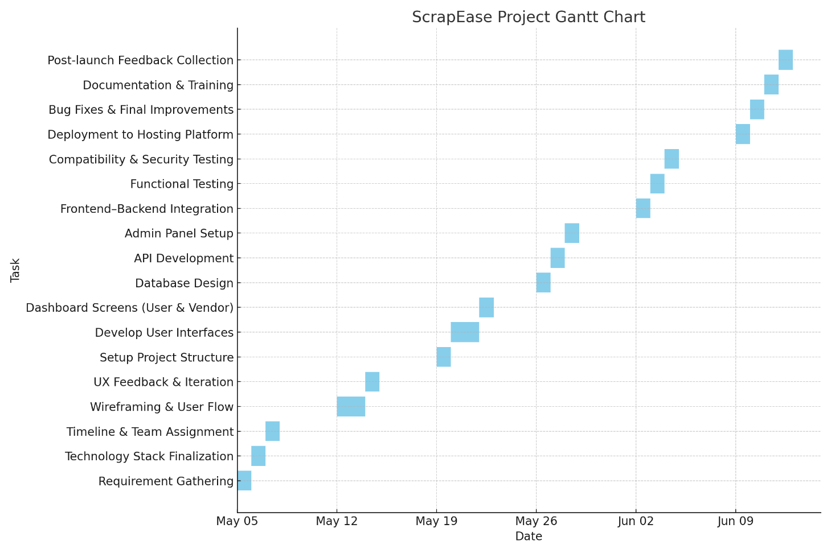
www.smslucknow.ac.in
Gantt Chart of Scrap ease

Slide 21
Limitations & Future Scope
www.smslucknow.ac.in
Limitations:
Dependence on vendor availability
AI recommendation accuracy needs improvement
No mobile app integration yet
Dependency on Internet Connectivity: The system relies heavily on stable internet for real-time monitoring and communication.
Future Scope:
Expansion to new cities for broader vendor network
Blockchain-based scrap pricing for fair valuation
AI-driven predictive demand forecasting

Slide 22
Conclusion
www.smslucknow.ac.in
ScrapEase digitizes scrap vendor booking for efficiency.
Encourages responsible waste disposal and recycling.
AI-driven system improves vendor management and scheduling.
Future upgrades will enhance scalability and system intelligence.

Slide 23
Refrences
www.smslucknow.ac.in
Technical References
React.js, Node.js, MongoDB documentation
AI-driven vendor recommendation studies.
Industry & Environmental References
Recent studies on scrap management & recycling.
Government policies on sustainable waste disposal.
Studies on sustainable waste management technologies.
Existing scrap collection platforms and digital solutions.
Copyright © SMS LUCKNOW

