Slide 1

Philips Code to Care
AI in Healthcare
ThinkHer
To predict when the next period will most likely to start for a given female user and finding relationship between symptoms and period cycle length.
Team Name : AAAchievers
College Name: Shri Govindram Seksaria Institute of Technology and Science(SGSITS),Indore
Team members: Amul Verma
Ashutosh Maheshwari
Avani Chaskar

Slide 2
Background
Menstrual cycle characteristics, including cycle length and bleed length, may serve as sensitive and noninvasive measures of reproductive health.
Altered patterns of menstruation reproductive dysfunction
Registering which may enable earlier detection of potential menstrual dysfunction.
Therefore, it is very important to track the menstrual cycle and related symptoms.
Notes:
https://academic.oup.com/biostatistics/article/7/1/100/243078
Symptoms: bloating, cramp, diarrhea, dizzy, headache, mood swing, nausea, sore etcM
Avani

Slide 3
Insights from Data
6729 Users
13512 entries for 10 Symptoms
34942 Period’s Data
Notes:
ashutosh

Slide 4
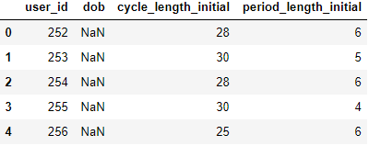
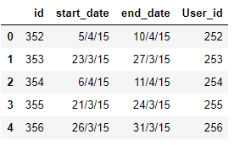
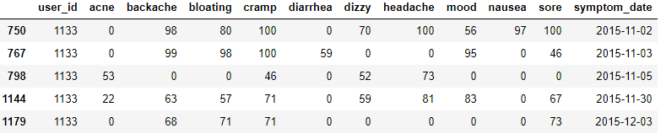
How the tables look like...
Initial User data
Menstrual Cycle data
Symptom data

Slide 5
Process Pipeline
Data Exploration
03
Data Preprocessing
.
01
02
Data Modelling
Notes:
Amul

Slide 6
Data Preprocessing
anomalous entries
2779 missing records
Data Cleaning
unusual period lengths
incorrect date values
users with minimum entries
Notes:
Ashutosh

Slide 7
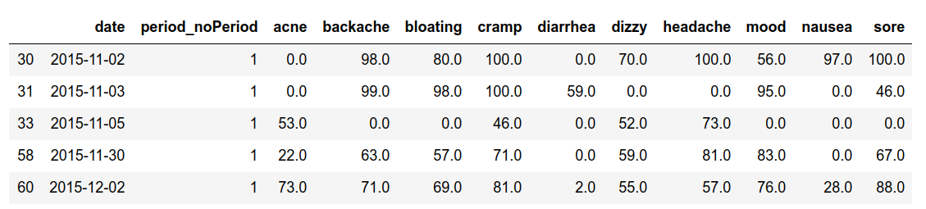
Data Modelling
Initial User data
Menstrual Cycle data
Symptom data
Notes:
Alter the images with new clean dataset tables
Combined Dataset of periods ,symptom and user after cleaninig the dataset ashutosh ----- add alll tables

Slide 8
Data Exploration
Three approaches used -
Predicting next cycle using rolling mean
Correlation between symptom and cycle length
Multi Layer Perceptron

Slide 9
Predicting Next Period Cycle
Using Modified simple moving Average method(SMA) to predict next period cycle.
Weights are assigned according to the timestamp.
Next Cycle=Start_Date+(w1*cycle1+w2*cycle2+w3*cycle3)
For Example :-
We predict that the starting date of user 1133's next period is 2019-03-03 +
(0.2*31+0.3*25+0.5*30) = 2019-03-31.
Notes:
Amul

Slide 10
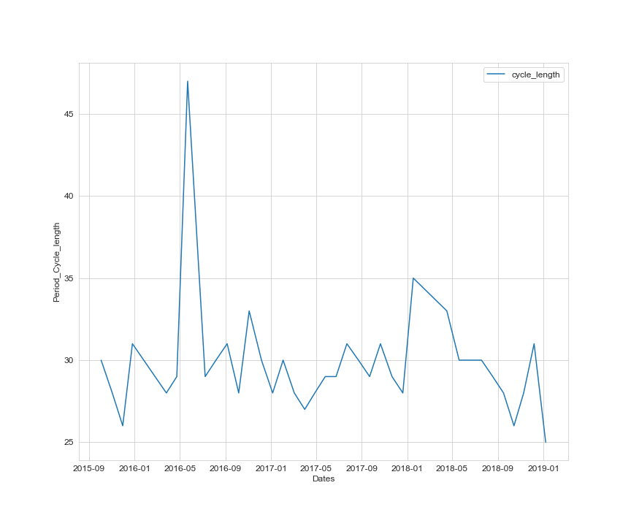
Predicting Next Period Cycle
Weighted average according to timestamp(Simple Moving Average (SMA) ).
Notes:
Legends , Fullform

Slide 11
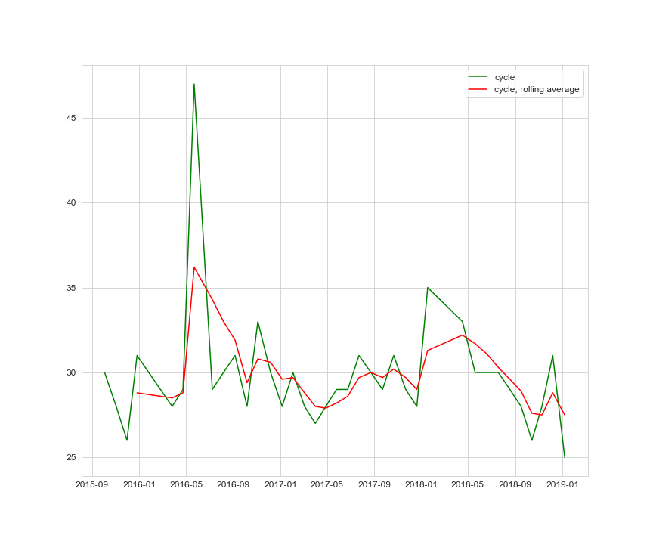
Predicting Next Period Cycle
Notes:
//why didn’t you use mlp? TO fine tune weights for weighted mean.
Amul

Slide 12

Correlation between symptoms and cycle length
The correlation between the symptoms and the period length using “Pearson” correlation function to find the relation between the both.
Correlation coefficient are always < 1. When correlation coefficient = 1 perfectly linearly related.
Correlation Coefficient of some symptoms were > 0 stating its linear relationship with cycle length.
Notes:
Amul

Slide 13
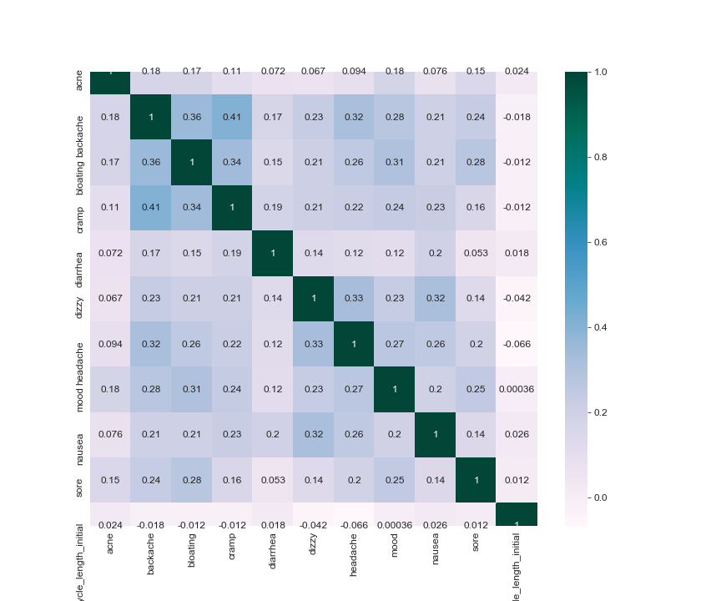
Symptom-Cycle length Correlation Heat Map
Notes:
Amul

Slide 14
Correlation between Symptoms and Cycle Length
Four symptoms which majorly affect the cycle length
Diarrhea
Mood
Nausea
Sore
Notes:
Ashutosh

Slide 15
Multi Layer Perceptron Model
To predict next period cycle from current symptoms and period length.
training and testing data ratio - 80:20.
Solver for weight optimization - Adam
activation function - soft_max
as error function - cross_entropy
The accuracy obtained from the model was 78.1432 %.
Notes:
adam- to find proper weights and biases for our network via minimizing the cost function , a type of gradient descent optimization algorithm.

Slide 16
Importance of Analysis
Alert users on basis of their symptoms about possible medical conditions.
To predict ovulation, and/or to describe their menstrual cycle to their doctors.
To be prepared in emergency situations.
Better understanding of the characteristics of cycle length
Notes:
It leads to appropriate methods for defining standard and nonstandard cycles, thus facilitating common methods of data analysis used in epidemiology

Slide 17
Challenges Faced
Selection of dataset and where to find it?
What model to use to predict next period cycle ?
Required detailed understanding of menstrual cycle.
Notes:
ashutosh

Slide 18
Future Scope
Medicine Recommendation based on any irregularities
Collecting more data from fitness tracking applications and Wearables.
Prompting users to feed data on a regular basis.
Notes:
ashutosh

Slide 19
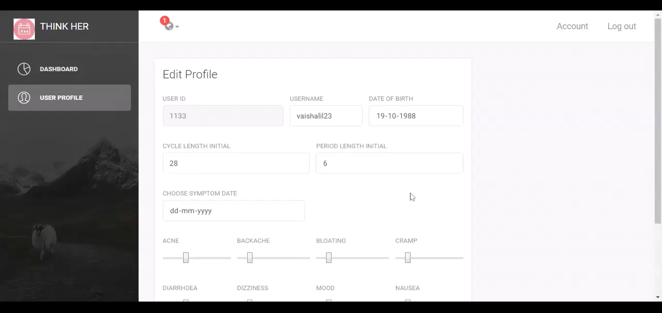
Notes:
ashutosh

Slide 20
Thanks!
Any questions?

