Slide 1
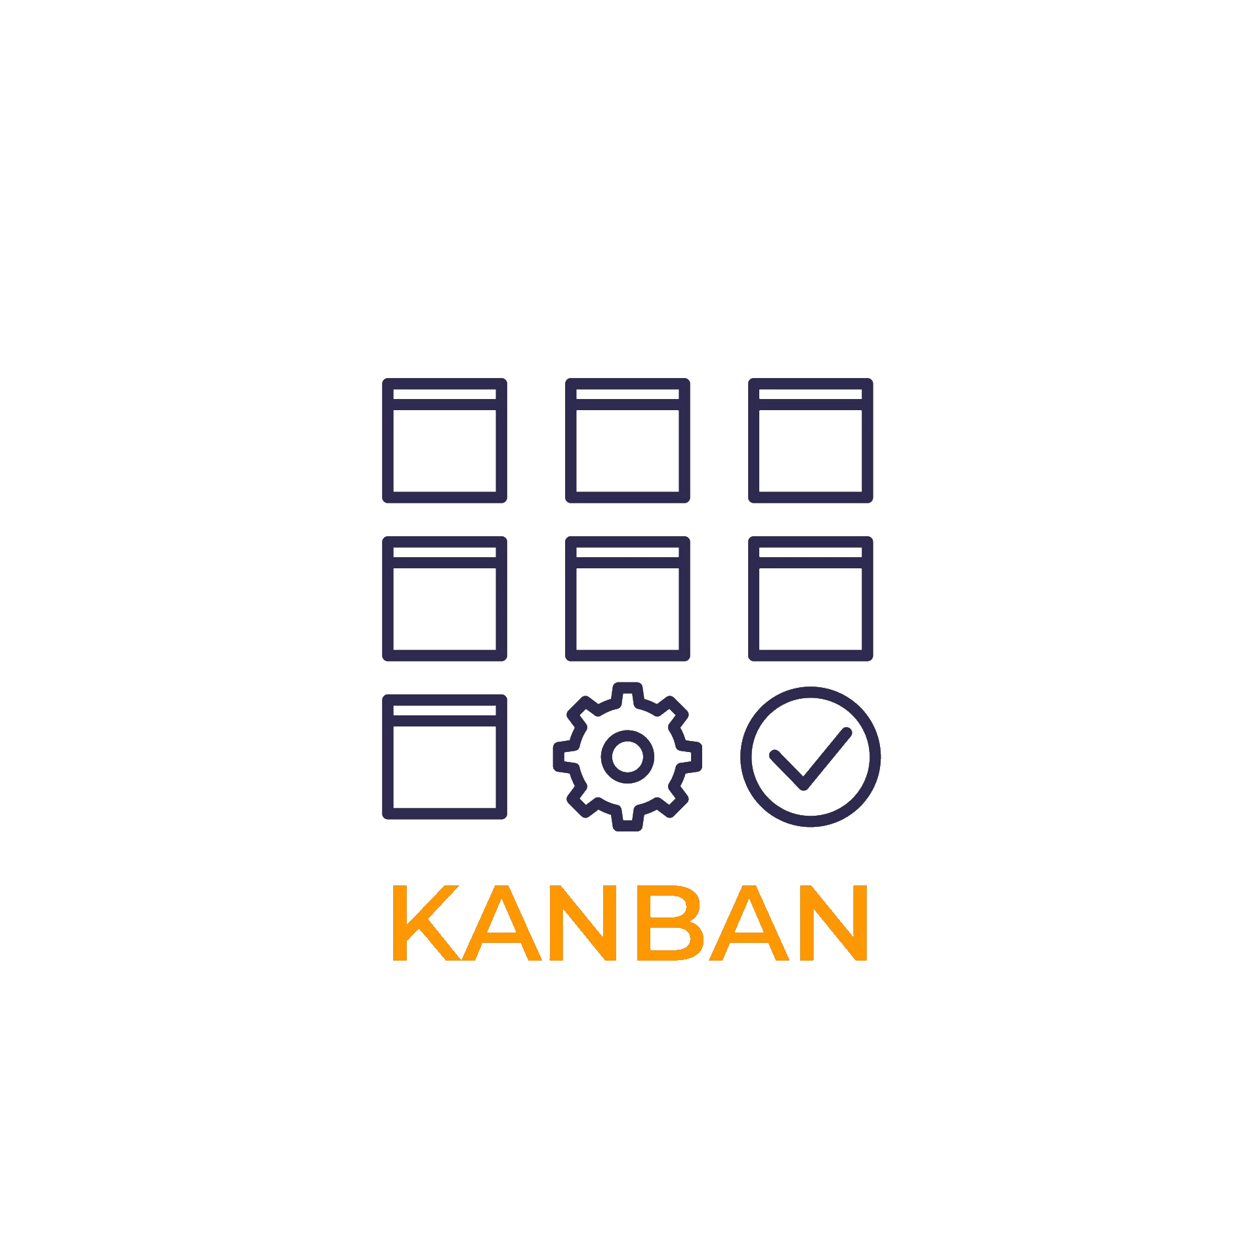
Kanban Board
By Ashutosh, Darshan and Kavi

Slide 2

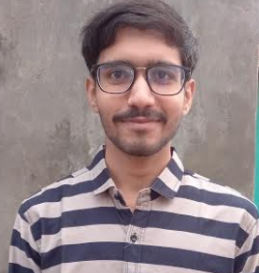
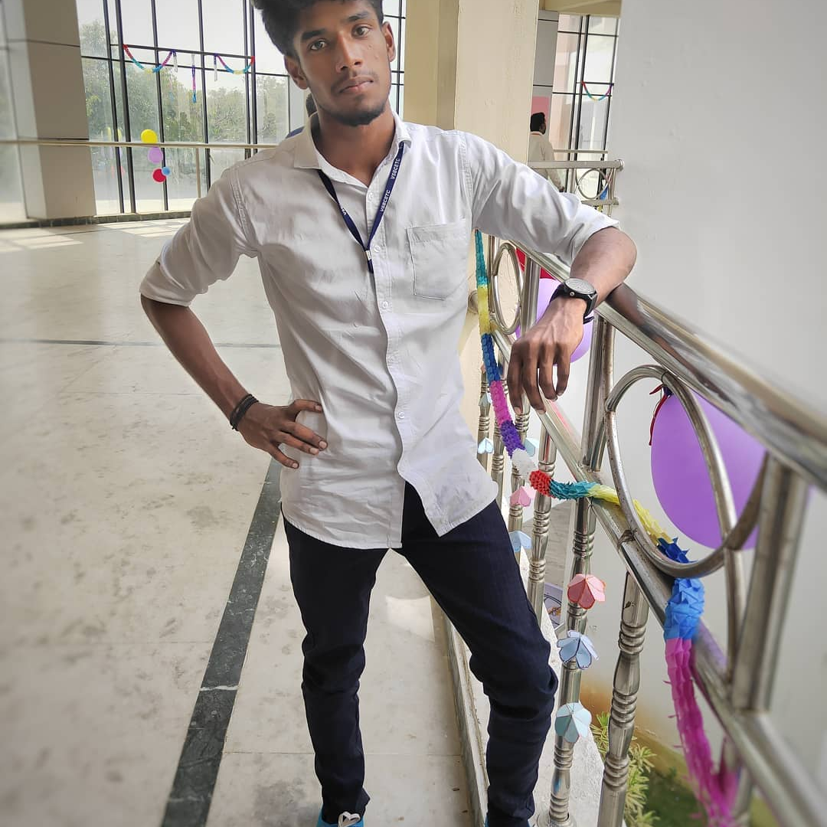
Our Team
Ashutosh Kumar Darshan Panchal Kaviyarasu
Kanban Board

Slide 3
About Kanban Board
‘Kanban’ is a japanese word which means visual signal.
It is used to manage work at personal level or organizational level.
Kanban board visually depicts work at various stages of a process using cards.
Cards are moved from left to right to show progress and help teams coordinate accordingly.
Kanban Board

Slide 4
Why Kanban Board?
Track the progress of individual team members.
It improves visibility of work.
Improved team collaboration.
Improved work efficiency.
Kanban Board

Slide 5
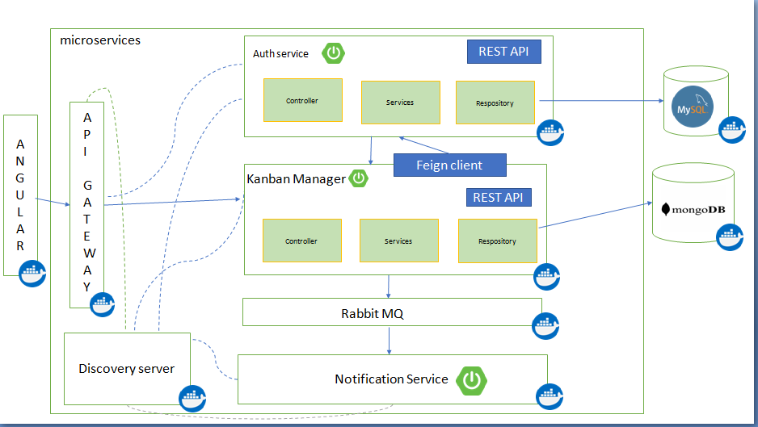
Architecture Diagram
Kanban Board

Slide 6









Technologies Used
Kanban Board

Slide 7
Features of Kanban Board
Registration and Login: In this app user is able to register and a registered user is able to login.
Reset Password: If an user forgets his password he can change his password by generating an OTP which will be received on his mail.
Add Workspace: Users can add one or more spaces in their profile.
Kanban Board

Slide 8
Features of Kanban Board
Add Task: Users can add tasks in their respective workspaces.
Add Status: Users can add the status of their tasks.
Set Priority: Users can set the priority levels for the tasks added.
Set Due Date:Users can set the deadline for the tasks added.
Upload Profile Picture: Users can upload their pictures so it will be easy to recognize other users.
Kanban Board

Slide 9
Future Enhancement
We can implement email service where an email is sent when some changes are being made in the workspace.
We can provide a feature to create a subspace of a workspace.
We can provide a feature to create a subtask of a task.
Kanban Board

Slide 10


