Slide 1
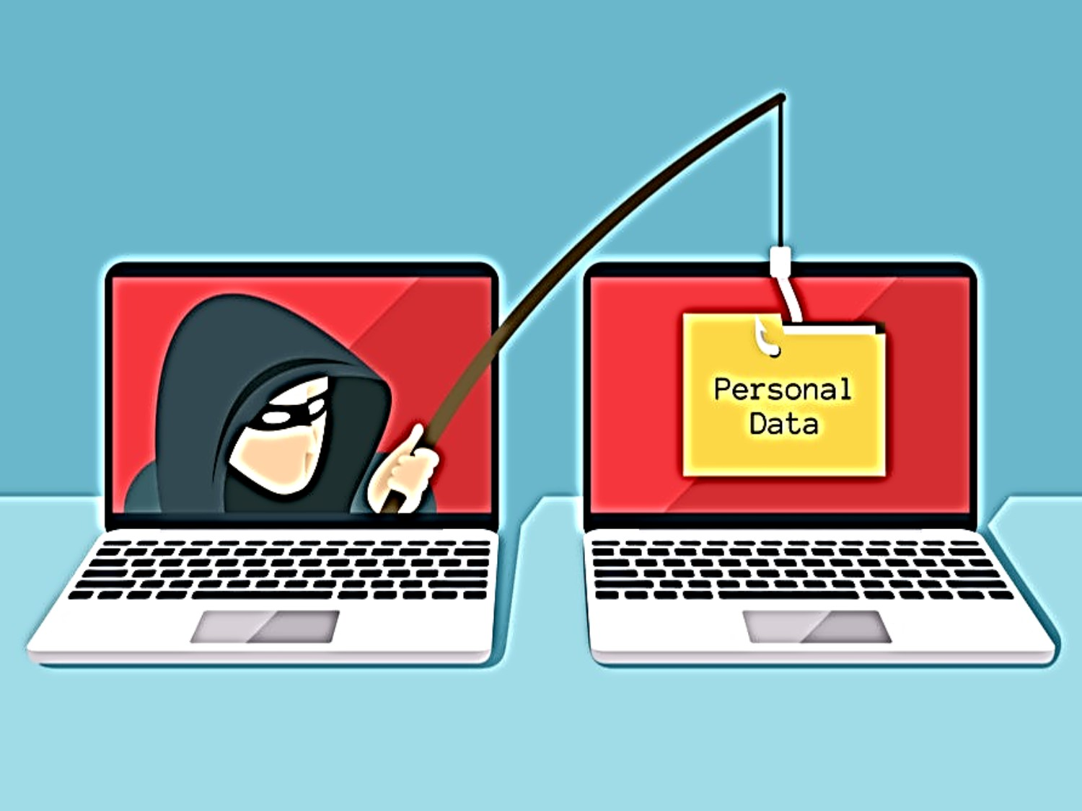
Phishing Attack in Hacking
By Ashutosh Palhare
Varsha Battise

Slide 2
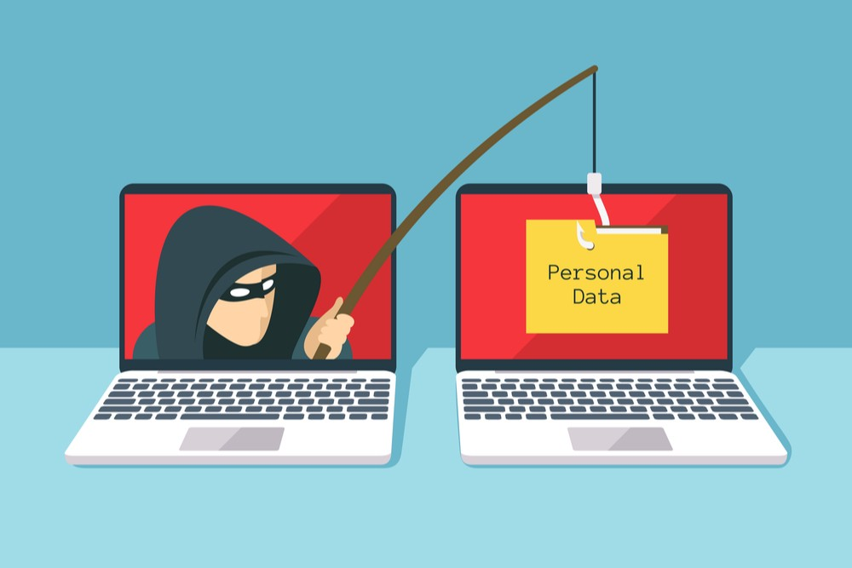

Slide 3
Table of Contents
I. Introduction
II. How it Work
III. Types of Phishing
IV. How to prevent phishing
V. What Is Anti Phishing
VI. Conclusion

Slide 4
Introduction
What is Phishing
Phishing is a cyber attack that uses disguised email as a weapon. The goal is to trick the email recipient into believing that the message is something they want or need — a request from their bank, for instance, or a note from someone in their company — and to click a link or download an attachment.

Slide 5
How it work
It sends Phishing Link to people via email or message. When anyone clicks on this link, they come to the Phishing Page. The user feels that he is the original website and he logs in there with his Id and Password. As soon as they log in, this ID and Password goes to the hacker and the user does not even know that he has been victim of Phishing Attack.

Slide 6
Types Of Phishing
SMS Phishing
Pharming Attack
Spear Phishing
Voice Phishing
Whaling Attacks

Slide 7
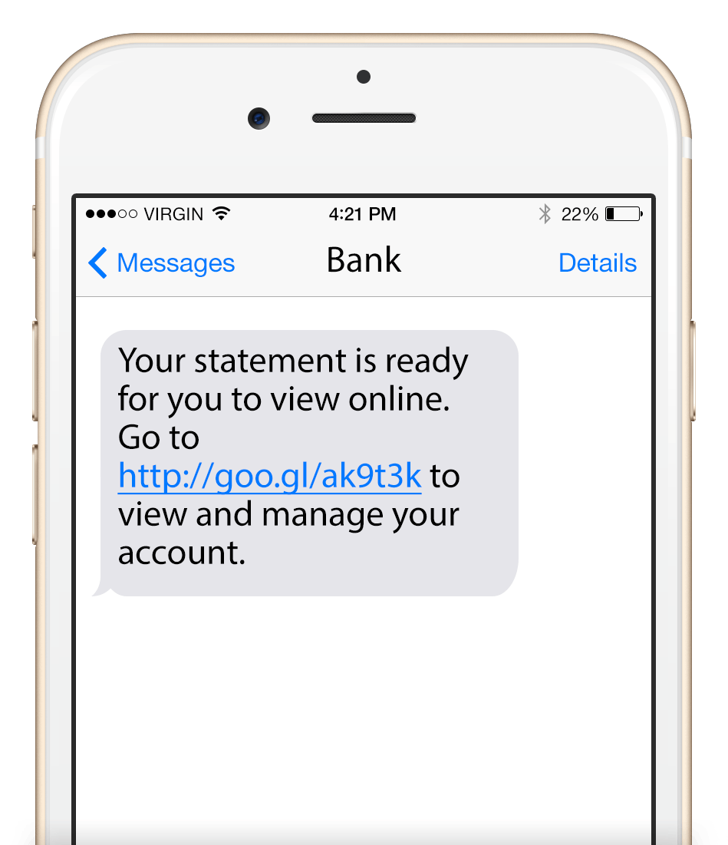
SMS Phishing
There are also many types of Phishing Attack. You have been told further about the types of Phishing Attack.

Slide 8
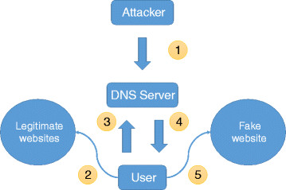
Pharming Attack
This attack relies on DNS cache poisoning so that the user can be directly accessed from the Valid Site on a fraud website, by logging into this fraud site their login information can be stolen.

Slide 9
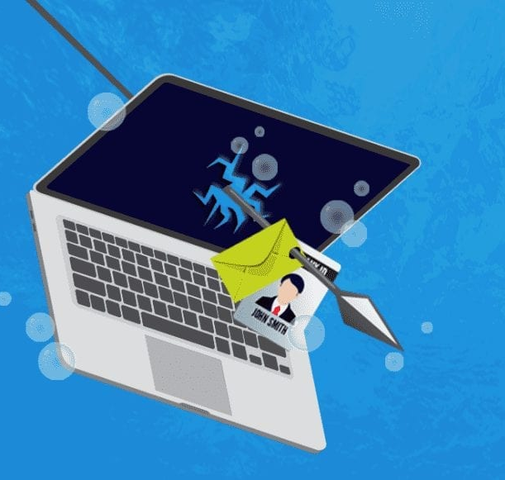
Spear Phishing
Spear Phishing attacks are done on companies or any particular individuals. In this phishing, the reference of the colleague or officers of his company who is attacked includes his location, name, personal reference.

Slide 10
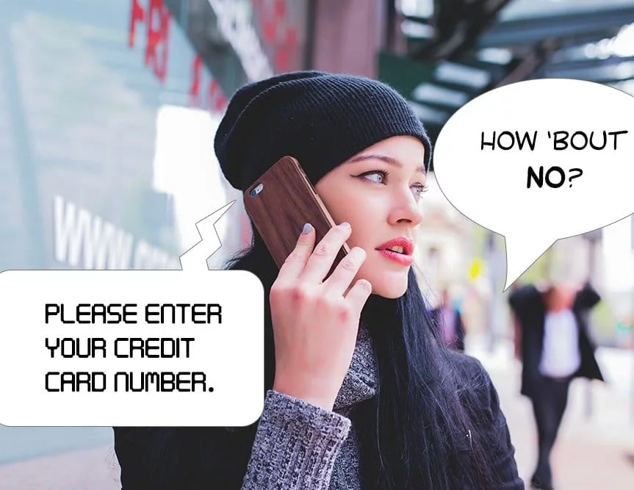
Voice Phishing
It happens on Voice Communication Media. In this, hackers ask for information about people's credit card or debit card through a call.

Slide 11
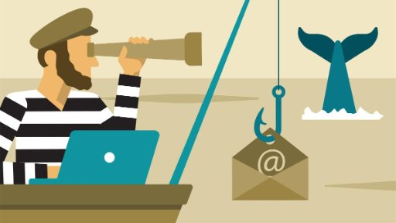
Whaling Attacks
This is a kind of Spear Phishing Attack. In which target the officials of an organization to get more money.

Slide 12
How to prevent phishing
Do not click on any unknown link and do not enter your information in any unknown link.
You must have heard that a website with HTTP remains secure. But it is not the case that hackers have become very smart now. He also uses HTTP on Phishing Page, so instead of HTTP, see his domain.
You must keep in mind the URL while logging into any of your accounts.
Do not open any unknown spam mail and do not click on the link given in it and also do not download the attachment attached to it.
If you use a computer. So make sure to use a good anti-virus in your computer which will give you web security.

Slide 13
What Is Anti Phishing
But Google has created an Anti Phishing Security feature to prevent hackers. With this feature, users of millions of iPhones and iPads will avoid falling prey to hacking through phishing emails.
Security will be like this if the user clicks on a link which according to Google will be full of suspicion, then a warning pop-up related to it will appear on the screen. In this warning, there is a message that if the user ignores the first warning and goes ahead, the Gmail app gives the message of the second warning.

Slide 14
Conclusion
In today's presentation, you learned What is Phishing, in addition to this, you also learned that How to Prevent Phishing hopes that the information given by us will be useful for you.

