Slide 1


SHRI VAISHNAV VIDYAPEETH VISHWAVIDYALAYA
SHRI VAISHNAV INSTITUTE OF INFORMATION TECHNOLOGY, INDORE
VOID HACKS ( ) 4.0

Slide 2
Welcoming you all in the shortlisting round.
Here we are with 2 problem statements. Your team is required to solve any one problem. The solution should be provided in the ppt itself. You are required to provide the complete solution containing your approach, code as well as screenshots of the working solution. You also need to give the solution use case and technology stack used in your solution.

Slide 3
TEAM NAME: Ash Technologies
MEMBER DETAILS:
Aashutosh Soni (Leader).
Aarav Singh Chouhan.
Aditya Paliwal.
Deependra Parmar.

Slide 4

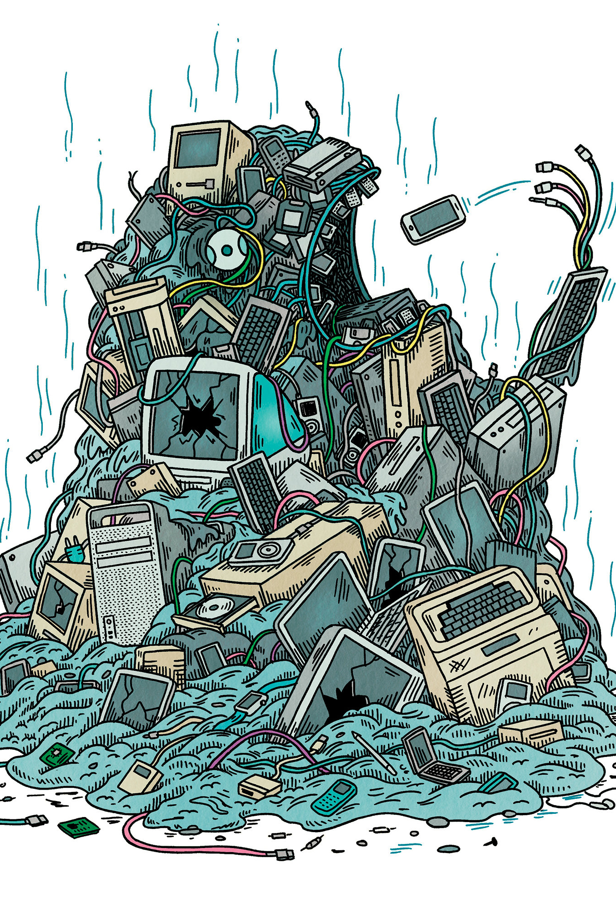
PROBLEM STATEMENT 1
According to a report of 2022, electronic waste (e-waste) is the fastest growing form of domestic waste globally, with around 150 million metric tones being produced in 2021 alone, of which only 25% was recycled. This is environmentally and socially problematic. You need to propose a system that can resolve this problem and citizens can use that directly without getting involved of third party.

Slide 5
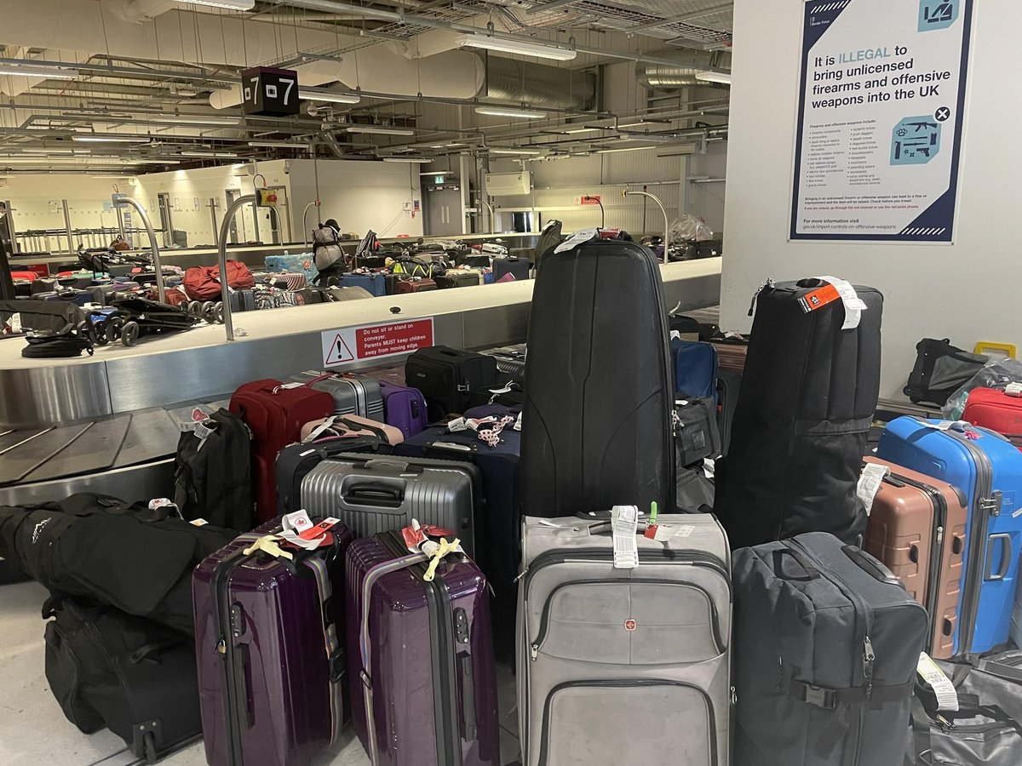
PROBLEM STATEMENT 2
Roshni is an employee of TCS India, She is working in the USA on some projects with Bank of America. At the time of her return to India, she had a lot of bags with her. According to the rules some airlines also enforce weight limitations, typically starting at 5kg/11lbs. She doesn't want to pay that amount because it covers a very larger amount equal to the price of one more person's ticket. To avoid that charge she needs a solution. The task is to find a solution for her to save some money without getting her bags lost and damaged.

Slide 6
PROBLEM STATEMENT NO.:
SOLUTION & INNOVATION:

Slide 7
SOLUTION USE CASES

Slide 8
Technology STACK

