Slide 1

Clustering in Wireless Sensor Networks:
Performance Comparison of EAMMH
And LEACH Protocols using MATLAB
Project guide :
Er. Pardeep Singh
Ashutosh Kumar Gupta (13558)
Neha Negi (13544)
Disha Singh (13550)
Utkarsh Singh (13586)

Slide 2
Introduction
LEACH stands for Low-Energy Adaptive Clustering Hierarchy
This wireless sensor network is considered to be a dynamic clustering method
LEACH has two phases

Slide 3
Problems :
The reason we need network protocol such as LEACH is due to the fact that a node in the network is no longer useful when its battery dies.
This protocol allows us to space out the lifespan of the nodes, allowing it to do only the minimum work it needs to transmit data.

Slide 4
The Cluster-Head :
The LEACH Network is made up of nodes, some of which are called cluster-heads
  The job of the cluster-head is to collect data from their surrounding nodes and pass it on to the base station
  LEACH is dynamic because the job of cluster-head rotates

Slide 5
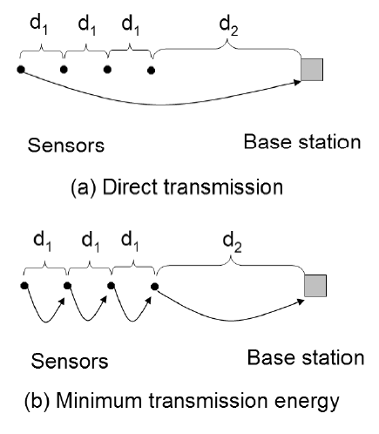
Direct vs Minimum Transmission:
The amount of energy used in figure (a) can be modeled by this formula:
  εampk(3d1 + d2)²
Whereas the amount of energy used in figure (b) uses this formula:
  εampk(3d1² + d2²)

Slide 6
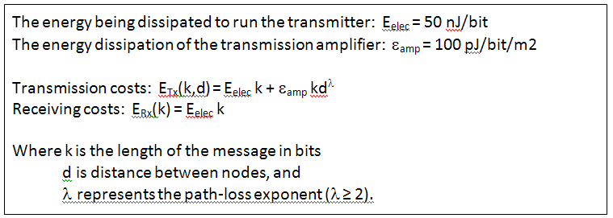
The Amount of Energy Depletion:
This is the formula for the amount of energy depletion by data transfer:

Slide 7
Leach’s Two Phases
The LEACH network has two phases: the set-up phase and the steady-state
  The Set-Up Phase
    Where cluster-heads are chosen
  The Steady-State
    The cluster-head is maintained
    When data is transmitted between nodes

Slide 8
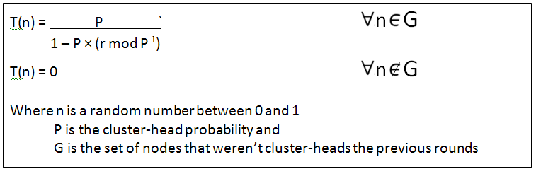
Stochastic Threshold Algorithm
Cluster-heads can be chosen stochastically (randomly based) on this algorithm:
If n < T(n), then that node becomes a cluster-head
The algorithm is designed so that each node becomes a cluster-head at least once

Slide 9
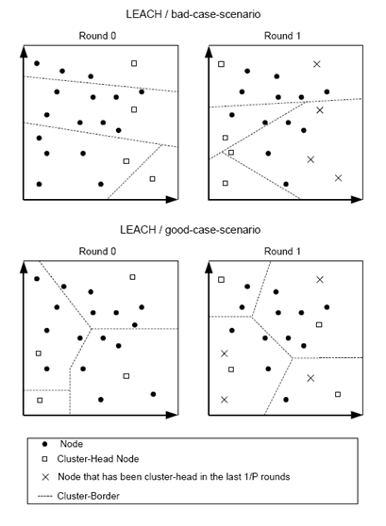
Example :
While neither of these diagrams is the optimum scenario, the second is better because the cluster-heads are spaced out and the network is more properly sectioned

Slide 10
EAMMH Routing Protocol
EAMMH stands for Energy Aware Multi-hop Multi-path Hierarchical.
It was developed by inducing the features of energy aware routing and multi-hop intra cluster routing.
The operation of the EAMMH protocol is broken up into rounds where each round begins with a set-up phase.

Slide 11
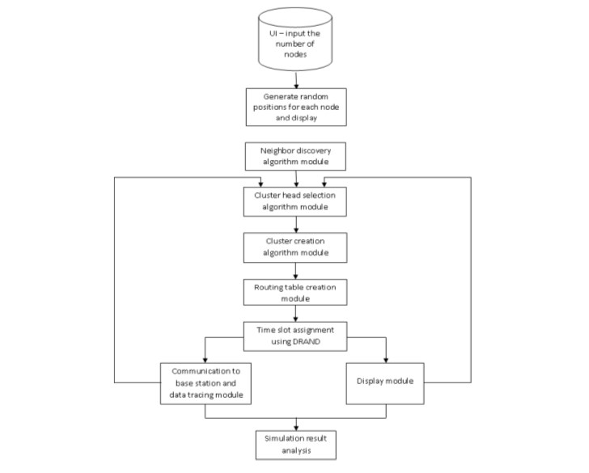
Flowchart of EAMMH

Slide 12
Phases of EAMMH
Setup Phase
Initially, after the node deployment the neighbor discovery takes place. This can be done using many methods like: k-of-n approach, ping, beacon messaging.
The setup phase operates in the following sequence:
1. CH (Cluster Head) Selection
2. Cluster Formation

Slide 13
Phases of EAMMH
Data Transmission Phase
Once the clusters are created, the sensor nodes are allotted timeslots to send the data.
When a node receives data from one its neighbors, it aggregates it with its own data.

Slide 14
Phases of EAMMH
It uses a heuristic function to make this decision and the heuristic function is given By,
h = K ( Eavg / h min * t ) ........ (1)
where
K is a constant,
Eavg is average energy of the current path,
h min is minimum hop count in current path,
t = traffic in the current path.

Slide 15
Phases of EAMMH
The path with highest heuristic value is chosen. If this path’s E min > threshold, it is chosen. Else the path with the next highest heuristic value is chosen,
where,
Emin = E avg /const ...........(2)
If no node in the routing table has Emin greater than threshold energy, it picks the node with highest minimum energy.

Slide 16
Simulation and Analysis of Results
Simulation and Analysis of Results Both LEACH and EAMMH are simulated using MATLAB. The parameters taken into
consideration while evaluating EAMMH and LEACH are as follows.
Round Number vs Average Energy of Each node (with variation of probability)
Round Number vs Number of Dead nodes (with variation of probability)

Slide 17
Assumptions
To simplify the simulation of these protocols few assumptions are made. They are as follows:
Initial energy of nodes is same.
Nodes are static.
Nodes are assumed to have a limited transmission range after which a another equation for energy dissipation is used.
Homogeneous distribution of nodes.
Nodes always have to send the data.

Slide 18
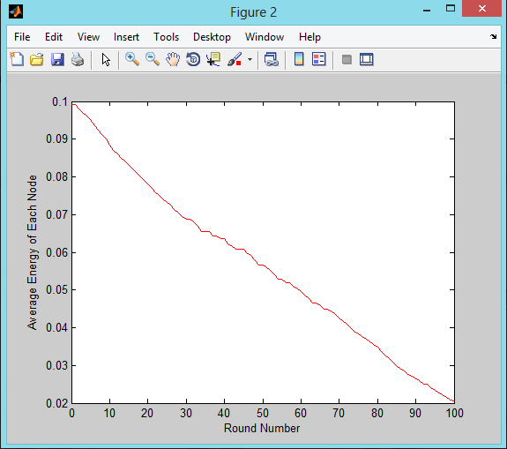
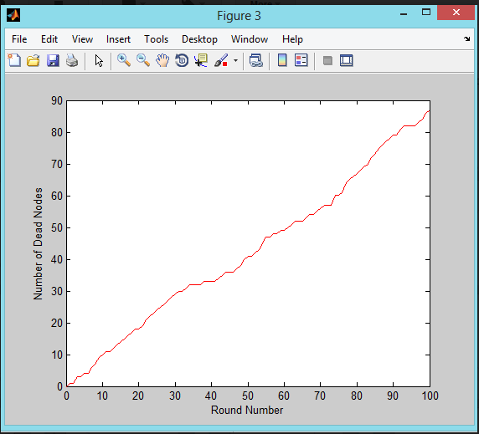
Leach at 0.01 Probability

Slide 19
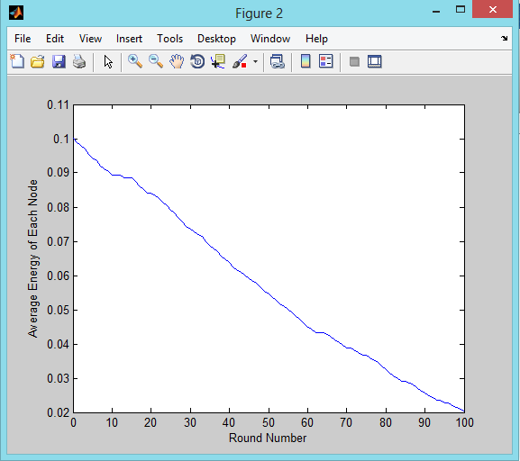
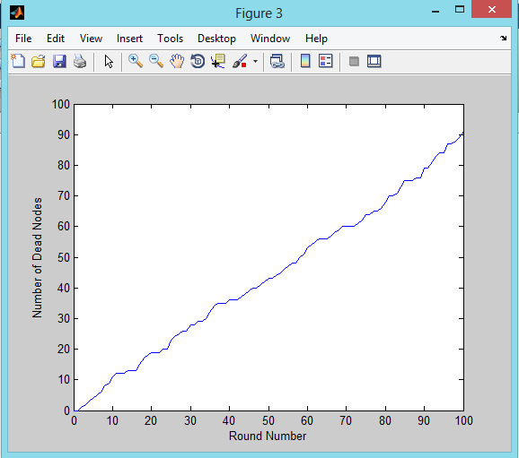
EAMMH at 0.01 Probability

Slide 20
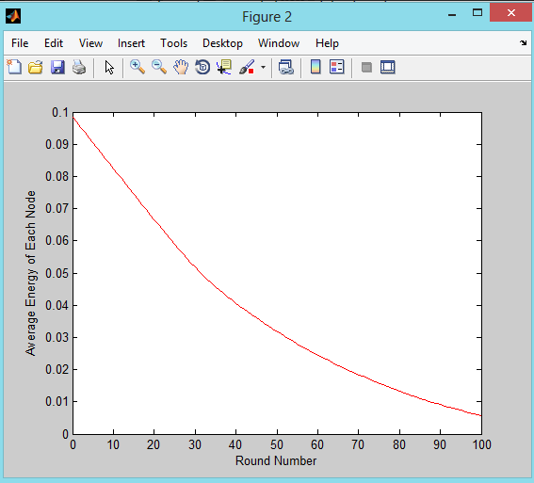
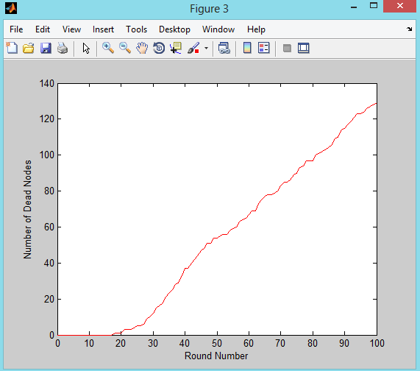
Leach at 0.2 Probability

Slide 21
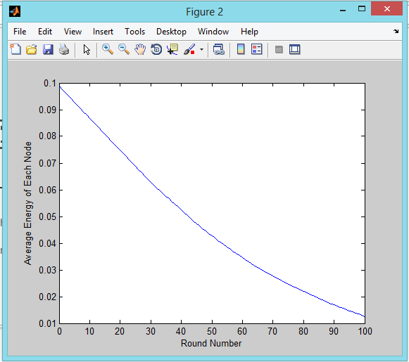
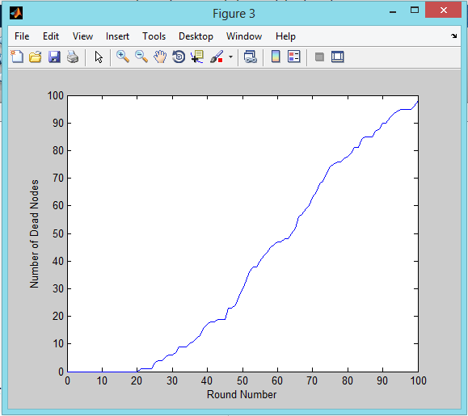
EAMMH at 0.2 Probability

Slide 22
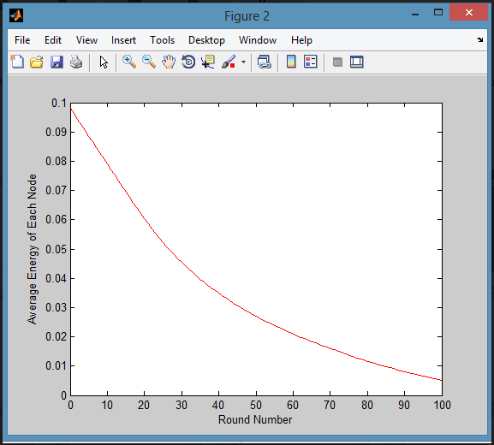
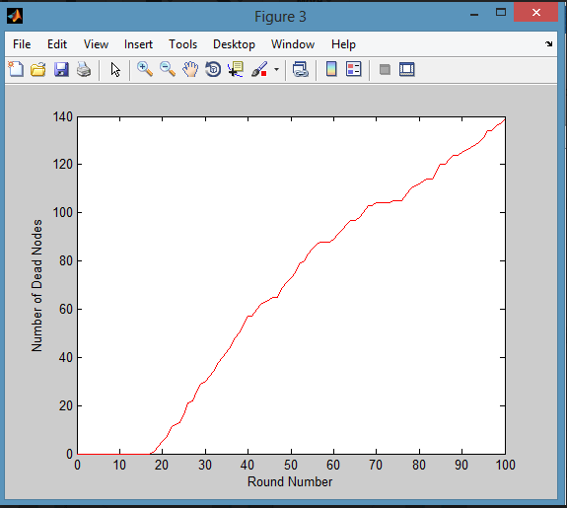
Leach at 0.5 Probability

Slide 23
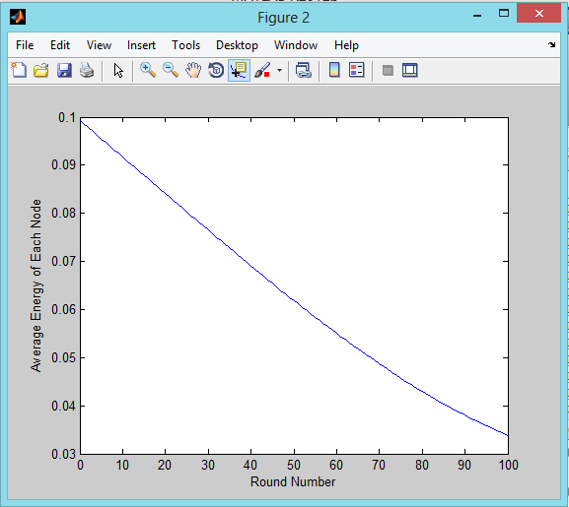
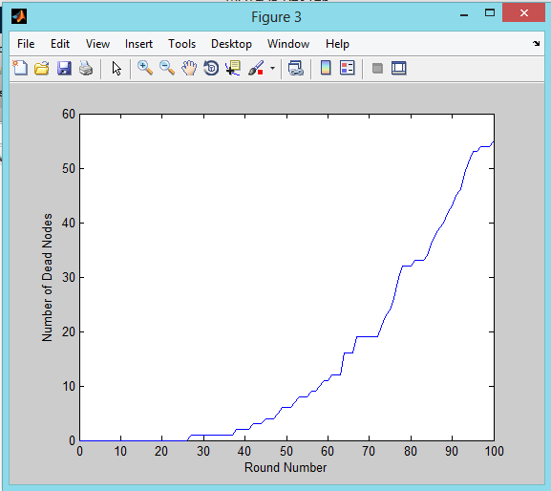
EAMMH at 0.5 Probability

Slide 24
Conclusion
Wireless Sensor Networks are usually spread over large areas are recently finding applications in many fields.
Wireless Sensor Networks are powered by the limited capacity of batteries.
LEACH can be preferred in cases of smaller networks where the total number of nodes is less than fifty where it performs slightly better than EAMMH and EAMMH can be chosen in larger networks.

