Slide 1
DocQuorum
From a document and a schema to checked JSON: agentic extraction with open models
Every example in this deck is a real benchmark document and a stored pipeline output
A
B
C
D
Routes A-D, as in the pipeline figure
Notes:
ExtractBench (370 enterprise PDFs) and UNIKIE-BENCH (4,472 images). Model: Qwen3.8-27B (FP8) on one GPU; MinerU2.5 parser for scans.

Slide 2
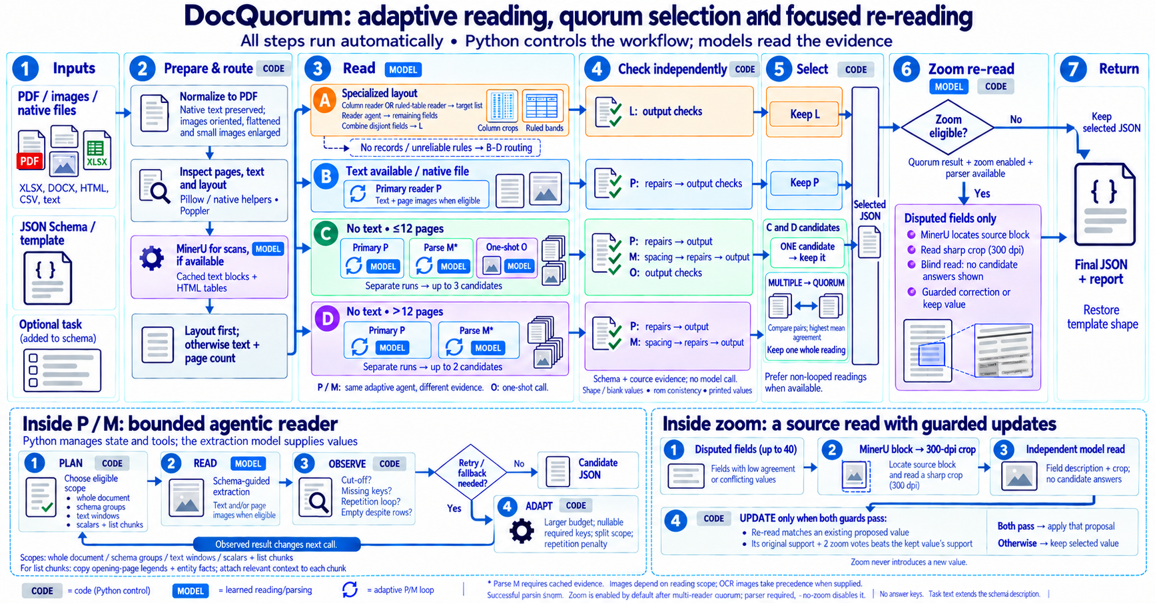
The whole pipeline
Pipeline figure v3 (generated with Codex), describing docquorum.extract.
Notes:
Read left to right: inputs, prepare and route, read, check each candidate, select, return. Routes: A layout readers, B text available, C no text and at most 12 pages, D no text and longer.

Slide 3
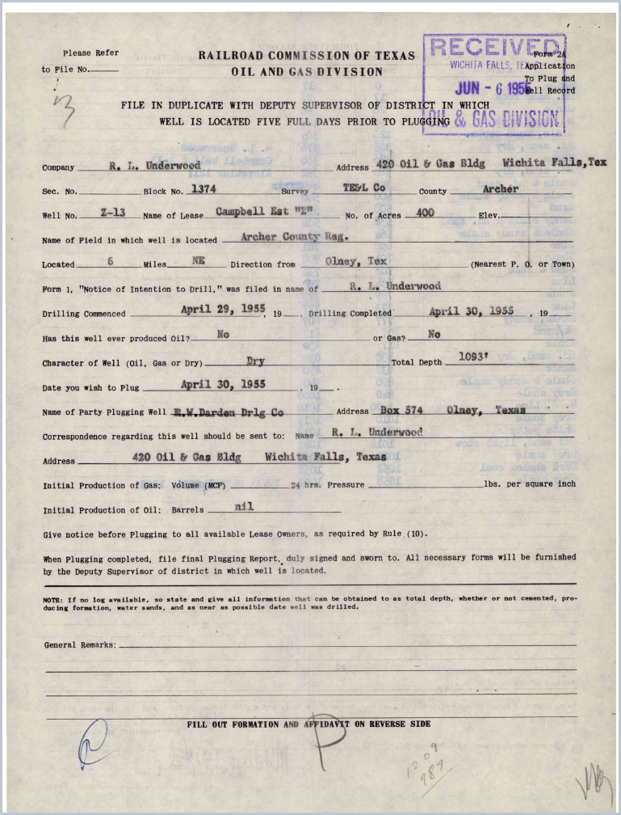
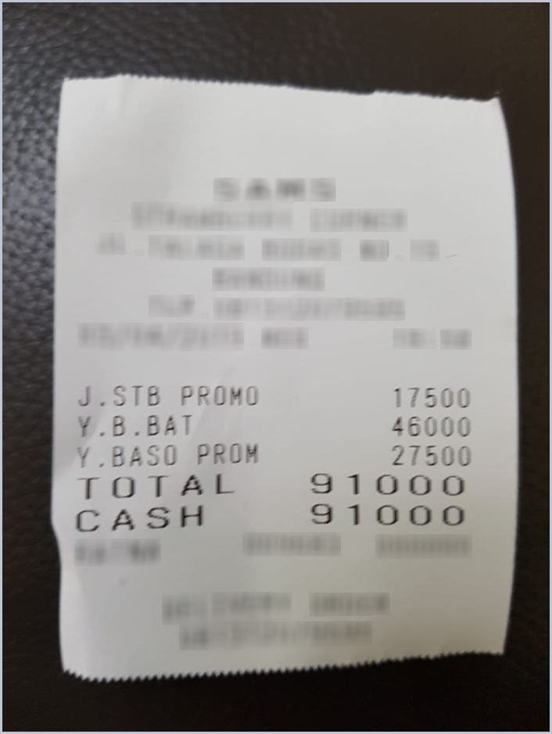
1
INPUTS
A document, a schema, and an optional task
Document (PDF or image)
JSON Schema (77 fields)
Optional task (free text)
“A single point-of-sale purchase RECEIPT (retail or restaurant). DOC-TYPE / SCOPE RULE: if one file bundles MULTIPLE distinct receipts or transactions …”
"p1_company": {
"anyOf": [{"type": "string"},
{"type": "null"}],
"description": "The 'Company'
field in the identification
block on page 1 ... Extract
verbatim as printed; null if
blank. Do NOT confuse with
'Name of Party Plugging
Well' ..."
},
"p1_county": {...},
"p1_total_depth": {...},
... 74 more fields
Or: image + JSON template
{"menu": [
{"price": "",
"nm": ""}],
"total": {
"cashprice": "",
"total_price": ""}}
1955 well-plugging application, Railroad Commission of Texas. Scan, 2 pages, no text layer.
ExtractBench short: 2A-9-160298_109929 (schema shortened); task from hingham_lowes_receipt; UNIKIE-BENCH Catering-Services test_1.jpg.
Notes:
The schema is the contract: field names, types and descriptions. The optional task text says what the user wants in words. A JSON template (empty leaves) can replace the schema.

Slide 4
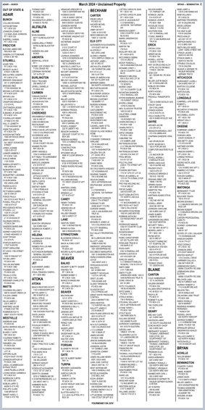

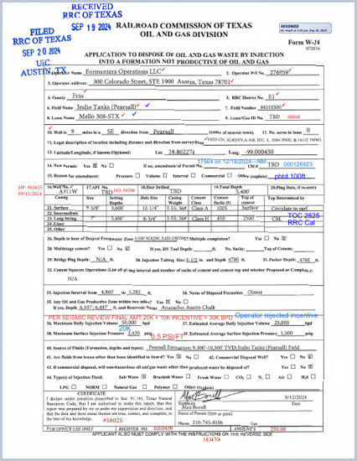
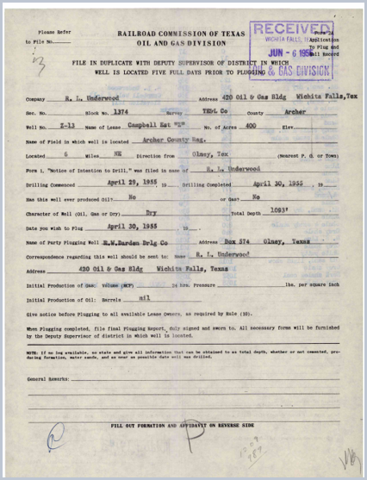
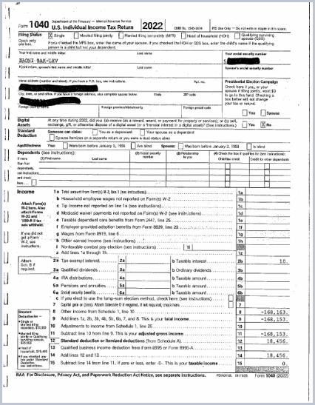
2
PREPARE & ROUTE
The document decides how it is read
A
Layout reader
B
Reader agent on text + images
B
Reader agent on text + images
C
3 readings, then quorum
D
Reader agent on the parse
Oklahoma unclaimed-property register
59 pages · 15,280 characters/page
Equal-width columns of records
Oklahoma County purchase order
1 page · 2,253 characters/page
Digital PDF: exact text layer
Texas W-14 well form
1 page · 252 characters/page (OCR layer)
Scan with an OCR text layer
1955 plugging application
2 pages · no embedded text
No text and at most 12 pages
Tax return (bar-lev-2022)
25 pages · no embedded text
No text and more than 12 pages
Characters per page = embedded text from pdftotext. Thumbnails: ExtractBench documents named on each card.
Notes:
Layout first: equal-width columns of records, or a ruled table on a scan, go to a layout reader. Otherwise a PDF with a text layer (digital, or an OCR layer) is read once; a scan without text is parsed by MinerU and read several ways (12 pages or fewer) or through its parse (longer).

Slide 5
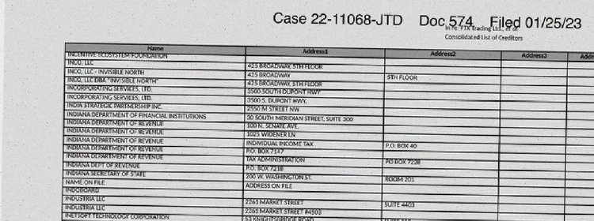
2
PREPARE: MINERU PARSE OF A SCAN
A scanned table comes back as cells, not loose text
Scanned page (top part)
The same rows as cells (65 on this page)
Name | Address1 | City | State | PostalCode
INCENTIVE ECOSYSTEM FOUNDATION
INCO, LLC | 425 BROADWAY, 5TH FLOOR
INO, LLC - INAVAILABLE NORTH | 425 BROADWAY | NEW YORK | NY | 10013
INO, LLC DBA "INAVAILABLE NORTH" | 425 BROADWAY, 5TH FLOOR | NEW YORK | NY | 10013-2599
INCORPORATING SERVICES, LTD. | 3500 SOUTH COOPONT HWY | NEW YORK | NY | 10013
INCORPORATING SERVICES, LTD. | 3500 S. DUPONT HWY. | LOVER | DE | 19901
MinerU output (raw, abbreviated)
<TABLE>
<tr><td>Name</td><td>Address1</td><td>Address2</td><td>Address3</td><t…
<tr><td>INCENTIVE ECOSYSTEM FOUNDATION</td><td></td><td></td><td></td><td></td…
<tr><td>INCO, LLC</td><td>425 BROADWAY, 5TH FLOOR</td><td></td><td></td><td></…
Columns stay aligned: an empty Address2 or City stays empty instead of pulling the next value into its place.
Recognition errors remain, so the page image is sent with the parse.
ExtractBench long: real_ftx_full_corrupted, page 47; cached MinerU2.5 parse (cache/parse).
Notes:
MinerU2.5 returns tables as HTML rows and cells, so an empty column cannot shift every later value. Letters can still be misread; the reader also gets the page image, which decides where they disagree.

Slide 6
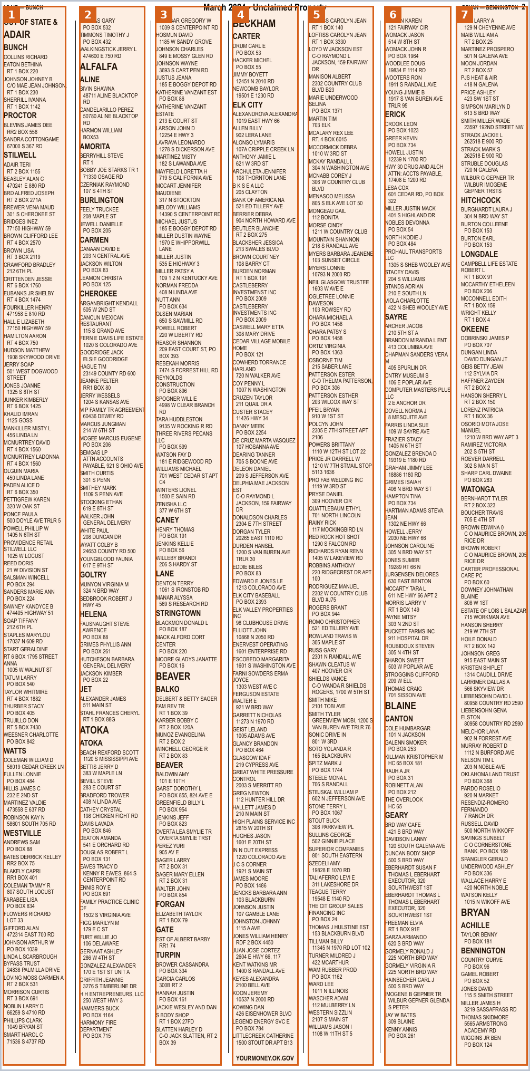
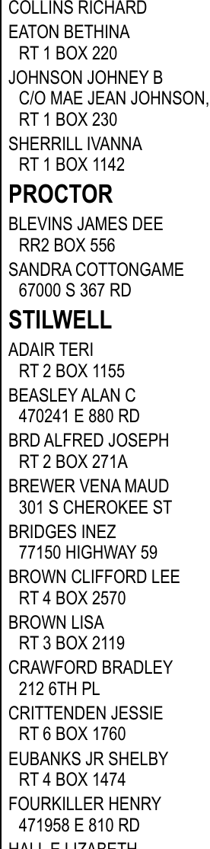
3
READ · ROUTE A: COLUMN READER
Columns of records: read each column top to bottom
What the reader returns for column 1
name | locale | page
COLLINS RICHARD | null | 2
EATON BETHINA | RT 1 BOX 220 | 2
JOHNSON JOHNEY B | C/O MAE JEAN JOHNSON, RT 1 BOX 230 | 2
SHERRILL IVANNA | RT 1 BOX 1142 | 2
7
59
26,675
columns found on the page
pages
records in the final output
Read across the page, a 7-column register mixes names from different columns; cut into columns, each record is read in the order it was printed.
ExtractBench long: real_oklahoma_unclaimed_2024, page 2. Records from the stored final output.
Notes:
Trigger from page geometry only: three or more text columns of near-equal width on most sampled pages. One model call per column; a record that continues from the previous column comes back with its first field empty and is joined to the record before it.

Slide 7
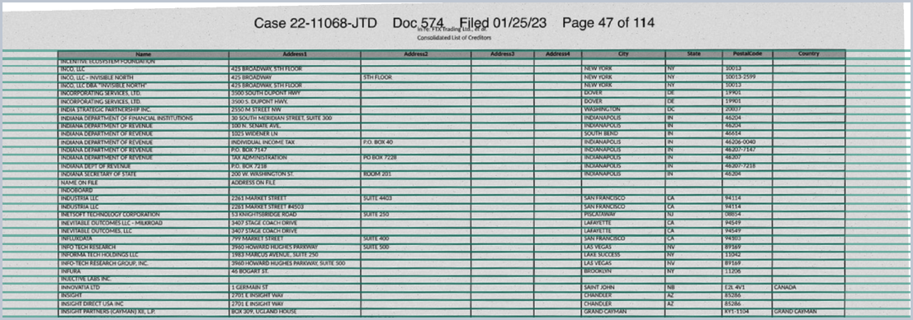
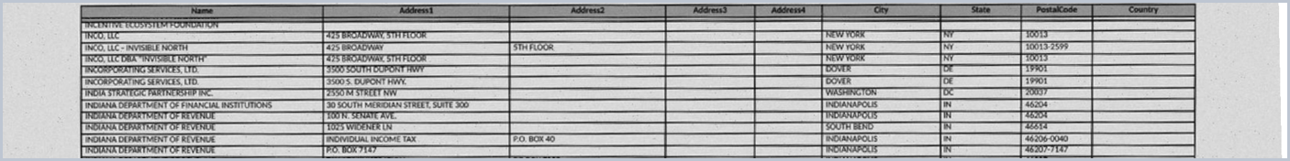
3
READ · ROUTE A: RULED-TABLE READER
Ruled tables: count the rows from the lines, then read in bands
Page 47
67
67
rows counted from the rules
rows returned by the reader
Bands: 12 + 12 + 12 + 12 + 12 + 7
name | address_1 | city | state
INCENTIVE ECOSYSTEM FOUNDATION | null | null | null
INCO, LLC | 425 BROADWAY, 5TH FLOOR | NEW YORK | NY
INCO, LLC - INVISIBLE NORTH | 425 BROADWAY | NEW YORK | NY
Detected rules (green) after deskewing by 1.15°
One call = the header row + one band of 12 rows. The decoding schema allows exactly 12 entries.
ExtractBench long: real_ftx_full_corrupted, page 47. Rows from the stored final output.
Notes:
The page is deskewed, the printed rules found, and the rows between them counted. Each band of at most 12 rows is sent with the header row stacked on top, and the reply must contain exactly that many entries, so repeated identical rows can neither multiply nor disappear.

Slide 8
3
READ · ROUTE C: THREE READINGS OF ONE SCAN
Three independent readings of the same scan
field | P image reading | M parse reading | O one-shot
p1_company | R. L. Underwood | R. L. Underwood | null
p1_county | Archer | Archer | null
p1_well_no | Z-13 | Z-13 | null
p1_name_of_lease | Campbell Est "Z" | Campbell Est "Z" | null
p1_drilling_commenced | April 29, 1955 | April 29, 1955 | null
p1_party_plugging_well | R.W. Darden Dr'lg Co | R.W.Darden Drlg Co | null
p2_correspondence_name | R.L. Underwood | R.L.Underwood | null
Red: empty, or the two readings disagree (P and M differ only in spacing and punctuation).
P
59 / 77
M
59 / 77
O
1 / 77
fields filled
fields filled
fields filled
ExtractBench short: 2A-9-160298_109929; stored readings after their checks.
Notes:
P: the reader agent on the page images. M: the reader agent on the MinerU parse plus images. O: the benchmark's own one-shot reader. Here O returned almost nothing: 1 of 77 fields filled.

Slide 9
4
CHECK: STRUCTURE
Checks that repair the structure of a reading
Rows copied into another list
Identical records capped at the printed count
Pueblo check register (ExtractBench medium)
FTX creditor list, text layer (long)
562 → 51 batch rows
146 → 37 rows on page 59
Check 01033982 ($700.88) was also filed as a batch with the same number and amount.
Page 59 prints the line “NAME ON FILE” 37 times; the reading had 146.
Value F1 84.73 → 99.91
Value F1 84.47 → 90.77
Stacked lines folded into one record
Template rows dropped
Clinical adverse-event listing (long)
Texas W-14 well form (short)
1,499 → 668 records
5 → 2 casing rows
Subject R1002: three printed lines became one event with its resolved date.
Three rows had only the printed row label (e.g. “Intermediate”) and nothing filled.
Value F1 38.80 → 68.77
Value F1 82.30 → 93.23
Stored readings before and after each check, re-run with docquorum/checks and scored with ExtractBench's scorer.
Notes:
No model call: each check reads only the schema and the document's own text. Each fires only when the schema or the page triggers it. On a few short documents some repairs lowered the score slightly (for example, removing duplicates on three election reports); the examples here are the cases each check was built for.

Slide 10
4
CHECK: VALUES
Checks that make values exactly what the page prints
Every schema field present
A blank tick box is false
Caterpillar 330 excavator spec sheet (short)
Texas P-4 form (short)
missing keys → null
6 boxes: null → false
The reply left 7 optional fields out of every spec row; the scorer counts an absent key as a miss.
The field description says “false if left blank”; the reader had returned null.
Value F1 61.48 → 95.74
Value F1 91.67 → 96.67
Quotes as printed
Numbers as printed
Census statistical table (short)
Schedule K-1 (short, one-shot reading)
Bachelor's → Bachelor’s
33.333333 → 33.3333333
The page prints a curly apostrophe; only the quote character is copied from the page.
A rounded value is replaced by the one printed figure it restates (6 share fields).
Value F1 60.12 → 62.58
Value F1 85.42 → 97.92
Stored readings before and after each check, re-run with docquorum/checks and scored with ExtractBench's scorer.
Notes:
These checks work on values, not rows. They never invent content: every replacement is a value the page itself prints, or null where the schema allows null.

Slide 11
5
SELECT: THE QUORUM
Keep the reading the others agree with most
Mean agreement with the other readings
P
0.98
M
reading | agreement | kept?
P image reading | 0.604 | kept
M parse reading | 0.604
O one-shot | 0.218
0.23
0.23
P and M tie; the tie goes to the reading listed first. The whole of P is returned.
O
Agreement is not accuracy
Answer-key F1 here: P 95.24 · M 95.24 · O 22.50.
On the scanned purchase order, the quorum kept the one-shot reading (78.26) although the image reading scored higher (82.61).
Edge = how much two readings agree (recall-weighted value F-score). P and M agree almost completely; O agrees with neither.
2A-9-160298_109929: agreement from docquorum.quorum on the checked readings. F1 shown for illustration only.
Notes:
Agreement of reading b with reading a is the benchmark scorer's value score of b with a as the reference, recall-weighted (beta = 2). Each reading's score is its mean agreement with the others. A whole reading is kept; no fields are mixed. The answer key is never used by the pipeline.

Slide 12
6
RETURN
One checked JSON, in the shape the user asked for
Schema in → JSON out (1955 form, 77 fields)
Template in → same template filled
{
"p1_company": "R. L. Underwood",
"p1_address": "420 Oil & Gas Bldg Wichita Falls, Tex",
"p1_county": "Archer",
"p1_well_no": "Z-13",
"p1_name_of_lease": "Campbell Est \"Z\"",
"p1_drilling_commenced": "April 29, 1955",
"p1_total_depth": "1093'"
... 70 more fields
}
{"menu": [{"price": "",
"nm": ""}],
"total": {"cashprice": "",
"total_price": ""}}
{"menu": [ {"price": "17500", "nm": "J.STB PROMO"}, {"price": "46000", "nm": "Y.B.BAT"}, {"price": "27500", "nm": "Y.BASO PROM"} ], "total": {"cashprice": "91000", "total_price": "91000"}}
Left: final output for the 1955 form (stored). Right: UNIKIE-BENCH Catering-Services test_1.jpg, quorum over six stored readings.
Notes:
For a JSON Schema the kept object is returned as is. For a template the result is restored to the template's shape, with an empty string for anything absent. The receipt output matches the answer key.

Slide 13
ExtractBench: DocQuorum is 3rd of 48
# | System | Short | Medium | Long | Overall | $/page | s/doc
1 | LlamaExtract Agentic Plus | 96.94 | 94.45 | 90.18 | 95.91 | 0.081 | 152
1 | Pulse (Effort) | 96.46 | 95.01 | 93.51 | 95.91 | 0.105 | 165
3 | DocQuorum (ours, open 27B) | 96.34 | 94.11 | 90.41 | 95.43 | 0.029* | 568
4 | LlamaExtract Agentic | 96.04 | 92.11 | 91.83 | 94.77 | 0.033 | 80
5 | Codex (GPT-6 Sol Evidence) | 95.99 | 92.42 | 87.25 | 94.57 | 0.098 | 100
6 | Codex (GPT-5.6 Sol Evidence) | 96.04 | 90.19 | 82.73 | 93.77 | 0.216 | 104
7 | Codex (GPT-5.5) | 95.68 | 91.15 | 78.88 | 93.57 | 0.278 | 76
8 | Codex (GPT-5.5 Evidence) | 95.59 | 88.72 | 87.97 | 93.35 | 0.336 | 101
9 | Pulse (Non-effort) | 93.17 | 92.22 | 89.07 | 92.70 | 0.030 | 113
10 | LlamaExtract Cost-Effective | 94.03 | 89.51 | 83.73 | 92.27 | 0.011 | 120
11 | Codex (GPT-5.6 Terra Evidence) | 95.60 | 86.69 | 77.36 | 92.26 | 0.095 | 78
12 | OpenAI GPT-6 Astra | 97.22 | 90.56 | 31.70 | 91.91 | 0.111 | 57
13 | Codex (GPT-5.6 Luna Evidence) | 93.50 | 87.43 | 80.05 | 91.16 | 0.012 | 126
14 | Codex (GPT-6 Luna Evidence) | 93.09 | 87.71 | 80.88 | 91.01 | 0.010 | 219
 | … 34 more systems (models, coding agents, APIs)
ExtractBench leaderboard snapshot (2 October 2026, 47 published systems); value F1 (%) by the benchmark's scorer; $/page and s/doc as published (s/doc averaged over the 370 documents). – not published (open models the leaderboard ran itself). *DocQuorum: open weights on one GPU, no price per call; its measured tokens (random 20) priced at the Qwen3.8-27B list price, weighted by split as the leaderboard's $/page is. Full table: docs/docquorum.pdf.
Notes:
370 enterprise PDFs: 252 short, 98 medium, 20 long. Overall is the mean over all documents. DocQuorum uses the open Qwen3.8-27B model; the two systems above it are commercial.

Slide 14
UNIKIE-BENCH: DocQuorum is 1st of 16
# | System | Macro F1
1 | DocQuorum (ours, open models) | 82.65
2 | Gemini-3-Pro | 82.37
3 | Qwen3-VL-Plus | 80.20
4 | Qwen3-VL-8B | 79.12
5 | Qwen-VL-Max | 77.77
6 | GLM-4.1V-9B | 69.91
7 | GPT-4o | 69.15
8 | MiMo-VL-7B-RL | 68.88
9 | InternVL3.5-8B | 67.70
10 | GPT-5 | 67.59
11 | MiniCPM-V4.5-8B | 67.15
12 | Claude-Sonnet-4.5 | 66.39
13 | Kimi-VL-A3B | 66.14
14 | Gemma-3-12B | 48.09
15 | Ministral-3-8B | 37.62
16 | SmolVLM2-2.2B | 23.69
82.65
macro F1; best published: Gemini-3-Pro 82.37
4,472
document images in 11 scenarios
+3.53
over the best published open model (Qwen3-VL-8B, 79.12)
UNIKIE-BENCH (ACL 2026), Table 4: 15 published systems; macro F1 (%) over 11 scenarios, 4,472 images.
Notes:
Every input capped at the benchmark's 1,605,632 pixels, as for the published systems. DocQuorum keeps the reading that agrees most among six readings from three open models, then re-reads fields the readings dispute on an enlarged crop of the page (zoom re-reading).

