Slide 1
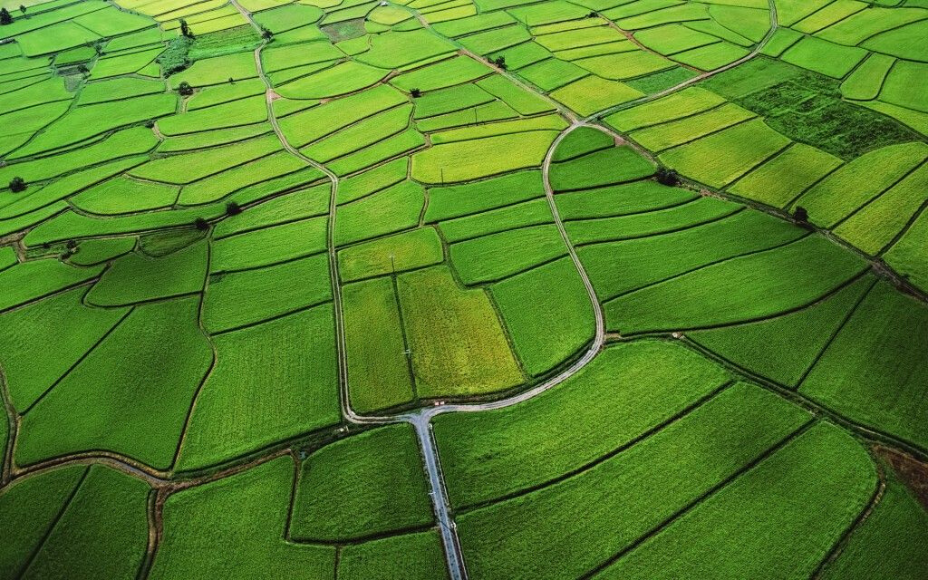
Doryforos
Ministry/Organization name : ISRO
Title : Land Cover Classification, Analysis, Prediction(L-CAP)
Problem Statement : Automated mapping of trees/farms in satellite image
Problem Code : (NM386)
Team Name : Doryforos
Team Leader Name : Rachel Jose
College Code : 1 - 3508330114

Slide 2

Idea
SOLUTION
Land use classification is a resource intensive and expensive process.
Our solution is a supervised learning technique of automating land use classification.We have used a temporal convolutional network (TFCN) based architecture to perform the task based on data obtained from ISRO.
Further building on the provided data we have developed a web-app based solution which can perform crop classification and real-time land-use change detection.Our results are available at:
https://sihaanssr.github.io/isro
Land use classification automation | 2020

Slide 3
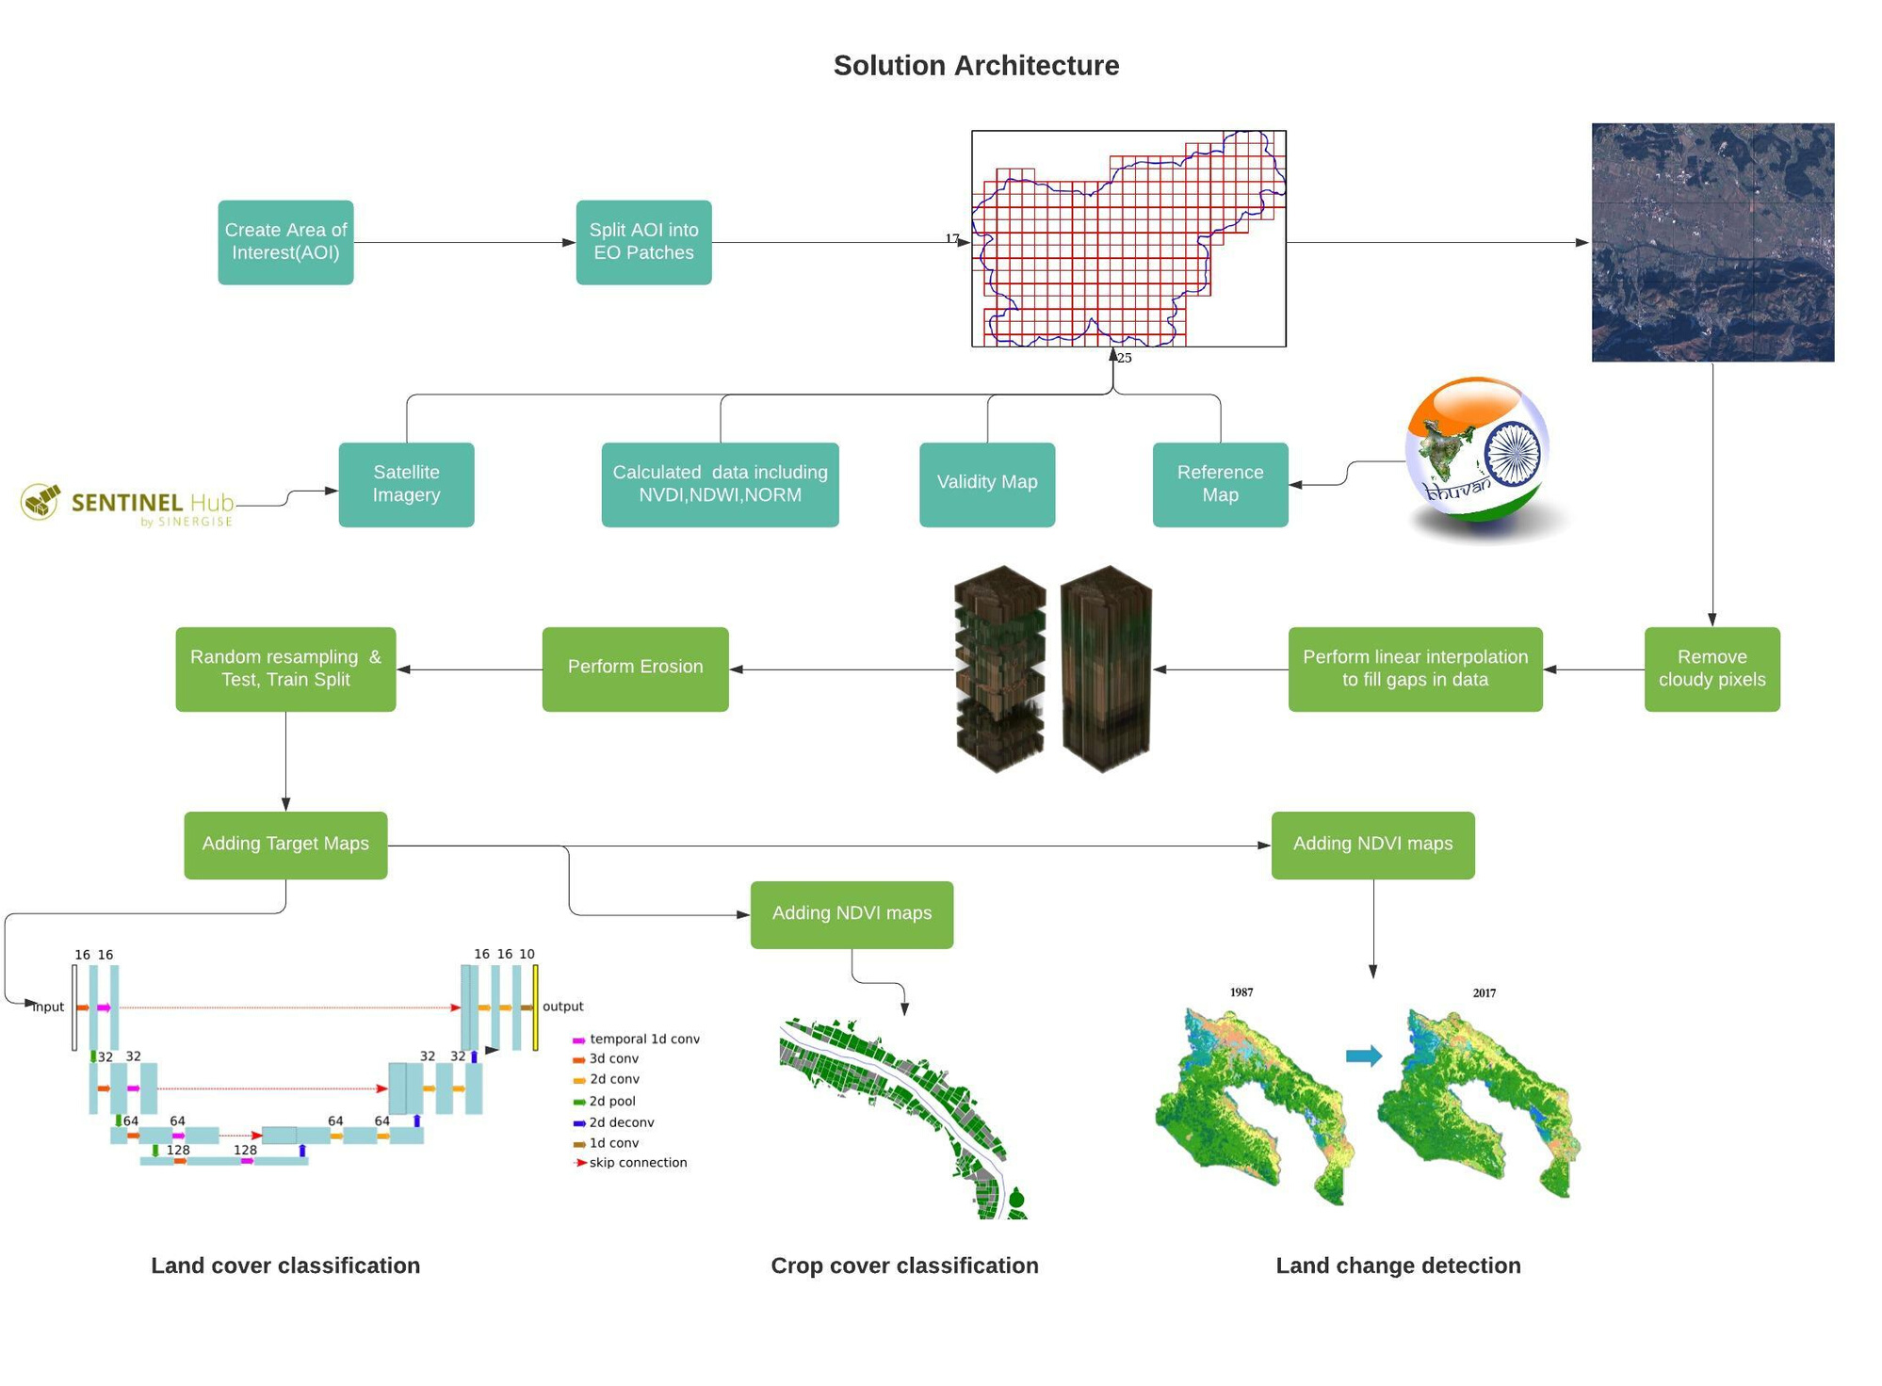

Slide 4
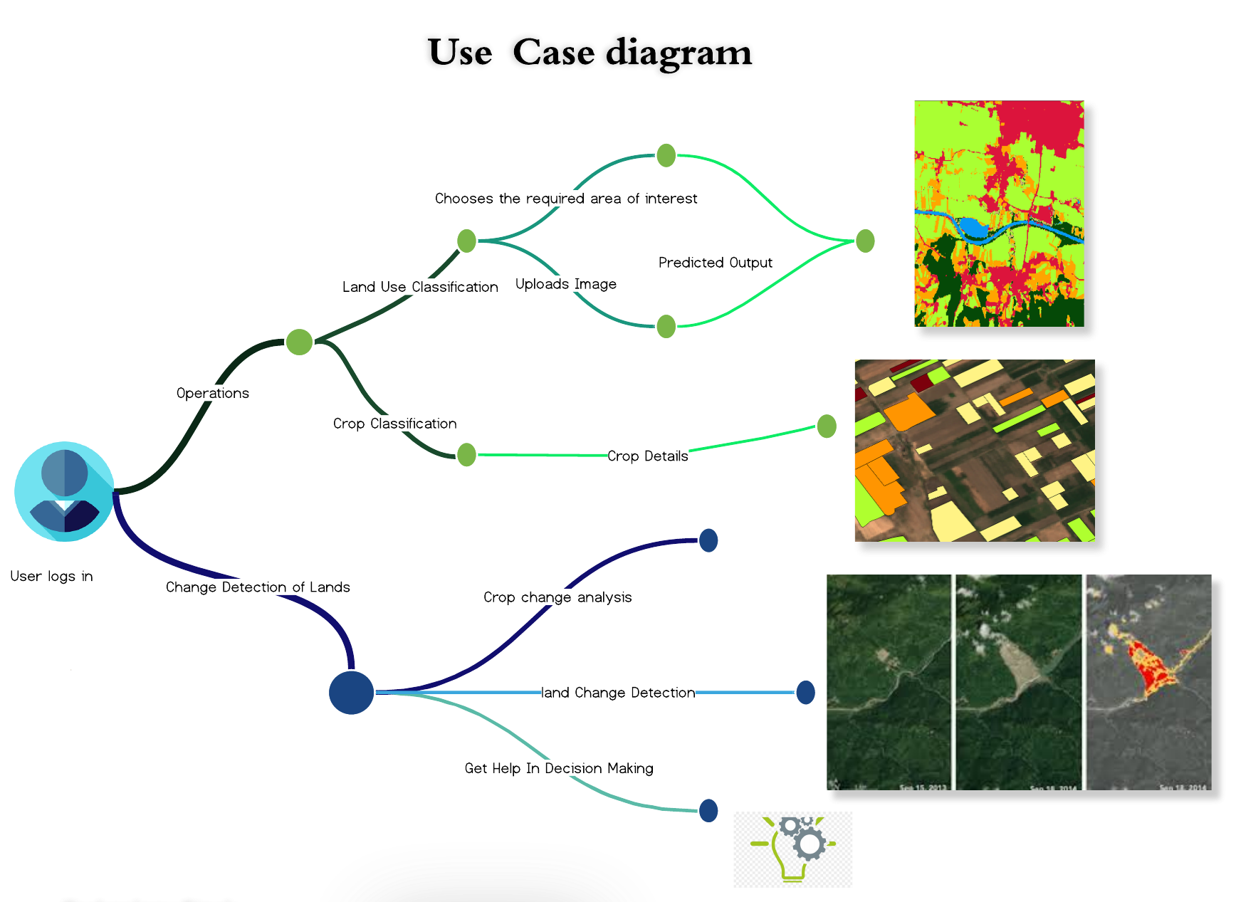

Technology Stack

Slide 5






ASSESSING CHANGES THAT HAVE OCCURED OVER A GEOGRAPHICAL AREA FROM SATELLITE IMAGES
PROPER ANALYSIS OF LAND BEFORE AND AFTER ANY NATURAL / MAN MADE CALAMITY
SHOWSTOPPER
ANALYSIS OF DEFORESTRATION, SHRINKING OF FRESH WATER SOURCES AND COASTAL EXPANSION
HELP IN BETTER POLICY MAKING FOR URBAN AS WELL AS RURAL AREAS
DEVELOPEMENT ANALYSIS OF URBAN GROWTH AND IRRIGATION

