Slide 1
Book Review Semtiment Analysis
Ashutosh Tripathi

Slide 2
Sentiment Analysis : Introduction
Sentiment analysis or opinion mining is a method of extraction of sentiment from textual data. Generally, the sentiment is shown in terms of whether the text is positive , negative or neutral.
Sentiment analysis is important for both business case and for reseach purposes.
For business case, it is important to understand how the customers are reacting to any product or services. By understanding the sentiment , the business can take important decisions such as to improve products / services or to promote if the feedback is positive.
For research, it leads to new findings which can be useful for other areas of NLP.

Slide 3
Contents:
Problem Statement
Dataset
Modelling
Results
Application Transformation

Slide 4
Problem Statement
We are provided with book review dataset. The dataset contains commnets of readers describing how they felt about the book and expressing theres likings and dislikings. User generally provide a title as summary and the reviews.
Business Problem : The stakeholders concerned want to know how people are reacting to the books. Given huge volume of data involved it is very expensive for a human to manually check each review and assign sentiments. We need to develop an automated system which can read the reviews and automatically assign the sentiments.
Solution: We need to develop a Machine Learning solution which can learn from the dataset and able to classify the text into positive , negative and neutral classes.

Slide 5
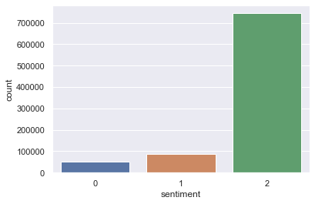
Dataset
The train data has following characteristics:
Total Length : 882380
3 useful columns:
Review : The text review
Summary : A short header or title (text)
Score : A rating between 1 - 5.
The score is then transformed into sentiment with 1 and 2 as negative, 3 as neutral, 4 and 5 as positive. The ration of negative , neutral and positive is roughly 6 : 10 : 84. We see the data is highly unbalanced.
Test data : length 99995, with only review and summary columns.

Slide 6
Modelling
Pre-Processing : There was no pre-processing applied to text in the final version of the model. The main reason being Pre-Sentence Embeddings were used as the base of the model and since these pre-trained models are based on huge corpus of text with no tradional pre-processing. Another reason for not applying any pre-processing was big amount of data. From my experience I have seen pre-processing may be useful when dealing with small data.
Holdout Data: Prior to modelling or any analysis , I seperated out 20% of data as holdout set with stratified spliting.
Two Models : Two different models were built based on the word count in the review.
Less that equal to 250 words : Xlnet transformer model was used with fine tuning.
2. Greater than 250: A Bi-LSTM based method using embedding from Universal Sentence Encoder. The time sequence in the Bi-LSTM were individual sentence embediing instead of words. Apart from LSTM for review , the model parallely uses an ANN with sentence embedding from summary.

Slide 7
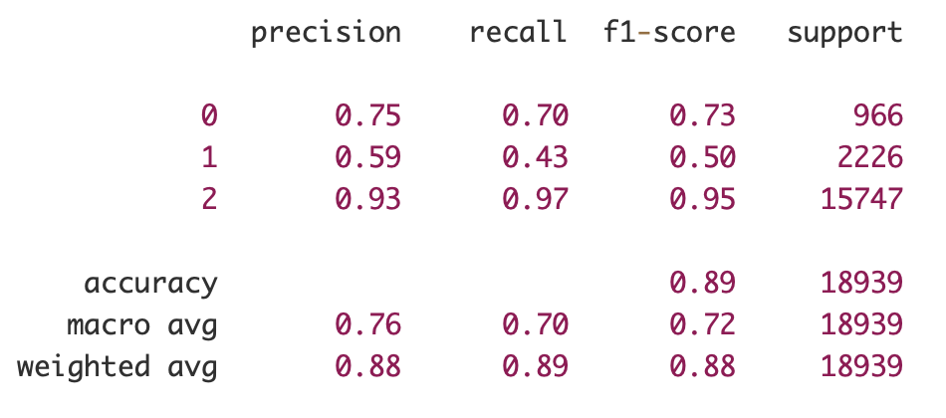
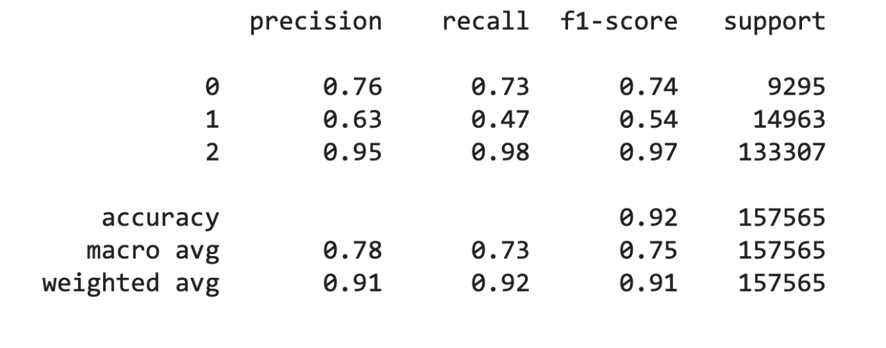
Results and Metrics on Holdout Set
Bi-LSTM / Universal Sentence Encoder based model for word count > 250.
Accuracy is 89 %.
Macro precision, recall and F1 are 76,70 and 72 respectively.
Weighted precision, recall and F1 are 88,89 and 88 respectively.
XLNET Based model for word count <= 250.
Accuracy is 92 %.
Macro precision, recall and F1 are 78,73 and 75 respectively.
Weighted precision, recall and F1 are 91,92 and 91 respectively.

Slide 8
Application and Production
The whole sentiment module is futher transformed as two-way appliation:
Rest Service : Using Flask as backend , the model offers Sentiment as a Service using web API calls.
Bulk File Processing : The application can be used to find sentiment of bulk text by uploading files in CSV format.
The whole application is further wrapped inside a DOCKER Solution which can be easily ported from one system to another or in a cloud native environment.

