Slide 1

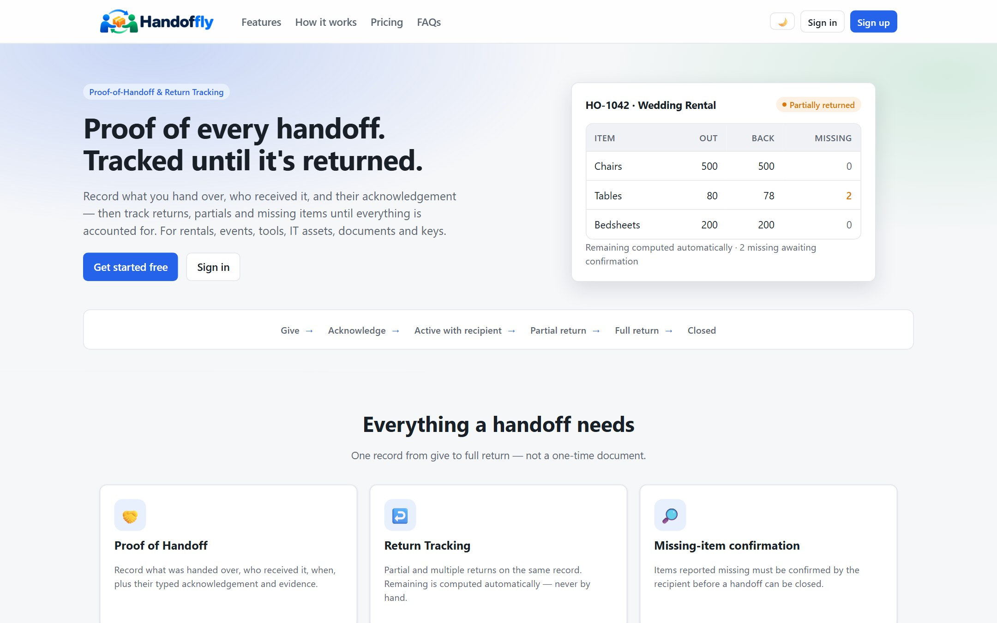
Proof of every handoff.
Tracked until it’s returned.
Universal proof-of-handoff and return tracking for rentals, events, tools, IT assets, documents and keys.
Product overview for clients
Notes:
Welcome. HandOffly keeps one record for everything you hand to someone, from the moment you give it to the moment it is fully returned. In the next half hour I will show the problem, how it works, what it does for your business, and the plans. The picture on the right is the real product, not a mock-up.

Slide 2




Handoffs fail at the same four points
No proof
No confirmation
The list lives on paper or in a chat, and anyone can edit it later.
The recipient never confirms they accepted this exact list.
History is overwritten
Missing items are argued
Items come back in parts and the original quantity is lost.
Nobody can say what is still outstanding, so it is settled by memory.
Notes:
Most handoffs are recorded in a notebook, a chat thread or a spreadsheet. That works until something goes wrong. These are the four places it breaks: there is no proof of what was given, the recipient never confirmed it, returns in parts overwrite the original numbers, and missing items get argued about later. HandOffly is designed around exactly these four points.

Slide 3


A record of every handoff, not an inventory
HandOffly is
HandOffly is not
One living record for each handoff
A stock or warehouse system
A typed acknowledgement from the recipient
A one-time document that is signed and forgotten
Partial and multiple returns on the same record
Built for one industry only
An audit trail that is never edited
An accounting or billing system
Notes:
It is important to say what this is not. It is not an inventory or warehouse system. It does not tell you how much stock you hold. It answers three questions for every handoff: what did we give, did the recipient acknowledge it, and what is still outstanding. One engine serves every industry; only the category you type changes.

Slide 4

One record, from Give to Closed
1
2
3
4
5
6
Give
Acknowledge
Active with recipient
Partial returns
Full return
Closed
Add items and the recipient, then send a secure link.
The recipient accepts with a typed acknowledgement.
Items are out. Due dates and overdue are tracked.
Record each return as items come back.
Nothing remains. Missing items are confirmed.
The record becomes read-only.
Exceptions stay on the record too: declined by the recipient, cancelled, disputed or overdue.
Notes:
Every handoff follows the same path whatever is being handed over. You create it, you give it with a secure link, the recipient acknowledges, the items are out with them, returns are recorded in as many parts as needed, and when everything is accounted for the record is closed and becomes read-only. Exceptions such as declined, cancelled, disputed and overdue are recorded too.

Slide 5
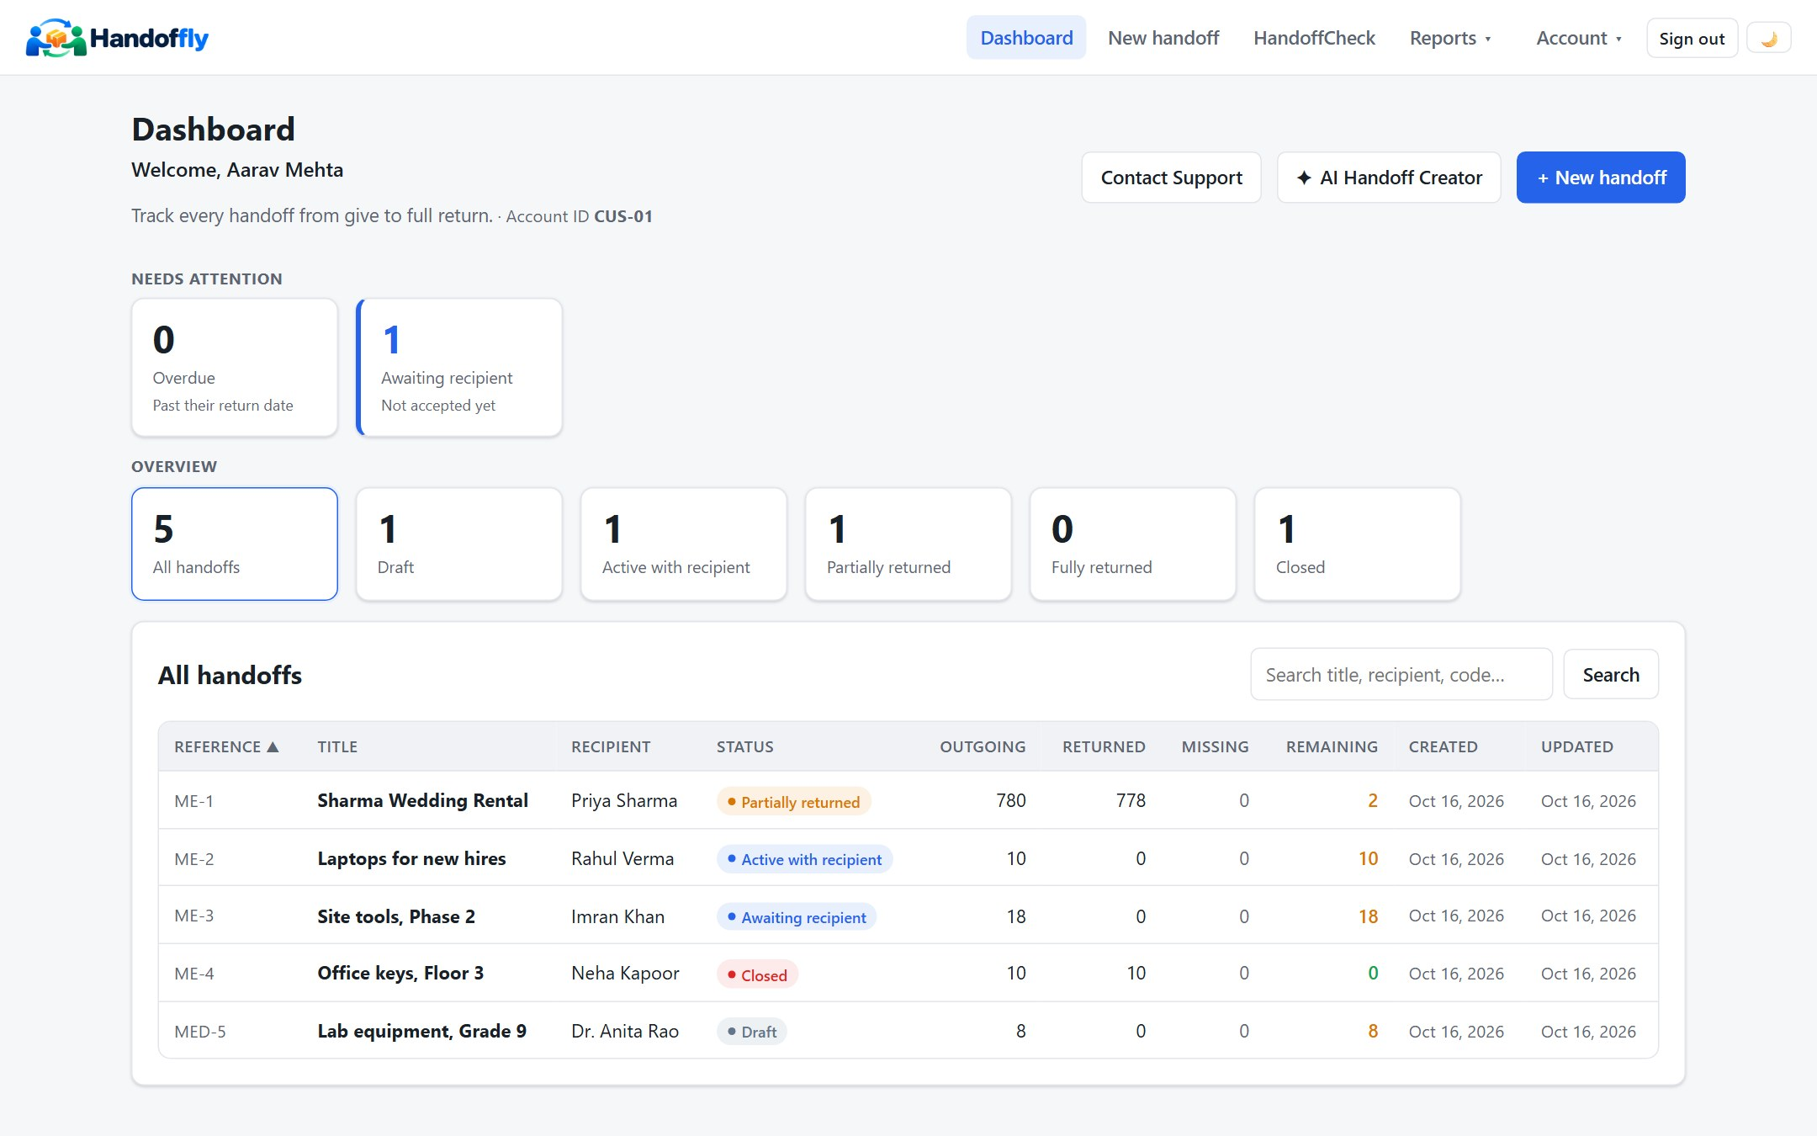



Your whole operation on one screen
Needs attention
Overdue handoffs and unanswered ones come first.
Status at a glance
Draft, active, partly returned, closed. One click filters the list.
Always calculated
Given, returned, missing and remaining for every handoff.
Notes:
This is the real dashboard with sample data. At the top, what needs attention: overdue handoffs and ones the recipient has not answered yet. Below, every handoff with its reference, recipient, status and the quantities given, returned, missing and remaining. The remaining number is always calculated by the system, never typed by hand.

Slide 6
Partial returns, remaining calculated for you
780
Sharma Wedding Rental
Example
Chairs
500 of 500
Given
778
Tables
78 of 80
2 still to come back
Returned
Bedsheets
200 of 200
2
The original quantities never change. Every return is its own entry on the same handoff.
Remaining
Notes:
This is the core idea. Five hundred chairs went out and five hundred came back. Eighty tables went out and seventy-eight came back, so two are still outstanding. Bedsheets all came back. The system shows the remaining count automatically. The outgoing quantities are never overwritten, and every return is a separate entry on the same handoff, so the history is always intact. A missing item must be confirmed by the recipient before the handoff can close.

Slide 7
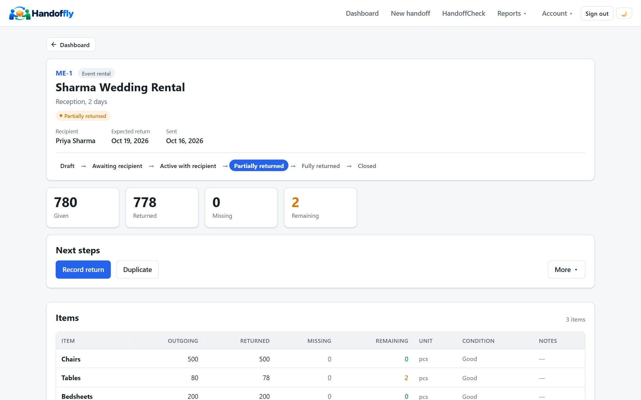



Every handoff shows exactly where it stands
Lifecycle strip
The current stage is highlighted, with the path ahead.
Totals that add up
Given, returned, missing and remaining at the top.
Next steps offered
Record return, duplicate, and more, only when they apply.
Notes:
Opening a handoff shows its reference, the recipient, the expected return date and a lifecycle strip with the current stage highlighted. The totals sit right under it. Only the actions that make sense at this stage are offered, for example record a return, or duplicate this handoff for the next job.

Slide 8
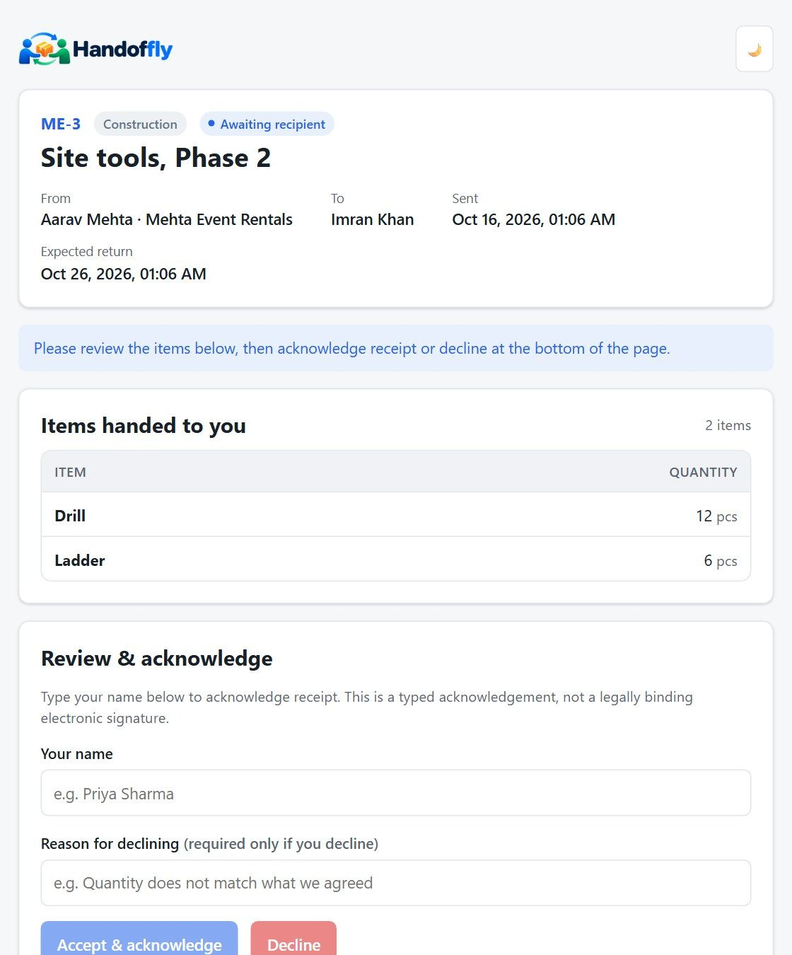



The recipient needs nothing but a link
You send a secure link
It opens exactly one handoff, needs no account and expires.
They review the items
The list, quantities and dates are shown before they respond.
They accept or decline
Accepting records their typed name and the time.
A typed acknowledgement records their confirmation. It is not a legally binding e-signature.
Notes:
This is what your customer or colleague sees. There is nothing to install and no account to create. They open the link from the email, check the items, and either accept by typing their name or decline with a reason. The link opens only this one handoff and it expires. We are careful with wording: the typed name is an acknowledgement of the items, a record of their confirmation, not a legally binding electronic signature.

Slide 9






Built for anything given out and expected back
Event and tent-house rental
Construction and tools
IT and office assets
Chairs, tables, linen, decor
Drills, ladders, safety gear
Laptops, phones, accessories
Schools and institutions
Keys and access items
Repair and service shops
Books, lab equipment, devices
Keys, cards, remotes
Customer items, spare parts
Notes:
The same engine serves every industry. A tent house hands out chairs and tables by the hundred. A construction firm hands out tools to crews. An IT team hands out laptops with serial numbers. Schools, offices, key holders and repair shops all follow the same pattern: something goes out, someone acknowledges it, and it needs to come back. Documents work the same way. There is no per-industry setup, only a free-text category.

Slide 10





Everything a handoff needs
Proof of handoff
Secure recipient link
Partial and multiple returns
Items, quantities, recipient, time and acknowledgement in one record.
One handoff per link, no account needed, and it expires.
Any number of returns on the same handoff.
Missing-item confirmation
Attachments and evidence
Audit trail
A missing item is confirmed before the handoff can close.
Photos and files stored with the handoff and checked on upload.
Every event is recorded and never edited.
Also included: PDF and email, duplicate a handoff, import items from CSV or Excel, your own reference numbers, due dates and overdue tracking.
Notes:
These capabilities are on every plan. Proof of handoff, the secure link, partial returns, missing-item confirmation, evidence and the audit trail. On top of that you can download or email a PDF, duplicate an earlier handoff, import items from a CSV or Excel file, get references with your own prefix, and see due dates and overdue handoffs.

Slide 11
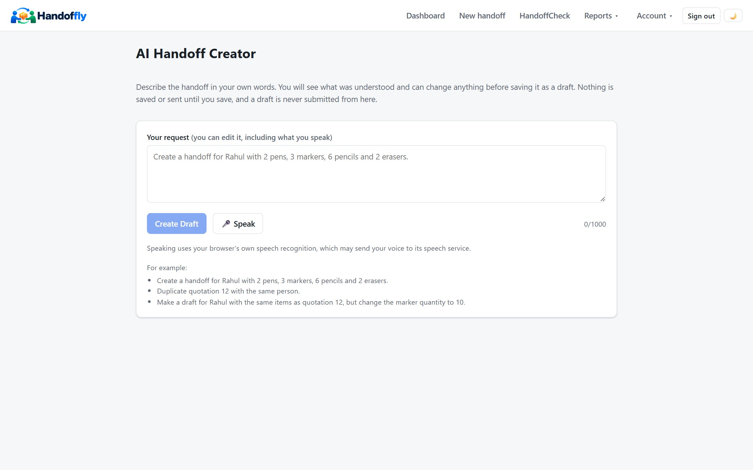



Describe it, review it, save the draft
Say it or type it
Speak or type the request in your own words.
Review what was understood
See the draft before anything is saved.
Change anything
Edit items, quantities and the recipient.
Save the draft
You submit it yourself. It is never sent for you.
“Create a handoff for Rahul with 2 pens and 3 markers.”
On every plan. The core workflow never needs AI.
Notes:
Typing a handoff takes time, so there is an optional assistant. You describe the handoff in your own words, typed or spoken. It shows you what it understood, you can change anything, and then you save it as a draft. It only ever prepares a draft: nothing is sent to anyone until you submit it yourself. It is available on every plan, and the core workflow never depends on AI.

Slide 12





HandoffCheck finds the differences for you
File A
File B
Reads the files you already have
Quotation
Purchase order
CSV, Excel and PDF, including HandOffly’s own PDFs.
Highlights every difference
HandoffCheck compares them line by line
Mismatched quantities and items that appear in only one file.
Item | File A | File B | Result
Chairs | 500 | 500 | Match
Tables | 80 | 78 | Difference
Lamps | 40 | — | Only in A
Optional AI help
Suggests which columns hold the item and the quantity.
Included in the Half-yearly and Yearly plans.
Example
Notes:
HandoffCheck is a separate tool for a common problem: two documents that should match but do not. You upload, for example, a quotation and a purchase order, or what you gave and what came back. It reads CSV, Excel and PDF files and highlights every difference: quantities that do not match and items that appear in only one file. An optional AI helper can suggest which columns hold the item and the quantity. HandoffCheck is included in the Half-yearly and Yearly plans. The table shown is an example.

Slide 13
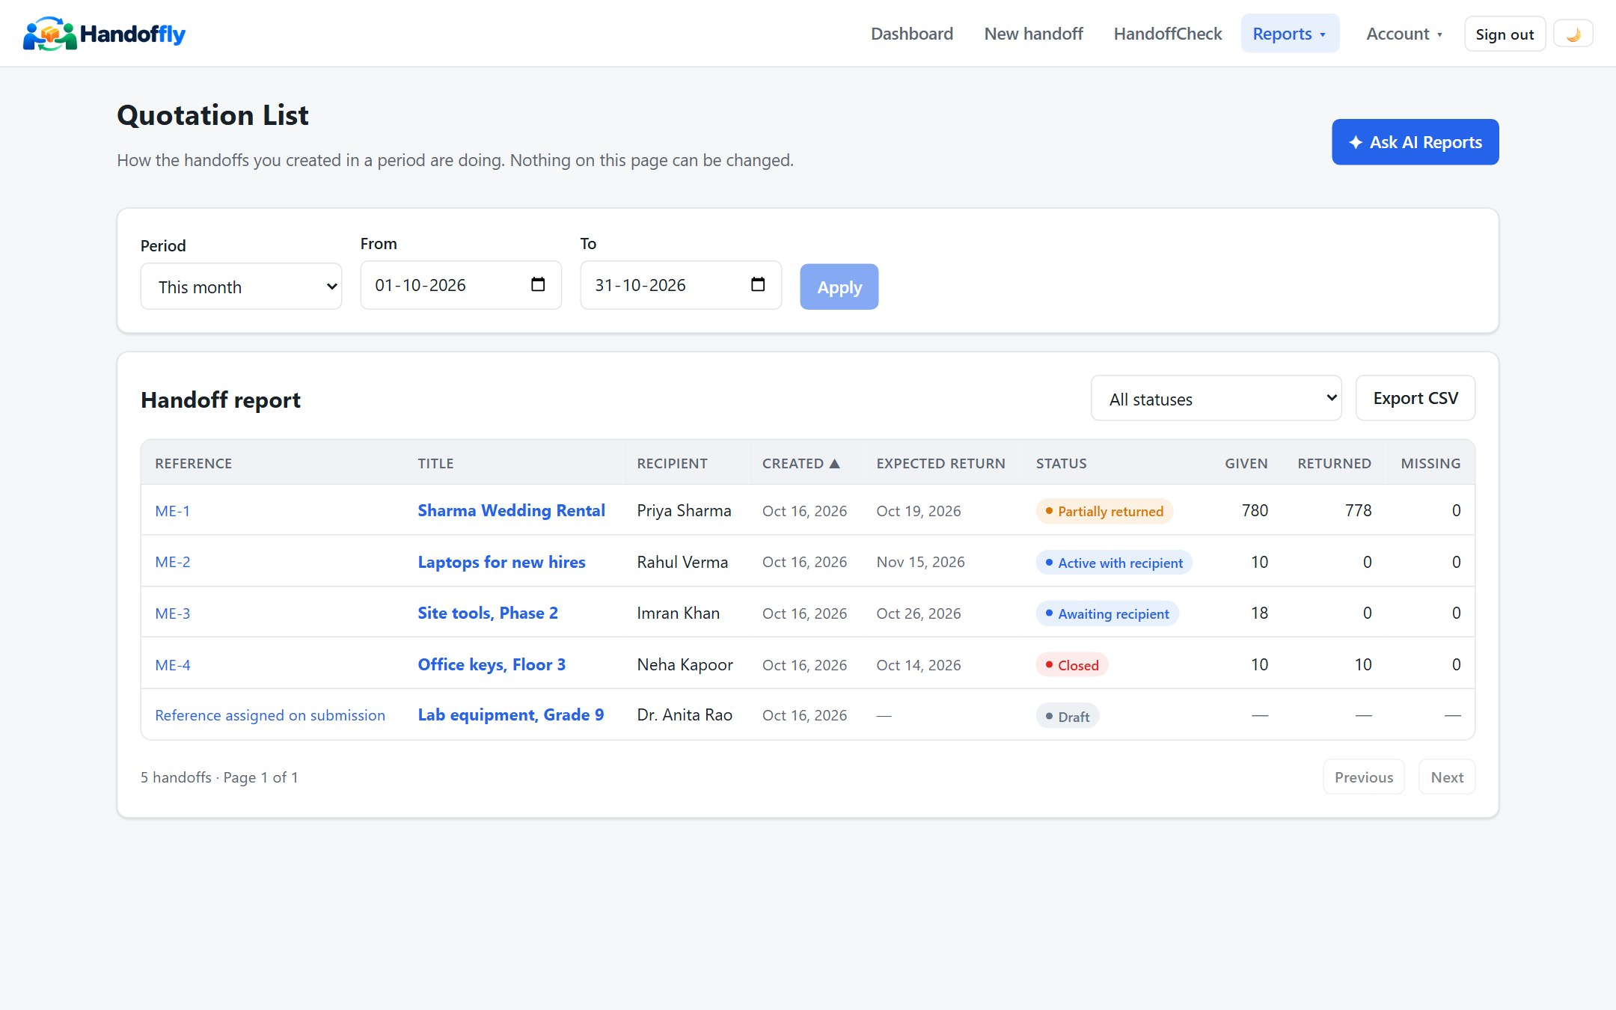

Know what is outstanding without asking
Five optional email reminders
Return Reminder
Due back in the next 2 days
Overdue Reminder
Past their return date
Missing Item Reminder
Items still marked missing
Recipient Response Reminder
Sent, but not answered after a day
Weekly Summary
Reports: every handoff for a period, with filters, sorting and export. Ask questions in plain language on Half-yearly and Yearly.
The last 7 days at a glance
You choose the schedule and timezone. Each run is kept in a history.
Notes:
Reports lists the handoffs created in any period with how many were given, returned and missing, and it can be exported. On Half-yearly and Yearly you can also ask questions in plain language and the answer is calculated from your own data. Five optional reminder emails watch for you: what is due back soon, what is overdue, what still has missing items, what the recipient has not answered, and a weekly summary. You choose the schedule, and every run is kept in a history.

Slide 14



Evidence you can trust
Protected accounts
Handoff records are evidence
Passwords are stored hashed and sign-in attempts are rate limited.
Automatic sign-out
Sessions end after 15 minutes of inactivity, in the app and on the server.
So history is preserved and access is tight.
Single-handoff links
Recipient links are random, stored hashed, expire and open one handoff.
History preserved
A typed acknowledgement is a record of confirmation, not a legally binding e-signature.
Returns are separate entries and events are never edited. Closed is read-only.
Isolated and validated
Customers see only their own records. Uploads are checked on arrival.
Notes:
Handoff records are evidence, so they are protected and their history is kept intact. Passwords are stored hashed and sign-in attempts are rate limited. A session ends automatically after 15 minutes of inactivity, both in the app and on the server. Recipient links are random, stored hashed, expire, and open one handoff only. Returns are separate entries, events are never edited, and a closed handoff is read-only. Customers can only see their own records, and uploads are checked on arrival. Again, the typed acknowledgement is a record of confirmation and not presented as a legally binding signature.

Slide 15




One system, every device and role
Customer web app
Mobile web app
Support portal
Recipient page
Handoffs, returns, HandoffCheck, Reports, reminders, account and plans.
Installable on a phone. Create handoffs, record returns and view reports in the field.
For HandOffly staff: tickets, customers, plans and an audit log, by role.
A secure link to review, accept or decline. Nothing to install.
One backend and one set of business rules sit behind all of them, so every screen shows the same data.
Notes:
There are four ways in. The customer web app is the main workspace. The mobile web app can be installed on a phone for work in the field. The support portal is for HandOffly staff, with roles for administrators, managers and ticket agents. And the recipient page needs nothing installed. One backend and one set of rules sit behind all of them.

Slide 16
Simple pricing, core features on every plan
Best value
Monthly
Quarterly
Half-yearly
Yearly
₹199
₹549
₹999
₹1,999
per month
per 3 months · about ₹183 a month
per 6 months · about ₹167 a month
per year · about ₹167 a month
Unlimited handoffs and returns
AI Handoff Creator
Email support via the contact page
Unlimited handoffs and returns
AI Handoff Creator
Contact Support in the app
Everything in Quarterly
HandoffCheck comparison
AI Report Assistant
Tickets and priority support
Everything in Half-yearly
Direct phone support
Highest-priority support
Every plan includes unlimited handoffs, returns and missing-item tracking, and attachments. Upgrade any time by paying only the difference.
Notes:
Prices are in Indian rupees. All four plans include the full core product: unlimited handoffs, returns and missing-item tracking, attachments and evidence, and the AI Handoff Creator. Longer plans cost less per month and add tools and support. HandoffCheck and the AI Report Assistant come with Half-yearly and Yearly. Quarterly adds in-app contact support, Half-yearly adds tickets and priority handling, and Yearly adds a direct phone line and the highest priority. A customer on Monthly or Quarterly can upgrade to a longer plan by paying only the difference in list price.

Slide 17




What changes for your business
Fewer disputes
Less lost property
The recipient accepted a specific list, and every return is on the same record.
Outstanding and missing items are visible per handoff and in Reports.
Faster handoffs
Less chasing
AI-assisted drafts, duplicate and import replace retyping.
Scheduled reminders for due, overdue, missing and unanswered handoffs.
Works for any business
A record that holds up
One engine and free-text categories, with no per-industry setup.
Preserved history, an audit trail and a read-only closed state.
Notes:
Putting it together. Fewer disputes because the recipient accepted a specific list at a specific time. Less lost property because outstanding items are visible. Faster handoffs because drafts can be created from a sentence, duplicated or imported. Less chasing because reminders go out on a schedule. It works for any business without per-industry setup, and the record holds up because its history is preserved.

Slide 18
Start with your next handoff
1
2
3
Choose a plan and sign up
Create your first handoff
Record returns and close
Pick the plan that fits and create your account.
By hand, or by describing it to the AI Handoff Creator.
Add returns as items come back, and close when all is accounted for.
Questions?
Notes:
Getting started takes three steps: choose a plan and sign up, create your first handoff by hand or with the AI Handoff Creator, then record returns and close it when everything is accounted for. I am happy to take questions, and to walk through a live demo with your own items.

