Slide 1
Auto Management Intersection System
Team Protocol Pros

Slide 2
AGENDA
Introduction​
​Project Plan
​Summary
Sofware Requirement
Design of the Project
Timeline
Code Example​
Solution
Total Slide: 15 slides
Estimate Time: 20 minutes

Slide 3
Meet our Team Members
Names | Roles
Ashutosh Mishra | Project Manager and Developer
Prakash Acharya | Technical Manager and Tester
Brendan Edgerley | Team Leader and Designer
Julian Villarreal | Researcher and Designer
Sarah Ryan | Technical Manager and Tester
Amado Lazo | Researcher and Project Manager
David Schelanko | Research and Developer

Slide 4
Introduction
SOLUTION
Problems
- Intersections are time-consuming.
- They are vulnerable to accidents.
- Huge potential to save time while considering security.
implementing the 'protocol and network architecture' for an ambiently intelligent, responsive, and sensible autonomous intersection management system

Slide 5
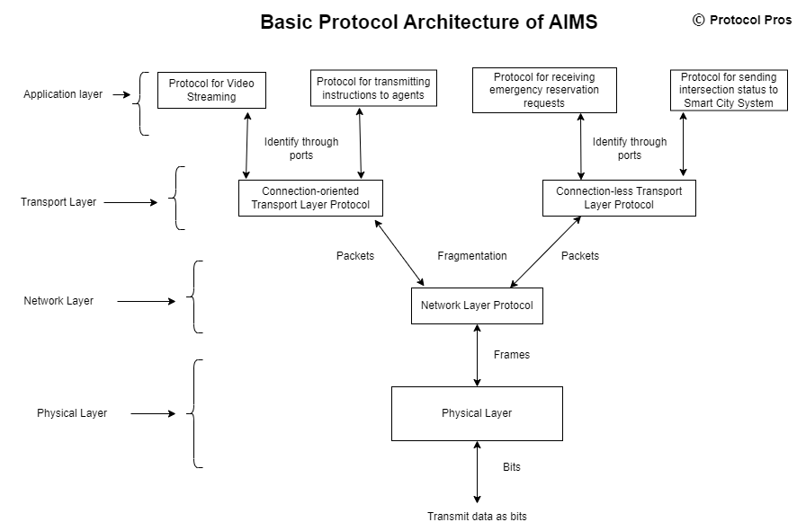
Solution
5

Slide 6
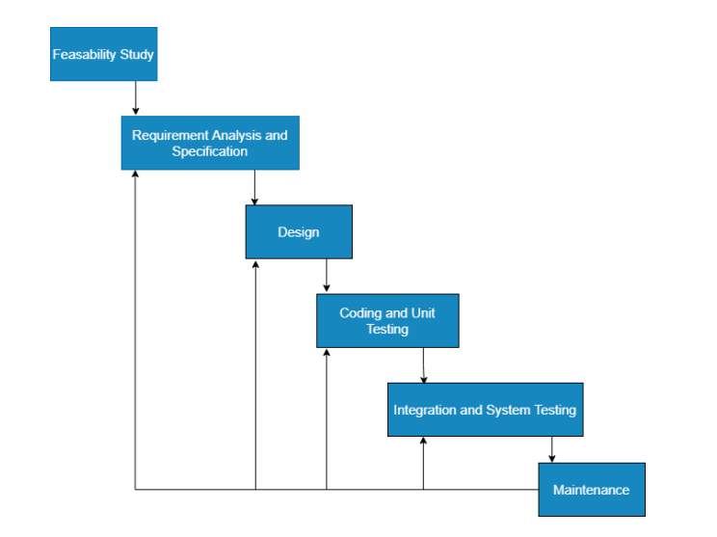
Project plan: Model
The iterative waterfall model was the optimal option for this structure of the project.
This model seems to be the most pertinent and effective to get the system developed.

Slide 7
TIMELINE
Aug 2022
SEP 2022
Oct 2022
Nov 2022
Dec 2022
Create a Group
Feasibility studies and Research
Requirement Analysis
Design
Coding and Unit Testing
Integration and System testing
Maintenace
Complete Application and turn in all document

Slide 8






Project plan: Phases
Feasibility Study
Requirement analysis and Specifications
design
Coding and Unit testing
Integration and system Testing
Analyzing which features are viable to implement.
Figure out requirements of the problem statement through overall analysis of the domain.
Figure out proper design methodologies of implementing the solution based on requirements.
Code and perform unit testing in the local environment.
Perform testing against each of the available test cases
Maintenance:
List out relevant test cases for the entire system. - Perform testing against each of the test cases available

Slide 9





Project Plan: Tasks
Task 1:
Task 2:
Task 3:
Task 4:
Task 5:
Setting up Video Streaming Protocols
Setting up UDP based protocols
Integrate [re-trained OCR model
Define the Hash Function for SHA-2 within HMAC authentication for Intersection-to-agent communication
Setting up HMAC authentication
Setting up connection-oriented protocol
Setting up SHA-2 logic for transmitting intersection status from AIMS to Smart City system
Setting up Protocol for intercommunication between AIMS and Smart City System
Develop algorithm for prioritizing emergency vehicles

Slide 10



Project Requirement
Functional requirements
Non-Functional requirements
Domain requirements
Receive the video stream from intersections, through the defined protocol.
Identify agents from the video, categorize the identified agents and analyze their behavior.
Setup priority policy of agents prior to the intersection operation.
Hardware Requirements:
RAM : 4GB (minimum) - Processor : Intel Core i5 (or equivalent, or above)
Hard Disk : 50GB (in the main server) - OS : Windows 10 (or equivalent, or above)
High-speed internet : 100mbps (including high-quality video streaming requirement) across single intersection for one video recording device
Ability to record video of the provided intersection.
A clear license plate on every vehicle passing through the intersection.
Roads having clear lane-division, proper sign in roads for vehicles passing through the intersection.
Ability to send instructions to every agent through cloud, with optimal latency such that the vehicles can pass exactly the same way as in the simulation.

Slide 11
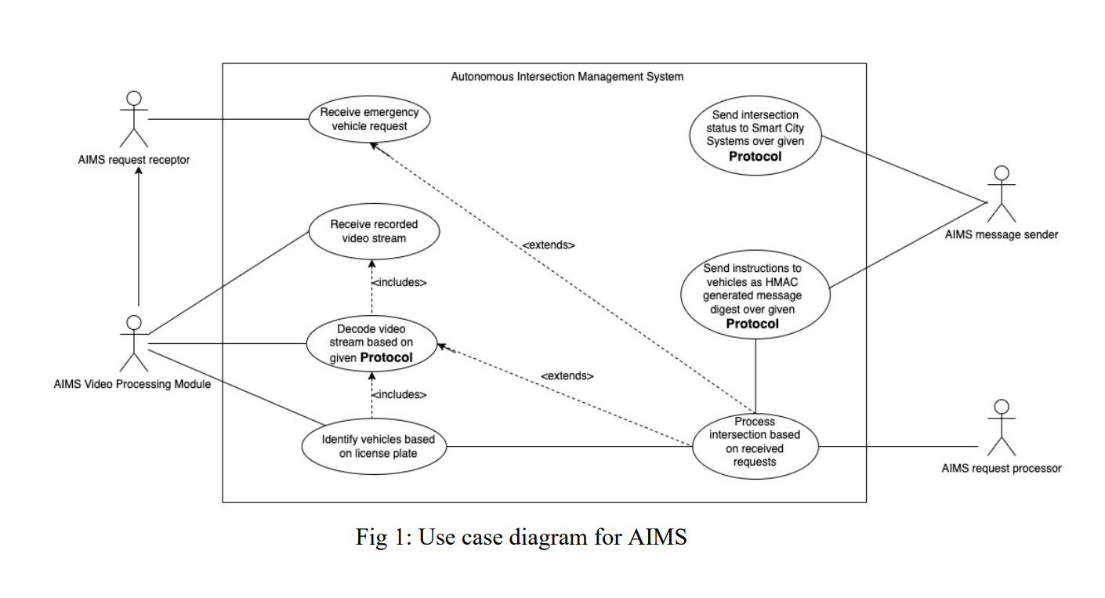
Design & Diagram
The Use Case diagram is shown below. This diagram serves to represent the interaction of entities within AIMS and the different use cases.

Slide 12
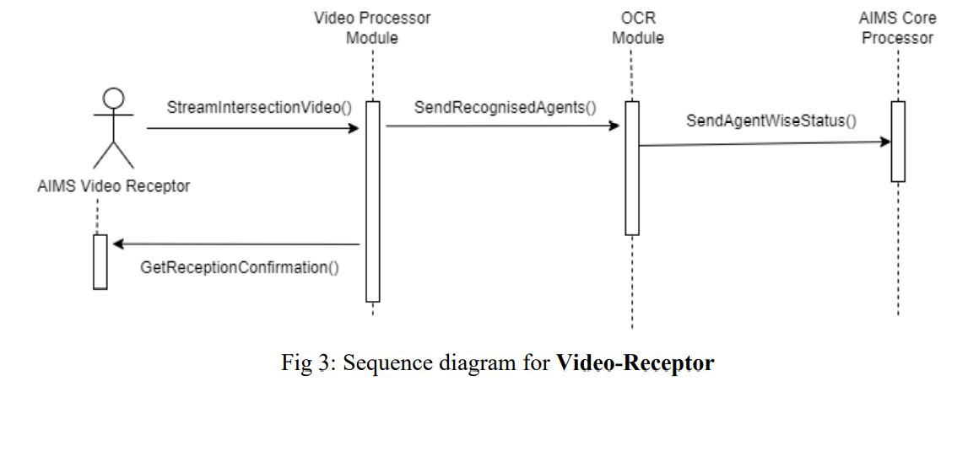
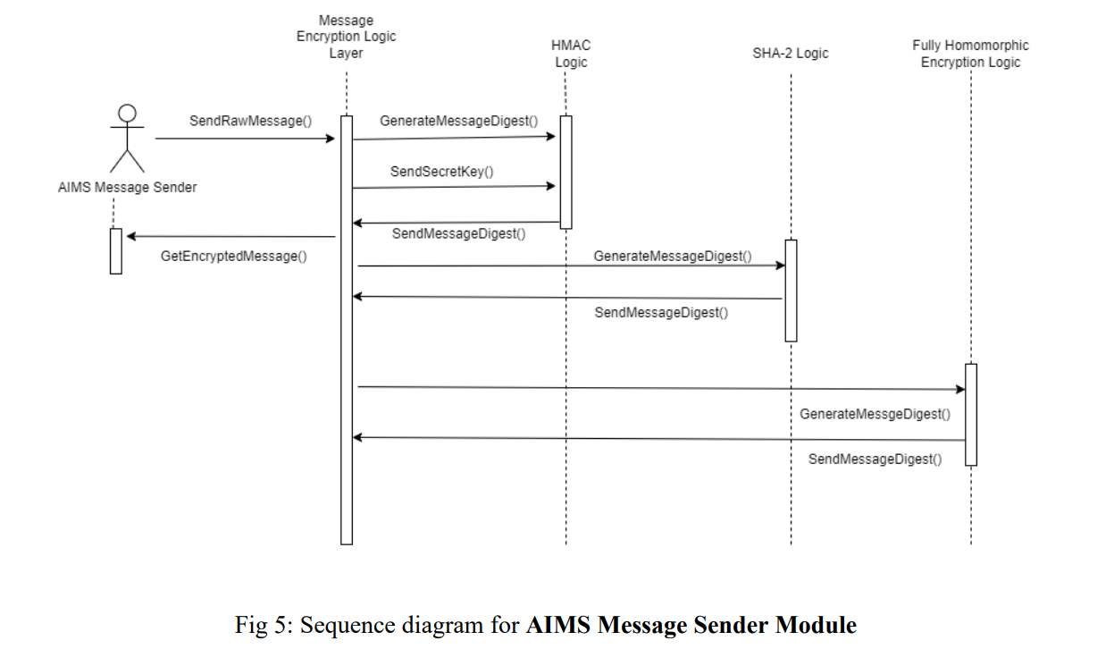
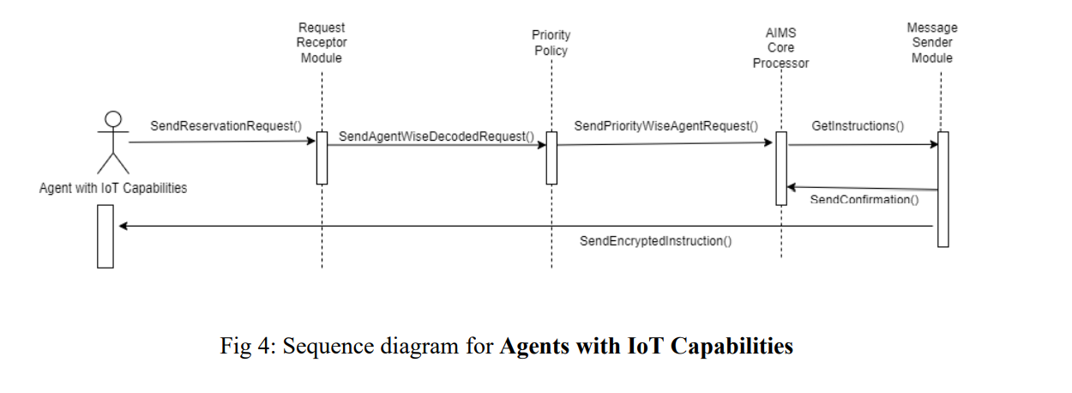
Design & Diagram
Tentative Sequence Diagrams covering 3 major modules of the AIMS system.

Slide 13
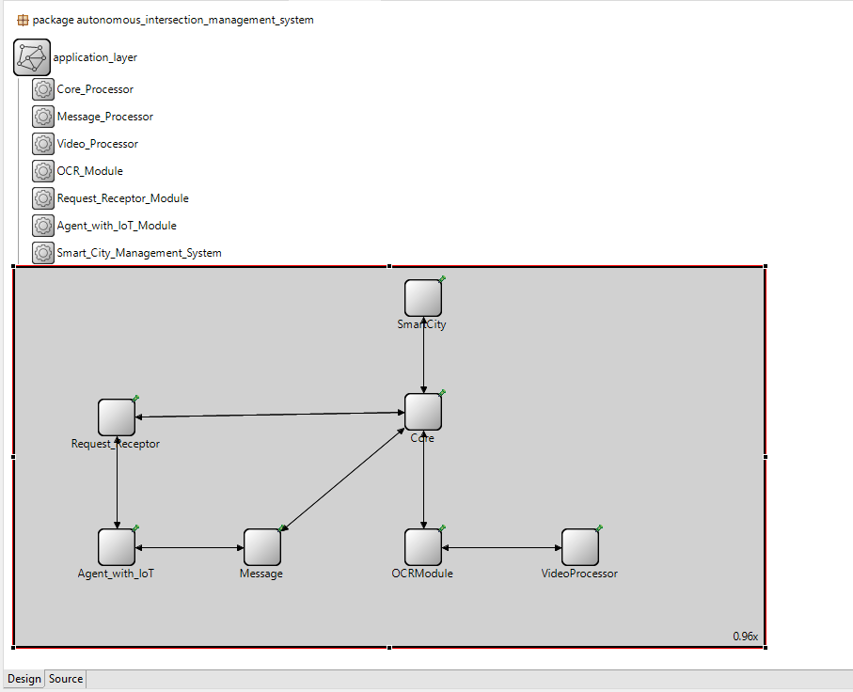
Implementation:
Structure of Nodes
with connectivity

Slide 14
SUMMARY
The main purpose of this project is to comprehend the possibilities of an intersection, and accordingly analyze, research, develop and execute a networking protocol for autonomous intersection management system.
This networking protocol will involve transmission of signals and critical information between entities involved in the system and enable assistance to the agents for deciding their trajectory based on the road conditions.

Slide 15
THANK YOU
Any Question or Feedback??

