Slide 1
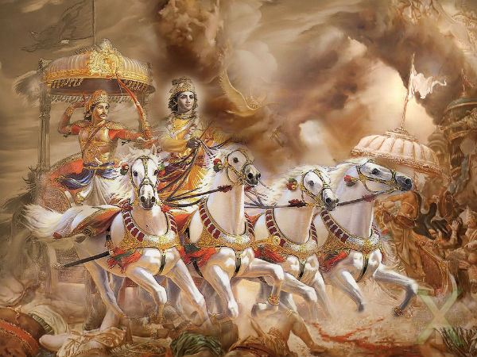

Information Retrieval System On Semantic Meaning Of Bhagavad Gita
Project Submitted By
Abhishek Sahu (21111002)
Alok Trivedi (21111008)
Ashutosh More (21111017)
Shivam Kharwar (21111058)
Tanikella Sai Kiran (21111061)

Slide 2
Motivation And Problem Statement
Bhagavad Gita is considered the quintessence of the philosophy of life.
This invaluable treasure of knowledge is limited to those who can understand its complex language and deep essence.
Our Goal is to design a Multi-lingual Information Retrieval System which can understand the query of user i.e. semantics and provide with an appropriate solution from the Bhagavat Gita.

Slide 3
Data Collection
The data is scraped from various popular Gita web pages by web scrapping
Then the data is stored in a python dictionary
The Key to the dictionary is the “shloka” and value is its corresponding “commentary”
These Files still have some inconsistencies like missing commentaries, duplicate commentaries
URL for the web-scrapping
Hindi: https://www.holy-bhagavad-gita.org/index/hi
English: https://vedabase.io/en/library/bg/
Odia: https://www.holy-bhagavad-gita.org/index/or
Telugu: https://www.holy-bhagavad-gita.org/index/te

Slide 4
Basic Models
For this task we have used
Boolean Retrieval System
Tf-Idf System
BM25 System
We have performed some Preprocessing task on them
Cleaning
Tokenization
Stopwords removal
Construction Of Posting List
Construction Of Term Frequency List

Slide 5
Basic Models
Boolean Retrieval System
Given a query, we will do basic preprocessing and we will find the score from Boolean incidence matrix.
TF-IDF
Here we will get the score using cosine similarity between query vector and document vector
BM25
We have calculated the score using BM25 formula and selected high score values

Slide 6
Latent Semantic Analysis
Trained LSI model using 30 topics.
01
Preprocessing Of Text
02
Computing Document-Term Matrix
03
Training using SVD
04
Given a query Q, we embed it into vector
05
Using Cosine Similarity, we find the similarity score
06

Slide 7
Machine Learning Embedding Models
Word2Vec – CBow
Word2Vec – SkipGram
Glove
FastText

Slide 8
Sentence Embedding
To find sentence embedding, we have used the following strategy
Tokenize a sentence into words
For each word get the embedding
Find mean of all the embeddings of words present in the sentence

Slide 9
Passage Embedding
MAX POOLING
MEAN POOLING
LINE BY LINE POOLING
WHOLE POOLING

Slide 10
Common Preprocessing
Download the pre-trained embeddings for different models
Basic Preprocessing on the commentaries
Computation Of Max Pooling Matrix
Computation Of Mean Pooling Matrix
Computation Of Line-by-Line 3d Matrix
Computation Of Whole Pooling Matrix
Pickle Them.
NOTE: We have used trained Word2Vec (Skipgram and CBow) on Bhagavad Gita Dataset

Slide 11
Implementation
Given a query Q, we have to do basic preprocessing and find its embedding
Different Strategy have used for retrieval
Max Pooling with Cosine Similarity and Euclidean Distance
Mean Pooling with Cosine Similarity and Euclidean Distance
Line-by-Line Pooling with Cosine Similarity and Euclidean Distance
Whole Pooling with Cosine Similarity and Euclidean Distance
KMeans Clustering with Max Matrix, Mean Matrix and Whole Pooling Matrix

Slide 12
Sentence BERT
Used Sentence Bert transformer which is trained on 100 languages including Hindi and English
Preprocessing
Cleaning Commentaries
Construction Of Max Pooling Matrix
Construction Of Mean Pooling Matrix
Construction Of Line-by-Line Pooling 3D Matrix
Construction Of Whole Pooling Matrix

Slide 13
Sentence BERT
Given a query Q either in Hindi or English, we have to do basic preprocessing and find its sentence embedding.
Different Strategy have used for retrieval
Max Pooling with Cosine Similarity and Euclidean Distance
Mean Pooling with Cosine Similarity and Euclidean Distance
Line-by-Line Pooling with Cosine Similarity and Euclidean Distance
Whole Pooling with Cosine Similarity and Euclidean Distance
KMeans Clustering with Max Matrix, Mean Matrix and Whole Pooling Matrix

Slide 14
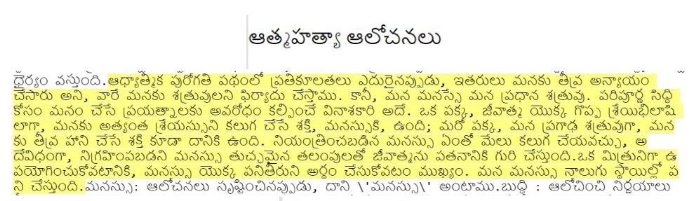
Outputs

Slide 15
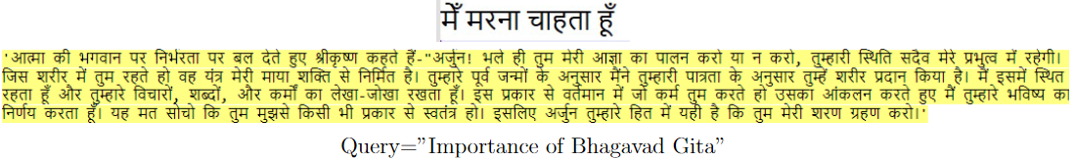
Outputs

Slide 16
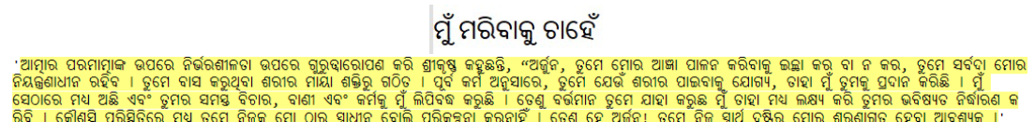
Outputs

Slide 17
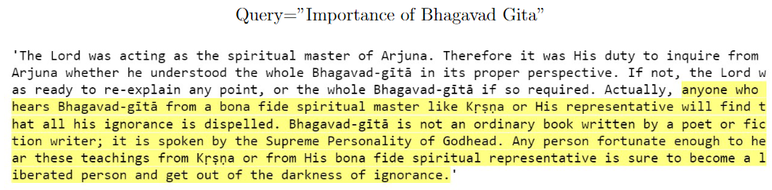
Outputs

Slide 18
Evaluation
Created Ground-Truth values for a set of 30 Queries
Each Query contains related chapter number and verse number pairs
Around 10 outputs for each query
We have found the Ground-Truth values by verifying outputs of different model
Evaluation Metrics: Mean Average Precision (mAP)

Slide 19
Findings
Boolean Retrieval System and TF-IDF are good models for exact keyword searching for all four languages. However, they are not efficient for semantic searching.
BM25 and LSI model work well for all four languages; also, it is very lightweight and fast compared to other models.
BERT models are performing very well for semantic and cross-lingual searching tasks for Hindi and English. It works well with Mean Pooling and Cosine Similarity metrics.
For all other models, Clustering with Max pooling performs well. Also, Mean Pooling with cosine similarity shows high values in the evaluations.

Slide 20
Future Work
Including better commentaries for different languages
Improving word embeddings which are highly specific for Bhagavad Gita
Construction of Knowledge graph, which helps to find a better result
Text Summarisation features which will help to find a summary of a relevant commentary
Extending this work for more languages
Use of State-Of-Art model like BERT, which can capture more context

Slide 21
Conclusion
The Multi-Lingual Information Retrieval System used for the Semantic meaning of the Bhagavad Gita provided a diverse range of results based on the Language and Model.
Sentence BERT shows good results when it comes to the semantic
LSA and BM25 are light-weight, fast and shows some good results
Mean pooling with cosine similarity outperform other similarity measures
KMeans clustering with Max Pooling shows good results

Slide 22
Contributions
Abhishek
LSA (H,O) ,Glove (H,O) ,Word2Vec (E,O,H) , SentBert (H, E) , FastText (O) ,Basic (H, O)
Alok
LSA (E,H) , Glove (E) , Word2Vec(H) , FastText (E) ,Basic (H)
Ashitosh
LSA (E,H) , Glove (H) , Word2Vec (E, H) ,FastText (H,E), Basic ( H, E)
Shivam
LSA (E,H) , Glove (E,H) , Word2Vec (E, H) ,FastText (H,E), Basic ( H, E)
Sai Kiran
LSA (E,T) , Glove (T) , Word2Vec (T) ,FastText (T), SentBert (H, E), Basic ( T, E)

Slide 23

THANK YOU

