Slide 1


Slide 2
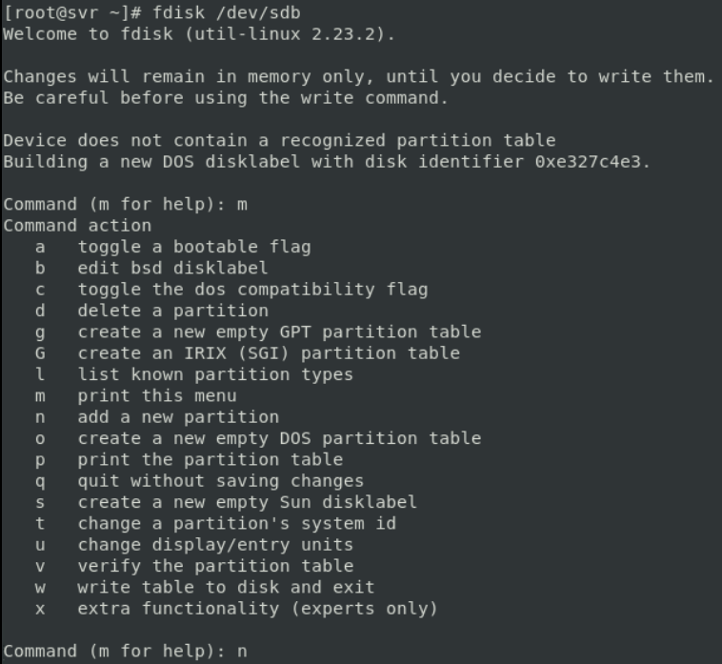

Slide 3
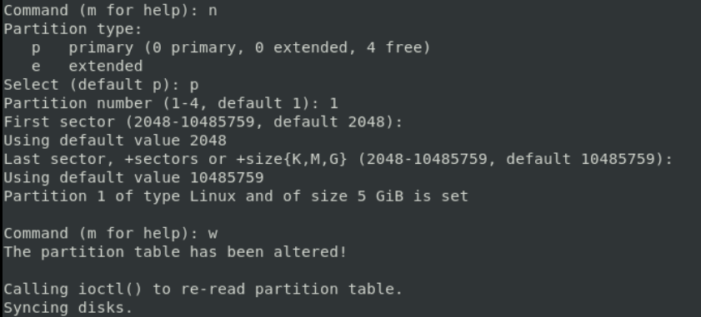

Slide 4


Slide 5


Slide 6


Slide 7
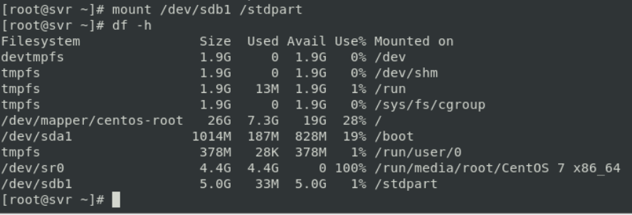
To mount

Slide 8
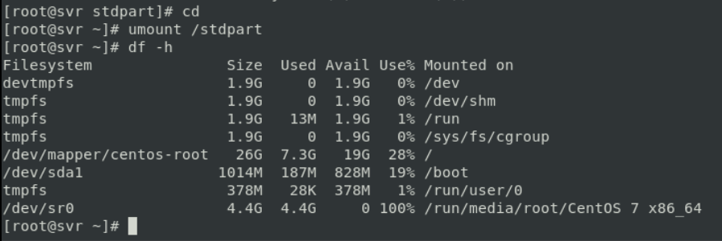
To unmount the temporary mount

Slide 9


Slide 10
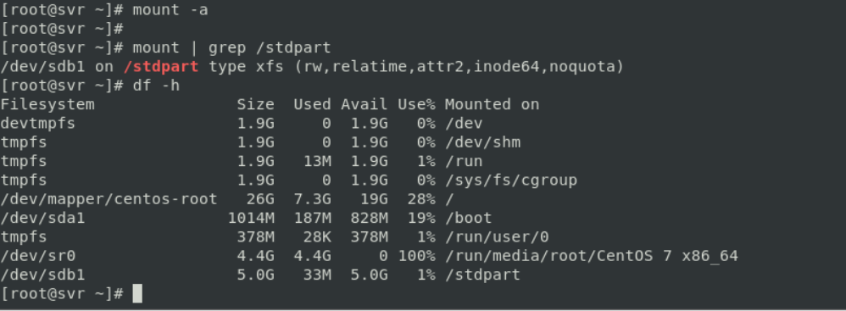
Permanently mounted

Slide 11
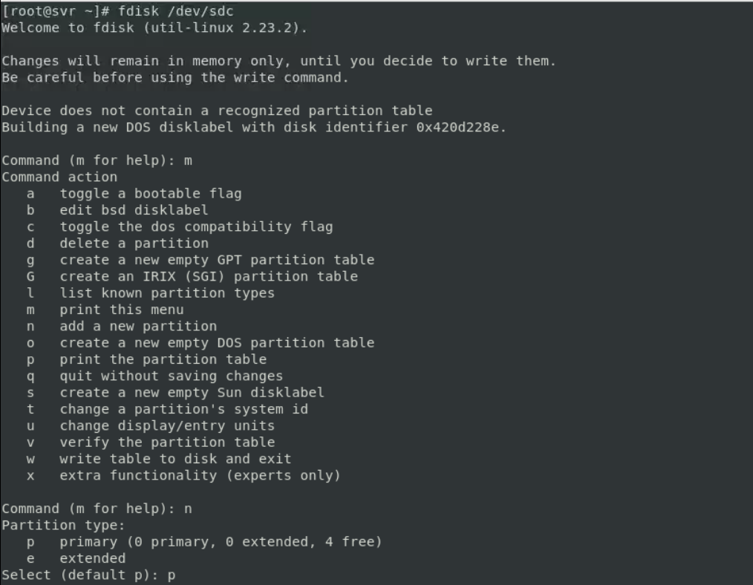

Slide 12
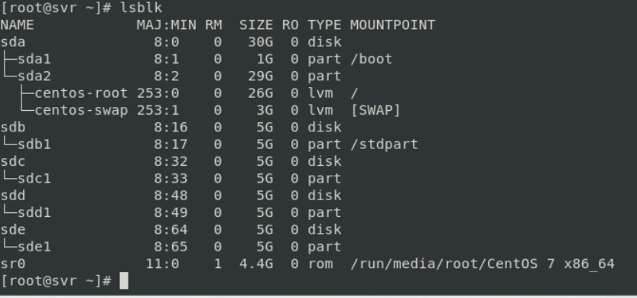

Slide 13
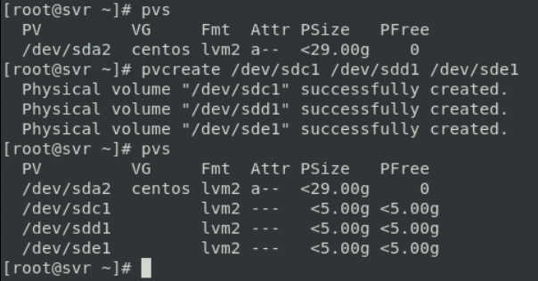
Create the partitions from those disks added

Slide 14

Created vg group

Slide 15


Slide 16
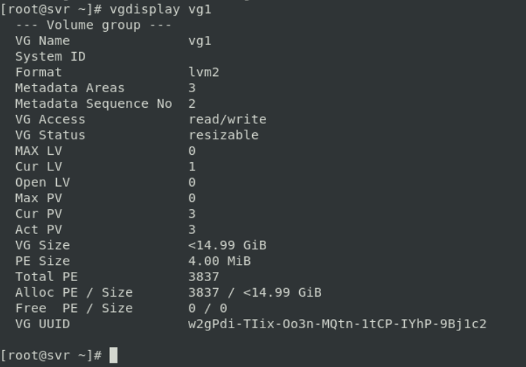

Slide 17


Slide 18
Creating mount point
Mkdir /lvm

Slide 19

vim /etc/fstab

Slide 20
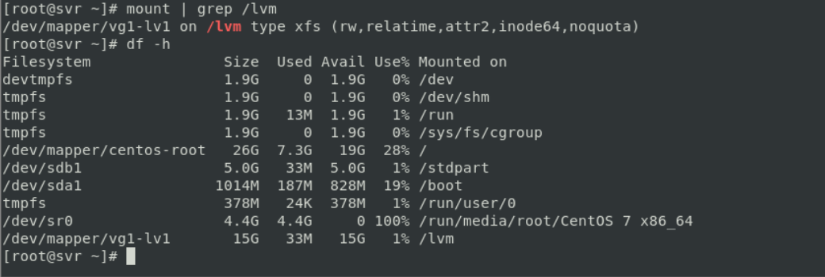

Slide 21
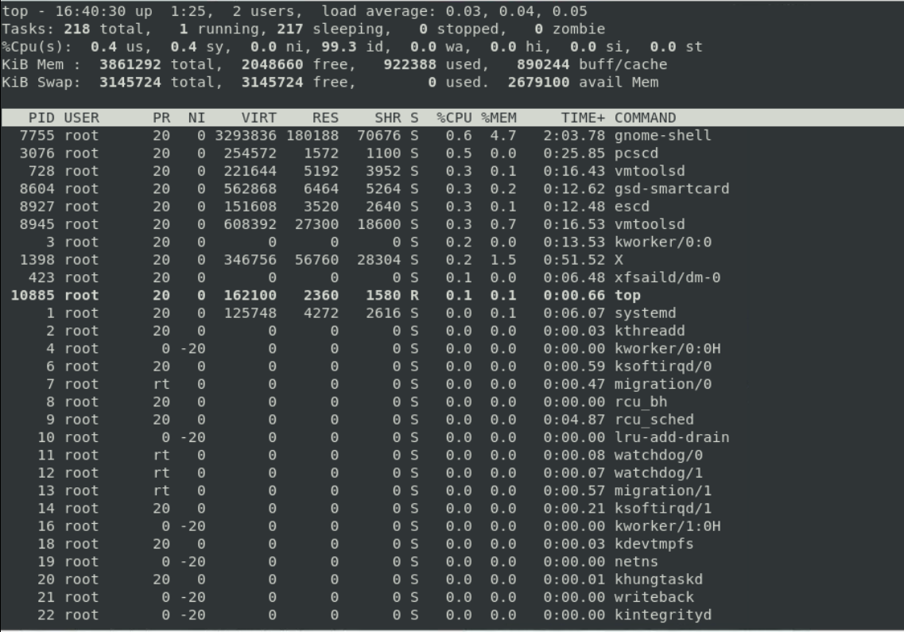
By top Command

Slide 22


Slide 23
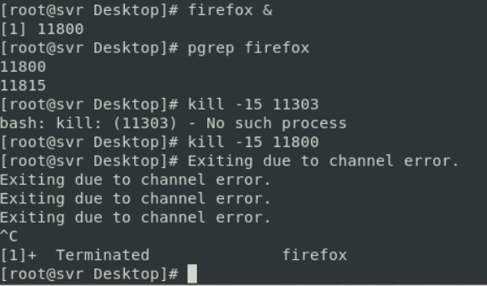

Slide 24


Slide 25
