Slide 1
Workshop 1: Introduction to Git and Python

Slide 2
Topics
Introduction to git and github
Introduction to python and jupyter notebooks
Introduction to Python: Different types of Loops
Some sources on installation for Git and Python

Slide 3
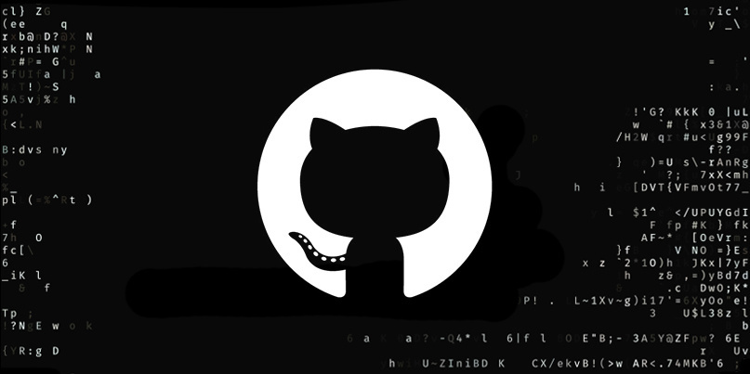
Introduction to GitHub

Slide 4
Introduction to GitHub
Version control system

Slide 5
Introduction to GitHub
Version control system
Remote Git repository

Slide 6
What is Version Control System
A version control system keeps track of changes we made in the files.
Because of this, we can always go back to a working state if we make some changes that don’t work (and we cant remember what changes we did on the working version)
save
save
save
S1
S2
S6
S7
Code doesn’t work

Slide 7
What is Version Control System
A version control system keeps track of changes we made in the files.
Because of this, we can always go back to a working state if we make some changes that don’t work (and we cant remember what we did)
save
save
save
Go back
S1
S2
S6
S7
Code doesn’t work: delete this update

Slide 8
What is Version Control System
A version control system keeps track of changes we made in the files.
Because of this, we can always go back to a working state if we make some changes that don’t work (and we cant remember what we did)
save
save
save
S1
S2
S6
S7

Slide 9

What is Git
Think of Git as a software that helps in version controls (tracks different versions)
It uses an efficient (and therefore fast) system/algorithm for version control (track changes)

Slide 10
What is GitHub
GitHub is most common version control hosting service.
Owned by Microsoft now and majority of the companies use it
It is decentralized version control system – super fast

Slide 11
Careful with Data
Free version of GitHub is public (anyone can see and download the files/data)
Do not share data in GitHub from companies (for e.g. working with a company in practicum) unless you have authorization (which in most cases will be a NO from company)
If you collect your own data (e.g. surveys), share the data so that the person cannot be identified or traced back (anonymize the data: to avoid personally identifiable information)

Slide 12
Why learn about Git and GitHub
Good to add git profile in your resume. Recruiters and hiring managers get to know your profile better (and it also helps in standing out in the competition)
Its easy to use and it is similar to maintaining all your projects over the course of MSBA in one place
You will most probably need to learn it when working in a team. Most companies use it.

Slide 13
Working in a team
In a team, you will be working on one section of a large code. Here, you can create a new branch, write your code here and merge if with the final code (when you are done with your code).
save
New branch
Sb1
Sb2
save
save
save
Master branch
S1
S2
S6
S7

Slide 14
Working in a team
In a team, you will be working on one section of a large code. Here, you can create a new branch, write your code here and merge if with the final code (when you are done with your code).
save
Merge
New branch
Sb1
Sb2
save
save
save
save
Master branch
S1
S2
S6
S7
S11

Slide 15

Introduction to Python

Slide 16
Python or R programming language
At this point, its personal preference (both are equally good and easy – personally I find python easier)
Python is used more in machine learning community, R is used more in statistics community. Python might be easier to start with but visualization in R is much better than python.
I will be using python and jupyter notebooks for these workshops and tutorials. Should be very similar in R
(you can also use python IDE, Anaconda IDE, pyCharm, google colab)

Slide 17
Installing python in your local computer
Start with Anaconda: Open source distribution of python and R
It comes with most python libraries (and makes it easy to install others)
Search for anaconda.com and go to downloads (and install it based on your computer configuration – windows/mac

Slide 18
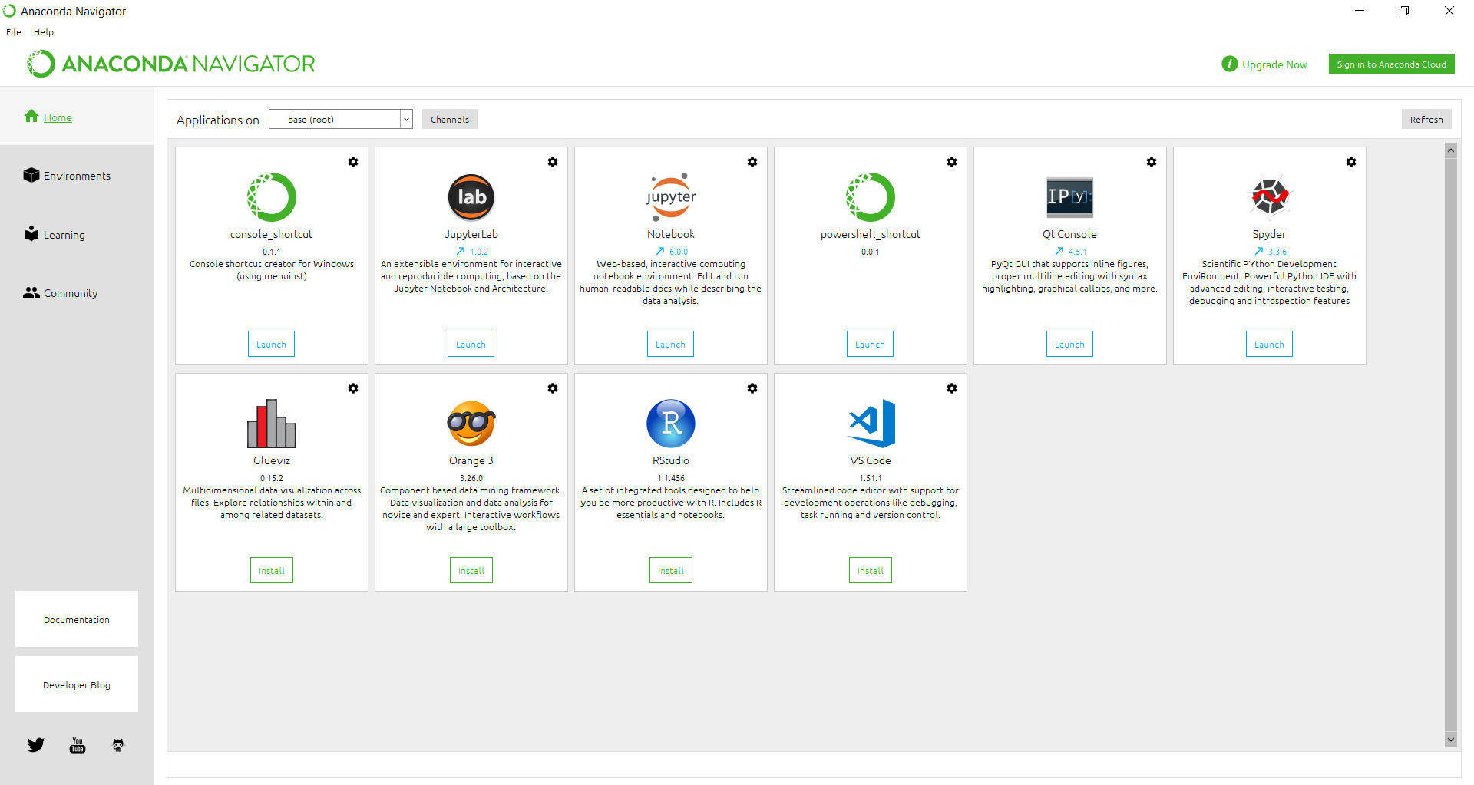
Jupyter notebook
Jupyter Notebook allows you to document and code simultaneously while you are working. Useful form of presentation (its faster to work with as it saves data in workspace). R has “markdowns” which are similar to python jupyter notebook.
Can also look for google colab.
Anaconda interface after installation

