Slide 1

Warehouse and Inventory Management System

Slide 2




ABSTRACT
The Blue Dart Express Warehouse & Inventory Management System (WIMS) is a database project developed to manage warehouse operations efficiently. It helps maintain supplier, product, inventory, customer, order, and shipment records in a centralized system.
The project is built using MySQL and uses Primary Keys and Foreign Keys to maintain data integrity and reduce redundancy. It supports inventory tracking, order management, shipment monitoring, and SQL-based reporting for better warehouse operations.

Slide 3
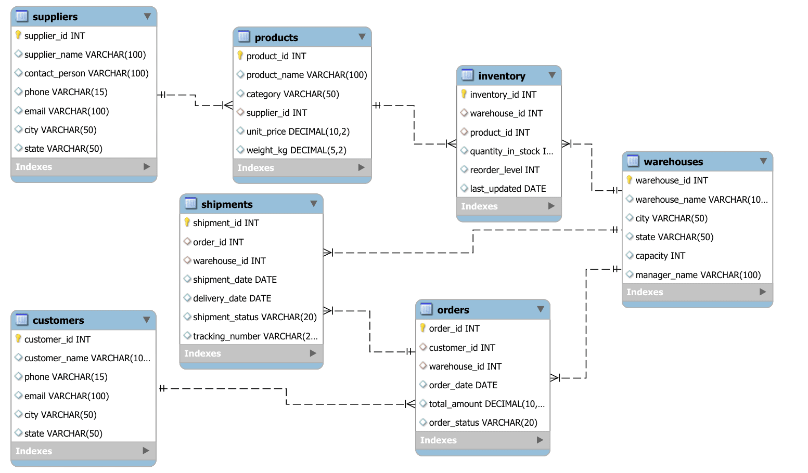
ER-DIAGRAM

Slide 4
STRUCTURE OF TABLE
INDEX | TABLES
1. | SUPPLIERS
2. | WAREHOUSES
3. | PRODUCTS
4. | INVENTORY
5. | CUSTOMERS
6. | ORDERS
7. | SHIPMENTS

Slide 5
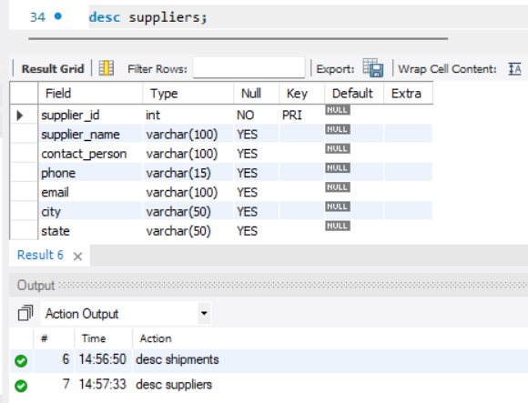
STRUCTURE OF SUPPLIERS TABLE
SUPPLIERS TABLE :-
This table stores the master details of all suppliers who provide products to the warehouse, including their contact information and location.
SYNTAX :-
DESC Suppliers;

Slide 6
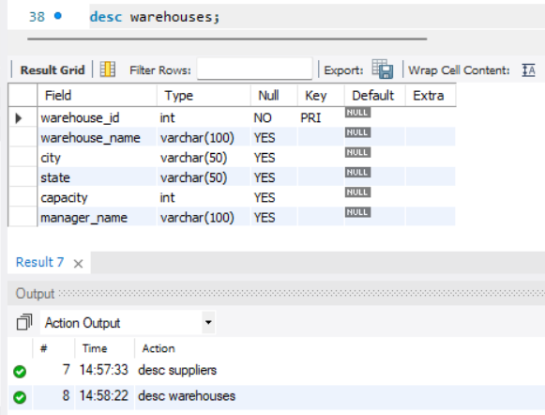
STRUCTURE OF WAREHOUSES TABLE
WAREHOUSES TABLE :-
This table stores the details of all warehouses where products are stored, managed, and distributed for customer orders.
SYNTAX :-
DESC Warehouses;

Slide 7
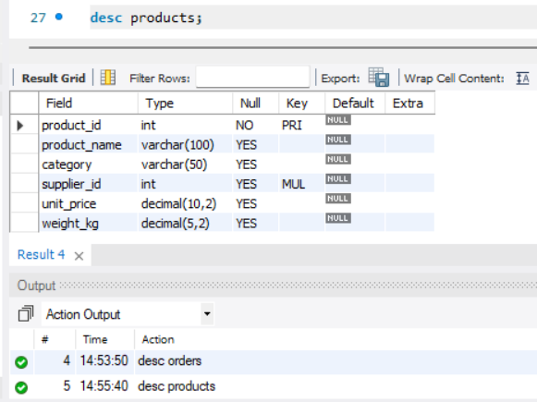
STRUCTURE OF PRODUCTS TABLE
PRODUCTS TABLE :-
This table stores the master list of all products available in the inventory, including their category, price, supplier, and product details.
SYNTAX :-
DESC Products;

Slide 8
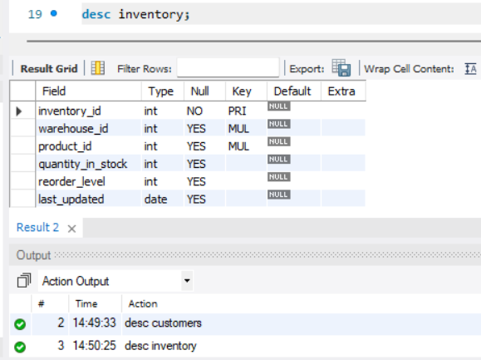
STRUCTURE OF INVENTORY TABLE
INVENTORY TABLE :-
This table stores the stock information for each product in every warehouse, including available quantity and stock updates.
SYNTAX :-
DESC Inventory;

Slide 9
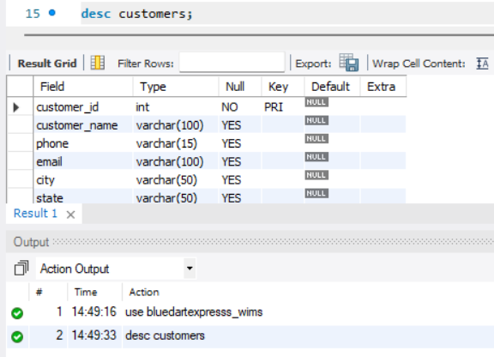
STRUCTURE OF CUSTOMERS TABLE
CUSTOMERS TABLE :-
This table stores the details of customers who place orders, including their contact information and delivery address.
SYNTAX :-
DESC Customers;

Slide 10
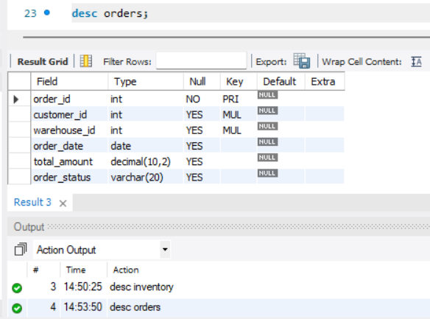
STRUCTURE OF ORDERS TABLE
ORDERS TABLE :-
This table stores all customer order records, including the ordered products, order date, warehouse, and order status.
SYNTAX :-
DESC Orders;

Slide 11
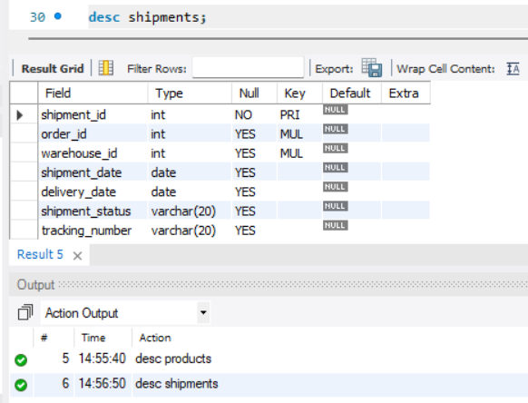
STRUCTURE OF SHIPMENTS TABLE
SHIPMENTS TABLE :-
This table stores shipment information for customer orders, including shipment date, delivery date, tracking number, and shipment status.
SYNTAX :-
DESC Shipments;

Slide 12
CONTENTS OF TABLE
INDEX | CONTENTS TABLES
1. | SUPPLIERS
2. | WAREHOUSES
3. | PRODUCTS
4. | INVENTORY
5. | CUSTOMERS
6. | ORDERS
7. | SHIPMENTS

Slide 13
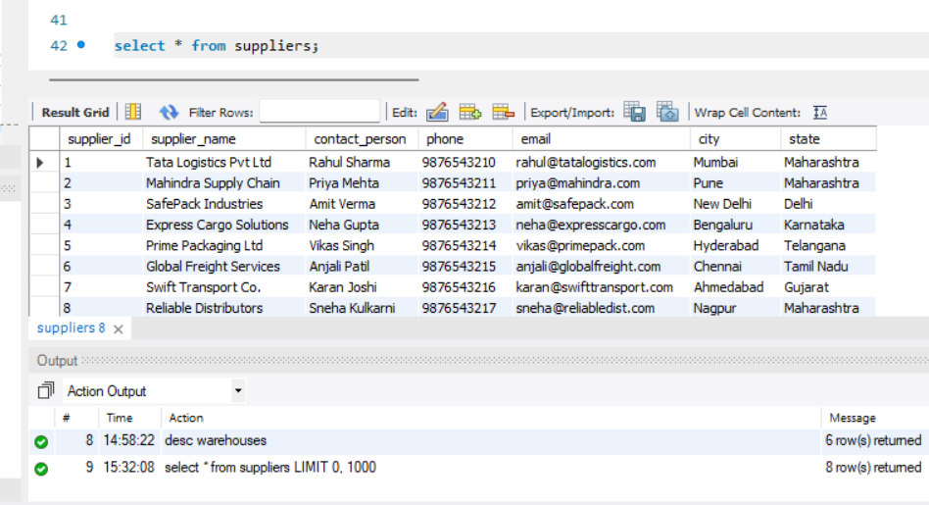
CONTENTS OF SUPPLIERS TABLE
SUPPLIERS TABLE :-
This table stores the master list of suppliers who provide products to the company, including their contact details and location.
SYNTAX :-
Select * from Suppliers;

Slide 14
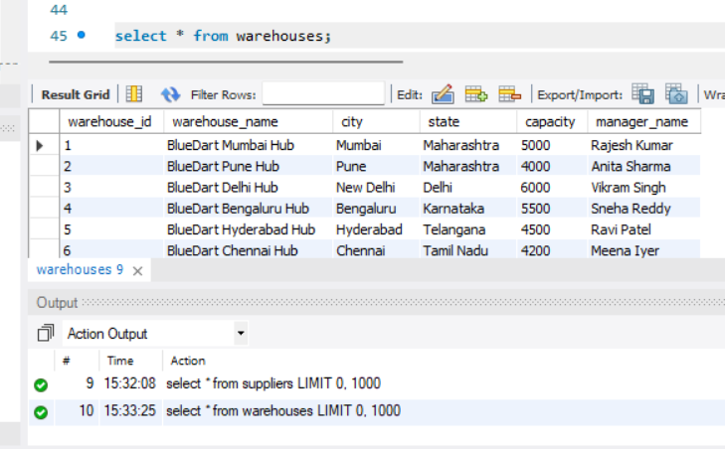
CONTENTS OF WAREHOUSES TABLE
WAREHOUSES TABLE :-
This table stores the details of all warehouses where products are stored, managed, and dispatched to customers.
SYNTAX :-
Select * from Warehouses;

Slide 15
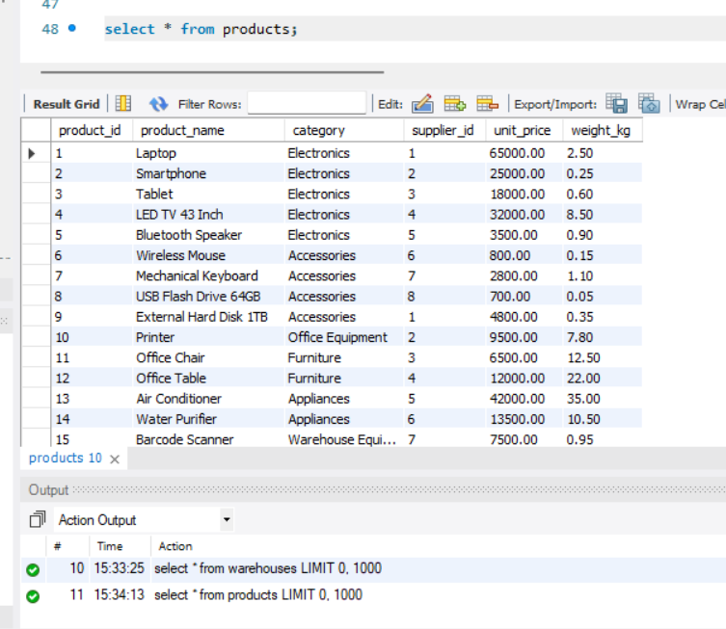
CONTENTS OF PRODUCTS TABLE
PRODUCTS TABLE :-
This table stores the master list of products available for sale, including their category, supplier, price, and stock-related information.
SYNTAX :-
Select * from Products;

Slide 16
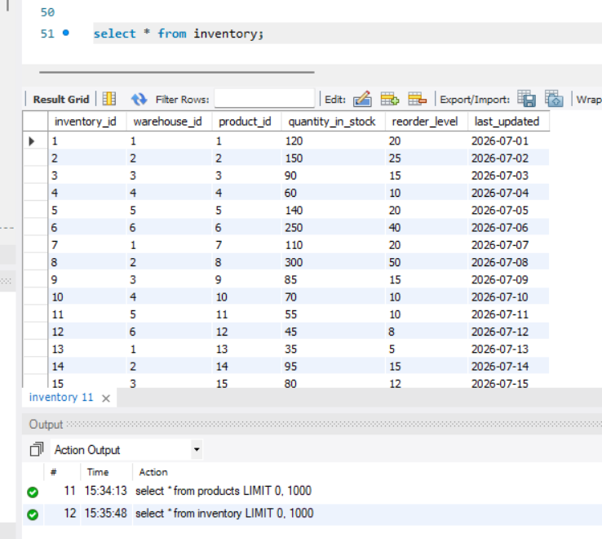
CONTENTS OF INVENTORY TABLE
INVENTORY TABLE :-
This table stores the current stock levels of products in each warehouse, helping track product availability and inventory movement.
SYNTAX :-
Select * from Inventory;

Slide 17
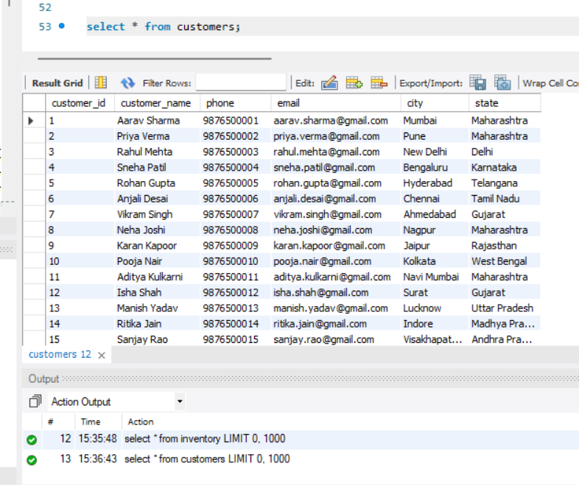
CONTENTS OF CUSTOMERS TABLE
CUSTOMERS TABLE :-
This table stores the master list of customers, including their personal details, contact information, and delivery address.
SYNTAX :-
Select * from Customers;

Slide 18
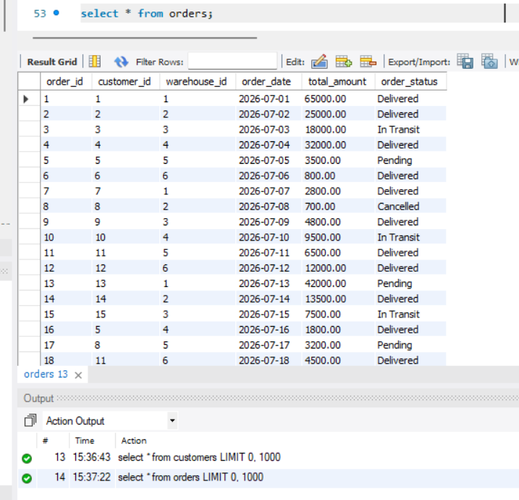
CONTENTS OF ORDERS TABLE
ORDERS TABLE :-
This table stores customer order transactions, including order details, ordered products, warehouse, order date, and order status.
SYNTAX :-
Select * from Orders;

Slide 19
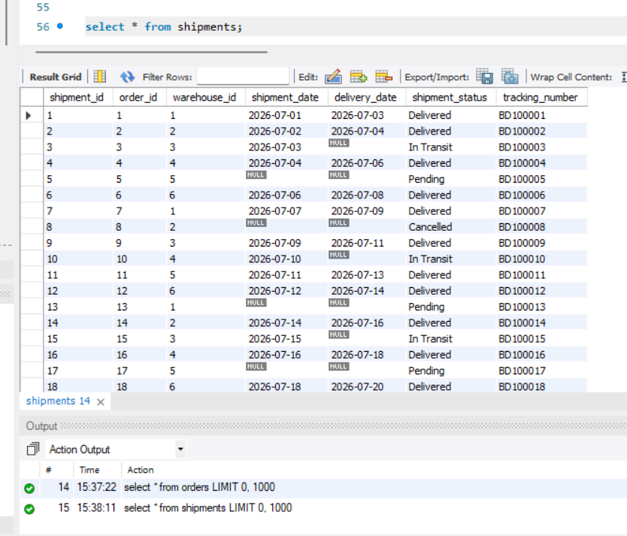
CONTENTS OF SHIPMENTS TABLE
SHIPMENTS TABLE :-
This table stores shipment records for customer orders, including shipment status, tracking number, shipment date, and delivery date.
SYNTAX :-
Select * from Shipments;

Slide 20
SUB QUERIES

Slide 21
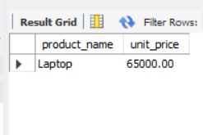
SUBQUERY
NAME OF THE MOST EXPENSIVE PRODUCT
SYNTAX :-
SELECT product_name, unit_price
FROM Products
WHERE unit_price = (
SELECT MAX(unit_price)
FROM Products
);

Slide 22
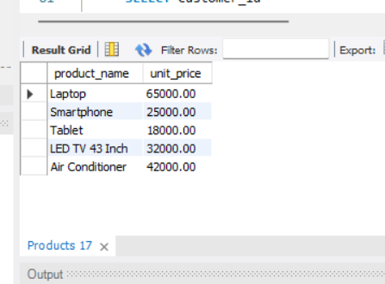
SUBQUERY
NAME OF THE PRODUCTS PRICED ABOVE THE AVERAGE UNIT PRICE
SYNTAX :-
SELECT product_name, unit_price
FROM Products
WHERE unit_price > (
SELECT AVG(unit_price)
FROM Products
);

Slide 23
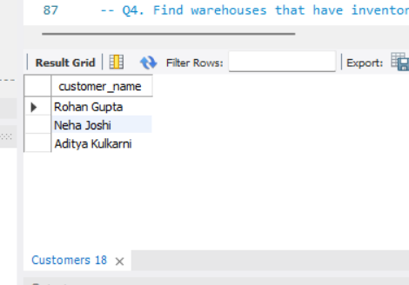
SUBQUERY
NAME OF THE CUSTOMERS WHO HAVE PLACED MORE THAN ONE ORDER
SYNTAX :-
SELECT customer_name
FROM Customers
WHERE customer_id IN (
SELECT customer_id
FROM Orders
GROUP BY customer_id
HAVING COUNT(order_id) > 1
);

Slide 24
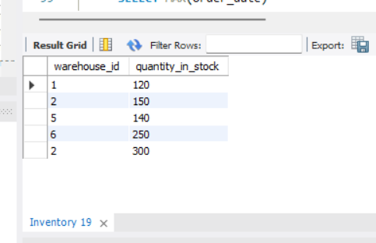
SUBQUERY
WAREHOUSES HAVING INVENTORY QUANTITY ABOVE THE AVERAGE STOCK LEVEL
SYNTAX :-
SELECT warehouse_id, quantity_in_stock
FROM Inventory
WHERE quantity_in_stock > (
SELECT AVG(quantity_in_stock)
FROM Inventory
);

Slide 25
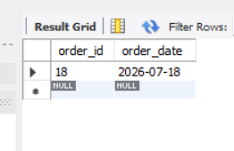
SUBQUERY
ORDERS PLACED ON THE LATEST ORDER DATE
SYNTAX :-
SELECT order_id, order_date
FROM Orders
WHERE order_date = (
SELECT MAX(order_date)
FROM Orders
);

Slide 26
JOINS

Slide 27
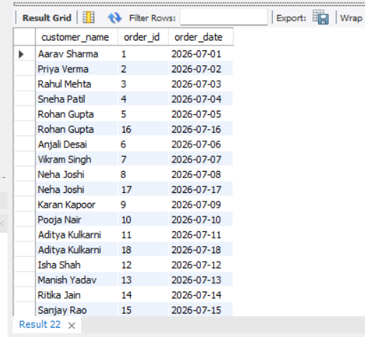
JOINS
CUSTOMER DETAILS WITH ORDER INFORMATION [INNER JOIN]
SYNTAX :-
SELECT c.customer_name,
o.order_id,
o.order_date
FROM Customers c
INNER JOIN Orders o
ON c.customer_id = o.customer_id;

Slide 28
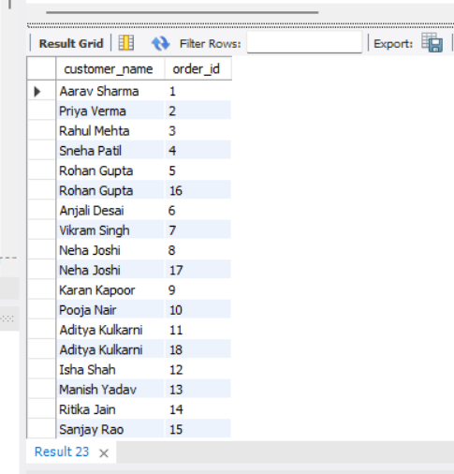
JOINS
ALL CUSTOMERS WITH THEIR ORDERS [LEFT JOIN]
SYNTAX :-
SELECT c.customer_name,
o.order_id
FROM Customers c
LEFT JOIN Orders o
ON c.customer_id = o.customer_id;

Slide 29
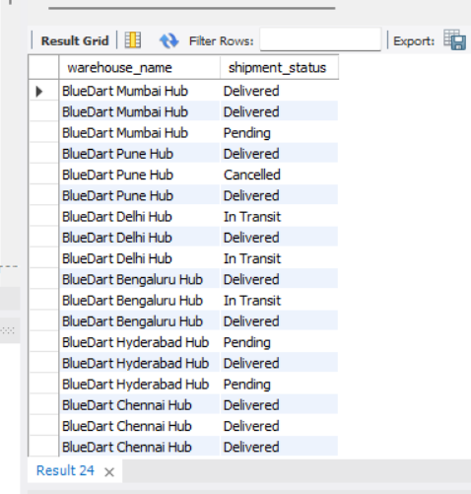
JOINS
WAREHOUSE WITH SHIPMENT STATUS [INNER JOIN]
SYNTAX :-
SELECT w.warehouse_name,
s.shipment_status
FROM Warehouses w
INNER JOIN Shipments s
ON w.warehouse_id = s.warehouse_id;

Slide 30
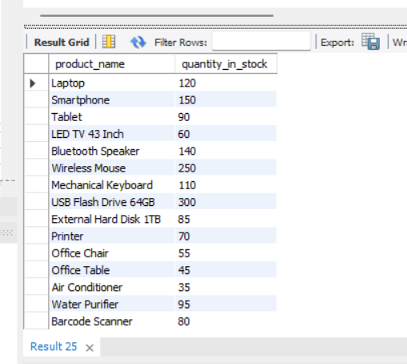
JOINS
PRODUCTS WITH INVENTORY DETAILS [INNER JOIN]
SYNTAX :-
SELECT p.product_name,
i.quantity_in_stock
FROM Products p
INNER JOIN Inventory i
ON p.product_id = i.product_id;

Slide 31
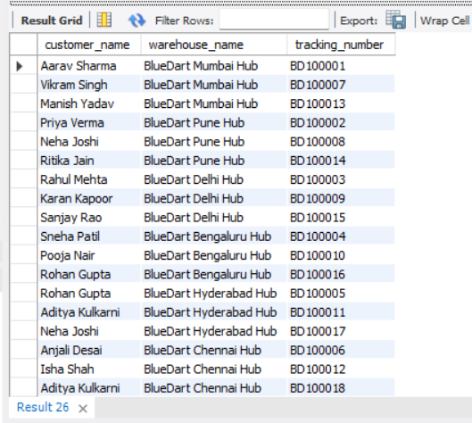
JOINS
CUSTOMER, WAREHOUSE & SHIPMENT TRACKING DETAILS [INNER JOIN]
SYNTAX :-
SELECT c.customer_name,
w.warehouse_name,
s.tracking_number
FROM Customers c
INNER JOIN Orders o
ON c.customer_id = o.customer_id
INNER JOIN Warehouses w
ON o.warehouse_id = w.warehouse_id
INNER JOIN Shipments s
ON o.order_id = s.order_id;

Slide 32
VIEWS

Slide 33
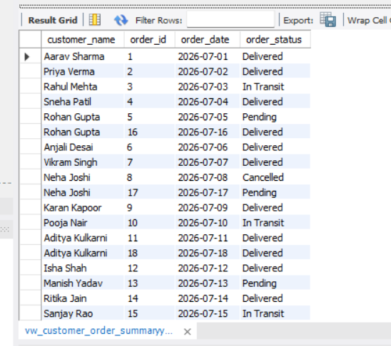
VIEWS
VIEW: CUSTOMER ORDER SUMMARY
SYNTAX :-
CREATE VIEW vw_customer_order_summaryy AS
SELECT c.customer_name,
o.order_id,
o.order_date,
o.order_status
FROM Customers c
JOIN Orders o
ON c.customer_id = o.customer_id;

Slide 34
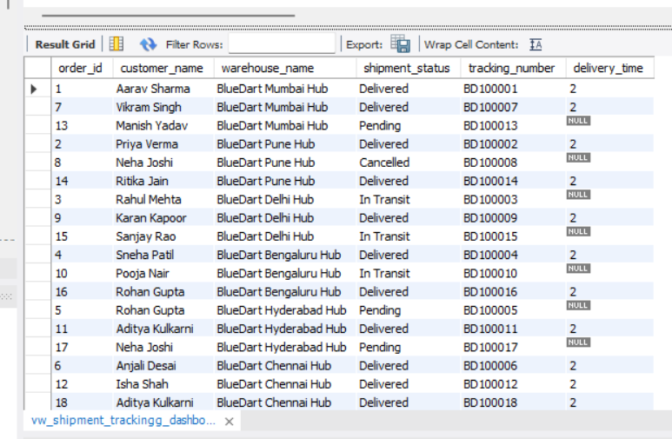
VIEWS
VIEW: SHIPMENT TRACKING DASHBOARD
SYNTAX :-
CREATE VIEW vw_shipment_trackingg_dashboard AS SELECT o.order_id, c.customer_name, w.warehouse_name, s.shipment_status, s.tracking_number,
DATEDIFF(s.delivery_date, s.shipment_date) AS delivery_time
FROM Orders o JOIN Customers c
ON o.customer_id = c.customer_id
JOIN Warehouses w
ON o.warehouse_id = w.warehouse_id
JOIN Shipments s
ON o.order_id = s.order_id;

Slide 35
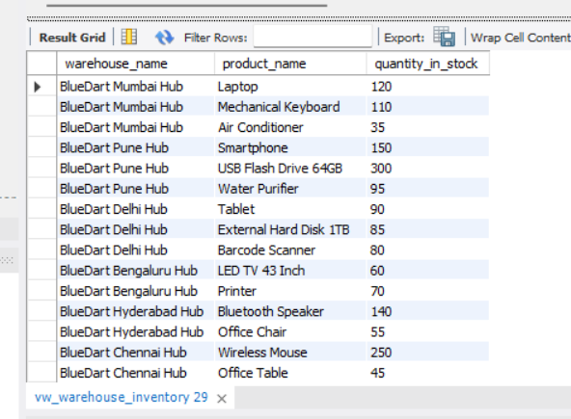
VIEWS
VIEW: WAREHOUSE INVENTORY
SYNTAX :-
CREATE VIEW vw_warehouse_inventory AS
SELECT w.warehouse_name, p.product_name, i.quantity_in_stock
FROM Warehouses w
JOIN Inventory i
ON w.warehouse_id = i.warehouse_id
JOIN Products p
ON i.product_id = p.product_id;

Slide 36
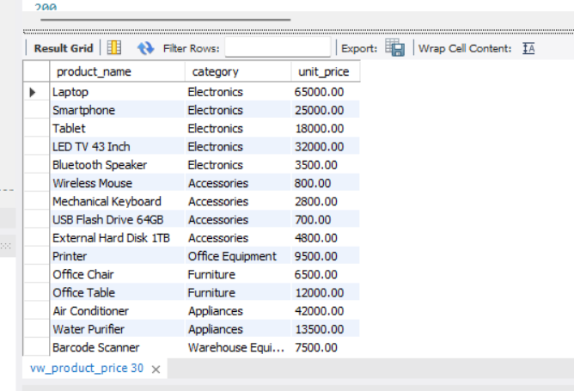
VIEWS
VIEW: PRODUCT PRICE DETAILS
SYNTAX :-
CREATE VIEW vw_product_price AS
SELECT product_name, category, unit_price
FROM Products;

Slide 37
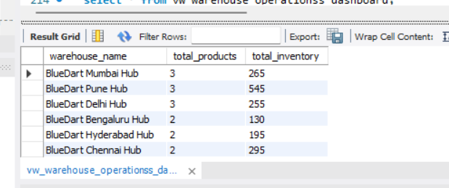
VIEWS
VIEW: WAREHOUSE OPERATIONS DASHBOARD
SYNTAX :-
CREATE VIEW
vw_warehouse_operationss_dashboard AS
SELECT w.warehouse_name,
COUNT(p.product_id) AS total_products, SUM(i.quantity_in_stock) AS total_inventory
FROM Warehouses w JOIN Inventory i
ON w.warehouse_id = i.warehouse_id
JOIN Products p
ON i.product_id = p.product_id
GROUP BY w.warehouse_name;

Slide 38

PREPARED BY :
Ashutosh Patil
ITvedant — Data Science & Analytics with Artificial Intelligence | MAY26-T380
Blue Dart Express Warehouse & Inventory Management System

Slide 39

Thank You

