Slide 1




Scheduling Techniques for GPU Architectures
with Processing-In-Memory Capabilities
Ashutosh Pattnaik
Xulong Tang, Adwait Jog, Onur Kayıran, Asit Mishra,
Mahmut Kandemir, Onur Mutlu, Chita Das
PACT ‘16

Slide 2


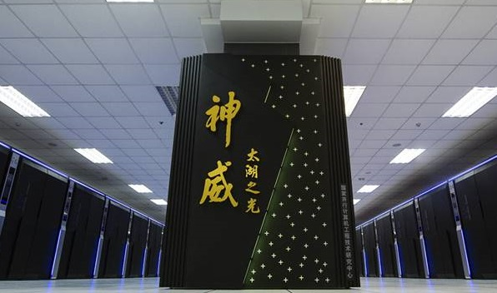
Era of Energy-Efficient Architectures
Peak Performance increased by ~27x in past 6 years
Energy Efficiency increased by ~7x in
past 6 years
Future: 1 ExaFlops/s at 20 MW Peak power
Greatly need to improve energy efficiency
as well as performance!
2010:
Tianhe-1A
4.7 PFlop/s, 4 MW
~1.175 TFlops/W
2013:
Tianhe-2
54.9 PFlop/s, 17.8 MW
~3.084 TFlops/W
2016:
Sunway TaihuLight
125.4 PFlop/s, 15.4 MW
~8.143 TFlops/W

Slide 3
Bottleneck
Continuous energy-efficiency and performance scaling is not easy.
Energy consumed by a floating-point operation is scaling down with technology scaling.
Energy consumption due to data transfer overhead is not scaling down!

Slide 4
Bottleneck
Across these 25 GPGPU applications:
49% of all transactions are off-chip.
This is responsible for 41% of total energy consumption of the system.
Data movement and system energy consumption caused by off-chip memory accesses.

Slide 5
Bottleneck
Main memory accesses lead to 45% performance degradation!
Performance normalized to a hypothetical GPU where all the off-chip accesses hit in the last-level cache.

Slide 6
Outline
Introduction and Motivation
Background and Challenges
Design of Kernel Offloading Mechanism
Design of Concurrent Kernel Management
Simulation Setup and Evaluation
Conclusions

Slide 7
Revisiting Processing-In-Memory (PIM)
It’s a promising approach to minimize data movement.
The concept dates back to the late 1960s
Technological limitations of integrating fast computational units in memory was a challenge
Significant advances in adoption of 3D-stacked memory has
enabled tight integration of memory dies and logic layer
brought computational units into the memory stack

Slide 8
PIM-Assisted GPU architecture
We integrate PIM units to a GPU based system and we call this as “PIM-Assisted GPU architecture”.
At least one 3D-stacked memory is integrated with PIM units and is placed adjacent to a traditional GPU design.

Slide 9
PIM-Assisted GPU architecture
Traditional GPU architecture*
Memory
GPU
Memory Link
* Only a single DRAM partition is shown for illustration purposes

Slide 10
PIM-Assisted GPU architecture
GPU architecture with 3D-stacked memory on a silicon interposer
Memory Dice
GPU
Memory Link
on Interposer
Silicon Interposer

Slide 11
PIM-Assisted GPU architecture
Now we add a logic layer to the 3D-stacked memory and we call this logic layer as GPU-PIM.
The traditional GPU logic is now called GPU-PIC.
Memory Dice
3D Stacked
Memory and Logic
GPU-PIM
GPU-PIC
Memory Link
on Interposer
Silicon Interposer

Slide 12
PIM-Assisted GPU architecture
Application can now be run on both GPU-PIC and GPU-PIM
Challenge: Where to execute the application on?
Memory Dice
3D Stacked
Memory and Logic
GPU-PIM
GPU-PIC
Memory Link
on Interposer
Silicon Interposer

Slide 13
Application Offloading
We evaluate application execution on either GPU-PIC or GPU-PIM
2.64
2.46
Optimal application offloading scheme provides 16% and 28% improvements in performance and energy efficiency, respectively.
2.51
2.64
5.95
2.50
2.60
2.1

Slide 14
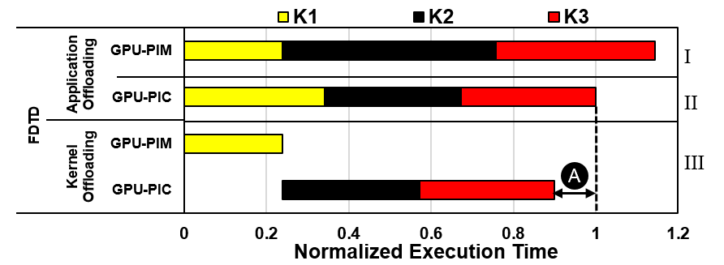
Limitations of Application Offloading
Limitation 1: Lack of Fine-Grained Offloading
FDTD

Slide 15
Limitations of Application Offloading
Limitation 1: Lack of Fine-Grained Offloading
Running K1 on GPU-PIM, and K2 and K3 on GPU-PIC provides the optimal kernel placement for improved performance.

Slide 16
Limitations of Application Offloading
Limitation 1: Lack of Fine-Grained Offloading
Limitation 2: Lack of Concurrent Utilization of GPU-PIM and GPU-PIC
From the application we find that kernel K1 and K2 are independent from each other.
GPU-PIC is idle!

Slide 17
Limitations of Application Offloading
Limitation 1: Lack of Fine-Grained Offloading
Limitation 2: Lack of Concurrent Utilization of GPU-PIM and GPU-PIC
I
Scheduling kernels based on their affinity is very important to achieve higher performance.
II
III
A
IV
K1 -> GPU-PIC
K2 -> GPU-PIM
B
V
K1 -> GPU-PIM
K2 -> GPU-PIC
C

Slide 18
Our Goal
To develop runtime mechanisms for
automatically identifying architecture affinity of each kernel in an application
scheduling kernels on GPU-PIC and GPU-PIM to maximize for performance and utilization

Slide 19
Outline
Introduction and Motivation
Background and Challenges
Design of Kernel Offloading Mechanism
Design of Concurrent Kernel Management
Simulation Setup and Evaluation
Conclusions

Slide 20
Design of Kernel Offloading Mechanism
Goal: Offload kernels to either GPU-PIC or GPU-PIM to maximize performance
Challenge: Need to know the architecture affinity of the kernels
We build an architecture affinity prediction model

Slide 21
Design of Kernel Offloading Mechanism
Metrics used to predict compute engine affinity and GPU-PIC and GPU-PIM execution time.
Category | Predictive Metric | Static/Dynamic
I: Memory Intensity of Kernel | Memory to Compute Ratio | Static
 | Number of Compute Inst. | Static
 | Number of Memory Inst. | Static
II: Available Parallelism in the Kernel | Number of CTAs | Dynamic
 | Total Number of Threads | Dynamic
 | Number of Thread Inst. | Dynamic
III: Shared Memory Intensity of Kernel | Total Number of Shared Memory Inst. | Static

Slide 22
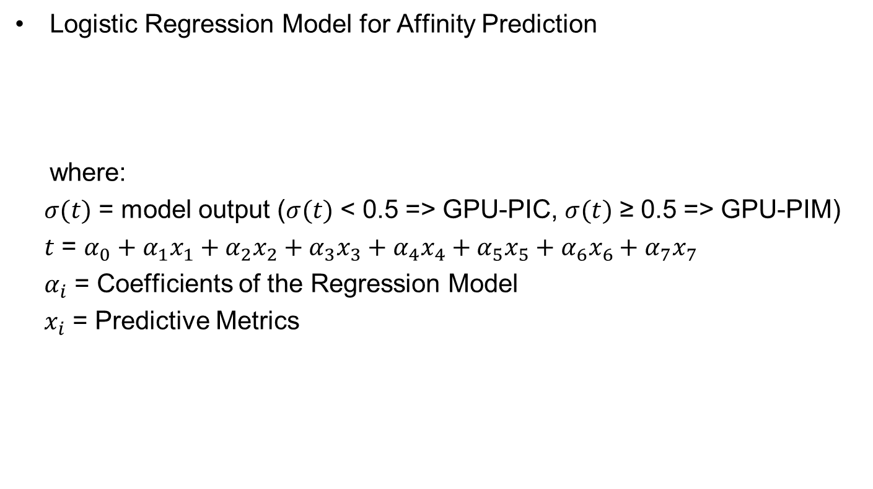

Design of Kernel Offloading Mechanism
Logistic Regression Model for Affinity Prediction
where:
$σ(t)$ = model output ($σ(t)$ < 0.5 => GPU-PIC, $σ(t)$ ≥ 0.5 => GPU-PIM)
$t$ = $α_{0}+α_{1}x_{1}+α_{2}x_{2}+α_{3}x_{3}+α_{4}x_{4}+α_{5}x_{5}+α_{6}x_{6}+α_{7}x_{7}$
$α_{i}$ = Coefficients of the Regression Model
$x_{i}$ = Predictive Metrics
$$σ(t)=\frac{e^{t}}{e^{t}+1}$$

Slide 23
Design of Kernel Offloading Mechanism
Training Set: we randomly sample 60% (15) of the 25 GPGPU applications considered in the paper.
These 15 applications consists of 82 unique kernels that are used for training the affinity prediction model.
Test Set: the remaining 40% (10) of the applications are used as the test set for the model
Accuracy of the model on the test set: 83%

Slide 24
Outline
Introduction and Motivation
Background and Challenges
Design of Kernel Offloading Mechanism
Design of Concurrent Kernel Management
Simulation Setup and Evaluation
Conclusions

Slide 25
Design of Concurrent Kernel Management
Goal: Efficiently manage the scheduling of concurrent kernels to improve performance and utilization of the PIM-Assisted GPU architecture
For efficiently managing kernel execution on both GPU-PIM and GPU-PIC, we need
Kernel-level Dependence Information
Architecture Affinity Information
Execution Time Information

Slide 26
Design of Concurrent Kernel Management
For efficiently managing kernel execution on both GPU-PIM and GPU-PIC, we need
Kernel-level Dependence Information
Obtained through exhaustive analysis to find RAW dependence for all considered applications and input pairs
Architecture Affinity Information
Execution Time Information

Slide 27
Design of Concurrent Kernel Management
For efficiently managing kernel execution on both GPU-PIM and GPU-PIC, we need
Kernel-level Dependence Information
Obtained through exhaustive analysis to find RAW dependence for all considered applications and input pairs
Architecture Affinity Information
Utilizes the affinity prediction model built for kernel offloading mechanism
Execution Time Information

Slide 28
Design of Concurrent Kernel Management
For efficiently managing kernel execution on both GPU-PIM and GPU-PIC, we need
Kernel-level Dependence Information
Obtained through exhaustive analysis to find RAW dependence for all considered applications and input pairs
Architecture Affinity Information
Utilizes the affinity prediction model built for kernel offloading mechanism
Execution Time Information
We build linear regression models for execution time prediction on GPU-PIC and GPU-PIM
We use the same “Predictive metrics” and training set used for affinity prediction model

Slide 29
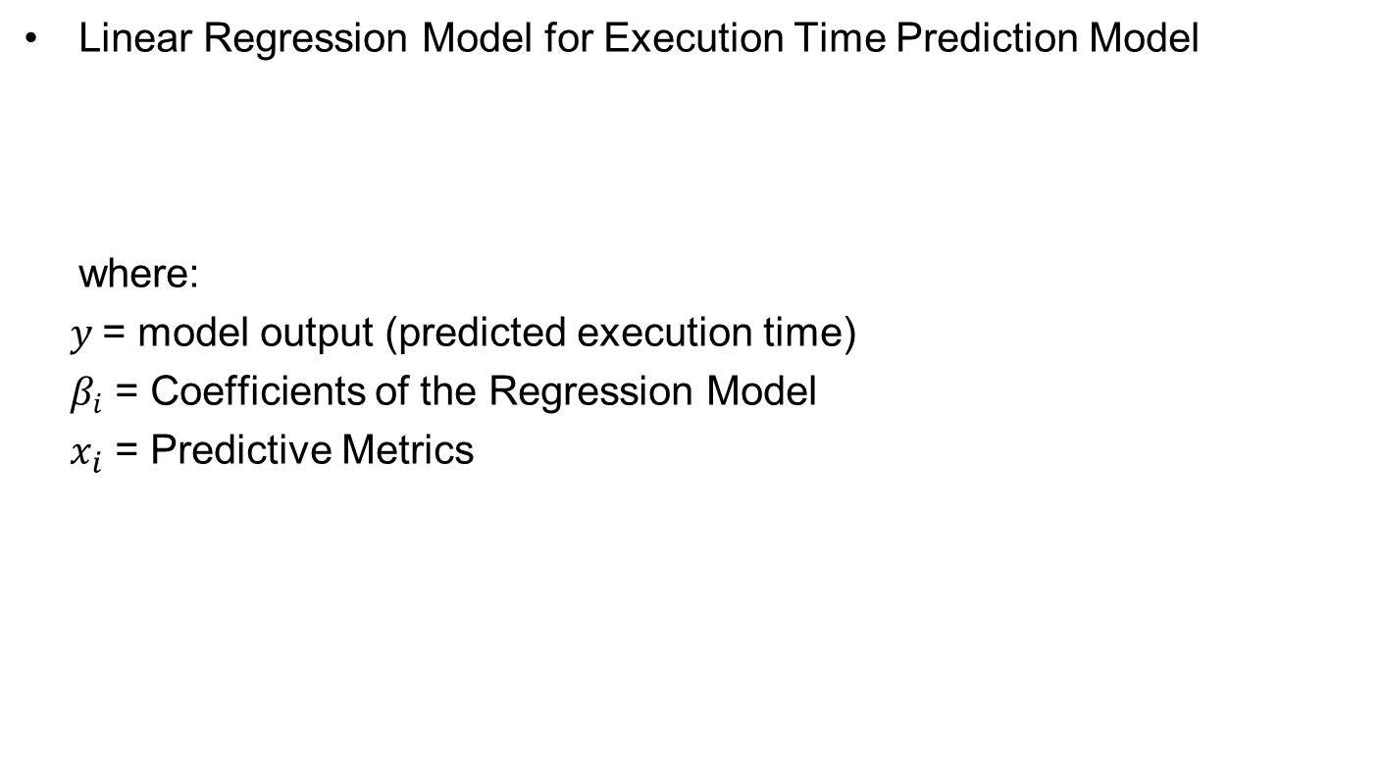
Design of Concurrent Kernel Management
Linear Regression Model for Execution Time Prediction Model
where:
$y$= model output (predicted execution time)
$β_{i}$ = Coefficients of the Regression Model
$x_{i}$ = Predictive Metrics
$$y\text{ = }β_{0}+β_{1}x_{1}+β_{2}x_{2}+β_{3}x_{3}+β_{4}x_{4}+β_{5}x_{5}+β_{6}x_{6}+β_{7}x_{7}$$

Slide 30
Design of Concurrent Kernel Management
Lets run through an example
GPU-PIC Queue
GPU-PIM Queue
K7
GPU-PIM has no
more kernels in its
work queue to
schedule
K6
K5
K4
idle
GPU-PIC is currently
executing kernel K4
GPU-PIM is
currently idle

Slide 31
Design of Concurrent Kernel Management
We can potentially pick any kernel (assuming no data dependence among themselves and K4) from GPU-PIC Queue and schedule them onto GPU-PIM
But which one to pick?
GPU-PIC Queue
GPU-PIM Queue
K7
K6
K5
K4
idle
GPU-PIC is currently
executing kernel K4
GPU-PIM is
currently idle

Slide 32
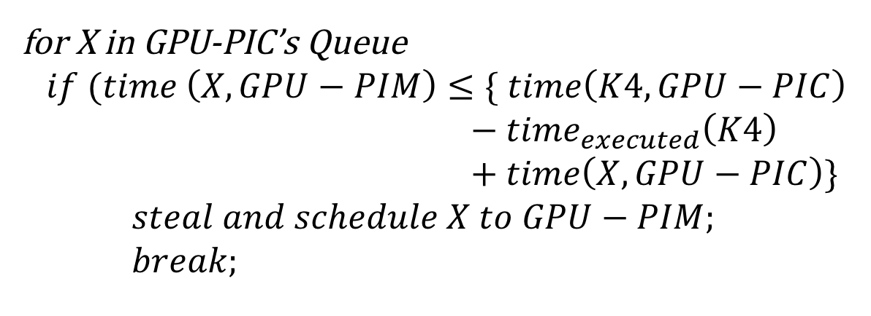
Design of Concurrent Kernel Management
We steal the first kernel that satisfies a given condition and schedule it on to GPU-PIM Queue.
Pseudocode:
time(kernel, compute_engine) returns the estimated execution time of “kernel” when executed on ”compute_engine”
Estimated execution time of
currently executing
kernel K4 on GPU-PIC
for X in GPU-PIC’s Queue
$$if (time \left(X, GPU−PIM\right)≤\{ time\left(K4,GPU−PIC\right)$$
$− time_{executed}\left(K4\right)$
$+ time\left(X, GPU−PIC\right)\}$
$steal and schedule X to GPU−PIM;$
$break;$

Slide 33
Outline
Introduction and Motivation
Background and Challenges
Design of Kernel Offloading Mechanism
Design of Concurrent Kernel Management
Simulation Setup and Evaluation
Conclusions

Slide 34
Simulation Setup
Evaluated on GPGPU-Sim, a cycle accurate GPU simulator
Baseline configuration
40 SMs, 32-SIMT lanes, 32-threads/warp
768 kB L2 cache
GPU-PIM configuration
8 SMs, 32-SIMT lanes, 32-threads/warp
No L2 cache
GPU-PIC configuration
32 SMs, 32-SIMT lanes, 32-threads/warp
768 kB L2 cache
25 GPGPU Applications classified into 2 exclusive sets
Training Set: The kernels are used as input to build the regression models
Test Set: The regression models are only tested on these kernels

Slide 35
Performance (Normalized to Baseline)
Training Set
Test Set
Performance improvement for Test Set applications
Kernel Offloading = 25%
Concurrent Kernel Management = 42%

Slide 36
Energy-Efficiency (Normalized to Baseline)
More results and detailed description
of our runtime mechanisms are in the paper.
Training Set
Test Set
Energy-Efficiency improvement for Test Set applications
Kernel Offloading = 28%
Concurrent Kernel Management = 27%

Slide 37
Conclusions
Processing-In-Memory is a key direction in achieving high performance with lower power budget.
Simply offloading applications completely onto PIM units is not optimal.
For effective utilization of PIM-Assisted GPU architecture, we need to
Identify code segments for offloading onto GPU-PIM
Efficiently distribute work between GPU-PIC and GPU-PIM
Our kernel-level scheduling mechanisms can be an effective runtime solution for exploiting processing-in-memory in modern GPU-based architectures.

Slide 38
Scheduling Techniques for GPU Architectures
with Processing-In-Memory Capabilities
Ashutosh Pattnaik, Xulong Tang, Adwait Jog, Onur Kayıran,
Asit Mishra, Mahmut Kandemir, Onur Mutlu, Chita Das.
PACT ‘16

Slide 39
Backup Slides

Slide 40
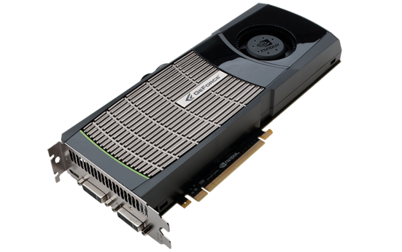
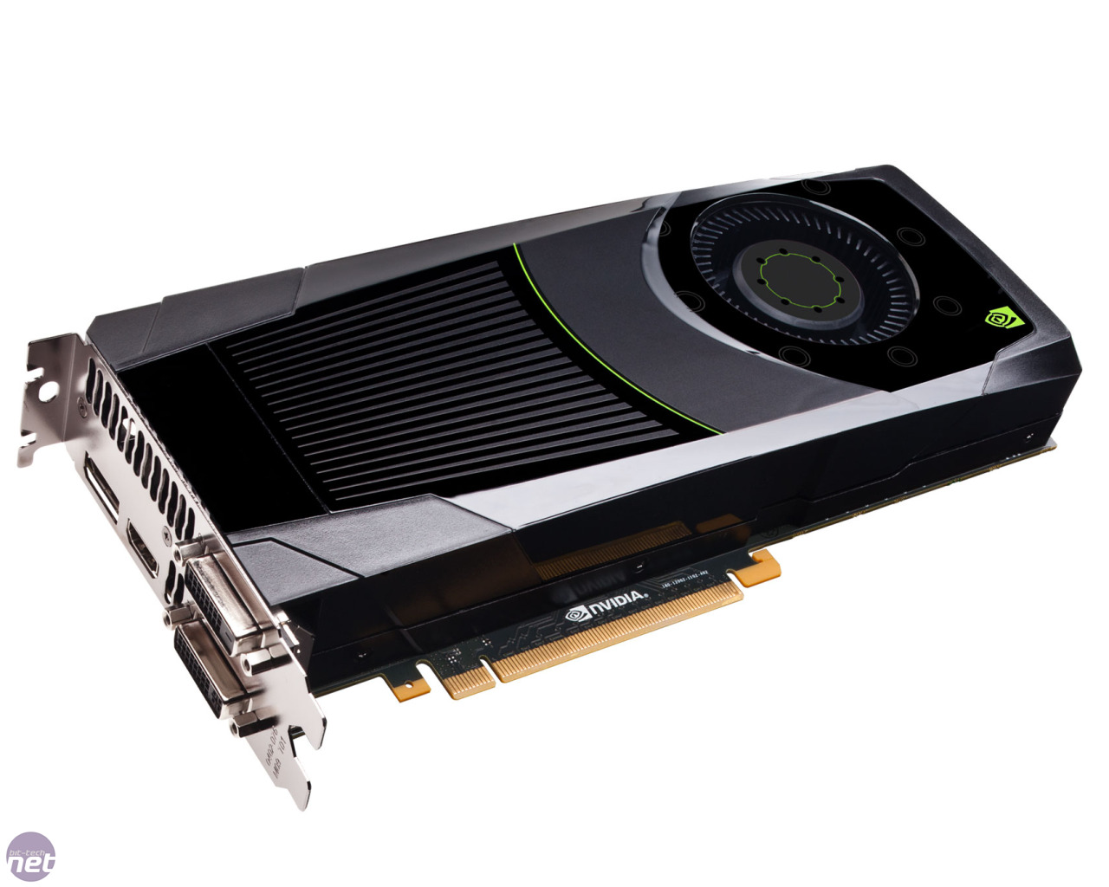
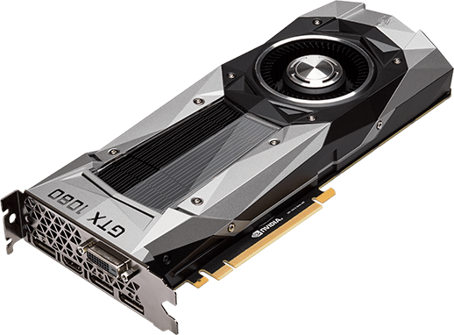
Era of Throughput Architectures
GPUs are scaling: Number of CUDA Cores, DRAM bandwidth
Number of CUDA Cores are scaling rapidly
Memory bandwidth is scaling at a much slower pace
Memory bandwidth being a bottleneck!
2010:
GTX 480
(Fermi)
448 cores
(178 GB/sec)
2012:
GTX 680
(Kepler)
1536 cores
(192 GB/sec)
2016:
GTX 1080
(Pascal)
2560 cores
(320 GB/sec)
Notes:
As we know GPU are scaling both in terms of number of CUDA cores as well peak DRAM
Bandwidth. For example, the latest NVIDIA GPU GTX 1080 has more than 2000 cores.
Given such powerful GPUs, the question is -- Are we “still” using them efficiently?
Memory Bandwidth not increasing fast enough.

Slide 41
Input sensitivity of Regression models

Slide 42
Accuracy of execution time-bin prediction model
Average Accuracy
GPU-PIM = 80%
GPU-PIC = 77%
Classification error of test kernel execution times.
Notes:
PIM Classification error

Slide 43
Modified CUDA runtime to support Kernel Offloading Mechanism
CUDA Runtime
GPU-PIM
Affinity Prediction Model
ii
Kernel Distribution
Unit
Execution Time Prediction Model
GPU-PIC
iii
iv

Slide 44
Effects of Kernel Offloading Mechanism
Training
Test
Percentage of execution time GPU-PIM and GPU-PIC execute kernels with our kernel offloading scheme.

Slide 45
Effects of Concurrent Kernel Management
Training
Testing
Percentage of execution time when kernels are concurrently running on GPU-PIM and GPU-PIC with our concurrent kernel management scheme

