Slide 1




Exploiting Core Criticality for Enhanced GPU Performance
Adwait Jog, Onur Kayıran, Ashutosh Pattnaik,
Mahmut T. Kandemir, Onur Mutlu,
Ravishankar Iyer, Chita R. Das.
SIGMETRICS ‘16

Slide 2
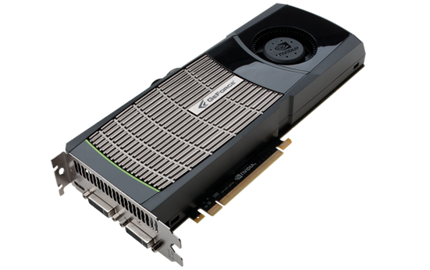

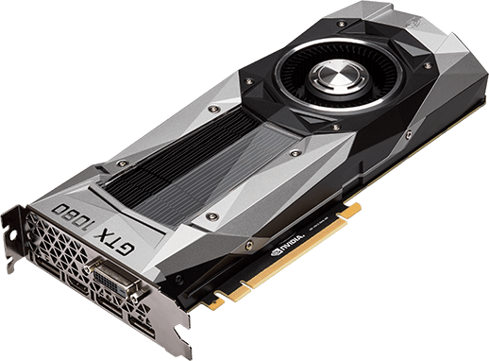
Era of Throughput Architectures
GPUs are scaling: Number of CUDA Cores, DRAM bandwidth
Number of CUDA Cores are scaling rapidly
Memory bandwidth is scaling at a much slower pace
2010:
GTX 480
(Fermi)
448 cores
(178 GB/sec)
2012:
GTX 680
(Kepler)
1536 cores
(192 GB/sec)
2016:
GTX 1080
(Pascal)
2560 cores
(320 GB/sec)
Notes:
As we know GPU are scaling both in terms of number of CUDA cores as well peak DRAM
Bandwidth. For example, the latest NVIDIA GPU GTX 1080 has more than 2000 cores.
Given such powerful GPUs, the question is -- Are we “still” using them efficiently?
Memory Bandwidth not increasing fast enough.

Slide 3
Current Trend
Modern Schedulers (e.g., FR-FCFS)
assume that all memory requests are equally critical towards performance.
maximize memory data throughput.
Inability of FR-FCFS to distinguish memory requests from different GPU cores lead to
GPU cores experiencing significant variation in average memory access latencies
some GPU cores becoming more “critical” than others
Notes:
Due to such variation, the number of stalling warps that belong to the cores that suffer
from higher memory access latencies is typically higher than that of other cores, making
the former type of cores less latency tolerant, i.e., more critical for overall performance.
Thus, because different cores have varying degrees of tolerance to latency during
execution, their corresponding memory requests have varying degrees of criticality

Slide 4
Coefficient of Variation (COV) in Average Memory Access Latencies
To understand further,
consider the COV (ratio of Standard Deviation over Arithmetic Mean) in memory access latencies
some GPU cores experience higher avg. memory latency than others
these cores are less latency tolerant (“critical”)
latency variations correlate with IPC variation
We need to take core criticality into account.
Prioritize requests from GPU cores with less latency tolerance
Contention is present in entire memory hierarchy.
In this work, we only consider main memory contention
We propose CLAMS, a criticality aware memory scheduling mechanism

Slide 5
Outline
Introduction and Motivation
Core Criticality: Metrics and Analysis
Design of Criticality Aware Memory Scheduler
Infrastructure Setup and Evaluation
Conclusions

Slide 6
Core Criticality: Metrics
We need to quantify core criticality.
Use latency tolerance as a measure of core criticality.
Classify warps into short- and long-latency warp
Short-latency: compute instruction/data in private cache
Long-latency: stalled due to pending memory requests
Calculate short-latency ratio
Ratio of short-latency warps over total issued warps
Assign criticality rank
Quantize short-latency ratio
8 discrete steps, with step size of 1/8.
rank-1: short-latency ratio < 1/8, Most critical
rank-8: short-latency ratio > 7/8, Least critical

Slide 7
Core Criticality: Metrics
Th_{CR} : Criticality-Rank-Threshold
Core is critical if current rank <= Th_{CR}
Takes any integer value from 1 to 8.
PCC(Th_{CR} ): Percentage of critical cores for given Th_{CR}
PCC(Th_{CR} ) of 100%, all cores critical
PCC(Th_{CR} ) of 0%, all cores non-critical
Th_{CR} = 7, PCC(7)=100%
Th_{CR} = 4, PCC(4)=33%
Th_{CR} = 1,
PCC(1)=0%

Slide 8
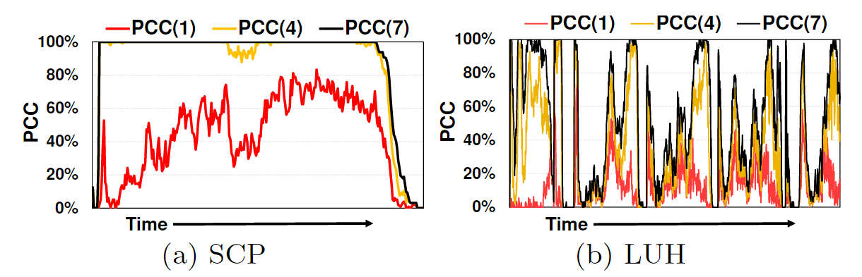
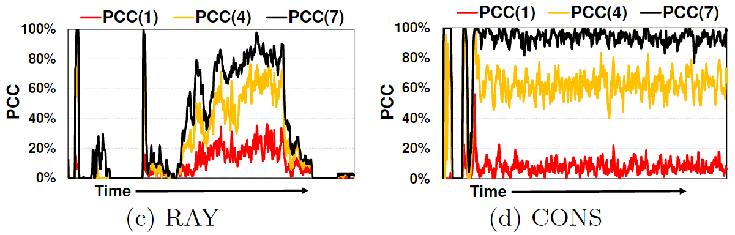
Core Criticality: Metrics
PCC is dependent on the chosen criticality-rank threshold
PCC varies within an application over time
PCC varies across applications
PCC reduces significantly as main memory bandwidth increases

Slide 9
Core Criticality: Metrics and Analysis
If PCC(Th_{CR} ) is low for any given Th_{CR}, then
GPU cores have similar latency tolerance
Memory scheduler should preserve locality
PCC(Th_{CR} ) is calculated periodically and requires
Exchange of global information across cores and MCs
Hardware overhead of calculation
Expensive approach!
We need a metric which can be calculated at the MCs
9

Slide 10
Core Criticality: Metrics and Analysis
We use Percentage of Critical Requests (PCR).
Tag memory requests with core’s current rank
Calculate the percentage of critical memory requests present in the MC request buffer
Eliminates the exchange of global information between GPU cores and MCs
Similar to PCC, PCR needs to be calculated for a given Th_{CR.}

Slide 11
Core Criticality: Metrics and Analysis
PCR patterns for an application similar to PCC
Similar observations hold for PCR
PCR considers criticality of requests instead of their corresponding cores
Time
Time
Time

Slide 12
Core Criticality: Analysis
Scope of criticality aware memory scheduler
Distribution of criticality-rank differences across DRAM requests
criticality-rank differences: difference between highest and lowest criticality-rank of requests in MC at the same time
diff-0 denotes % of DRAM cycles, all memory requests have same rank
Significant rank difference in LUH, RAY, SCAN
High scope
Rank difference is 0 for most of the time for CFD, GAUSS
Low scope

Slide 13
Outline
Introduction and Motivation
Core Criticality: Metrics and Analysis
Design of Criticality Aware Memory Scheduler
Infrastructure Setup and Evaluation
Conclusions

Slide 14
Design of CLAMS
Two major challenges
Co-existence of critical and non-critical requests
Finding appropriate value of Th_{CR}
Low Th_{CR} -> less critical cores
High Th_{CR} -> too many critical cores
Balancing DRAM locality and criticality
Switching between schedulers optimized for criticality or locality
Calculate PCR(Th_{CR}) periodically and compare with Switching-Mode-Threshold(Th_{SM})
PCR(Th_{CR}) > Th_{SM}, locality mode
PCR(Th_{CR}) <= Th_{SM}, criticality mode
Need to find appropriate value of Th_{SM}

Slide 15
Design of CLAMS
Three different approaches
Static-CLAMS
Single and fixed set values for Th_{CR} and Th_{SM}
Semi-Dyn-CLAMS
Dynamically calculates Th_{CR}, based on fixed Th_{SM} and PCR(k) ∀ k information at MC
Dyn-CLAMS
Calculates both, Th_{CR} and Th_{SM}.
Working modes of CLAMS
Decided based on per bank’s memory requests
Locality mode
Criticality mode
Notes:
It prioritizes: 1) row-
hit requests over all other requests, 2) critical requests over
other requests, 3) older requests over younger ones. Hence,
if there are no critical requests present, this mode follows
the baseline FR-FCFS scheduling policy [74,93], which prioritizes: 1) row-hit requests over all other requests, 2) older
requests over younger ones.
Criticality mode.
In this mode, CLAMS is criticality-
focused, and optimizes mainly for criticality. It prioritizes:
1) critical requests over all other requests, 2) row hit requests
over other requests, 3) older requests over younger ones.
Hence, if there are no critical requests present, this mode
falls back to the baseline FR-FCFS policy.

Slide 16
Design of Static-CLAMS
rank-4 provides a mix of both, critical and non-critical requests
We choose Th_{CR} = 4
But, many applications have different distribution such as SCP
Assuming Th_{SM} = 20% -> locality mode most of the time
Assuming Th_{SM} = 80% -> criticality mode most of the time
Potentially degrade DRAM row buffer locality
Take away:
We need to adapt Th_{CR} based on the application
Th_{CR} and Th_{SM} should not be determined independently

Slide 17
Design of Semi-Dyn-CLAMS
Computes Th_{CR}
Based on fixed Th_{SM} value, and PCR(k) ∀ k ∈ {1...8} information at MC
We find a value for Th_{CR} such that PCR(Th_{CR}) is ≦Th_{SM} and is as close to it as possible
This will switch scheduler into criticality mode
In case no such Th_{CR} can be found, switch to locality mode

Slide 18
Design of Semi-Dyn-CLAMS
Lets look at SCP
Assume Th_{SM} = 40%, and Th_{CR} can take any value in {1,4,7}.
Th_{CR} = 1, is chosen for first half of execution as PCR(1) <= 40%. Scheduler works in criticality mode.
For second half of execution, for no Th_{CR,} is PCR(Th_{CR}) <= 40%. Scheduler switches to locality mode.
Most of the requests are critical and cannot be prioritized
Th_{CR} is obtained using the PCR(k) information at the MC
But, actual working mode of scheduler determined based on the requests to be issued to a particular bank.
Aware of requests destined to each bank
Aware of all requests in the MC
2
Take away:
Semi-Dyn-CLAMS aggressively uses criticality mode
Only goes to locality mode, when too many critical requests present in the MC buffer
Can lead to significant loss in locality and performance
No feedback on Th_{SM} when new value of Th_{CR} is calculated.
1
Time
1
2

Slide 19
Design of Dyn-CLAMS
Even though Semi-Dyn-CLAMS facilitates criticality mode
Actual mode based on requests to each bank
Can be locality mode even though PCR(Th_{CR}) <= Th_{SM}
Dyn-CLAMS attempts to improve the loss in locality.
Dynamically calculates Th_{CR} and updates Th_{SM} based on the new value of Th_{CR}.
Key Idea:
Gauge the negative effect of loss in row locality on latency tolerance
Mitigate the loss by lowering Th_{SM} while maintaining the value of Th_{CR.}

Slide 20
Design of Dyn-CLAMS
Initialize Th_{SM} = 40%, and Th_{CR} = 8
Calculate Th_{CR} based on Semi-Dyn-CLAMS
Th_{CR} updated to 1
Update Th_{SM} to new value of PCR(Th_{CR})
In second half of execution
Scheduler goes into locality mode, similar to Semi-Dyn-CLAMS
1
Take away:
Dynamically updating Th_{CR} allows scheduler to aggressively work in criticality mode
By reducing Th_{SM}, the scheduler’s starts to improve locality by using locality mode for the banks
chances of a bank’s PCR(Th_{CR}) > Th_{SM} increase
3
2
Th_{SM}
2
1
3
Time

Slide 21
Outline
Introduction and Motivation
Core Criticality: Metrics and Analysis
Design of Criticality Aware Memory Scheduler
Simulation Setup and Evaluation
Conclusions

Slide 22
Simulation Setup
Evaluated on GPGPU-Sim, a cycle accurate GPU simulator
Baseline configuration similar to scaled-up version of GTX480
32 SMs, 32-SIMT lanes, 32-threads/warp
16KB L1 (4-way, 128B cache block) + 48KB Shared Mem/SM
6 partitions/channels
Applications classified into 2 groups
Group A: Moderate to High scope
Group B: Low scope

Slide 23
Performance with CLAMS (Normalized to FR-FCFS)
More results and detailed description
of Dyn-CLAMS effects in the paper
Group A
Group B
Performance improvement for Group A applications
Static-CLAMS = 4.6%
Static-CLAMS-Best = 9.3%
FR-FCFS-Cap-Best = 4%
Semi-Dyn-CLAMS = 6.5%
Dyn-CLAMS = 8.4%

Slide 24
Take Away Messages
Variation in average memory access latencies across the GPU cores, makes some GPU cores more “critical” than others.
Memory schedulers being agnostic to the criticality of GPU cores can lead to sub-optimal performance
We need to orchestrate the exploitation of core-criticality and DRAM locality
Dyn-CLAMS provides an average performance improvement of 8.4%.

Slide 25
Exploiting Core Criticality for Enhanced GPU Performance
Adwait Jog, Onur Kayıran, Ashutosh Pattnaik,
Mahmut T. Kandemir, Onur Mutlu,
Ravishankar Iyer, Chita R. Das.
SIGMETRICS ‘16

Slide 26
Backup Slides

Slide 27
Design of Semi-Dyn-CLAMS
Lets look at CONS
Assume Th_{SM} = 40%, and Th_{CR} can take any value in {1,4,7}.
Th_{CR} = 4, is chosen. Scheduler works in criticality mode most of the time.
1
Time

Slide 28
Design of Dyn-CLAMS
Initialize Th_{SM} = 40%, and Th_{CR} = 8
Calculate Th_{CR} based on Semi-Dyn-CLAMS
Th_{CR} updated to 4
Update Th_{SM} to new value of PCR(Th_{CR})
Similar to the curve of PCR(4)
With the reduction of Th_{SM}, chances of scheduler going to locality mode increase
1
3
Th_{SM}
1
3
Time

Slide 29
Take Away Messages
Memory schedulers being agnostic to the criticality of GPU cores can lead to sub-optimal performance
Variation in average memory access latencies across the GPU cores, makes some GPU cores more “critical” than others.
Core criticality aware memory system is required for enhanced GPU performance
Percentage of Critical Cores (PCC) is a good proxy to measure Percentage of Critical Requests (PCR) which defines the criticality of a GPU core.
Dynamically choosing between either exploiting core-criticality or DRAM locality
Dyn-CLAMS provides an average performance improvement of 8.4% across Group-A applications.

Slide 30
Scheme Runtime Plots

Slide 31
Th_{SM} = 40%
Th_{SM} = 80%
Th_{SMinit} = 40%
Th_{SMinit} = 80%
Time
Time
Th_{SM} = 40%
Th_{SM} = 80%
Th_{SMinit} = 40%
Th_{SMinit} = 80%
(Th_{CR} )
B
B
(Th_{SM} )
A
Time
B
B
Time

Slide 32
Results

Slide 34
Useful-BW
Wasted-BW

