Slide 1



Controlled Kernel Launch for Dynamic Parallelism in GPUs
Xulong Tang, Ashutosh Pattnaik, Huaipan Jiang,
Onur Kayiran, Adwait Jog, Sreepathi Pai, Mohamed Ibrahim,
Mahmut T. Kandemir, Chita R. Das
HPCA - 23

Slide 2
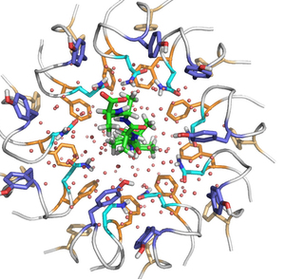
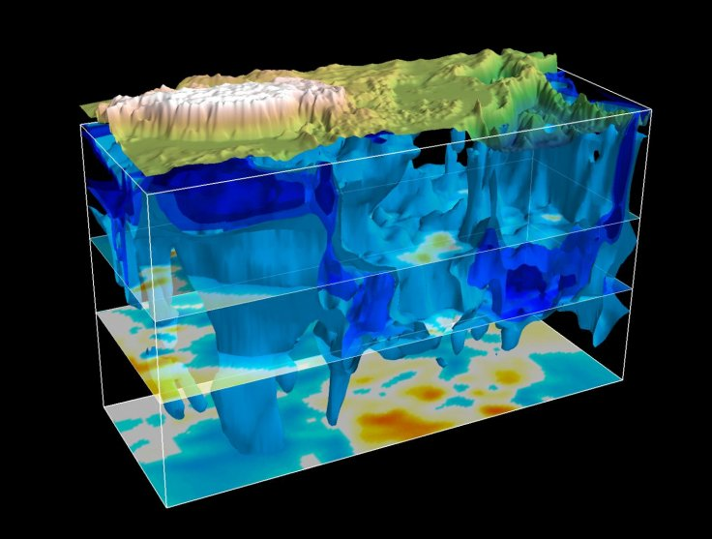

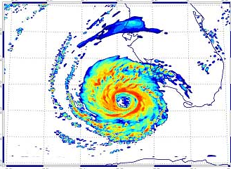
Irregularity of Applications
Irregular applications
Molecular dynamics
Earthquake simulation
Weather simulations
Economics
Most of these applications
use GPUs for acceleration.
Are GPUs being used efficiently?
Image source:
http://www.nature.com/nature/journal/v516/n7530/fig_tab/nature13768_SF5.html
https://en.wikipedia.org/wiki/Weather_Research_and_Forecasting_Model
http://www.tibetnature.net/en/massive-fast-moving-structure-seen-beneath-tibetan-plateau-in-earthquake-simulation-study/
https://hgchicago.org/courses/advanced-courses/economic-science/

Slide 3
Irregularity: Source of GPU Inefficiency
Imbalanced workload among GPU threads
Thread-1 (T1) undertakes more computations than other threads.
Underutilized hardware resources
Threads, register files, shared memory, etc.
T1
T3
T2
T4
Execution time
PE1
PE2
PE3
PE4
Idle

Slide 4
Dynamic Parallelism in GPUs
Application
Dynamic parallelism (DP)
Allow applications to launch kernels at the device (GPU) side, without CPU intervention.
Advantages
High GPU occupancy
Dynamic load balancing
Supports recursive parallel applications
Parent Kernel
…
Parent Kernel
T1
T2
T3
Threads
Is Dynamic Parallelism the solution for all
irregular applications?
Child Kernel
Child Kernel
…
Child Kernel
…
Child Kernel
Child Kernel
…
Child Kernel
…
Child Kernel
Execution Time
PE1
PE2
PE3
PE4
Execution Time
PE1
PE2
PE3
PE4
Idle

Slide 5

Dynamic Parallelism in GPUs
More child kernels increase overhead, and do not improve parallelism further, due to hardware limits.
Launching child kernels improves parallelism.
Performance
Performance peak
All work in
parent kernel
All work in
child kernels
There is no free lunch!
Workload distribution ratio between parent and child

Slide 6
Executive Summary
Dynamic Parallelism improves parallelism for irregular applications running on GPUs.
However, aggressively launching child kernels without knowledge of hardware state degrades performance.
DP needs to make smarter decisions on how many child kernels should be launched.
Our proposal: SPAWN, a runtime framework,
which uses GPU hardware state to decide
how many kernels to launch

Slide 7
Outline
Introduction
Background
Characterization
Our proposal: SPAWN
Evaluation
Conclusions

Slide 8
Background: DP Usage in Applications
Host code
1. int main(){
2. …
parent<<< p_grid, p_cta>>>(type *workload);
…}
Three key parameters related to child kernel.
Workload distribution
ratio (THRESHOLD)
Child kernel dimension (c_grid, c_cta)
Child kernel execution order (c_stream)
parent (type *workload){
2. …
3. if (local_workload > THRESHOLD){
4. child<<< c_grid, c_cta, shmem, c_stream>>> 5. else
6. while(local_workload){…}
7. …}
Parent kernel
1. __global__ void child(*c_workload){
2. …
3. }
Child kernel

Slide 9
Background: Hardware Support for DP
Runtime APIs
Device Runtime APIs
Application
3
Stream Queue Management (SQM)
Software Support
1
2
K1
Software Work
Queues
Host
(CPU)
K2
K3
4
Grid Management Unit (GMU)
K1
Hardware Work
Queues
K2
Hardware Support
K3
5
CTA scheduler
PE
PE
PE
PE
6

Slide 10
Outline
Introduction
Background
Characterization
Our proposal: SPAWN
Evaluation
Conclusions

Slide 11
Characterization of DP Applications
Three key parameters.
Workload distribution ratio, child kernel dimension, child kernel sequence
Observations
Workload distribution is very important.
Preferred workload distribution ratio varies for different applications and inputs.
Best offline-search: peak performance through manually varying the workload distribution ratio (THRESHOLD).
Baseline-DP: offload most computations by launching child kernels.
BFS-citation
BFS-graph500
MM-small
Most work done by parent threads
Most work done by child kernels

Slide 12
Overheads
Runtime APIs
Device Runtime APIs
Launch overhead: from invoking API to kernels being pushed into GMU and ready to start execution.
Queuing latency: Kernels waiting in GMU due to the hardware limitations.
Maximum number of concurrently running kernels.
Maximum number of concurrently running CTAs.
Available hardware resources.
Application
3
Stream Queue Management (SQM)
Software Support
1
2
K1
Software Work
Queues
Host
(CPU)
K2
K3
4
+
+
Grid Management Unit (GMU)
6
3
4
K1
K2
Hardware Work
Queues
Hardware Support
K3
5
CTA scheduler
PE
PE
PE
PE
6

Slide 13
Workload Distribution
Ⅰ
Parent Kernel
Launch Overhead
Parent Kernel Waiting
Too many child kernels.
CTA_{parent}
HWQ
CTA_{parent}
HWQ
Time
Parent Kernel
Child Kernel

Slide 14
Workload Distribution
Ⅰ
Parent Kernel
Launch Overhead
Parent Kernel Waiting
Too many child kernels.
CTA_{parent}
HWQ
CTA_{parent}
HWQ
Time
Ⅱ
Parent Kernel
Launch Overhead
Not enough child kernels.
A
CTA_{parent}
HWQ
CTA_{parent}
HWQ
Parent Kernel
Child Kernel

Slide 15
Workload Distribution
Ⅰ
Parent Kernel
Launch Overhead
Parent Kernel Waiting
Too many child kernels.
CTA_{parent}
HWQ
CTA_{parent}
HWQ
Time
Important to decide how many child kernels to launch
Ⅱ
Parent Kernel
Launch Overhead
Not enough child kernels.
A
CTA_{parent}
HWQ
CTA_{parent}
HWQ
Ⅲ
Parent Kernel
Launch Overhead
B
CTA_{parent}
HWQ
Parent Kernel
CTA_{parent}
HWQ
Child Kernel

Slide 16
Opportunities
(best)
Average speedup of best Offline-Search scenario
over non-DP implementation: 1.73x
over Baseline-DP implementation: 1.61x

Slide 17
Our goal
Improving hardware resource utilization of DP applications
Preventing the application from reaching the hardware limitations
Dynamically controlling the performance tradeoffs between increasing parallelism and incurring overheads

Slide 18
Outline
Introduction
Background
Characterization
Our proposal: SPAWN
Evaluation
Conclusions

Slide 19
Design Challenges
PT1
If processed by launching child kernel.
overheads
C1
Scenario I
PT2
overheads
C2
PT3
Better not to launch
overheads
C3
If processed within parent thread.
Time
t1
t2
t3
t4
t5
t6

Slide 20
Design Challenges
PT1
overheads
C1
Scenario I
PT2
overheads
C2
Important to decide whether to launch child kernels or not
PT3
Better not to launch
overheads
C3
If processed by launching child kernel.
PT1
overheads
C1
Scenario II
PT2
Better to launch
overheads
C2
If processed within parent thread.
PT3
overheads
C3
Time
t1
t2
t3
t4
t6
t5

Slide 21



SPAWN
Device Runtime
Feedback
Child CTA Queuing System (CCQS)
SPAWN Controller
launch kernels
PEs
$$λ$$
$$T$$
GMU
$$n$$
Compute in Parent Thread
Launch overhead
Queuing
latency
Execution
time
Child CTA Queuing System (CCQS)
CTA arrival rate (λ), Number of CTAs (n), throughput (T)
Provide feedback information to update the predictive metrics.
Launch overhead: a function of the number of child kernels being launched.
Queueing latency: CTAs waiting in GMU
Execution time: CTAs executed on PEs.
SPAWN Controller

Slide 22
SPAWN Controller
Whether to launch child kernel or not
Process the computations by launching a kernel with (x) CTAs:
Estimated execution time
t_child = launch overhead + n/T + x/T
Where
T = Throughput
λ = CTA arrival rate
n = Number of CTAs in CCQS

Slide 23
SPAWN Controller
Whether to launch child kernel or not
Process the computation within the thread:
If a parent thread with (w) computations to process
Estimated execution time:
t_parent= w * avg_pwarp_time
Where
w = Number of computations to process
avg_pwarp_time = Average parent warp execution time
If t_parent < t_child, processing within parent thread. Otherwise launch the child kernels.

Slide 24
Outline
Introduction
Background
Characterization
Our proposal: SPAWN
Evaluation
Conclusions

Slide 25
Evaluation Methodology
GPGPU-sim v3.2.2
13 SMXs (PEs), 1400MHz, 5-stage pipeline
16KB 4-way L1 D-cache, 128B cacheline
1536KB 8-way L2 cache, 128B cacheline.128KB/Memory Partition
Greedy-Then-Oldest (GTO) dual warp scheduler
Concurrency Limitations
Concurrent CTA limit: 16 CTAs/SMX (PE) (208 CTAs in total)
Concurrent kernel limit: 32 hardware work queues

Slide 26
Evaluation
More results and discussions are
present in the paper.
Performance Improvement:
69% over non-DP (all work done by parent kernel)
57% over baseline-DP (most work done by child kernels).
Within 4% of the Best-Offline-Search scenario.

Slide 27
Conclusions
Dynamic parallelism improves parallelism for irregular applications running on GPUs.
Aggressive and hardware-agnostic kernel launching degrades performance because of overheads and hardware limitations.
We propose SPAWN, which makes smart child kernel launching decisions based on the hardware state.
SPAWN improves performance by 69% over non-DP implementation and 57% over baseline-DP implementation.

Slide 28
Questions?
Controlled Kernel Launch for Dynamic Parallelism in GPUs
Xulong Tang, Ashutosh Pattnaik, Huaipan Jiang,
Onur Kayiran, Adwait Jog, Sreepathi Pai, Mohamed Ibrahim,
Mahmut T. Kandemir, Chita R. Das
HPCA - 23

Slide 29
Backup Slides

Slide 30
Workload Distribution
Child CTAs got scheduled and start execution.
i
iii
ii
iv
Parent CTAs start finishing and relinquish resources for child CTAs.
Resource under utilization due to launch overheads, concurrent kernel limits.

Slide 31
Evaluation
Baseline-DP
SPAWN

Slide 32
Accuracy
-20% -10% AVG +10% +20%
-20% -10% AVG +10% +20%

Slide 33
Evaluation
6000
4000
2000
Saved cycles

Slide 34
SPAWN
Source to Source Translation
CPU Execution
CUDA Runtime
CUDA
Program
SPAWN
Kernel
Launch
Software support
Source to source translation.
Extended API call with local workload parameter.
Hardware support
Tracking and updating historical execution statistics.

Slide 35
Background: Hardware Supports DP
Runtime APIs
Device Runtime APIs
Launch overhead: from invoking API to kernels being pushed into GMU and ready to start execution.
Queuing latency: Kernels waiting in GMU due to the hardware limitations.
Maximum number of concurrent running kernels.
Maximum number of concurrent running CTAs.
Available hardware resources.
Application
3
Stream Queue Management (SQM)
SWQ 1
SWQ 2
SWQ 3
Software Support
1
2
K1
K4
K7
Software Work
Queues
Host
(CPU)
K2
K5
K8
K3
K6
K9
4
+
+
Grid Management Unit (GMU)
6
3
4
Pending Kernel Pool
32 Hardware Work
Queues
Hardware Support
5
CTA scheduler
CU/SMX
CU/SMX
CU/SMX
CU/SMX
6
Interconnect
L2 Cache

Slide 36
Accuracy

Slide 37
Background
Three key parameters related to child kernel.
THRESHOLD
Child kernel dimension (c_grid, c_cta).
Child kernel execution order (c_stream).
(a)
1. int main( int argc, char** argv){
2. dim3 p_grid; dim3 p_cta; /**parent kernel dimension*/
/**parent kernel launch*/
3. parent<<< p_grid, p_cta>>>(type *workload); }
parent (type *workload){
/**each parent threads pick up its workload*/
2. type *local_workload = workload[tid];
3. if (local_workload > THRESHOLD){
4. child<<< c_grid, c_cta, shmem, c_stream>>>(type *local_workload);}
5. else
6. while(local_workload){…}
/**waiting for all children to finish*/
7. cudaDeviceSynchronize();
8. }
(b)
1. __global__ void child(*c_workload){
2. …
3. }
(c)

Slide 38
Characterization of DP Applications
Three key parameters.
Workload distribution (THRESHOLD)
Child kernel dimension (c_grid, c_cta).
Child kernel execution order (c_stream).
Observations
Varying the workload distribution ratio (THRESHOLD) results in significant performance impact.
The preferred workload distribution ratio for each benchmark, even each input, is different.
Performance
All work in
parent kernel
All work in
child kernels
Workload distribution between parent and child

Slide 39
Characterization of DP Applications
BFS-graph500
Offline-Search: manually varying the workload distribution ratio by twisting the THRESHOLD parameter.
MM-small
BFS-citation

Slide 40
SPAWN design
Accuracy

Slide 41



SPAWN
Child CTA Queuing System (CCQS)
Child kernel launch API
SPAWN Controller
launch childs
Feedback
SMXs
$$λ$$
$$T$$
GMU
$$n$$
Compute in Parent Thread
Launch overhead
Queuing
latency
Execution
time
Child CTA Queuing System (CCQS)
CTA arrival rate (λ), Number of CTAs (n), throughput (T)
Provide feedback information to update the predictive metrics.
SPAWN Controller
Cost of launching a child kernel:
Launch overhead + queuing latency + execution time
Cost of processing the work in parent thread:
Iterative execution.

