Slide 1



Crypto Pulse
Insight to Cryptocurrency using Power BI
Open Innovation
Ctrl Freaks
https://github.com/shubhamraj22/Crypto-Pulse.git

Slide 2

Basic Details Of Problem Statement
Problem Statement Title: Insight to Cryptocurrency using Power BI
Team Name: Ctrl Freaks
Team Leader Name: Ashutosh Pratap Singh
Institute Name: Galgotias University
Theme Chosen: Open Innovation

Slide 3


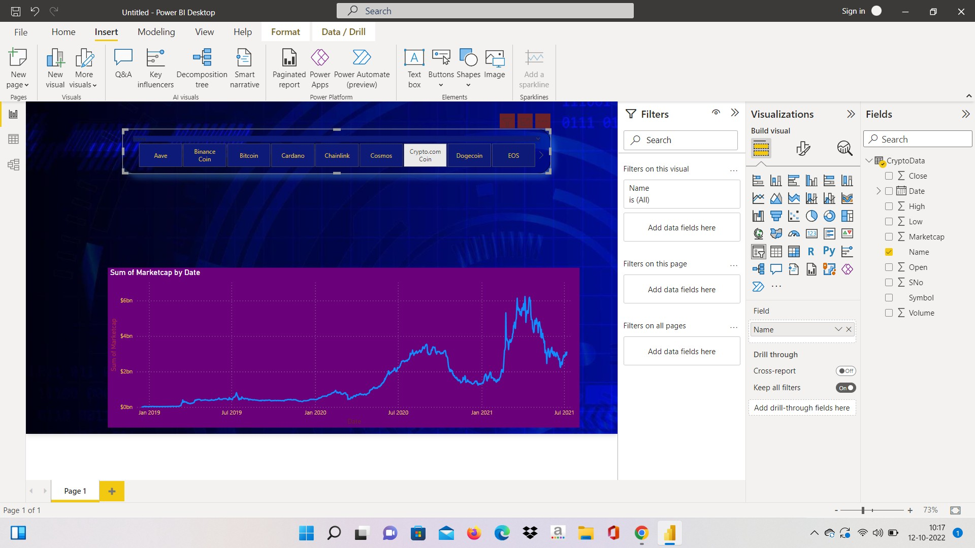

Idea / Approach Details
Describe Idea / Solution prototype Here.
Describe

Slide 4

Idea / Approach Details
Use Cases
The Dependencies
Individual Investors: Use Power BI to track portfolio performance and analyze market sentiment for informed decisions.
Cryptocurrency Traders: Utilize Power BI for real-time trading analytics and technical analysis to optimize strategies.
Institutional Investors: Monitor fund performance and ensure regulatory compliance with Power BI's data analysis tools.
Cryptocurrency Exchanges: Analyze market trends and enhance customer experience using Power BI dashboards.
Blockchain Developers: Utilize Power BI to analyze blockchain data and conduct market research for insights.
Data Access: Reliable access to cryptocurrency market data.
Integration with Power BI: Seamless integration of data sources with Power BI.
Market Knowledge: Basic understanding of cryptocurrency markets and investment principles.
Real-time Feeds: Access to real-time market data for traders.
Compliance Measures: Implementation of regulatory compliance tools.
Security Measures: Protection of sensitive financial data.
Customer Data Management: Access to customer data for exchanges.
Blockchain Data Access: Availability of blockchain data sources.
Market Research Tools: Access to tools for industry analysis.
YOUR LOGO ABOUT PROJECT PRICE TEAM

Slide 5




Important Pointers
Some proto types of the model/example.
Data Accuracy: Ensure that the cryptocurrency data being analyzed is accurate and reliable to make informed decisions.
Security Measures: Implement robust security measures to protect sensitive financial data and user information.
Regulatory Compliance: Adhere to regulatory requirements and compliance standards, especially regarding AML/KYC regulations.
Real-time Analysis: Utilize Power BI to monitor cryptocurrency markets in real-time and react promptly to market movements.
Diverse Data Sources: Incorporate diverse data sources beyond price, such as trading volume, sentiment analysis, and blockchain data, for comprehensive insights.
Customized Dashboards: Develop customized Power BI dashboards tailored to specific user needs, whether for individual investors, traders, or institutional investors.
Continuous Learning: Stay updated with evolving market trends, new analytical techniques, and regulatory changes to optimize analysis efforts.
Collaborative Analysis: Foster collaboration among teams by sharing insights and collaborating on Power BI reports and dashboards for collective decision-making.
Actionable Insights: Focus on deriving actionable insights from Power BI analyses to drive strategic decisions and improve outcomes in the cryptocurrency market.
ETHEREUM
PRICE: $3,514.51
BITCOIN
PRICE: $56,238.00

Slide 6
Business Idea
Cryptocurrency Portfolio Analysis Service: Create a service that allows cryptocurrency investors to analyze and visualize their portfolio performance using Power BI. Offer insights such as asset allocation, historical performance, risk analysis, and comparative analysis against various benchmarks.
Cryptocurrency Market Research Reports: Develop comprehensive market research reports on various cryptocurrency trends, ICOs, DeFi projects, and emerging technologies. Utilize Power BI to create interactive dashboards and visualizations that provide deep insights into market dynamics, trading volumes, sentiment analysis, and more.
Cryptocurrency Exchange Analytics Platform: Build a platform that integrates with multiple cryptocurrency exchanges and provides users with real-time analytics on trading activities, liquidity, order book dynamics, and market depth. Use Power BI to generate intuitive dashboards and reports for traders and institutional investors.
Cryptocurrency Compliance and Risk Management Solutions: Develop compliance and risk management solutions for cryptocurrency businesses and financial institutions. Use Power BI to create customizable compliance dashboards that monitor transactions, detect suspicious activities, and ensure regulatory compliance with AML (Anti-Money Laundering) and KYC (Know Your Customer) regulations.
Cryptocurrency Education and Training Platform: Launch an online platform that offers courses, webinars, and training programs on cryptocurrency investing, trading strategies, technical analysis, and blockchain fundamentals. Use Power BI to provide interactive data visualizations and case studies to enhance learning outcomes.
Cryptocurrency Market Sentiment Analysis Tool: Develop a sentiment analysis tool that aggregates news articles, social media posts, and forum discussions related to cryptocurrencies. Use natural language processing (NLP) algorithms to analyze sentiment and gauge market sentiment trends. Present the findings through Power BI dashboards that help traders make informed decisions.
Cryptocurrency Investment Advisory Service: Offer personalized investment advisory services to cryptocurrency investors based on their risk tolerance, investment goals, and market outlook. Utilize Power BI to create dynamic investment dashboards that track portfolio performance, identify investment opportunities, and provide actionable insights for clients.
Cryptocurrency Price Prediction Platform: Develop a machine learning-powered platform that predicts cryptocurrency price movements based on historical data, technical indicators, and market sentiment analysis. Use Power BI to visualize the predictive models and provide users with insights into potential price trends.

Slide 7


Team Member Details
Ashutosh P. Singh (Team Head)
Shivam Bhati
Shubham Chauhan
Shashank Chauhan
Shubham Raj

