Slide 1
MongoDB
Agenda
Who moved my cheese (RDBMS)?
What is NoSQl?
What is MongoDB?
Why are we looking at MongoDB?
How can you get started?
MongoDB Resources

Slide 2
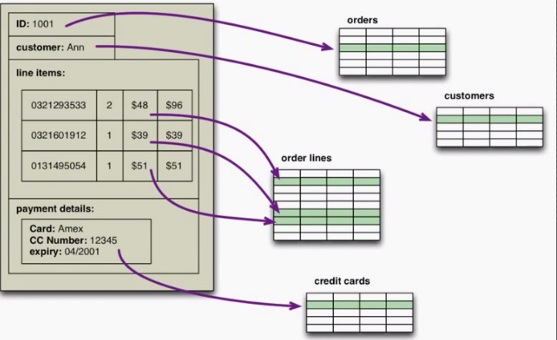
What happened to our RDBMS ?
Impedance Mismatch

Slide 3
Scale Much ?
RDBMS scales vertically
Vertical scaling is costly and hard
We need something that will scale horizontally

Slide 4
What is NoSql ?
Non-Relational
Cluster-Friendly
Schema-Less
Open-Source
Data Model | Database
Document Database | MongoDB, RavenDB, CouchDB, MarkLogic
Key-Value Store | DynamoDB, Riak, Redis
Columns Stores | Hadoop/HBase, Cassandra
Graph Database | Neo4J

Slide 5
Schemaless != NoSchema
We still need to think about our schema
You could shoot yourself in the foot
There is an implicit schema, you just don't know it yet.
e.g. Product[“price”] * Quantity

Slide 6
Consistency
RDBMS = ACID
NoSQl = Basically Available, Soft state, Eventual consistency
Aggregate Oriented databases don't necessarily need ACID.
Aggregates give you natural transaction boundaries
ACID matters when you cross aggregate boundaries

Slide 7
What is MongoDB
Document database
Stores data as JSON
BSON on disk
{
“id” : “asdf123456asdg2j”
“name” : “awesome”
}

Slide 8
Basics
Collections
Document
{
"_id" : ObjectId("51b7362fdb7a2222fc0c760b"),
"dateofbirth" : ISODate("1974-04-12T00:00:00Z"),
"email" : "awesome@awesomeness.com",
"firstname" : "Jane",
"score" : 0,
"surname" : "Doe",
"username" : "janedoe"
}
Database

Slide 9
Features
Document-Oriented Storage → Can be read by humans
Full Index Support → Index properties, multi-key indices
Replication & High Availability
Auto-Sharding
Querying → Easy within boundaries
Fast In-Place Updates
Map/Reduce → Suits many problem domains
GridFS → Store large chunks of data
Drivers → We don't have to hunt for drivers, they are there

Slide 10
Why are we even here ?
Rapid development times
Large scale data
Scale-up has limits, Scale-out is easier and cheaper

Slide 11
Resources
Home → http://www.mongodb.org/
Drivers → http://docs.mongodb.org/ecosystem/drivers/downloads/
Me → https://2guysfrommumbai.wordpress.com

Slide 12
Resources
Home → http://www.mongodb.org/
Drivers → http://docs.mongodb.org/ecosystem/drivers/downloads/
Me → https://2guysfrommumbai.wordpress.com

Slide 13
Q & A

