Slide 1
Layer-2 Firewall
Asma Sadat, Aroop Nanda, Ashutosh Senapati

Slide 2
Goal
Implement a Layer-2 SDN Firewall.
Use the Python based POX OpenFlow controller instead of the default Mininet Controller.
Understand what an SDN based Firewall does and implement it from scratch using POX.

Slide 3
Introduction to SDN FIREWALL
A firewall is a network security device that monitors incoming and outgoing network traffic and permits or blocks data packets based on a set of security rules. Its purpose is to establish a barrier between your internal network and incoming traffic from external sources (such as the internet) in order to block malicious traffic like viruses and hackers.
For an SDN based Firewall, we are going to use the OpenFlow controller to filter traffic between hosts according to some rules and accordingly let it pass through or not.
The way we will do this is by using the POX controller to establish our required policies or rules and filter traffic between hosts using the switches.

Slide 4
Tools Used
Mininet - to create a virtual network topology of choice
POX Controller – A platform written in Python, which communicates with OpenFlow 1.0 and includes support for Open vSwitch.
Python – The firewall rules are applied through Python

Slide 5
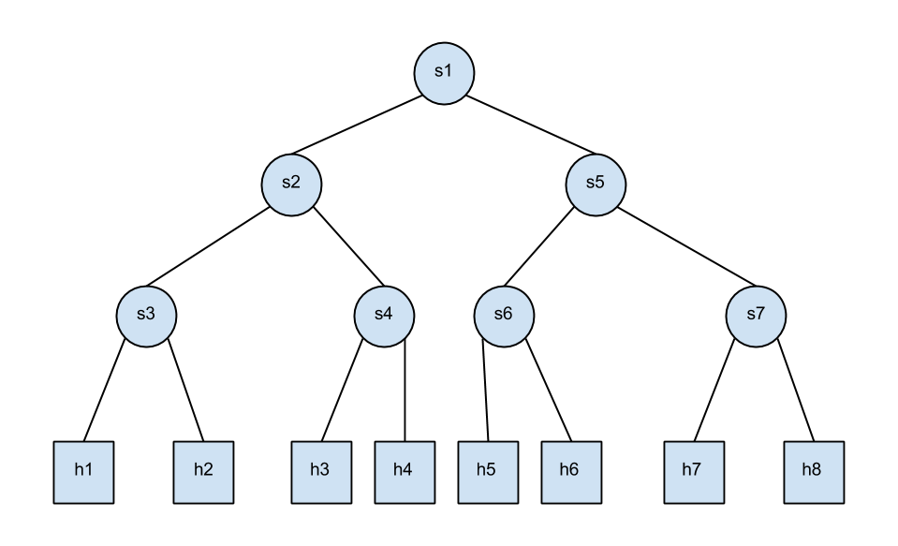
TOPOLOGY

Slide 6
Implementation
Topology Set up in Mininet: We will be adding MAC addresses while initializing the hosts so that we can easily define the Layer-2 rules for our Firewall.
For our Firewall, we will have the 4 following rules:
1) h1 and h2 are mutually blocked.
2) h2 and h4 are mutually blocked.
3) h2 and h7 are mutually blocked.
4) h3 and h8 are mutually blocked.

Slide 7
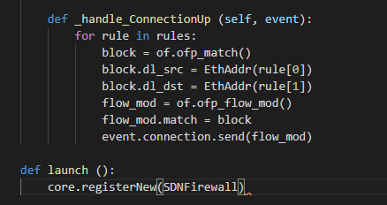
We create our SDNFirewall class in which the controller is going to be accessing and checking flows and modifying flowtables accordingly.
_handle_ConnectionUp will fire up each time a host tries to reach another through the switches.
POX requires a launch function where we pass our SDNFirewall class to it.

Slide 8
How it all works….
To start the Mininet emulation is simple. Run:
sudo mn –custom Custom_topo.py –topo mytopo controller=remote, ip=127.0.0.1
In the mininet CLI, we type pingall to see if our Firewall actually works.
According to our rules, h1 & h2 were never able to connect, neither were h2 & h4, h3 & h8, h2 & h7 able to connect respectively too!
We see that there is a packet loss of 14%, which is the expected behavior.

Slide 9
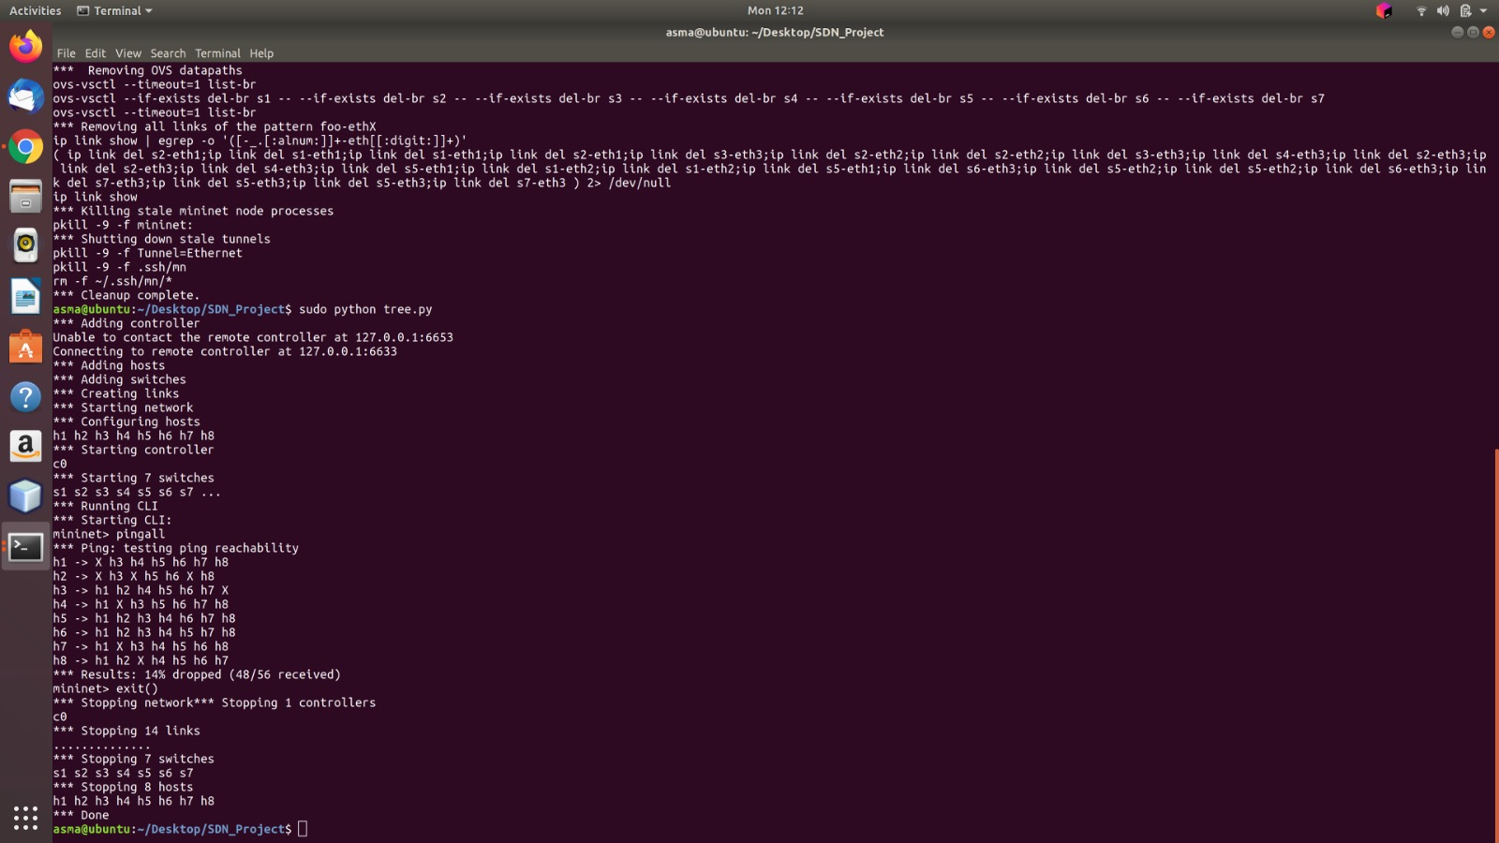

Slide 10
Conclusion
We implemented a layer-2 firewall using the POX controller.
Using rules specifying Layer-2 characteristics we were able to control the switches using POX to either permit traffic between hosts or restrict it.

Slide 11
Thank You!

