Slide 1

Baby
Care

Slide 2
Problem
Live births in India annually : 27 million
Infant Mortality Rate (India): 40.5 deaths/1,000 live births
Infant Mortality Rate (World ): 32 deaths/1,000 live births
Under five mortality rate : 5 million
Deaths due to vaccine preventable diseases : 1 million
Children unimmunized or partially immunized against vaccine-preventable diseases : 8.9 million
Notes:
https://www.nhp.gov.in/Immunization_ms

Slide 3
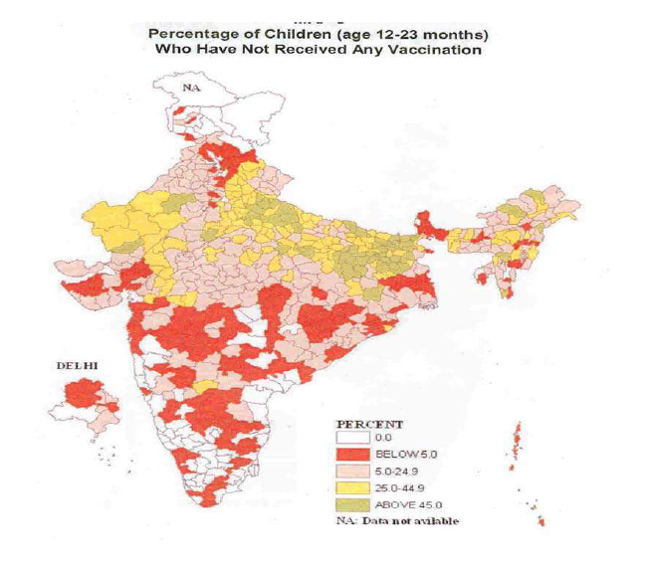
Percentage of Children (Age 12-23 Months) Not Received Any Vaccination

Slide 4
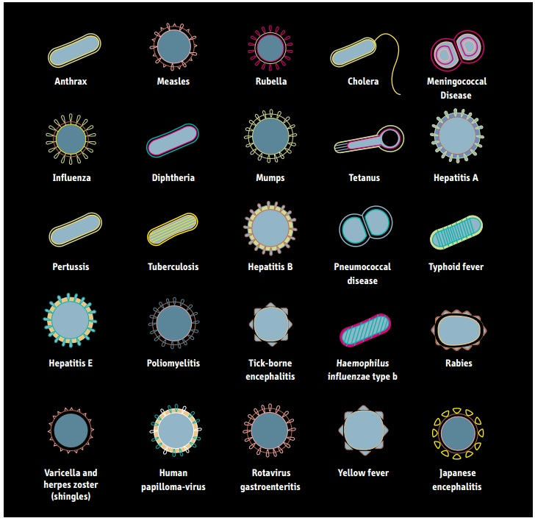
Vaccine-preventable diseases

Slide 5
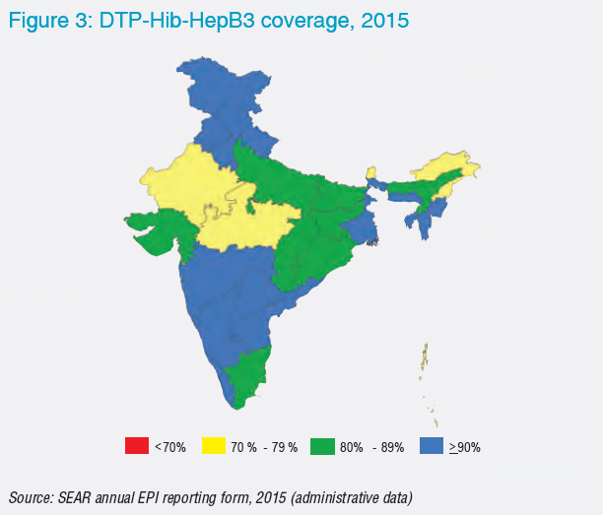

Slide 6
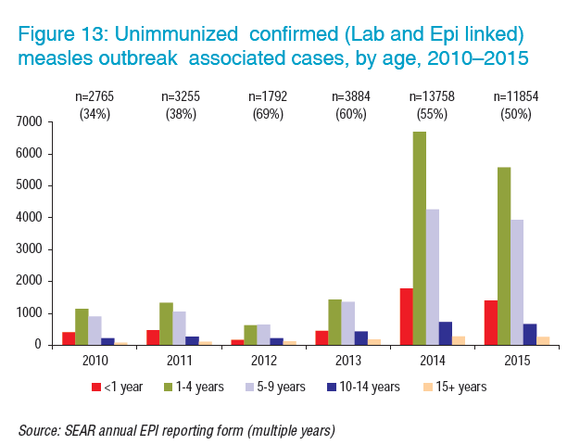

Slide 7
Why are people not immunizing their children?
People unaware of need for immunization
Place/time of vaccination unknown/inconvenient
Long waiting time for vaccines
Fear of side effects
No faith in immunization
Absence of vaccines at vaccination centres
Notes:
http://unicef.in/Whatwedo/3/Immunization

Slide 8
Why we are here?
Parents forget/miss the date of vaccination.
Parents unable to locate vaccination centre near them.
Parents are unaware about the vaccine requirements for their child.
Parents missing follow-up vaccination
Parents caught up in work and cannot take child for vaccination during the day.
Notes:
http://ns.umich.edu/new/releases/23958-most-kids-in-india-lack-timely-vaccinations

Slide 9

Reminder System
Reminder system provides user an Email reminder service and helps them to make sure their children get all necessary vaccinations by sending them reminder Emails on their registered email id prior to the scheduled vaccination date.
This way children will not miss the essential timely vaccines.

Slide 10

Scheduler
Get a general downloadable vaccine schedule containing the general duration of vaccines with their specific doses or get a specific vaccine schedule for your infant depending on her/his date of birth without any registration.
This way parents can easily track the vaccine requirements for their infants.

Slide 11

Locator
Locate service provides user with the location of either, the nearest vaccination points near their GPS location, or of vaccination points anywhere in the city where they can get their children vaccinated.

Slide 12
Phone Message Reminder
Phone message Reminder system provides user an SMS reminder service and helps them to make sure their children get all necessary vaccinations by sending them reminder SMS on their registered phone no. prior to the scheduled vaccination date.
This way children will not miss the essential timely vaccines.

Slide 13

Live Doc Talk
This feature allows Parents to chat with doctors abour their Baby’s Vaccines. Get personalized advice from verified doctors anytime.
This feature is built upon Telegram Bot.

Slide 14

News Section
Stay abreast with latest news related to vaccines and immunization. Learn about latest disease outbreaks around the globe and also the miraculous vaccine discoveries from around the world.

Slide 15
Thank You

