Slide 1



SMART INDIA HACKATHON 2026
  Problem Statement ID - 26102
  Problem Statement Title - Development of an AI-powered system to detect anomalies, fraud, and inefficiencies in MPLAD Scheme implementation regd.
  Theme - Smart Automation
  PS Category - Software
  Team ID - 146579
  Team Name (Registered on portal) – The-Lolgorithms

Slide 2
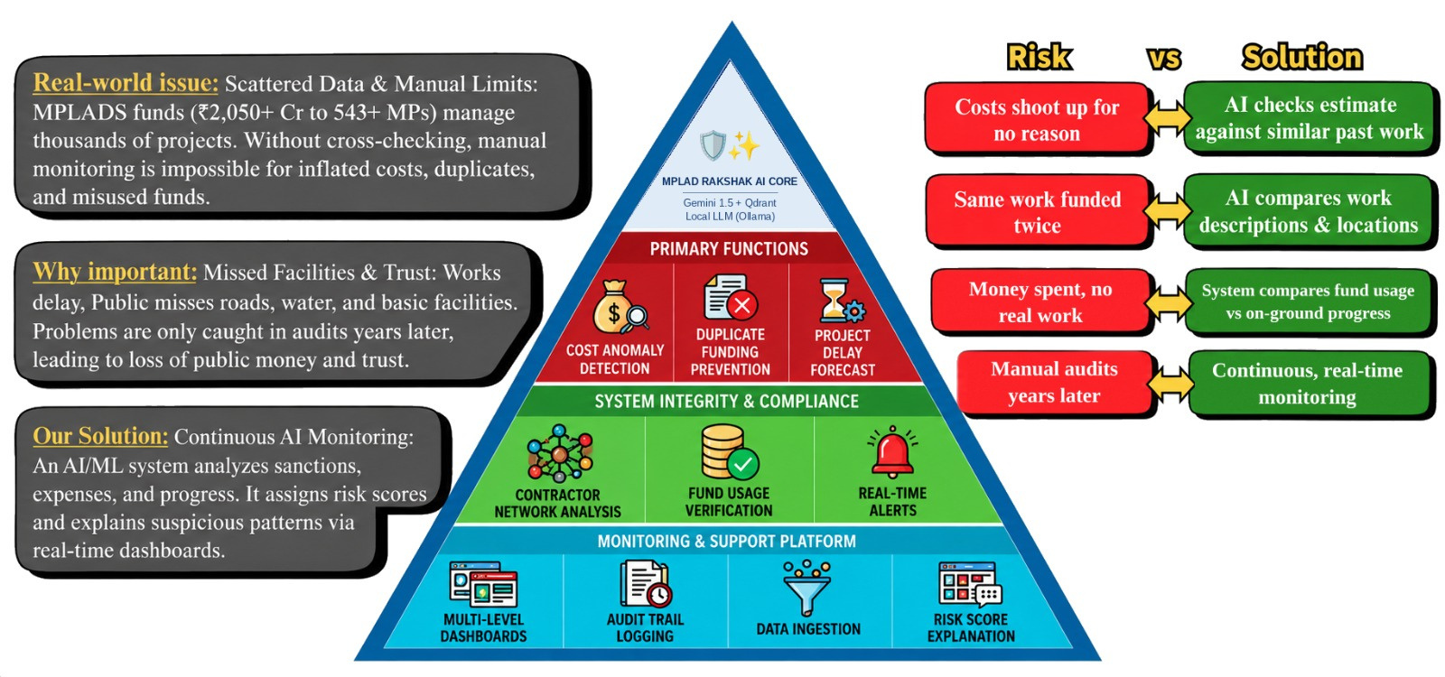
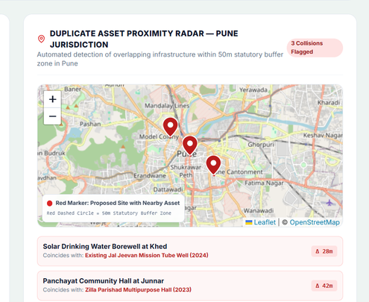
The-Lolgorithms
MPLADS Rakshak : AI-Powered Protection of Public Funds
Video
Website
@SIH Idea submission- Template
2

Slide 3
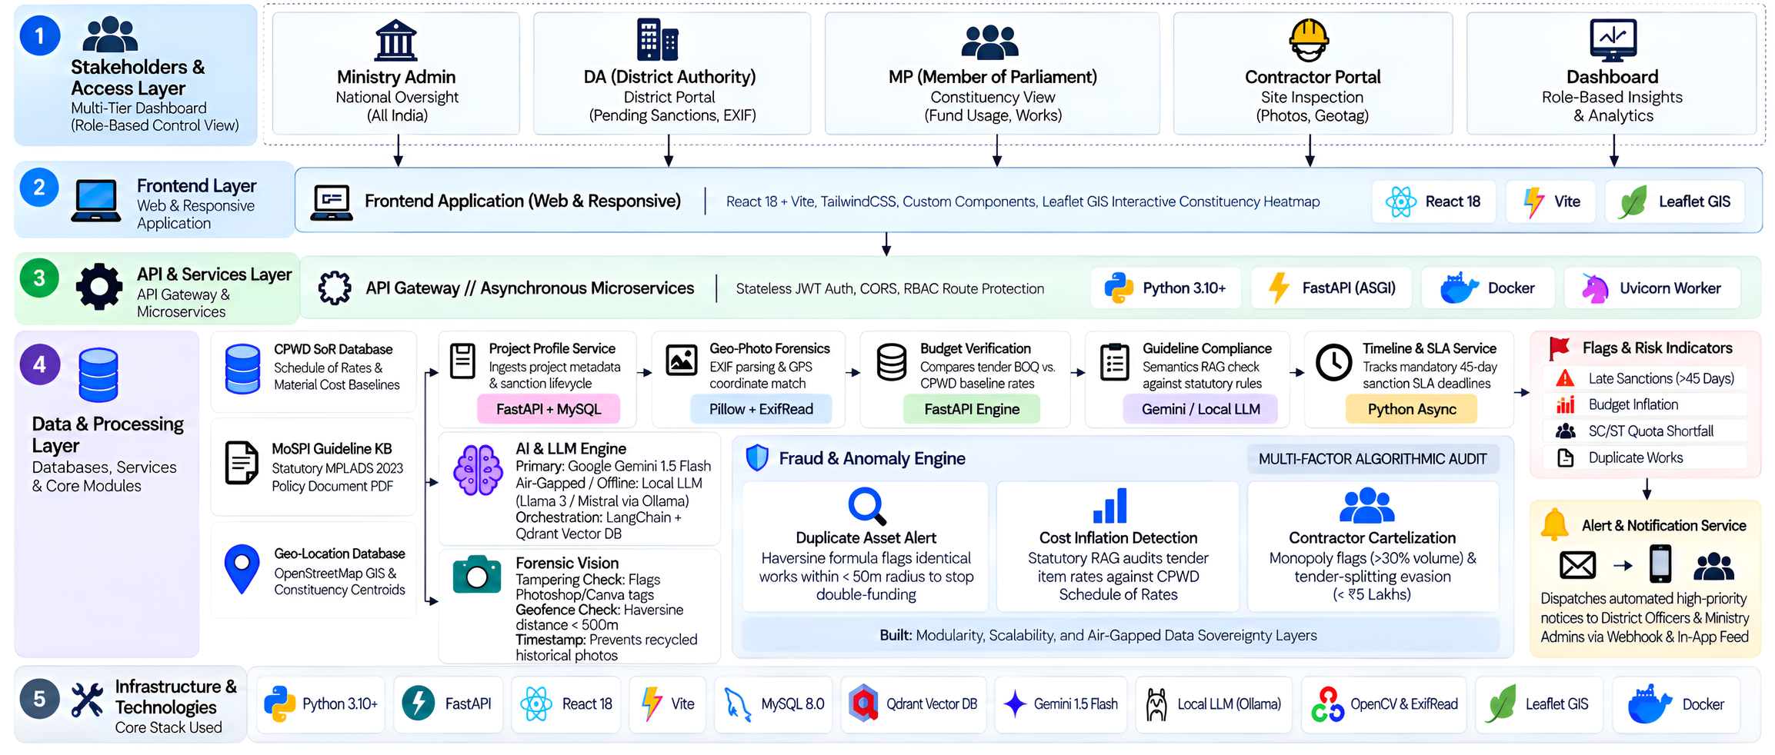
TECHNICAL APPROACH
The-Lolgorithms
@SIH Idea submission- Template
3

Slide 4
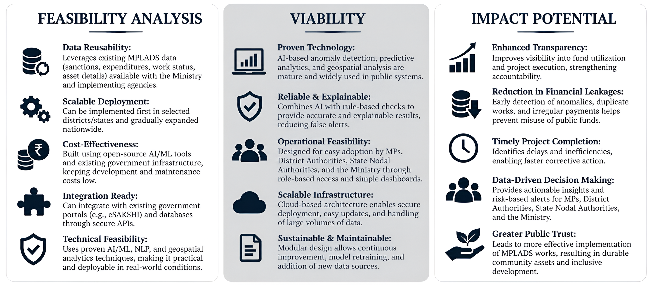
FEASIBILITY AND VIABILITY
The-Lolgorithms
@SIH Idea submission- Template
4

Slide 5
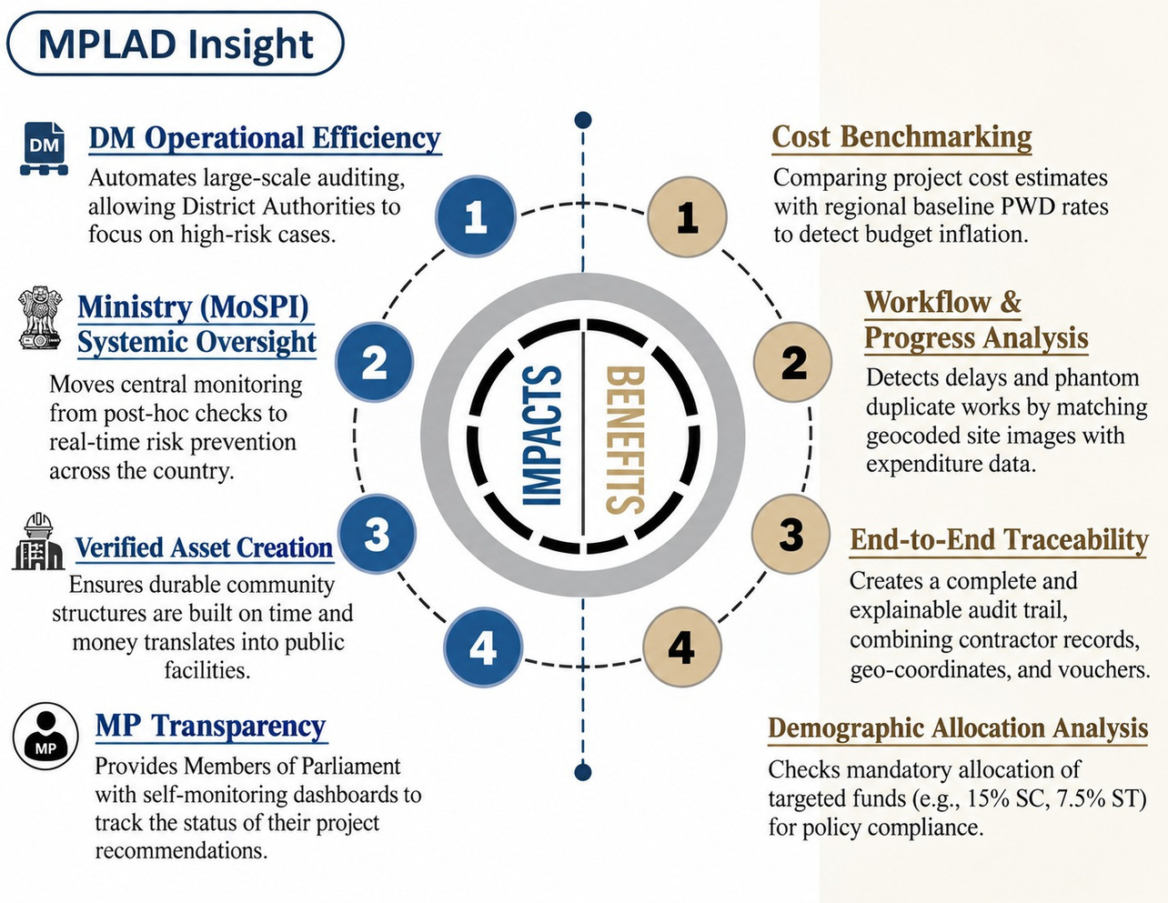
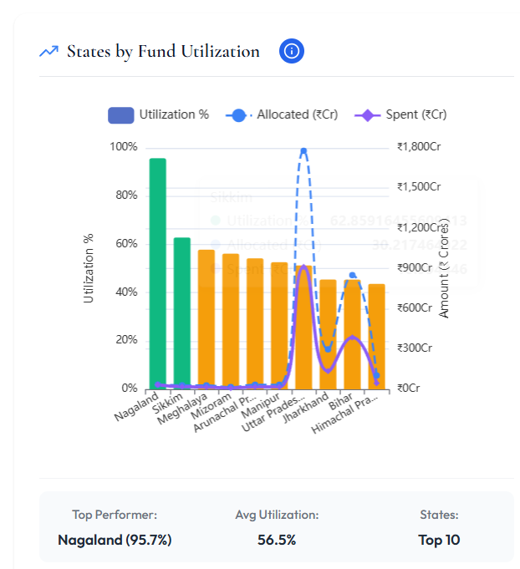
IMPACT AND BENEFITS
The-Lolgorithms
  Nagaland Leads-Achieved a peak 95.7% fund utilization rate.
  Top 10 Average-Maintaining a solid 56.5% baseline utilization.
@SIH Idea submission- Template
5

Slide 6

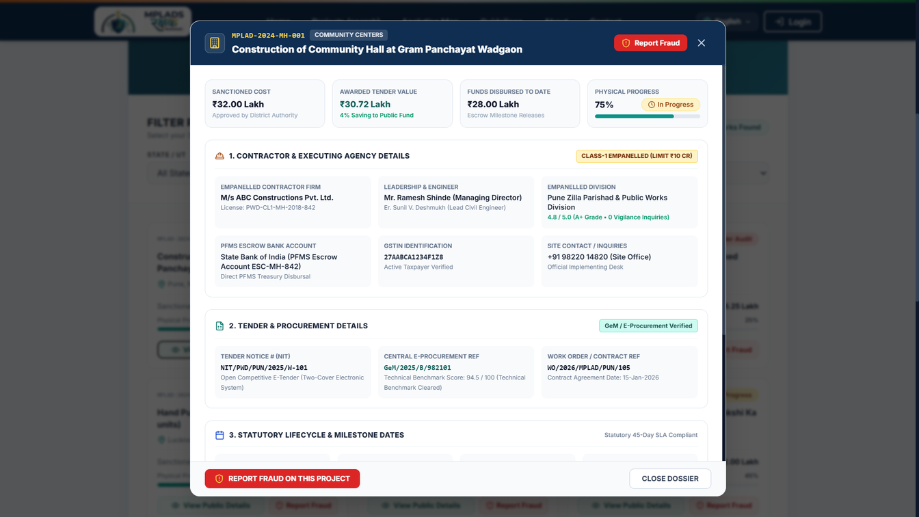
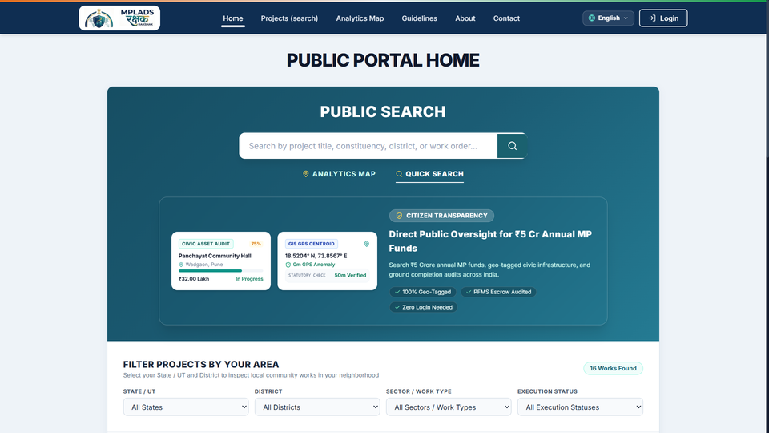
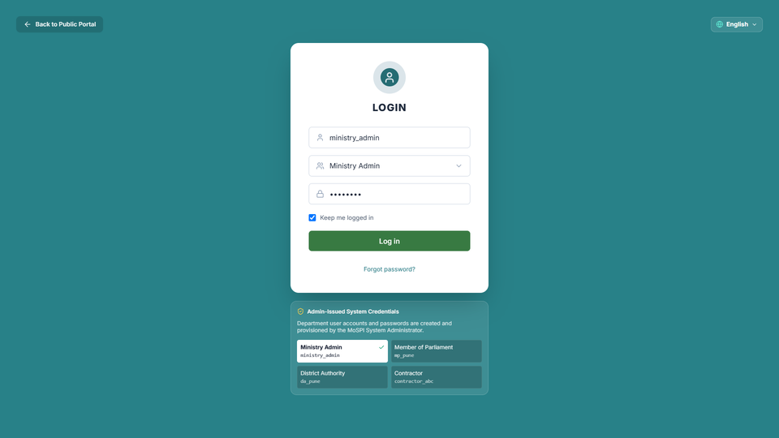
RESEARCH AND REFERENCES
The-Lolgorithms
MoSPI (Ministry of Statistics and Programme Implementation): https://mplads.mospi.gov.in/digigov/landingpage.html#aboutus
MoSPI (Ministry of Statistics and Programme Implementation): https://mplads.mospi.gov.in/digigov/dashboard.html
CPWD (Central Public Works Department): https://cpwd.gov.in/Documents/cpwd_publication.aspx
Vikaspedia (MeitY): https://en.vikaspedia.in/viewcontent/e-governance/online-citizen-services/mplads%E2%80%93esakshi-web-portal?lgn=en
YouTube (Drishti IAS): https://www.youtube.com/watch?v=bJjhhNngZIE
MoSPI (Ministry of Statistics and Programme Implementation): https://www.mospi.gov.in/
DMEO (Development Monitoring and Evaluation Office, NITI Aayog): https://dmeo.gov.in/index.php/node/432
NGO Darpan (NITI Aayog): https://ngodarpan.gov.in/#/faq
Empowered Indian: https://empoweredindian.in/mplads
Report
GitHub
Detailed Report
@SIH Idea submission- Template
6

