Slide 1
assigment2
File created on: 27-11-2020 19:07:39

Slide 2
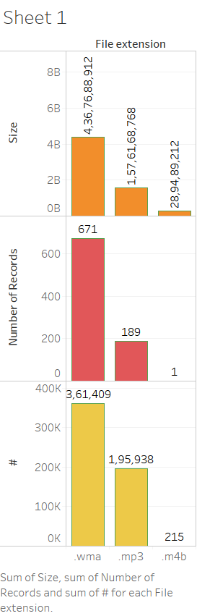

Slide 3
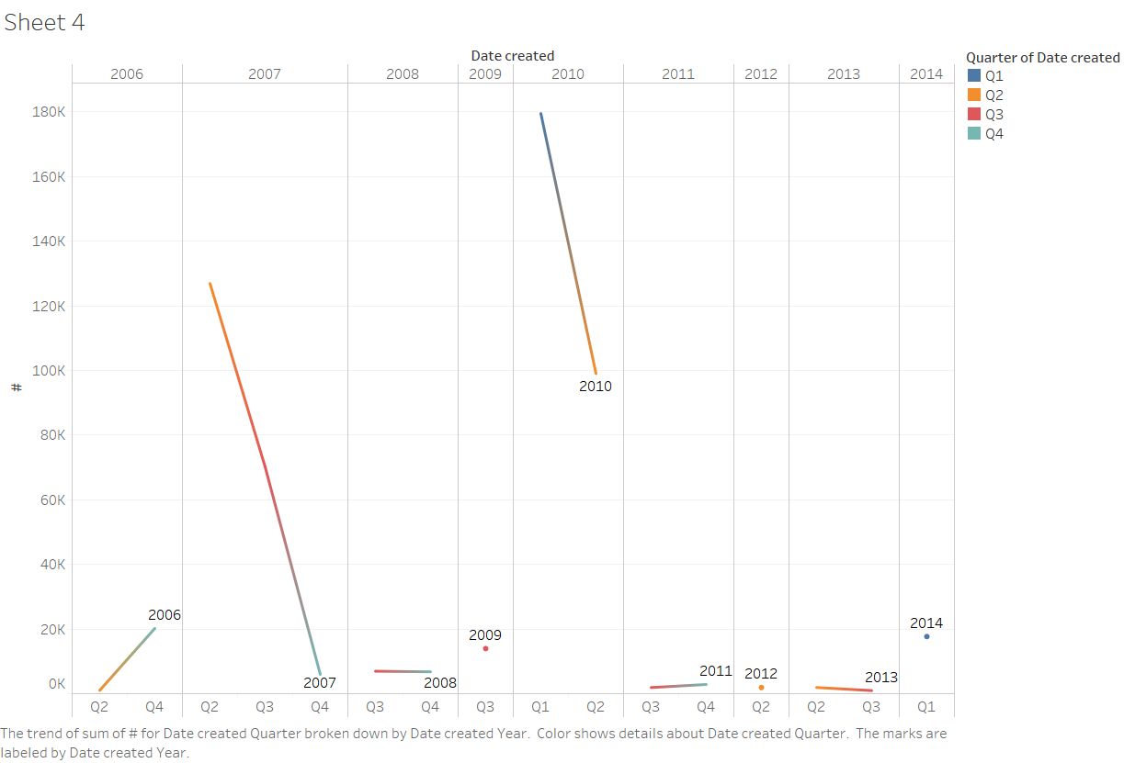

Slide 4
