Slide 1
Book1
File created on: 21-12-2020 18:36:07

Slide 2
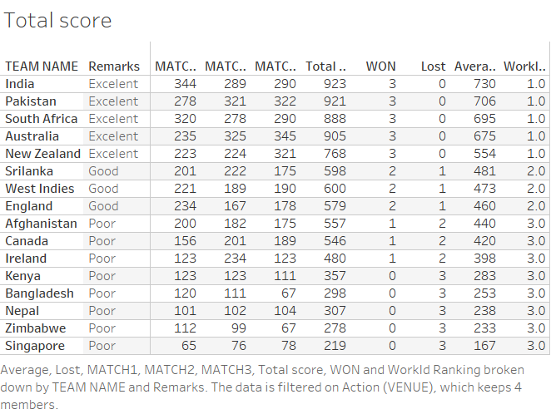

Slide 3
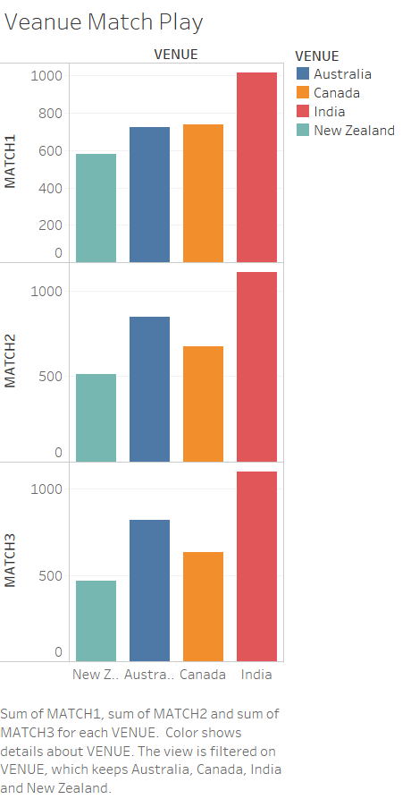

Slide 4
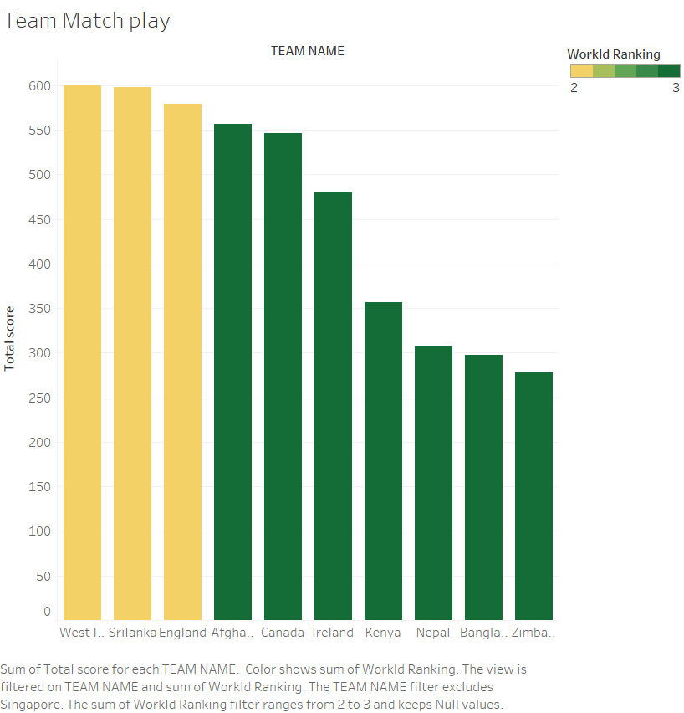

Slide 5
