Slide 1
Team name: Error 404
HackTU 2.0
Team members:
Ashutosh Soni
Shashank Agarwal
Tushar Patidar

Slide 2
Problem Statements
To develop an end-to-end IoT enabled smart pesticide sprayer with web access and mobile application support.
To develop an IoT enabled helping hand for farmers (in agriculture sector) for avoiding wastage of pesticides and eutrophication of land via mobile application for different types of plants and crops.

Slide 3

Product Name:
PlanTonic
Under Open Innovation
Track

Slide 4

Abstract & Introduction
Agriculture is one of the most important sector and it faces challenges in it’s way like less rainfall, soil erosion, etc. but there are some things we can contribute to for betterment.
Pesticides are potentially overused in agriculture while cropping. It seem to be a small factor but thinking globally on a large scale it can degrade the environment and biodiversity and lead to eutrophication. To overcome this we are developing an optimal and smart IoT based solution which not only helps our environment but also reduces labour work of farmers and improves the accuracy while spraying the pesticides via real time solution.

Slide 5
We aim to fix just that ☺ How? By inventing a smart IoT handheld Device

Slide 6
Proposed Solution
The PlanTonic implements IoT connectivity for providing pesticide and fertilizer to the plant by detecting the variety of plants and crops through an RFID tag attached to its Pot. This is made possible by using Blynk App and a web interface for providing NodeMCU cloud connectivity. We are using a servo motor to enable automated spraying based on plant requirement via mini database.

Slide 7

Methodology
The working is achieved by linking CP2102 of NodeMCU to Blynk IoT Service (via mobile app) and an Web Interface which will remotely tell the current status of operation of the sprayer and the app is equipped with the inbuilt display function which will tell what plant is being sprayed and also detect how many sprays are required for that specific plant via mini database.
This is achieved by using MFRC522 RFID sensor. The microcontroller signals the 9G Micro Servo to perform the spraying action of pulling the top of the sprayer respective number of times.
The microcontroller is programmed with an External Interrupt to spray accordingly if the user manually wants to do so which can also be implemented via Ultra Sonic Sensor. Also, the system is fitted with an Active Buzzer which beeps accordingly accounting the number of sprays required.

Slide 8



Technical Stash
Arduino IDE
Blynk
Adobe XD
Hardware
NodeMCU
MFRC522 (RFID Reader)
Passive Buzzer
9G Servo Motor
HC-SR04 (Ultrasonic Sensor)

Slide 9

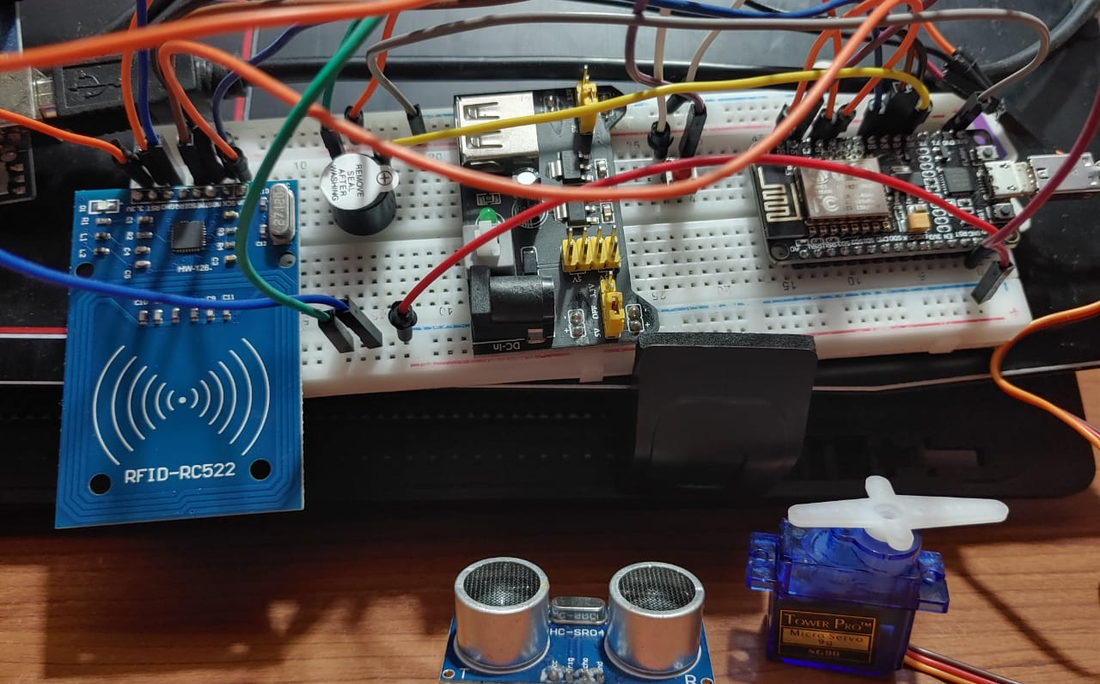
Functional prototype on a Breadboard

Slide 10

PlanTonic
WebApp UX Intro Page

Slide 11

Git Repo
https://github.com/ashutoshsoni57/hacktu-404-Sigma

Slide 12
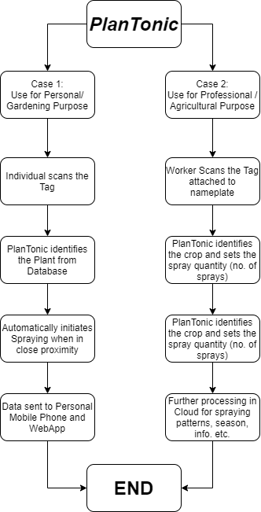
Flow

Slide 13
Work Done so far & WIP
Use Cases Identified
Circuit Implemented
Arduino Programming
UX Designing
Pushed to GitHub

Slide 14
Product Target
1. A Functional IoT Prototype with real-time monitoring.
2. Complete UX for PlanTonic WebApp
3. CAD Rendering of Final Product

Slide 15
Thanks!
Looking Forward to Round 3 with our prototypes READY !

