Slide 1
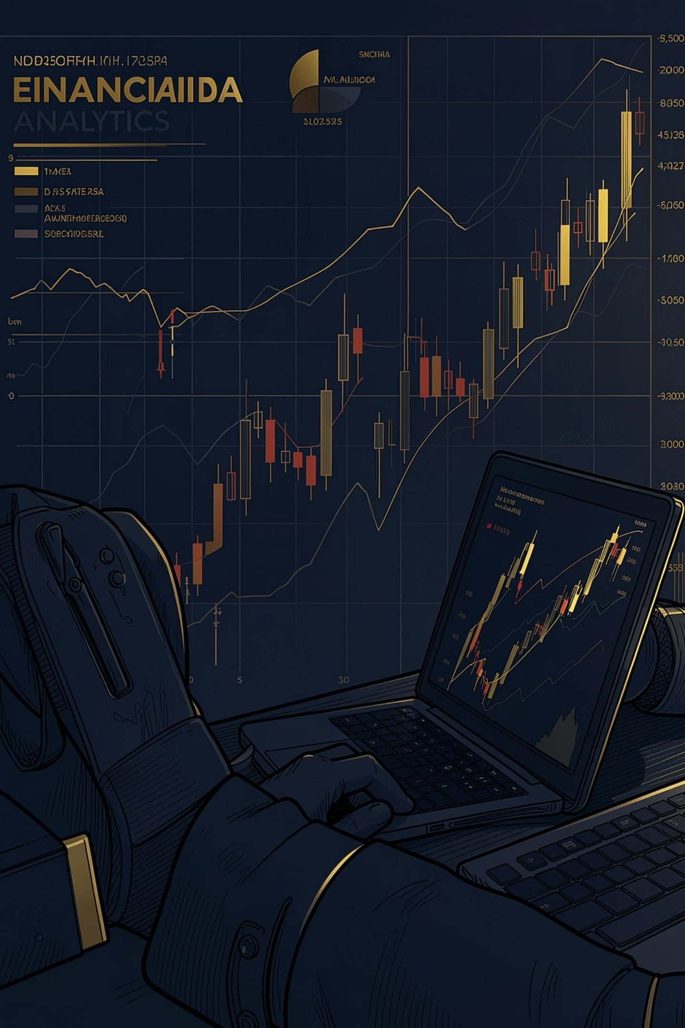

BLUESTOCK FINTECH
CAPSTONE PROJECT I
Mutual Fund Analytics
End-to-End Financial Analytics & Business Intelligence Solution
Presenter
Submitted To
Ashutosh Giri
B.Tech in Artificial Intelligence & Data Science
University School of Automation and Robotics
Guru Gobind Singh Indraprastha University
Bluestock Fintech
Final Capstone Project Submission
Academic Evaluation & Placement Portfolio

Slide 2

OVERVIEW
Project Overview
A comprehensive Mutual Fund Analytics solution engineered with Python, SQL, SQLite, and Power BI — covering the full lifecycle from raw data ingestion to actionable business intelligence.
The pipeline ensures data integrity at every stage, transforming multi-source mutual fund datasets into structured analytics-ready databases, and ultimately delivering interactive dashboards that surface alpha-generating insights for stakeholders.

Slide 3
ARCHITECTURE
Technologies & Architecture
Architecture Flow
Python
Raw Data Ingestion
Pandas, NumPy, Matplotlib
ETL Processing
SQLite & SQL
Relational database engine
SQLite Storage Layer
Power BI
Interactive BI dashboards
EDA & Performance Analytics
GitHub & Jupyter
Version control & notebooks
Advanced Analytics Engine
Power BI Dashboard & Insights

Slide 4
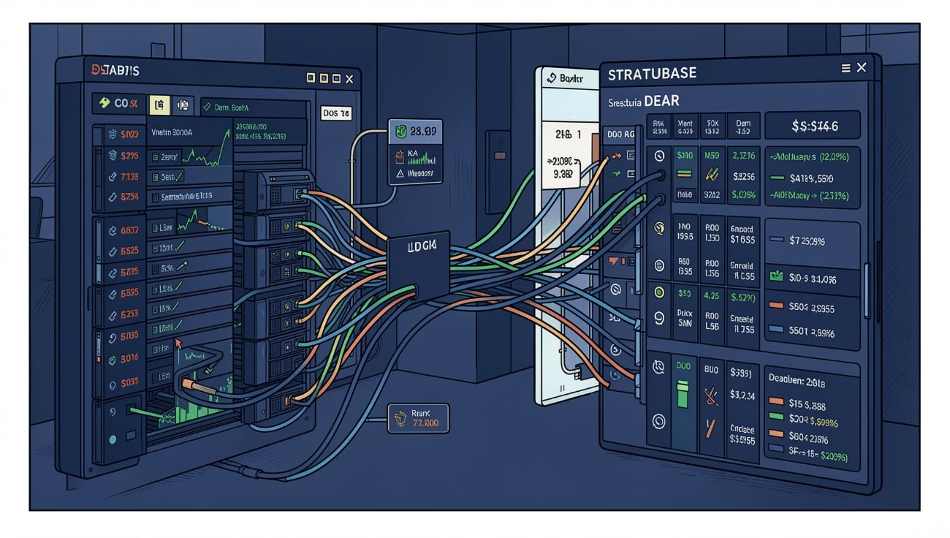
DATA PIPELINE
Dataset & ETL Pipeline
Ten Core Datasets + Live NAV integration
Historical NAV & AUM
SIP & Portfolio
Net asset values and assets under management across fund categories
Systematic investment plan flows and holdings breakdown
Benchmark & Transactions
Index comparisons and investor-level transaction records
Data Cleaning
Missing Values
Duplicate Removal
Type conversion, formatting, validation
Imputation & null handling
De-duplication across records
Standardization
SQLite Loading
Consistent schemas & naming
Normalized relational tables

Slide 5
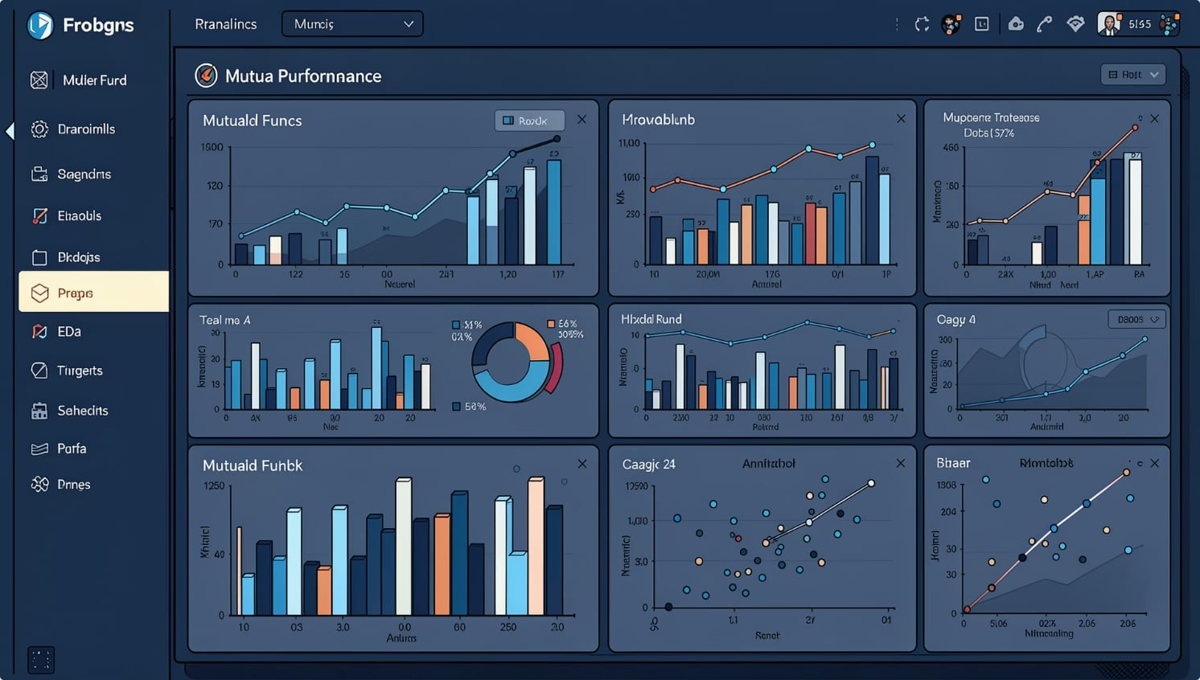
ANALYTICS
SQL Analytics & Exploratory Data Analysis
Six core business questions answered through advanced SQL queries against the normalized SQLite layer, surfacing patterns across fund performance, investor behaviour, and market benchmarks.
1
Top Performing Funds
Ranked by returns & consistency
2
Category Analysis
Equity, debt, hybrid comparisons
3
SIP Trend
Inflow patterns over time
4
Benchmark Comparison
Alpha vs. index performance
5
Portfolio Allocation
Asset distribution insights
6
Investor Behaviour
Redemption & holding patterns

Slide 6
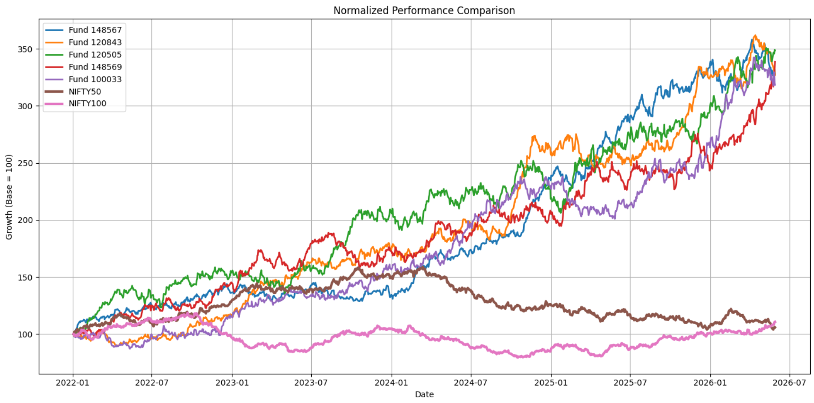
PERFORMANCE
Performance Analytics
Seven quantitative metrics computed for every fund scheme, enabling rigorous risk-adjusted evaluation beyond simple return figures.
Annual Return
Sharpe Ratio
Year-over-year yield
Risk-adjusted return
Sortino Ratio
Alpha & Beta
Downside-adjusted return
Market sensitivity metrics
Max Drawdown
VaR & CVaR
Worst-case decline
Tail-risk estimation
Normalized Performance Comparison

Slide 7
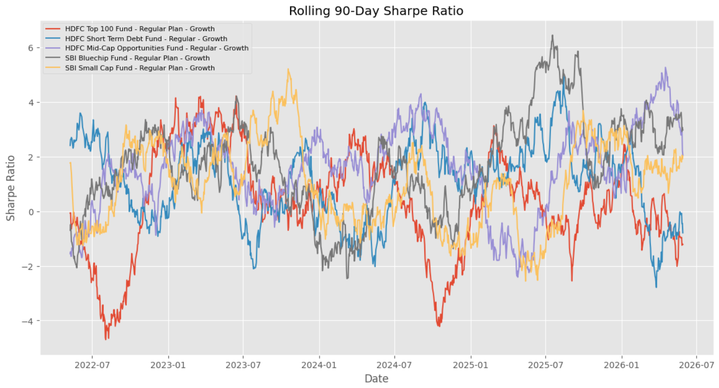
ADVANCED ANALYTICS
Advanced Analytics & Risk Analysis
Rolling Sharpe Ratio
Investor Cohort Analysis
90 days rolling windows for time-varying risk assessment
Behavioral segmentation by acquisition vintage and tenure
SIP Continuity
Diversification & Recommendations
Retention and churn modeling across SIP investor segments
Portfolio optimization scoring and a fund recommendation engine
Rolling 90-Day Sharpe Ratio

Slide 8
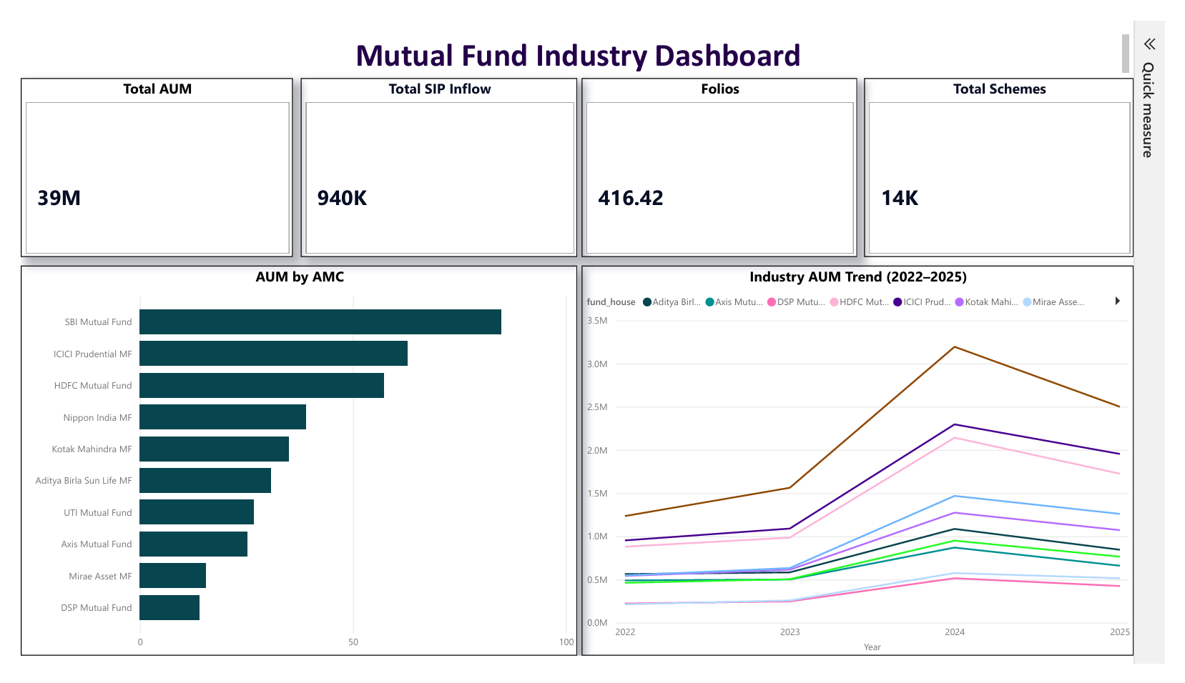
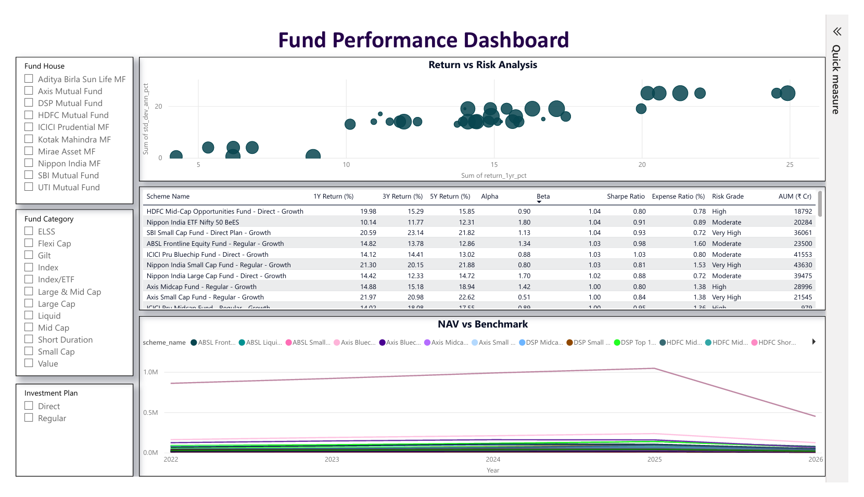
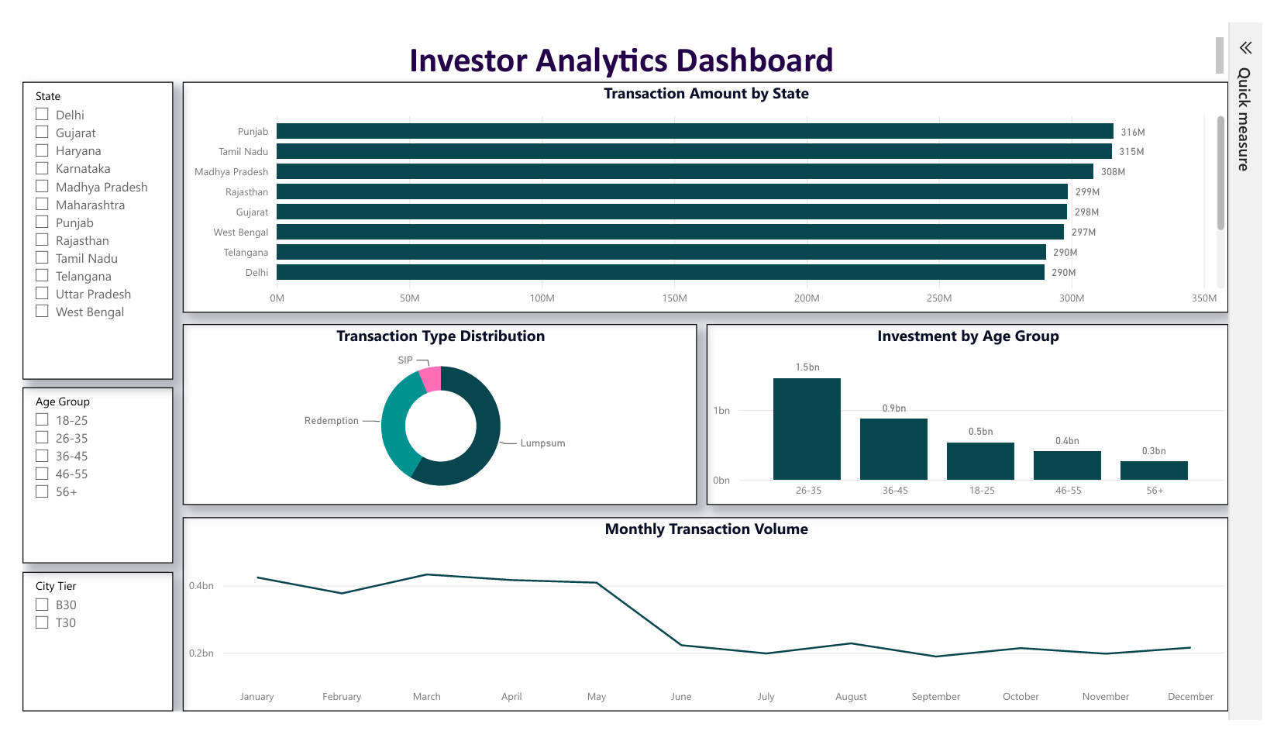
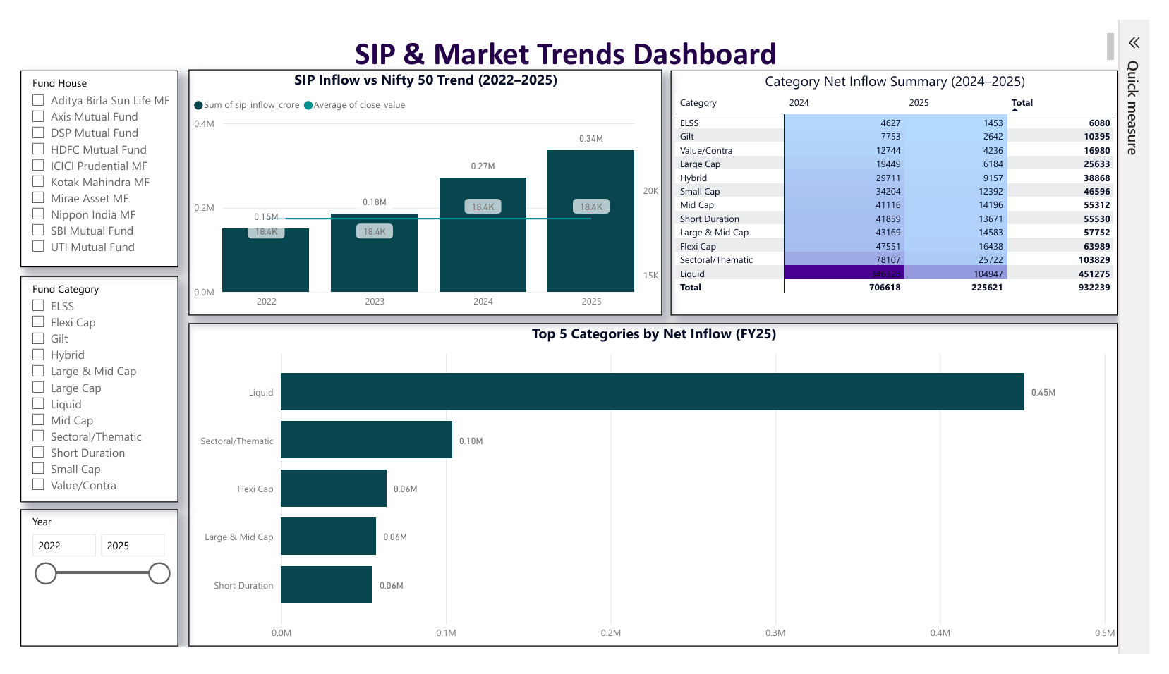
BUSINESS INTELLIGENCE
Interactive Power BI Dashboard
Four interconnected dashboards with interactive slicers, dynamic filtering, and real-time KPI cards — delivering self-serve business intelligence to stakeholders.
Industry Overview
Fund Performance
Investor Analytics
SIP & Market Trends
Market-wide AUM, category share, and trend summaries
Scheme-level returns, Sharpe ratio, and benchmark alpha
Cohort retention, SIP continuity, and behavior flows
SIP inflow patterns, seasonality, and market momentum

Slide 9
INSIGHTS
Business Insights & Recommendations
Key Findings
Strategic Recommendations
Equity funds delivered stronger long-term returns across all evaluated horizons
Diversify Holdings
Spread risk across equity, debt, and hybrid categories
SIP inflows consistently increased year-over-year, signaling growing investor discipline
Prioritize Sharpe Ratio
Large Cap funds exhibited the most stable performance with lower drawdowns
Select funds with superior risk-adjusted metrics
Higher Sharpe Ratio funds consistently outperformed on a risk-adjusted basis
Invest via SIP
Benchmark comparison identified a clear set of alpha-generating schemes
Systematic plans reduce timing risk and build discipline
Monitor Benchmarks
Review alpha and beta relative to indices regularly
Periodic Review
Rebalance portfolios quarterly for alignment

Slide 10
SUMMARY
Project Summary & Thank You
A complete analytics deliverable spanning data engineering, quantitative analysis, and interactive business intelligence.
ETL Pipeline
SQLite Database
EDA & Analytics
Robust data processing
Normalized schema
SQL, performance, advanced
Power BI Dashboard
Report & GitHub
Interactive BI layer
Documentation & repo
Thank you for your time and evaluation. This project reflects a commitment to rigorous analytics, clean engineering, and practical financial intelligence.
Questions?
Ashutosh Giri
Email: ashutoshgiri1918@gmail.com
LinkedIn: www.linkedin.com/in/ashutosh-giri-datascience
GitHub: https://github.com/ashuuuu7
Ashutosh Giri
B.Tech AI & Data Science
Guru Gobind Singh Indraprastha University
Capstone Project I — Bluestock Fintech

