Slide 1
Computing Factorial of a Number
factorial(0) = 1;
factorial(n) = n*factorial(n-1);
1

Slide 2
Program Computing Factorial
(using recursion)
#include<stdio.h>
int factorial(int n) {
if (n>=1)
return n*factorial(n-1);
else
return 1;
}
int main() {
int n;
printf("Enter a positive integer: "); scanf("%d",&n);
printf("Factorial of %d = %d", n, factorial(n));
return 0;
}

Slide 3
Computing Factorial
factorial(0) = 1;
factorial(n) = n*factorial(n-1);
factorial(4) =
int factorial(int n) {
if (n>=1)
return n*factorial(n-1);
else
return 1;
}

Slide 4
Computing Factorial
factorial(0) = 1;
factorial(n) = n*factorial(n-1);
factorial(4) = 4 * factorial(3)
int factorial(int n) {
if (n>=1)
return n*factorial(n-1);
else
return 1;
}

Slide 5
Computing Factorial
factorial(0) = 1;
factorial(n) = n*factorial(n-1);
factorial(4) = 4 * factorial(3)
= 4 * 3 * factorial(2)
int factorial(int n) {
if (n>=1)
return n*factorial(n-1);
else
return 1;
}

Slide 6
Computing Factorial
factorial(0) = 1;
factorial(n) = n*factorial(n-1);
factorial(4) = 4 * factorial(3)
= 4 * 3 * factorial(2)
= 4 * 3 * (2 * factorial(1))
int factorial(int n) {
if (n>=1)
return n*factorial(n-1);
else
return 1;
}

Slide 7
Computing Factorial
factorial(0) = 1;
factorial(n) = n*factorial(n-1);
factorial(4) = 4 * factorial(3)
= 4 * 3 * factorial(2)
= 4 * 3 * (2 * factorial(1))
= 4 * 3 * ( 2 * (1 * factorial(0)))
int factorial(int n) {
if (n>=1)
return n*factorial(n-1);
else
return 1;
}

Slide 8
Computing Factorial
factorial(0) = 1;
factorial(n) = n*factorial(n-1);
factorial(4) = 4 * factorial(3)
= 4 * 3 * factorial(2)
= 4 * 3 * (2 * factorial(1))
= 4 * 3 * ( 2 * (1 * factorial(0)))
= 4 * 3 * ( 2 * ( 1 * 1)))

Slide 9
Computing Factorial
factorial(0) = 1;
factorial(n) = n*factorial(n-1);
factorial(4) = 4 * factorial(3)
= 4 * 3 * factorial(2)
= 4 * 3 * (2 * factorial(1))
= 4 * 3 * ( 2 * (1 * factorial(0)))
= 4 * 3 * ( 2 * ( 1 * 1)))
= 4 * 3 * ( 2 * 1)

Slide 10
Computing Factorial
factorial(0) = 1;
factorial(n) = n*factorial(n-1);
factorial(4) = 4 * factorial(3)
= 4 * 3 * factorial(2)
= 4 * 3 * (2 * factorial(1))
= 4 * 3 * ( 2 * (1 * factorial(0)))
= 4 * 3 * ( 2 * ( 1 * 1)))
= 4 * 3 * ( 2 * 1)
= 4 * 3 * 2

Slide 11
Computing Factorial
factorial(0) = 1;
factorial(n) = n*factorial(n-1);
factorial(4) = 4 * factorial(3)
= 4 * 3 * factorial(2)
= 4 * 3 * (2 * factorial(1))
= 4 * 3 * ( 2 * (1 * factorial(0)))
= 4 * 3 * ( 2 * ( 1 * 1)))
= 4 * 3 * ( 2 * 1)
= 4 * 3 * 2
= 4 * 6

Slide 12
Computing Factorial
factorial(0) = 1;
factorial(n) = n*factorial(n-1);
factorial(4) = 4 * factorial(3)
= 4 * 3 * factorial(2)
= 4 * 3 * (2 * factorial(1))
= 4 * 3 * ( 2 * (1 * factorial(0)))
= 4 * 3 * ( 2 * ( 1 * 1)))
= 4 * 3 * ( 2 * 1)
= 4 * 3 * 2
= 4 * 6
= 24

Slide 13
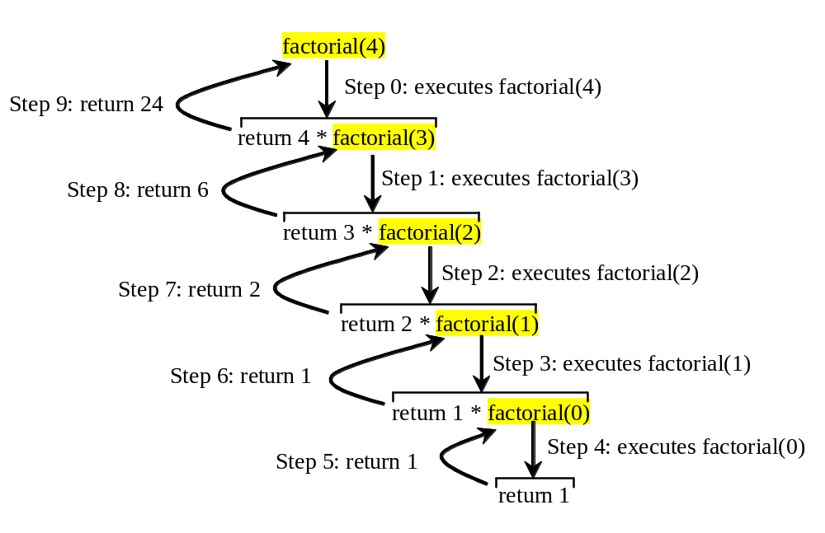

Trace Recursive factorial
Executes factorial(4)

Slide 14

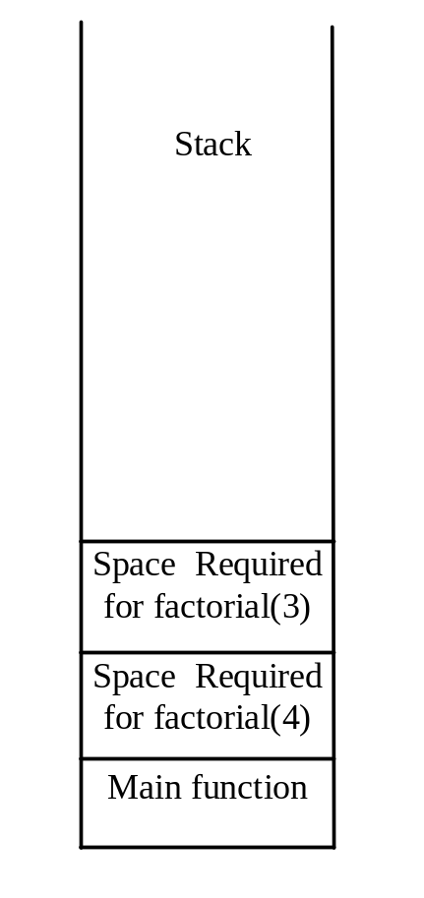
Trace Recursive factorial
Executes factorial(3)

Slide 15
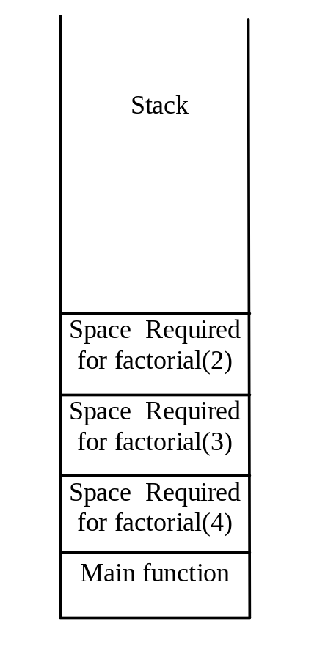
Trace Recursive factorial
Executes factorial(2)

Slide 16
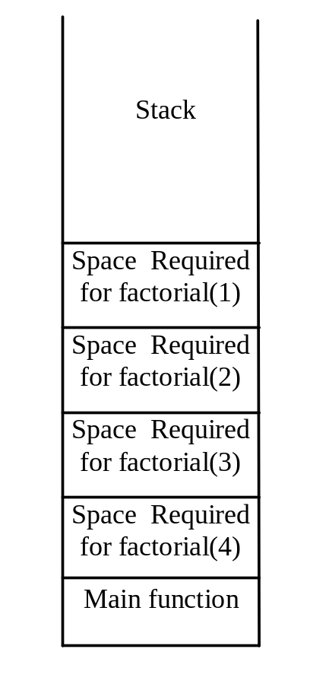
Trace Recursive factorial
Executes factorial(1)

Slide 17
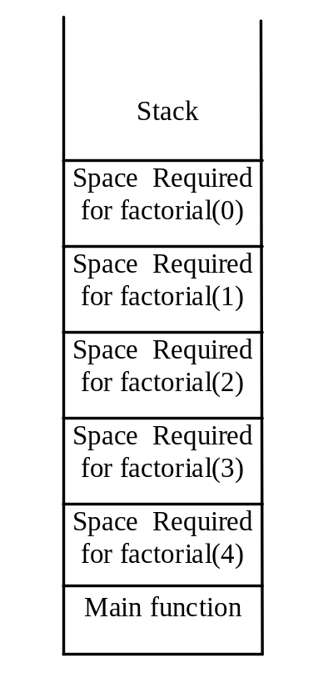
Trace Recursive factorial
Executes factorial(0)

Slide 18

Trace Recursive factorial
returns 1

Slide 19
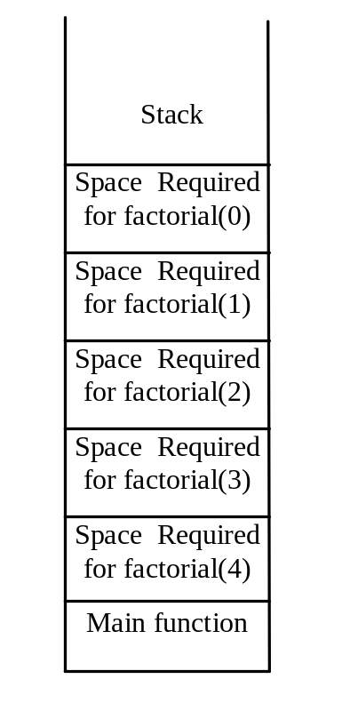
Trace Recursive factorial
returns factorial(0)

Slide 20

Trace Recursive factorial
returns factorial(1)

Slide 21

Trace Recursive factorial
returns factorial(2)

Slide 22
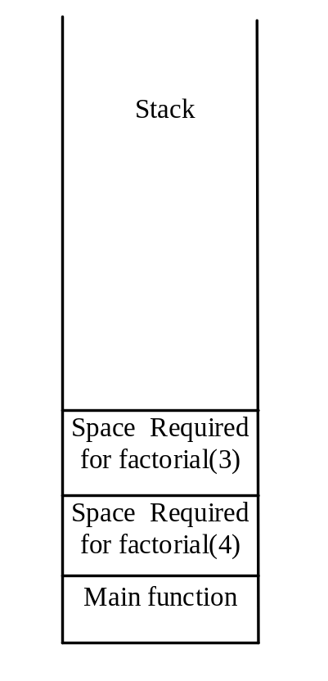
Trace Recursive factorial
returns factorial(3)

Slide 23

Trace Recursive factorial
returns factorial(4)

Slide 24

factorial(4) Stack Trace

