Slide 1
Development of a Multi-Modal Emotional Support Chatbot Leveraging Physiological Signals and Textual User Inputs

Slide 2






Stress Detection and Emotional Support Workflow
End-to-end pipeline: wearable sensing → stress detection → notification → physiologically-grounded chatbot support
user accepts
stress detected
Wearable Sensor Device Continuously collects real-time physiological signals (EDA, PR, SkinTemp, ACCEL, ACT_CLASS)
Stress Detection Model Processes streamed signals and classifies the user's real-time stress state
Notification to Phone “Stress detected. Talk to the Emotional Support Chatbot?”
Chatbot Conversation Starts Emotional Support Chatbot session opens on the user's device
Accept
Decline
continue monitoring
During the Conversation — Real-Time Multimodal Grounding
signals keep streaming throughout the conversation
user text
Chatbot UI — User Text User continues typing messages during the conversation
LLM Context-Aware Response Generation
personalized, empathetic response streamed back to the chat
Combines conversation text + real-time physiological signals to generate a personalized, empathetic reply
Real-Time Physiological Stream EDA, PR, SkinTemp, ACCEL, ACT_CLASS keep streaming from the wearable
physiological signals

Slide 3
Stress Detection → Emotional Support Chatbot
How are you feeling?
Stress detected.
Talk to chatbot?
A bit stressed.
I'm here with you
accept
mood
improves
Accept
Thanks, feeling better.
Stress
detected
Decline
live signal
Continuous signals
Notification
Chatting + live signals
Calmer state
EDA · PR · SkinTemp
user taps Accept
text + physio → LLM
signals settle down
physiological signal streams continuously throughout

Slide 4
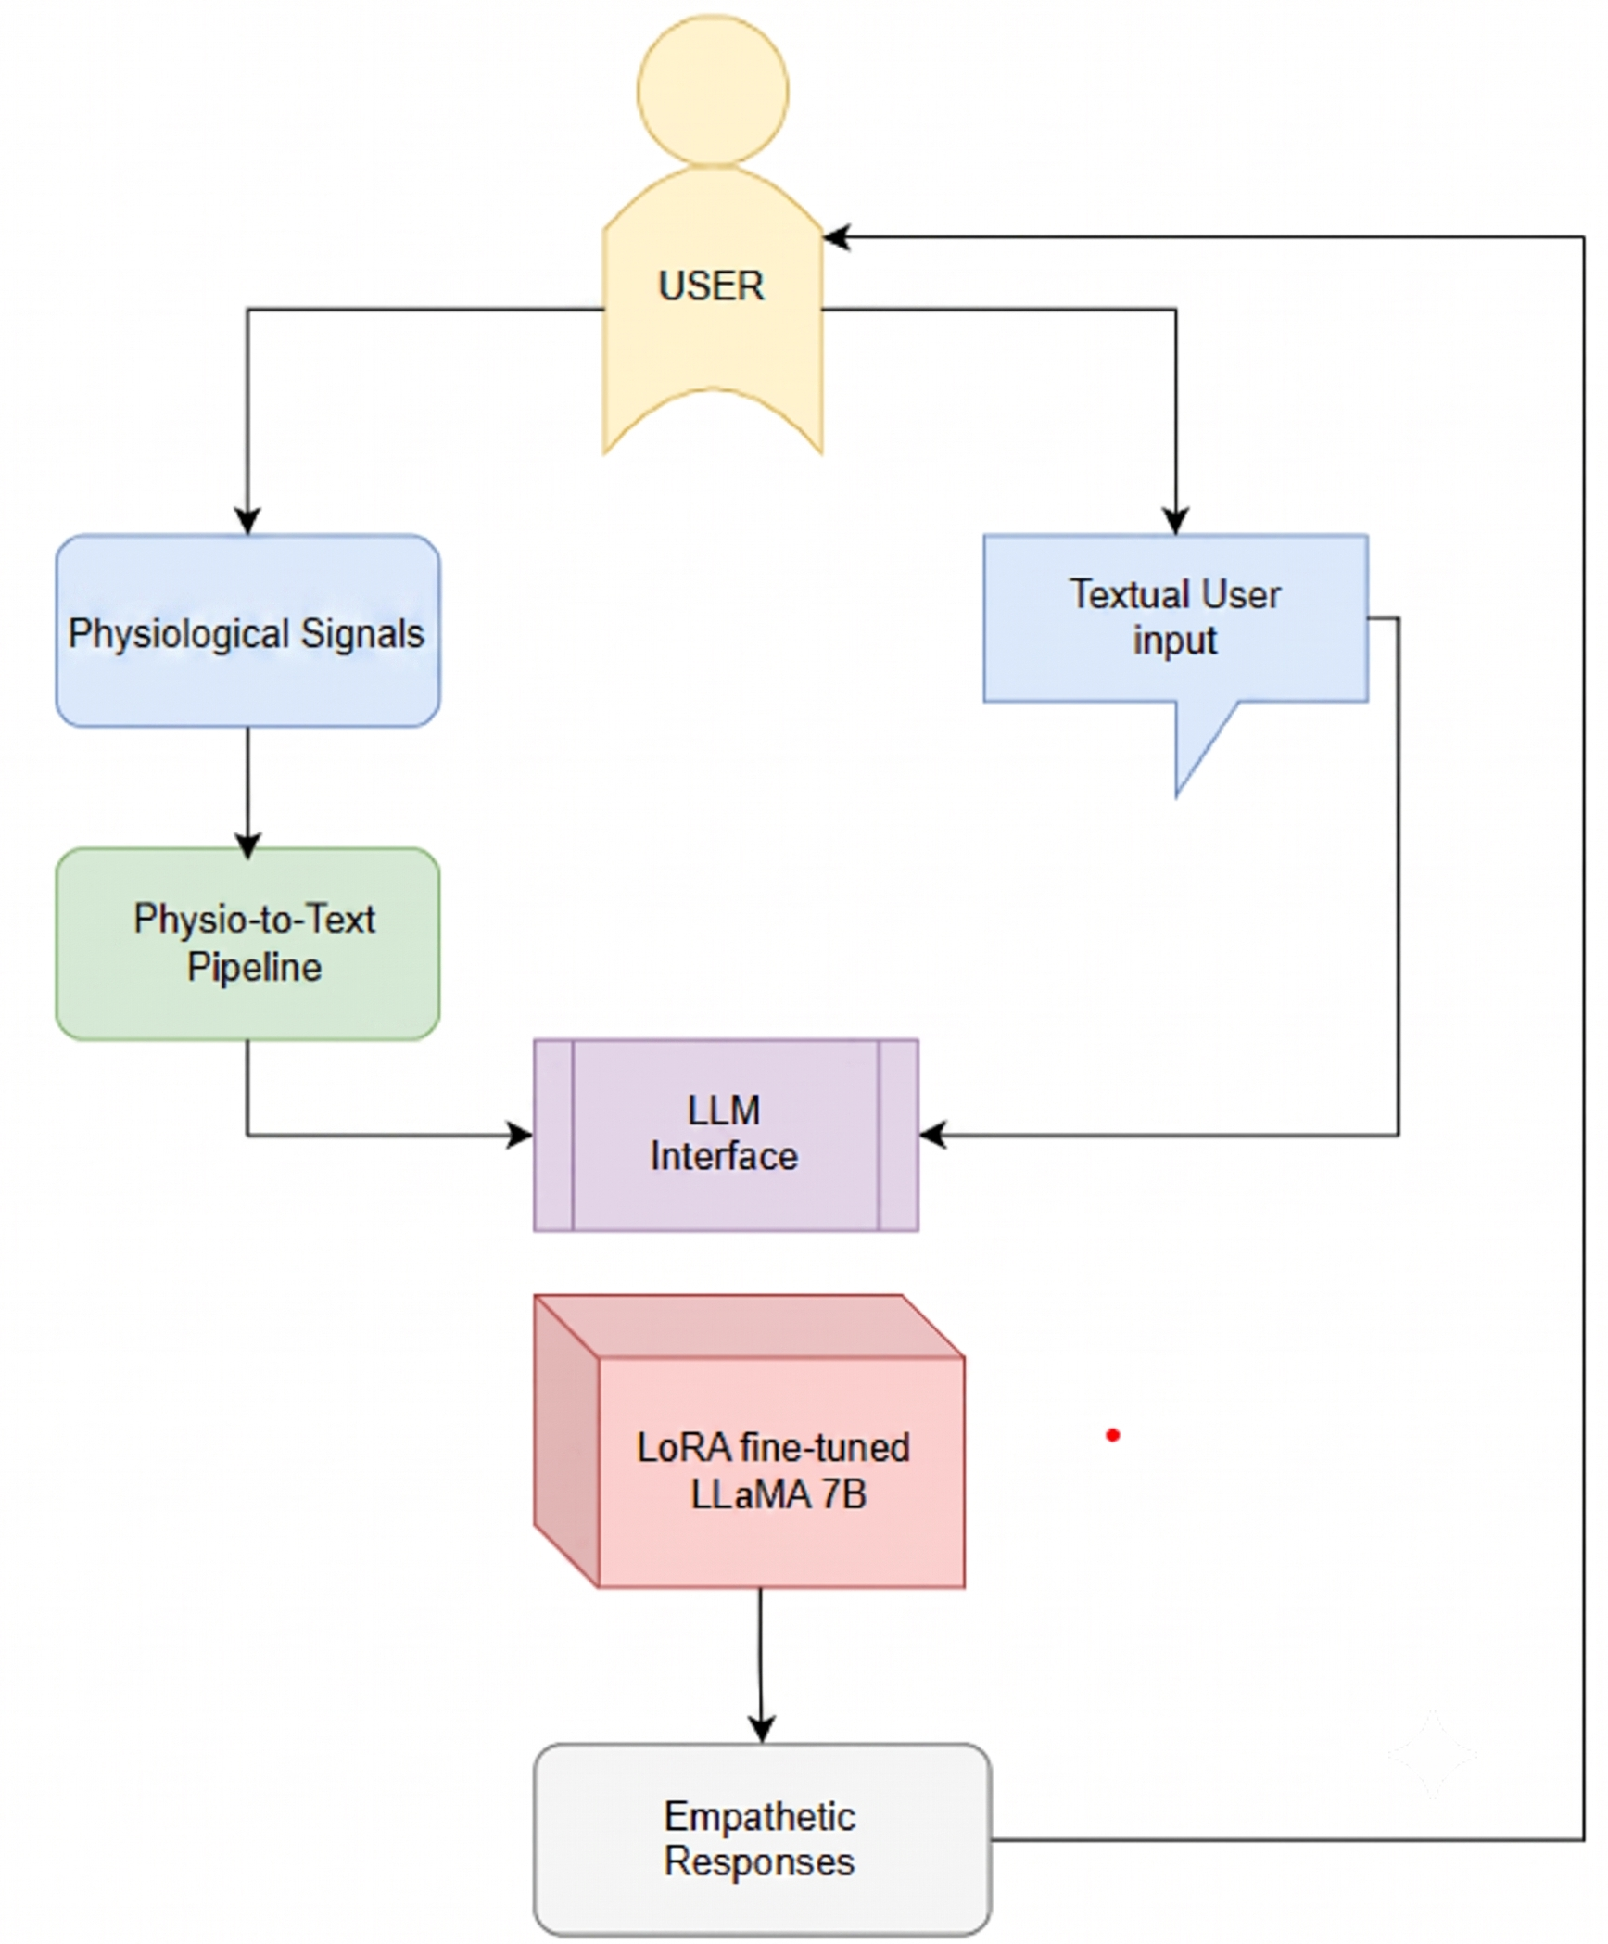
System Architecture

Slide 5
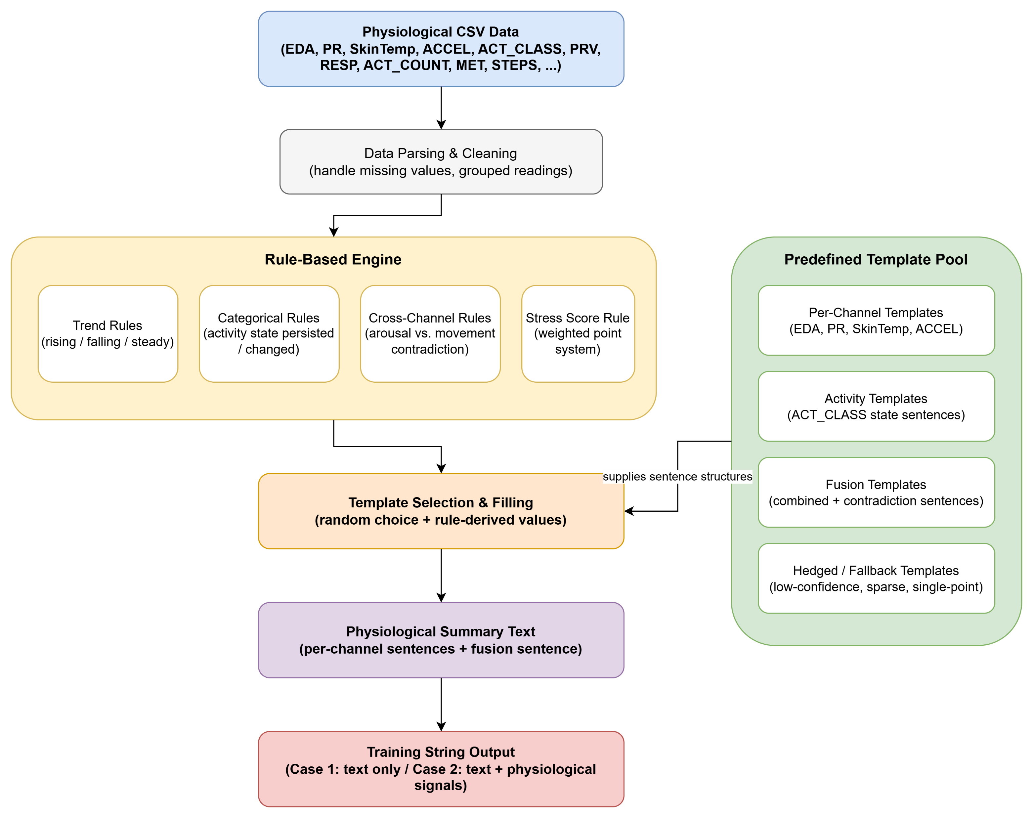
Physiological signals to physiological summary generation algo

Slide 6
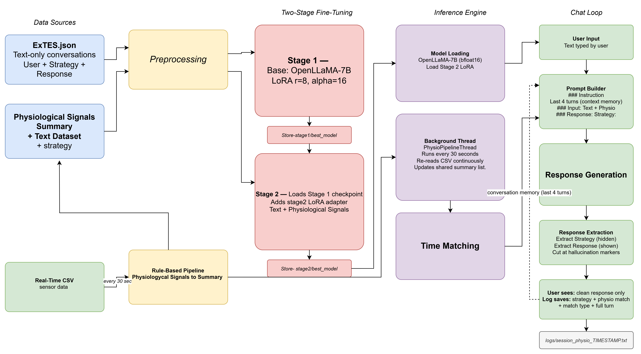
Real-Time Physiological + Text Emotional Support System

Slide 7
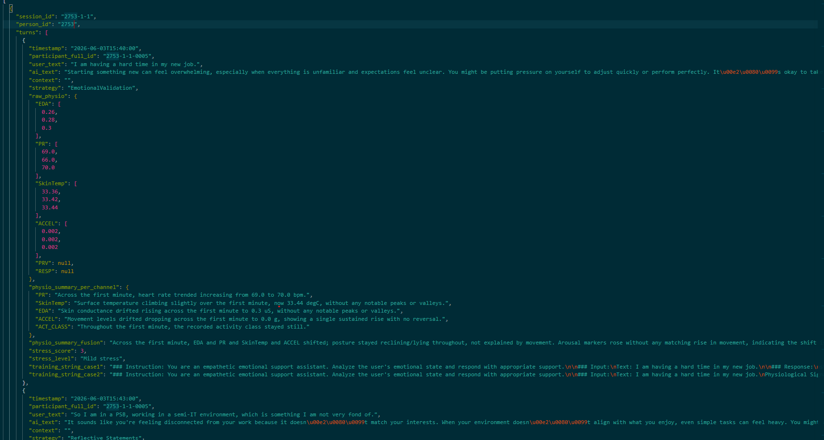

Slide 8
