Slide 1
Python Programming
Ashvani Kumar Dubey

Slide 2
History and Popularity
Python is an interpreted, high-level, general-purpose programming language
Created by Guido van Rossum and first released in 1991
Python 2.0 was released on 16 October 2000 with many major new features whereas Python 3.0 was released on 3 December 2008
Number 4 on TIOBE index for April 2019 after Java, C and C++
Number 1 on IEEE spectrum ratings in 2018.
Stack Overflow question visits, Python has a claim to being the fastest-growing major programming language, and has become the most visited tag on Stack Overflow within high-income countries
Python is used in a variety of purposes, ranging from web development to data science to DevOps

Slide 3
Python Setup
Python homepage
Python Interpreter
IDLE
Anaconda Distribution
Jupyter-notebook
Spyder
Quickly download 1,500+ Python/R data science packages
Manage libraries, dependencies, and environments with Conda
Few popular packages: Dask, NumPy, pandas, and Numba Matplotlib, Bokeh, Datashader, and Holoviews

Slide 4
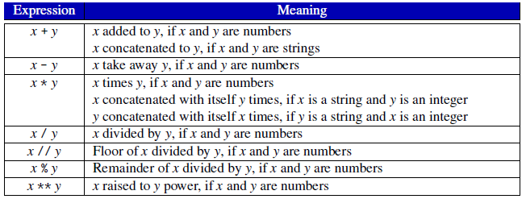
Values and Variables
Numeric types
Integer e.g. 4, 13690, -9999 etc.
Float e.g. 4.0, -3.5 etc.
Python type function returns type of the object
print(type(4)) returns int
print(type(4.0)) returns float
The equal sign (=) is used to assign a value to a variable
width = 20
height = 5 * 9
Python interpreter acts as a simple calculator
2 + 2; 2 * 3
10 / 3; 2 ** 8
21 % 2; 21 // 2

Slide 5
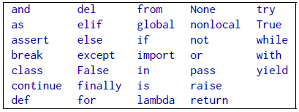
Variable (Identifier) naming convention
A Python identifier can be a combination of lowercase/ uppercase letters, digits, or an underscore
An identifier cannot begin with a digit
We cannot use special symbols in the identifier name
We cannot use a keyword as an identifier. Keywords are reserved names in Python and using one of those as a name for an identifier will result in a SyntaxError
An identifier can be as long as you want
Examples:
myVar = 3 - 9lives = 3232
var_3 = 3.5 - pass = 1
this_works_too = 4.83232 - pop% = 5

Slide 6
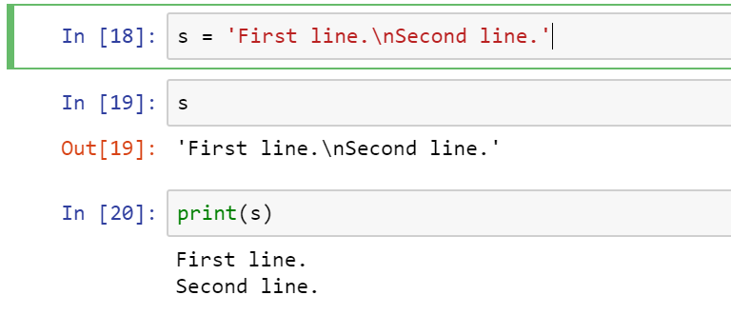
String
Python strings are created by enclosing values in single quotes ('...') or double quotes ("...") with the same result
\ can be used to escape quotes
Examples:
'hello world’ - 'doesn\'t'
"hello world“ - "doesn’t”
'"Yes," they said.’ - "\"Yes,\" they said.“
The print() function produces a more readable output, by omitting the enclosing quotes and by printing escaped and special characters

Slide 7
String Continued…
len is a built-in function that returns the number of characters in a string
Python uses 0-based indexing.
String = ‘Python’
String[0] = ‘P’; String[3] = ‘h’
String[-1] = ‘n’; String[-3] = ‘h’
Slicing sytanx is String[start:stop:step] where start is inclusive and stop is exclusive.
String[0:2] = ‘Py’; String[2:3] = ‘t’
String[:3] = ‘Pyt’; String[2:] = ‘thon’
String[-3:-1] = ‘hon’; String[:-1] = ‘Python’
Python strings cannot be changed — they are immutable. So String[0] = ‘J’ would through an error
Strings can be concatenated (glued together) with the + operator, and repeated with *
‘P’ | ‘y’ | ‘t’ | ‘h’ | ‘o’ | ‘n’
0 | 1 | 2 | 3 | 4 | 5
-6 | -5 | -4 | -3 | -2 | -1

Slide 8
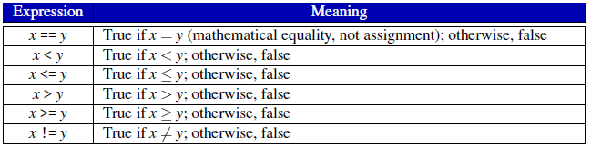

Conditional Execution
Boolean expression, sometimes called a predicate, may have only one of two possible values: false or true
True and False are the Python Boolean literals
Relational operators are ==, >=, <=,
>, < and !=
Example: 5 > 10 evaluates to False
whereas 5 > 3 evaluates to True.
We can combine simple Boolean expressions, each involving one relational operator, into more complex boolean expressions using the logical operators and, or, and not
Truth table for and, or and not

Slide 9
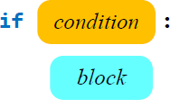
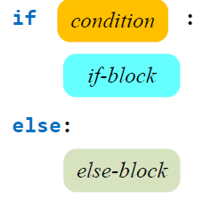
Conditional Execution
The general form of the if statement is:
For example:
if divisor != 0:
print(dividend, '/', divisor, "=", dividend/divisor)
The general form of an if/else statement is:
For example:
if divisor != 0:
print(dividend, '/', divisor, "=", dividend/divisor)
else:
print('Division by zero is not allowed')

Slide 10
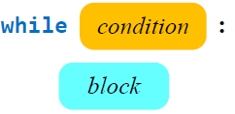
Iteration
Iteration repeats the execution of a sequence of code
Python has two different statements, while and for, that enable iteration
- for n in range(1, 11):
print(n)
The expression range(1, 11) creates a range object that allows the for loop to assign to the variable n the values 1, 2, . . . , 10.
range( begin,end,step ) where begin is the first value in the range; if omitted, the default value is 0, end is one past the last value in the range; the end value is always required and may not be omitted, step is the amount to increment or decrement; if the step parameter is omitted, it defaults to 1 (

Slide 11
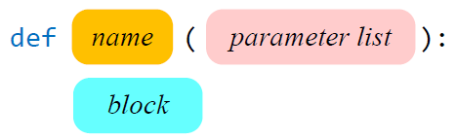
Defining functions
General form of function definition:
def keyword
The name is an identifier
Every function definition specifies the
parameters that it takes from the caller
Function body
For example:
def double(x):
return 2 * x
double(4)
Keyword pass can be used when a statement is required syntactically but the program requires no action
def count_to_10():
for i in range(1, 11):
print(i, end=' ‘)
print()
count_to_10()

Slide 12
Formatted Printing
TBD

