Slide 1



mini-wiki
A User-Submitted Instant Knowledgebase
Joe Wigdor
AD320 Fall 2024
North Seattle College

Slide 2


Introduction & Purpose
Value of Application
Allows users to contribute short articles (entries) on a single central topic.
Allows a group to quickly centralize information needed for a project
Encourages participation with interactive voting and time-bound validation
Instances are lightweight and can be containerized
Simple and attractive dynamic interface
Requirements
User accounts with authentication (Provided by Google)
Ability for users to submit, vote on, and delete entries
Automatic moderation via voting system
Integration with Google Firebase for real-time persistent storage
Search feature for entry titles.
About page and associated route
Catch-all route leads to main page

Slide 3
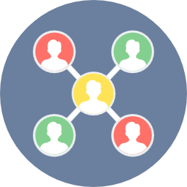

Features & Demonstration
Features
Logged out users can access the entries, but not contribute
Logged in users can submit new entries, vote on entries, and delete their own entries
Customizable wiki title
All entries have voting periods, if not positively voted, they are automatically deleted
Firebase securely stores title and entries
Entry list is dynamically updated on user interaction and periodically
Footer search bar quick scrolls to matching entry titles
Demonstration
New user can browse the list of entries and search for specific titles
They can create an account or log in with their Google credentials
Once logged in, they are presented with a submission form
User might want to change the wiki title
Whenever new entries are posted, the user can enter a positive or negative vote
Once the voting period expires, the entry is kept or deleted based on user voting
User can vote on and delete their own entries

Slide 4


Development Process & Reflection
Technical Walkthrough
React & Vite for a performant and secure front end
Firebase for authentication and storage
React Router for client-side navigation
CSS modules style specific components
Logic for voting, timing, and entry deletion integrated into react components
Process & Reflection
Strengths: Modular and reusable React components in a logical structure. Both real-time and interactive data updates.
Improvements: Input and DB logic could use more robust error handling. Would like to implement an administrator interface.
Lessons: The importance of making React components self-contained. Making a UI respond to a real time database.

