Slide 1
4thCoffee
www.4thcoffee.com

Slide 2
Recall: Covariance

Slide 3
Interpreting Covariance
cov(X,Y) > 0 X and Y are positively correlated
cov(X,Y) < 0 X and Y are inversely correlated
cov(X,Y) = 0 X and Y are independent

Slide 4
Correlation coefficient
Pearson’s Correlation Coefficient is standardized covariance (unit less):

Slide 5
Correlation
Measures the relative strength of the linear relationship between two variables
Unit-less
Ranges between –1 and 1
The closer to –1, the stronger the negative linear relationship
The closer to 1, the stronger the positive linear relationship
The closer to 0, the weaker any positive linear relationship

Slide 6
Scatter Plots of Data with Various Correlation Coefficients
Y
Y
Y
X
X
X
r = -1
r = -.6
r = 0
Y
Y
Y
X
X
X
r = +1
r = +.3
r = 0
Slide from: Statistics for Managers Using Microsoft® Excel 4th Edition, 2004 Prentice-Hall

Slide 7
Linear Correlation
Linear relationships
Curvilinear relationships
Y
Y
X
X
Y
Y
X
X
Slide from: Statistics for Managers Using Microsoft® Excel 4th Edition, 2004 Prentice-Hall

Slide 8
Linear Correlation
Strong relationships
Weak relationships
Y
Y
X
X
Y
Y
X
X
Slide from: Statistics for Managers Using Microsoft® Excel 4th Edition, 2004 Prentice-Hall

Slide 9
Linear Correlation
No relationship
Relationship
Y
X
Y
X
Slide from: Statistics for Managers Using Microsoft® Excel 4th Edition, 2004 Prentice-Hall

Slide 10
Calculating by hand…

Slide 11
Simpler calculation formula…
Numerator of covariance
Numerators of variance

Slide 12
Distribution of the correlation coefficient:
The sample correlation coefficient follows a T-distribution with n-2 degrees of freedom (since you have to estimate the standard error).
*note, like a proportion, the variance of the correlation coefficient depends on the correlation coefficient itself → substitute in estimated r

Slide 13
Continuous outcome (means)
Outcome Variable | Are the observations independent or correlated? |  | Alternatives if the normality assumption is violated (and small sample size):
 | independent | correlated
Continuous (e.g. pain scale, cognitive function) | Test: compares means between two independent groups ANOVA: compares means between more than two independent groups Pearson’s correlation coefficient (linear correlation): shows linear correlation between two continuous variables Linear regression: multivariate regression technique used when the outcome is continuous; gives slopes | Paired test: compares means between two related groups (e.g., the same subjects before and after) Repeated-measures ANOVA: compares changes over time in the means of two or more groups (repeated measurements) Mixed models/GEE modeling: multivariate regression techniques to compare changes over time between two or more groups; gives rate of change over time | Non-parametric statistics Wilcoxon sign-rank test: non-parametric alternative to the paired test Wilcoxon sum-rank test (=Mann-Whitney U test): non-parametric alternative to the test Kruskal-Wallis test: non-parametric alternative to ANOVA Spearman rank correlation coefficient: non-parametric alternative to Pearson’s correlation coefficient

Slide 14
Linear regression
In correlation, the two variables are treated as equals. In regression, one variable is considered independent (=predictor) variable (X ) and the other the dependent (=outcome) variable Y.

Slide 15
What is “Linear”?
Remember this:
Y = mX + B ?
m
B

Slide 16
What’s Slope?
A slope of 2 means that every 1-unit change in X yields a 2-unit change in Y.

Slide 17
Prediction
If you know something about X, this knowledge helps you predict something about Y.
(Sound familiar?…sound like conditional probabilities?)

Slide 18
Regression equation…
Expected value of y at a given level of x=

Slide 19
Predicted value for an individual…
y_{i}= α + β*x_{i} + random error _{i}
Fixed – exactly on the line
Follows a normal distribution

Slide 20
Assumptions (or the fine print)
Linear regression assumes that…
1. The relationship between X and Y is linear
2. Y is distributed normally at each value of X
3. The variance of Y at every value of X is the same (homogeneity of variances)
4. The observations are independent

Slide 21
The standard error of Y given X is the average variability around the regression line at any given value of X. It is assumed to be equal at all values of X.
Sy/x
Sy/x
Sy/x
Sy/x
Sy/x
Sy/x

Slide 22
Regression Picture
y_{i}
C
A
B
y
B
A
C
y_{i}
*Least squares estimation gave us the line (β) that minimized C²
x
R²=SSreg/SStotal
A² B² C²
SS_{reg}
Distance from regression line to naïve mean of y
Variability due to x (regression)
SS _{residual}
Variance around the regression line
Additional variability not explained by x—what least squares method aims to minimize
SS_{total}
Total squared distance of observations from naïve mean of y
Total variation

Slide 23
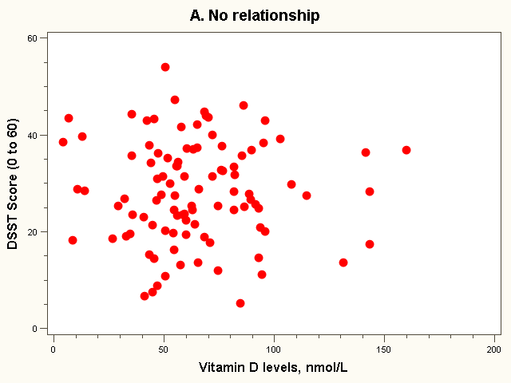
Dataset 1: no relationship

Slide 24
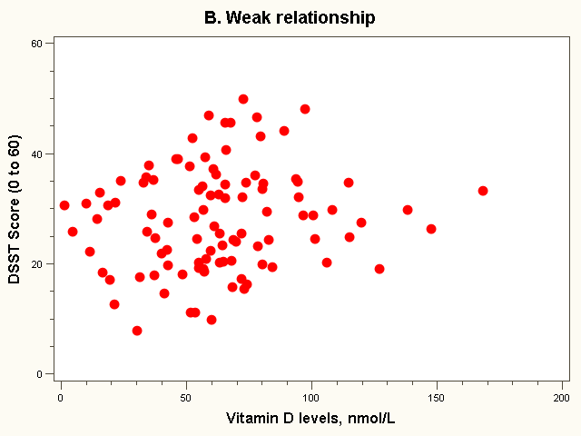
Dataset 2: weak relationship

Slide 25
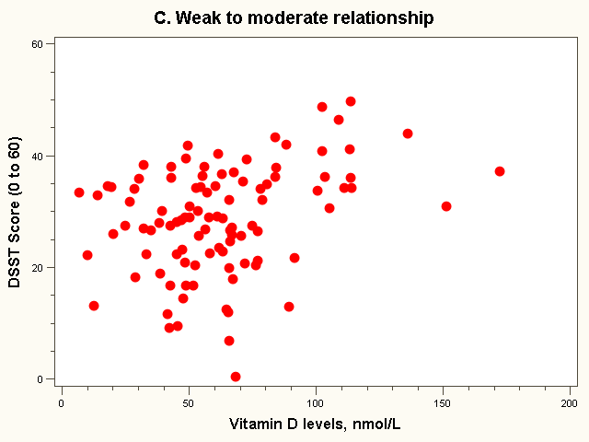
Dataset 3: weak to moderate relationship

Slide 26
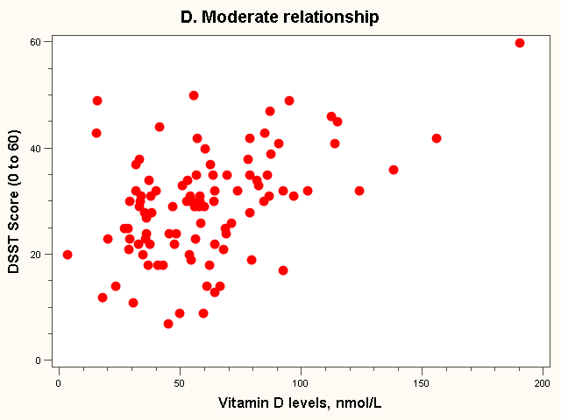
Dataset 4: moderate relationship

Slide 27
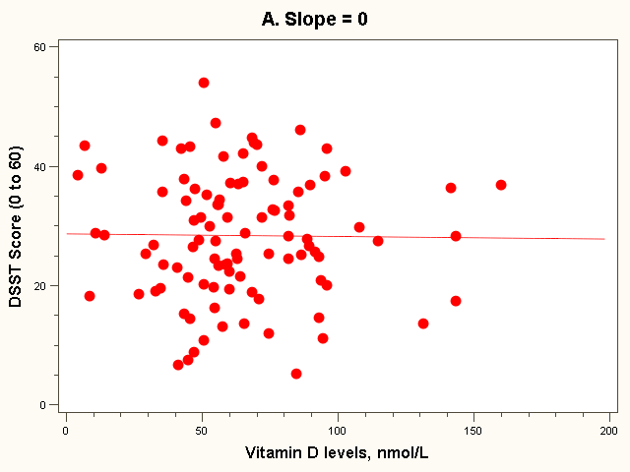
The “Best fit” line
Regression equation:
E(Yi) = 28 + 0*vit Di (in 10 nmol/L)

Slide 28
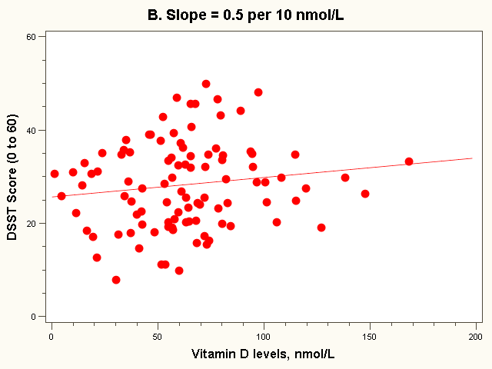
The “Best fit” line
Note how the line is a little deceptive; it draws your eye, making the relationship appear stronger than it really is!
Regression equation:
E(Yi) = 26 + 0.5*vit Di (in 10 nmol/L)

Slide 29
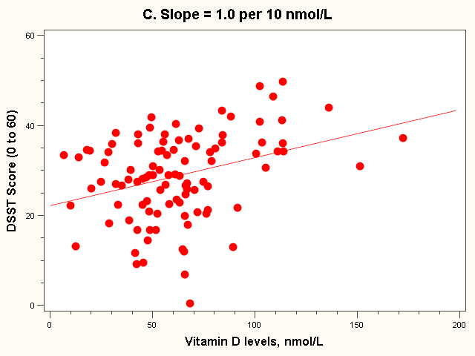
The “Best fit” line
Regression equation:
E(Yi) = 22 + 1.0*vit Di (in 10 nmol/L)

Slide 30
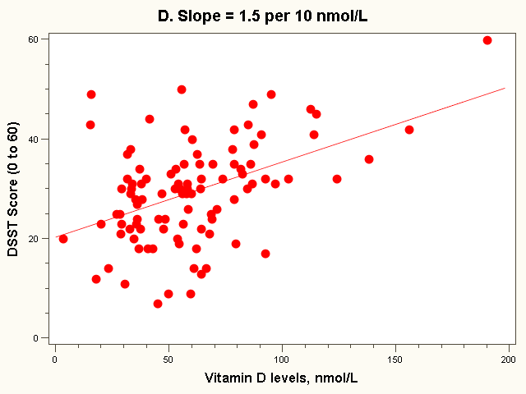
The “Best fit” line
Regression equation:
E(Yi) = 20 + 1.5*vit Di (in 10 nmol/L)
Note: all the lines go through the point (63, 28)!

Slide 31
Estimating the intercept and slope: least squares estimation
** Least Squares Estimation
A little calculus….
What are we trying to estimate? β, the slope, from
What’s the constraint? We are trying to minimize the squared distance (hence the “least squares”) between the observations themselves and the predicted values , or (also called the “residuals”, or left-over unexplained variability)
Differencei = yi – (βx + α) Differencei² = (yi – (βx + α)) ²
Find the β that gives the minimum sum of the squared differences. How do you maximize a function? Take the derivative; set it equal to zero; and solve. Typical max/min problem from calculus….
From here takes a little math trickery to solve for β…

Slide 32
Resulting formulas…
Slope (beta coefficient) =
Intercept=
Regression line always goes through the point:

Slide 33
Relationship with correlation
In correlation, the two variables are treated as equals. In regression, one variable is considered independent (=predictor) variable (X) and the other the dependent (=outcome) variable Y.

Slide 34
Example: dataset 4
SDx = 33 nmol/L
SDy= 10 points
Cov(X,Y) = 163 points*nmol/L
Beta = 163/33² = 0.15 points per nmol/L
= 1.5 points per 10 nmol/L
r = 163/(10*33) = 0.49
Or
r = 0.15 * (33/10) = 0.49

Slide 35
Significance testing…
Slope
Distribution of slope ~ T_{n-2}(β, s.e.( ))
H0: β1 = 0 (no linear relationship)
H1: β1 ≠ 0 (linear relationship does exist)
T_{n-2}=

Slide 36
Formula for the standard error of beta (you will not have to calculate by hand!):

Slide 37
Example: dataset 4
Standard error (beta) = 0.03
T₉₈ = 0.15/0.03 = 5, p<.0001
95% Confidence interval = 0.09 to 0.21

Slide 38
Residual Analysis: check assumptions
The residual for observation i, e_{i}, is the difference between its observed and predicted value
Check the assumptions of regression by examining the residuals
Examine for linearity assumption
Examine for constant variance for all levels of X (homoscedasticity)
Evaluate normal distribution assumption
Evaluate independence assumption
Graphical Analysis of Residuals
Can plot residuals vs. X

Slide 39
Predicted values…
For Vitamin D = 95 nmol/L (or 9.5 in 10 nmol/L):

Slide 40
Residual = observed - predicted
X=95 nmol/L
34

Slide 41
Residual Analysis for Linearity
Y
Y
x
x
residuals
x
x
residuals
Not Linear
✓
Linear
Slide from: Statistics for Managers Using Microsoft® Excel 4th Edition, 2004 Prentice-Hall

Slide 42
Residual Analysis for Homoscedasticity
Y
Y
x
x
residuals
x
x
residuals
✓
Non-constant variance
Constant variance
Slide from: Statistics for Managers Using Microsoft® Excel 4th Edition, 2004 Prentice-Hall

Slide 43
Residual Analysis for Independence
Not Independent
✓
Independent
residuals
X
residuals
X
residuals
X
Slide from: Statistics for Managers Using Microsoft® Excel 4th Edition, 2004 Prentice-Hall

Slide 44
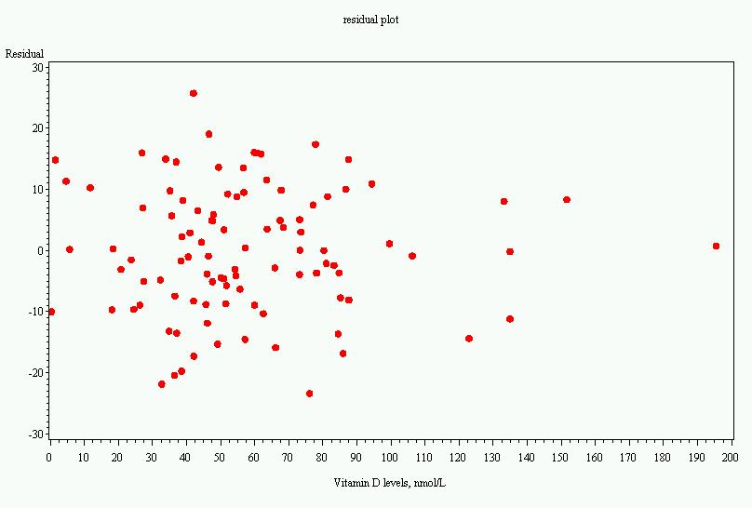
Residual plot, dataset 4

Slide 45
Multiple linear regression…
What if age is a confounder here?
Older men have lower vitamin D
Older men have poorer cognition
“Adjust” for age by putting age in the model:
DSST score = intercept + slope₁xvitamin D + slope₂ xage

Slide 46
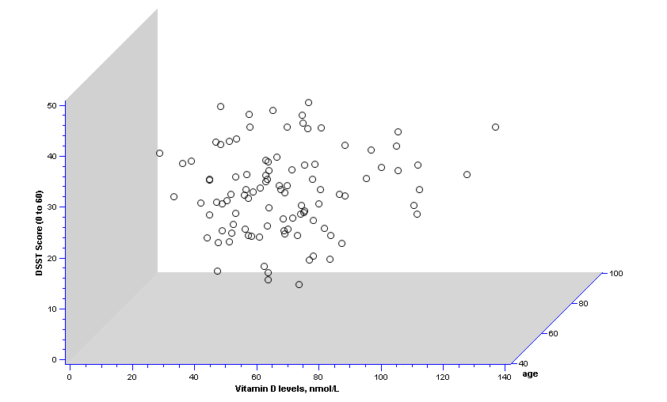
2 predictors: age and vit D…

Slide 47
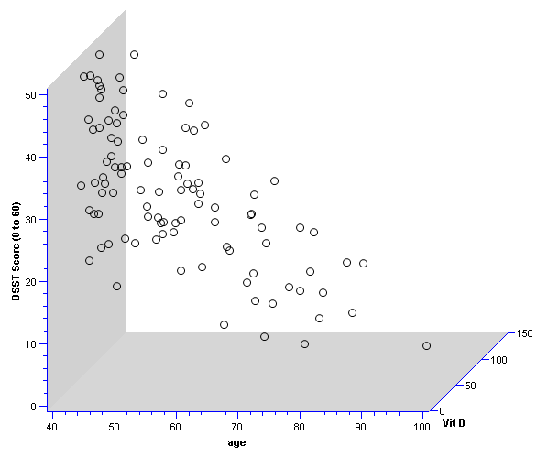
Different 3D view…

Slide 48
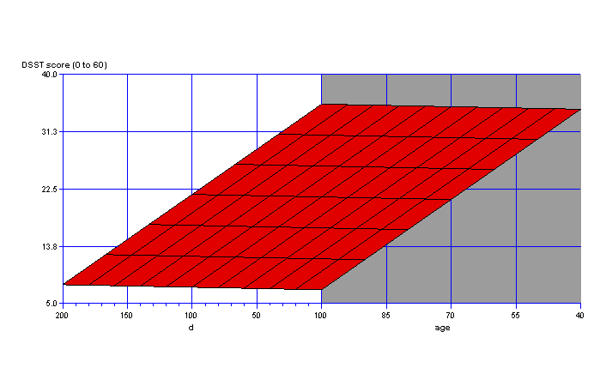
Fit a plane rather than a line…
On the plane, the slope for vitamin D is the same at every age; thus, the slope for vitamin D represents the effect of vitamin D when age is held constant.

Slide 49
Equation of the “Best fit” plane…
DSST score = 53 + 0.0039xvitamin D (in 10 nmol/L) - 0.46 xage (in years)
P-value for vitamin D >>.05
P-value for age <.0001
Thus, relationship with vitamin D was due to confounding by age!

Slide 50
Multiple Linear Regression
More than one predictor…
E(y)= α + β₁*X + β₂ *W + β₃ *Z…
Each regression coefficient is the amount of change in the outcome variable that would be expected per one-unit change of the predictor, if all other variables in the model were held constant.

Slide 51
Functions of multivariate analysis:
Control for confounders
Test for interactions between predictors (effect modification)
Improve predictions

Slide 52
A ttest is linear regression!
Divide vitamin D into two groups:
Insufficient vitamin D (<50 nmol/L)
Sufficient vitamin D (>=50 nmol/L), reference group
We can evaluate these data with a ttest or a linear regression…

Slide 53
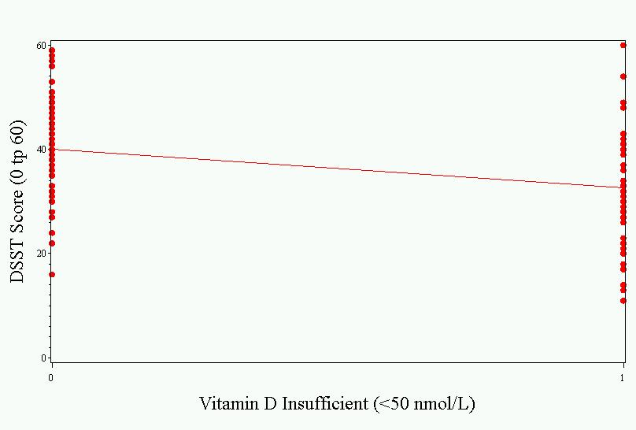
As a linear regression…
Intercept represents the mean value in the sufficient group.
Slope represents the difference in means between the groups. Difference is significant.
Parameter ````````````````Standard
Variable Estimate Error t Value Pr > |t|
Intercept 40.07407 1.47511 27.17 <.0001
insuff -7.53060 2.17493 -3.46 0.0008

Slide 54
ANOVA is linear regression!
Divide vitamin D into three groups:
Deficient (<25 nmol/L)
Insufficient (>=25 and <50 nmol/L)
Sufficient (>=50 nmol/L), reference group
DSST= α (=value for sufficient) + β_{insufficient}*(1 if insufficient) + β₂ *(1 if deficient)
This is called “dummy coding”—where multiple binary variables are created to represent being in each category (or not) of a categorical variable

Slide 55
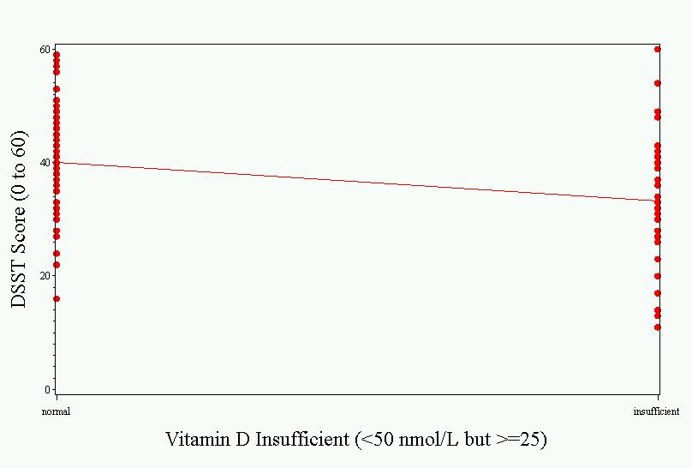
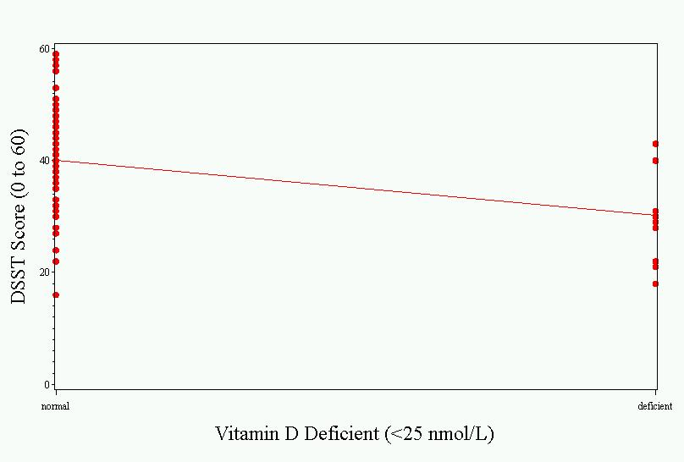
The picture…
Sufficient vs. Insufficient
Sufficient vs. Deficient

Slide 56
Results…
Parameter Estimates
Parameter Standard
Variable DF Estimate Error t Value Pr > |t|
Intercept 1 40.07407 1.47817 27.11 <.0001
deficient 1 -9.87407 3.73950 -2.64 0.0096
insufficient 1 -6.87963 2.33719 -2.94 0.0041
Interpretation:
The deficient group has a mean DSST 9.87 points lower than the reference (sufficient) group.
The insufficient group has a mean DSST 6.87 points lower than the reference (sufficient) group.

Slide 57
Other types of multivariate regression
Multiple linear regression is for normally distributed outcomes
Logistic regression is for binary outcomes
Cox proportional hazards regression is used when time-to-event is the outcome

Slide 58
Common multivariate regression models.
Outcome (dependent variable) | Example outcome variable | Appropriate multivariate regression model | Example equation | What do the coefficients give you?
Continuous | Blood pressure | Linear regression | blood pressure (mmHg) = α + βsalt*salt consumption (tsp/day) + βage*age (years) + βsmoker*ever smoker (yes=1/no=0) | slopes—tells you how much the outcome variable increases for every 1-unit increase in each predictor.
Binary | High blood pressure (yes/no) | Logistic regression | ln (odds of high blood pressure) = α + βsalt*salt consumption (tsp/day) + βage*age (years) + βsmoker*ever smoker (yes=1/no=0) | odds ratios—tells you how much the odds of the outcome increase for every 1-unit increase in each predictor.
Time-to-event | Time-to- death | Cox regression | ln (rate of death) = α + βsalt*salt consumption (tsp/day) + βage*age (years) + βsmoker*ever smoker (yes=1/no=0) | hazard ratios—tells you how much the rate of the outcome increases for every 1-unit increase in each predictor.

Slide 59
Multivariate regression pitfalls
Multi-collinearity
Residual confounding
Overfitting

Slide 60
Multicollinearity
Multicollinearity arises when two variables that measure the same thing or similar things (e.g., weight and BMI) are both included in a multiple regression model; they will, in effect, cancel each other out and generally destroy your model.
Model building and diagnostics are tricky business!

Slide 61
Residual confounding
You cannot completely wipe out confounding simply by adjusting for variables in multiple regression unless variables are measured with zero error (which is usually impossible).
Example: meat eating and mortality

Slide 62
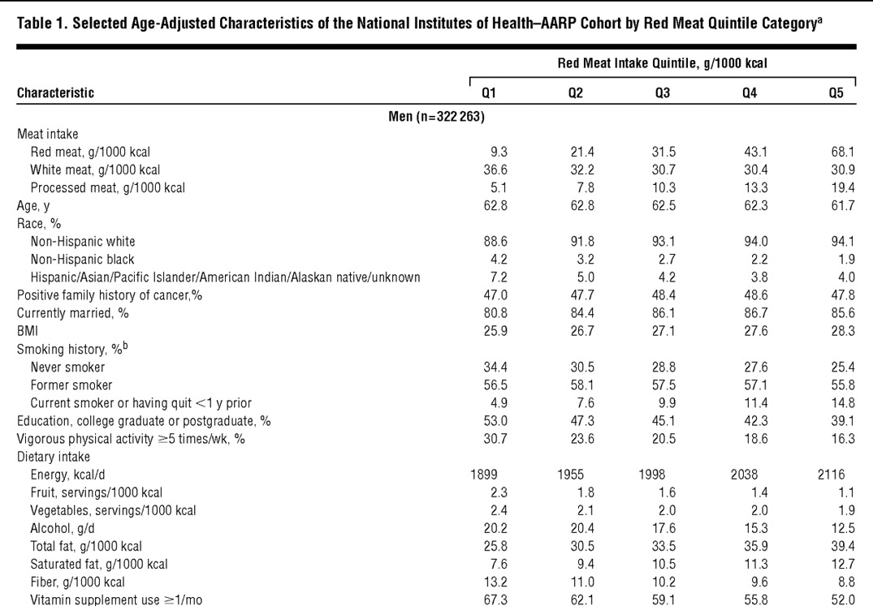
Men who eat a lot of meat are unhealthier for many reasons!
Sinha R, Cross AJ, Graubard BI, Leitzmann MF, Schatzkin A. Meat intake and mortality: a prospective study of over half a million people. Arch Intern Med 2009;169:562-71

Slide 63
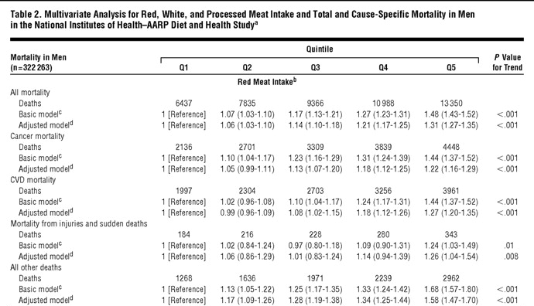
Mortality risks…
Sinha R, Cross AJ, Graubard BI, Leitzmann MF, Schatzkin A. Meat intake and mortality: a prospective study of over half a million people. Arch Intern Med 2009;169:562-71

Slide 64
Overfitting
In multivariate modeling, you can get highly significant but meaningless results if you put too many predictors in the model.
The model is fit perfectly to the quirks of your particular sample, but has no predictive ability in a new sample.

Slide 65
Overfitting: class data example
I asked SAS to automatically find predictors of optimism in our class dataset. Here’s the resulting linear regression model:
Parameter Standard
Variable Estimate Error Type II SS F Value Pr > F
Intercept 11.80175 2.98341 11.96067 15.65 0.0019
exercise -0.29106 0.09798 6.74569 8.83 0.0117
sleep -1.91592 0.39494 17.98818 23.53 0.0004
obama 1.73993 0.24352 39.01944 51.05 <.0001
Clinton -0.83128 0.17066 18.13489 23.73 0.0004
mathLove 0.45653 0.10668 13.99925 18.32 0.0011
Exercise, sleep, and high ratings for Clinton are negatively related to optimism (highly significant!) and high ratings for Obama and high love of math are positively related to optimism (highly significant!).

Slide 66
If something seems to good to be true…
Clinton, univariate:
Parameter Standard
Variable Label DF Estimate Error t Value Pr > |t|
Intercept Intercept 1 5.43688 2.13476 2.55 0.0188
Clinton Clinton 1 0.24973 0.27111 0.92 0.3675
Sleep, Univariate:
Parameter Standard
Variable Label DF Estimate Error t Value Pr > |t|
Intercept Intercept 1 8.30817 4.36984 1.90 0.0711
sleep sleep 1 -0.14484 0.65451 -0.22 0.8270
Exercise, Univariate:
Parameter Standard
Variable Label DF Estimate Error t Value Pr > |t|
Intercept Intercept 1 6.65189 0.89153 7.46 <.0001
exercise exercise 1 0.19161 0.20709 0.93 0.3658

Slide 67
More univariate models…
Obama, Univariate:
Parameter Standard
Variable Label DF Estimate Error t Value Pr > |t|
Intercept Intercept 1 0.82107 2.43137 0.34 0.7389
obama obama 1 0.87276 0.31973 2.73 0.0126
Compare with multivariate result; p<.0001
Love of Math, univariate:
Parameter Standard
Variable Label DF Estimate Error t Value Pr > |t|
Intercept Intercept 1 3.70270 1.25302 2.96 0.0076
mathLove mathLove 1 0.59459 0.19225 3.09 0.0055
Compare with multivariate result; p=.0011

Slide 68
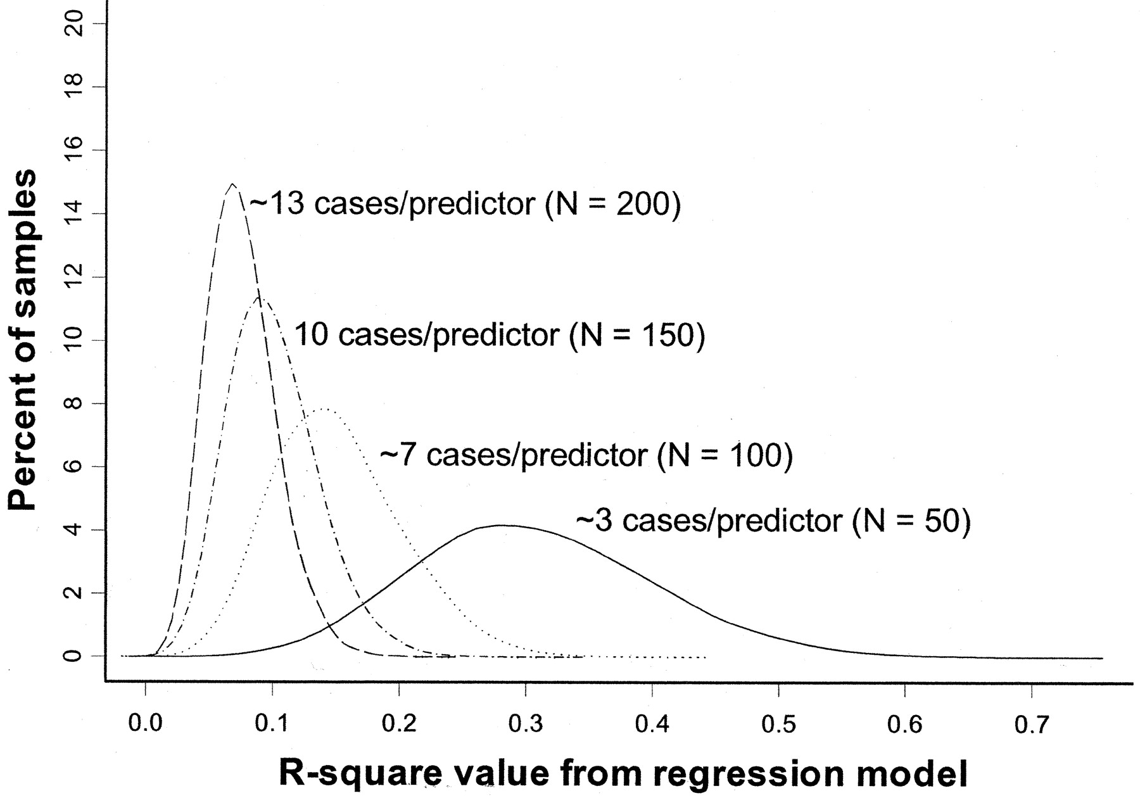
Overfitting
Rule of thumb: You need at least 10 subjects for each additional predictor variable in the multivariate regression model.
Pure noise variables still produce good R² values if the model is overfitted. The distribution of R² values from a series of simulated regression models containing only noise variables.
(Figure 1 from: Babyak, MA. What You See May Not Be What You Get: A Brief, Nontechnical Introduction to Overfitting in Regression-Type Models. Psychosomatic Medicine 66:411-421 (2004).)

Slide 69



THANK YOU
www.4thcoffee.com
VICTORIA LINDQVIST
+1 (589) 555‐0155
victoria@fourthcoffee.com

