Slide 1
TORCS Racing - Computational Intelligence

Slide 2
Agenda
What Controllers were used?
How we measured their Accuracy?
What Fitness Function was used?
What we did to improve performance?
What is the final outcome?

Slide 3
Controllers
Neural Networks
  Recurrent Neural Network (Pyrenn) using RTRL
  Echo State Network (Pyesn)
Evolutionary Computing
  NEAT and HyperNEAT
Swarm Behaviour
  Emergent Collective Behaviour

Slide 4
Accuracy Measure
Neural Networks
  80% training and 20% spliting, measure of MSE after 100 generations
Evolutionary Computing
  Evolved a Recurrent NN from scratch
  Fitness function = Maximum Distance Travelled
  Constrain = Car should stay within track edge
  Tested the network on 20% of test data to visualize the output
Swarm Behaviour
  No measure on accuracy, but only created an Emergent collective behaviour

Slide 5
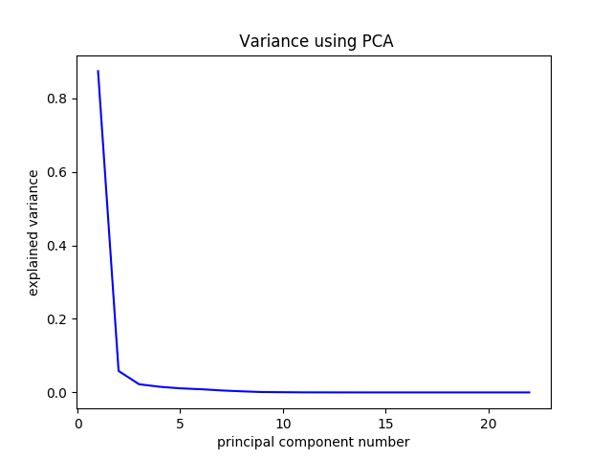
Performance Improvement
Feature Extraction
  PCA
  New features from Sensor 8,9 and 10
Activation Functions
  Tanh, Sigmoid, clamped and Sin
  Sin performed the best for our network

Slide 6
Performance Improvement
Normalization of Inputs
  Angle = Angle / ∏
  Speed = (max(0, min(Speed, 200)) / 100) -1
  D_center = max(min(D_center / 2, 1), -1)
  D_Edge= ((D_Edge + 1)/100.5)-1

Slide 7
Fitness Function
Constraint Opmimization problem
Maximize the fitness function
  Fitness = Distance travelled in a lap
  Constrain = Stay within the track edges

Slide 8
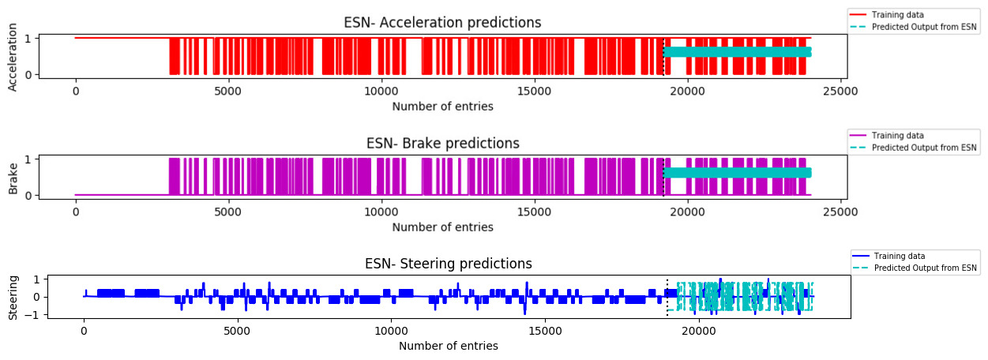
Results
Predictions of ESN

Slide 9
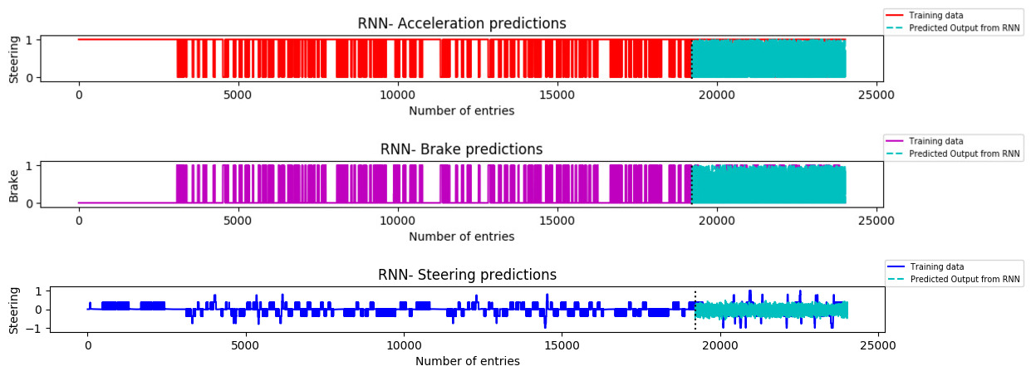
Results
Predictions of RNN

Slide 10
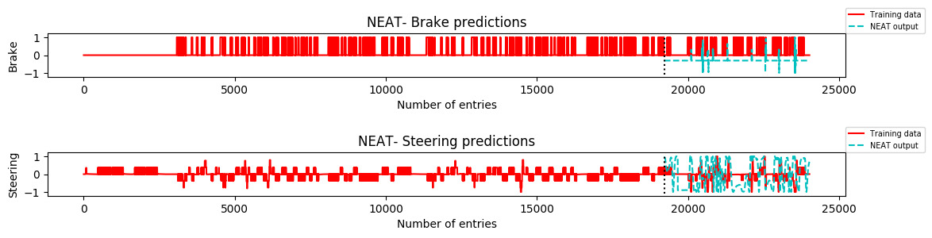
Results
Predictions from NEAT

Slide 11
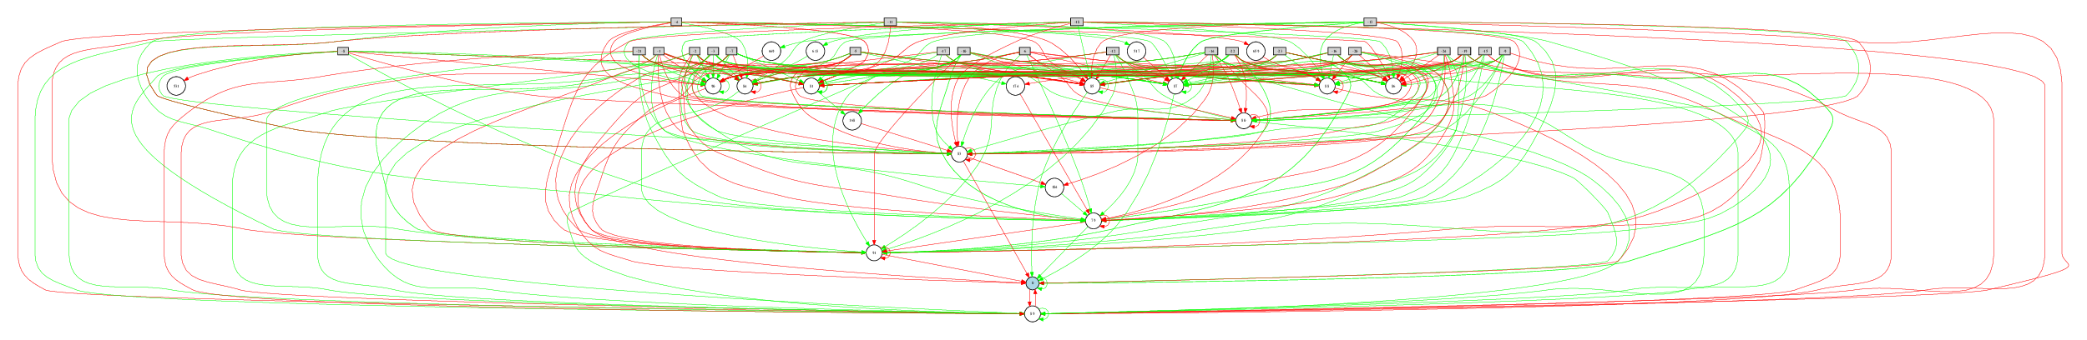
Results
NEAT- Steering Topology

Slide 12
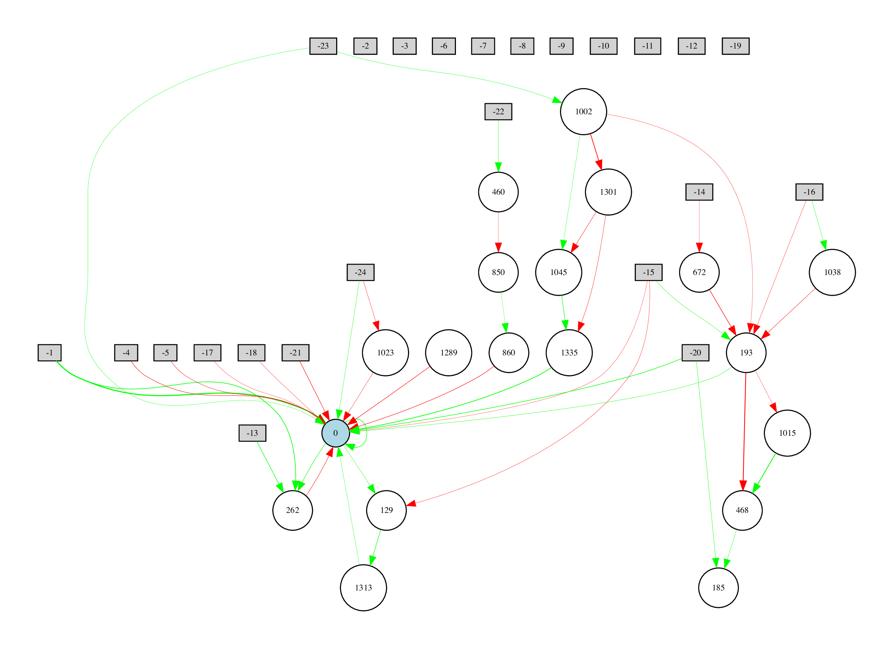
Results
NEAT- Brake Topology

Slide 13
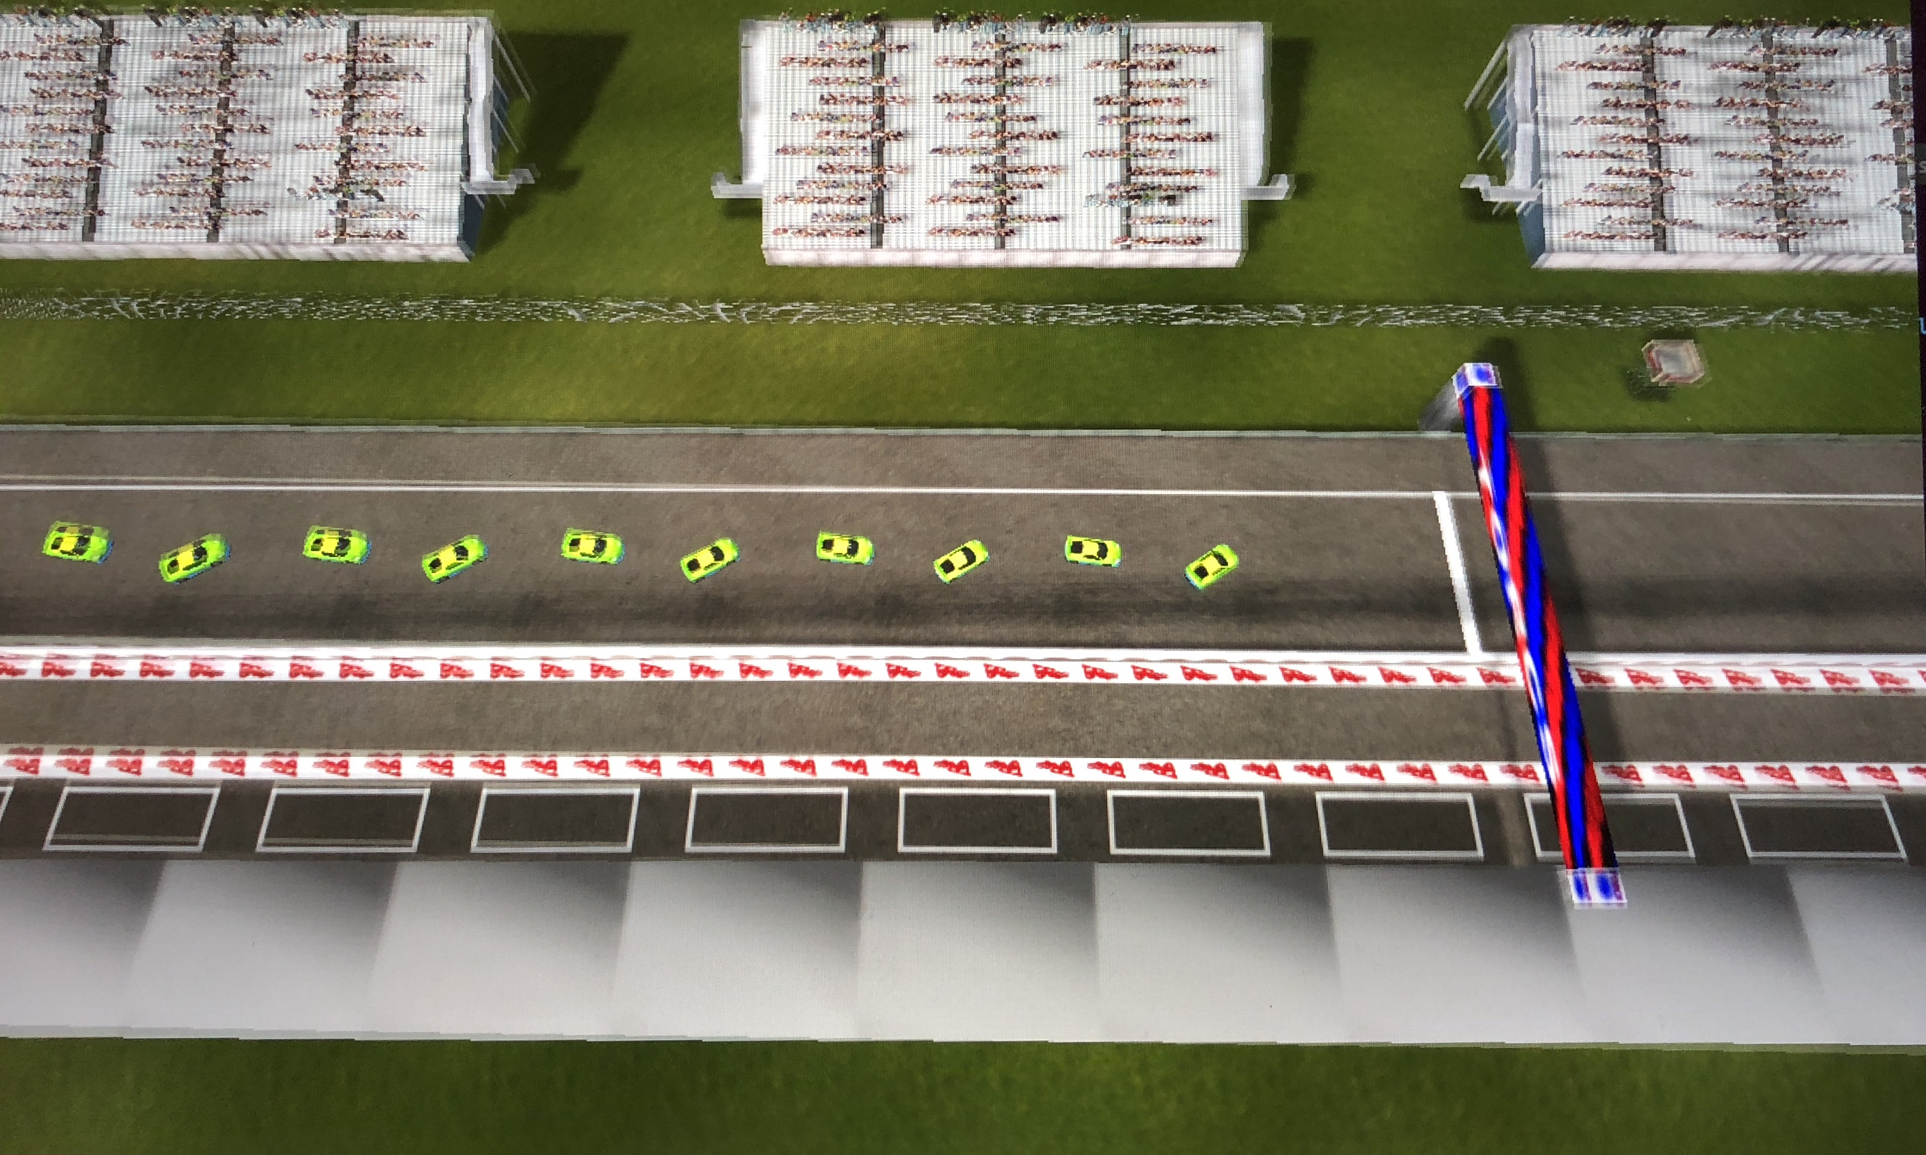
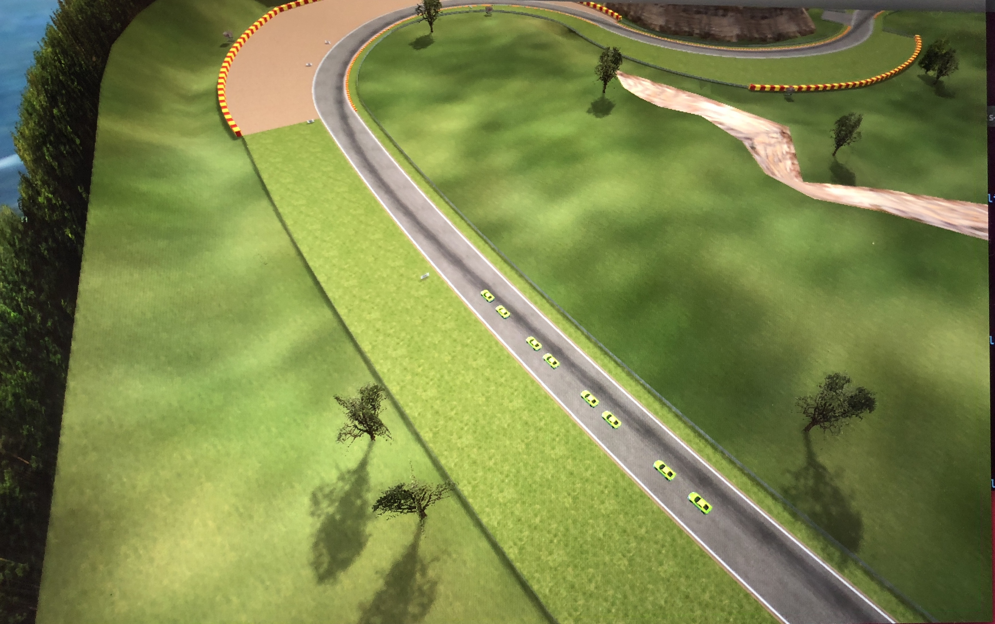
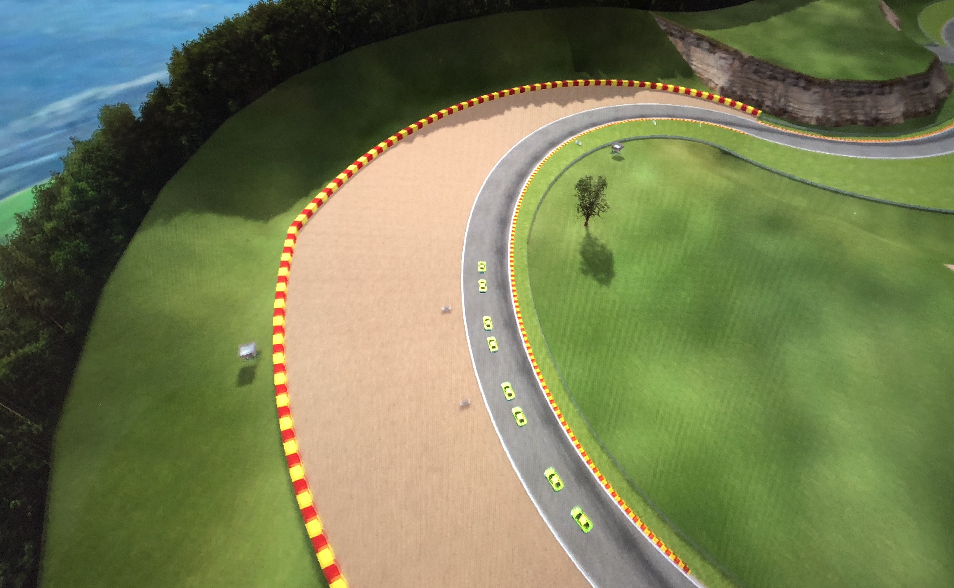
Results
  Emergent Collective Behaviour

