Slide 1

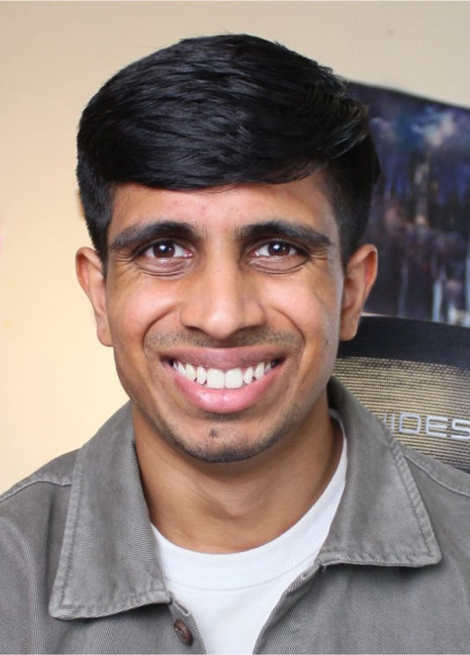

ECOWORLD · AI IN CONTENT MARKETING
AI in
Content Marketing
Build a content system that learns your brand,
your process, and your feedback.
Ashvin Praveen · Co-founder & CEO, Cleve.ai
From chatbots to content engines

Slide 2



WHY ME
I build, teach, and test these systems in the real world.
01
03
Learn the craft
Teach at scale
Tech + media,
building in public
National AI Competition
Nearly 2,000 students
02
04
Build the product
Grow the ecosystem
Cleve.ai
40,000+ users · Antler-backed
Malaysian.ai
Community for AI builders
The common thread: turning lived context into useful systems.
ASHVIN PRAVEEN · INTRODUCTION
02

Slide 3
THE SHIFT
A chatbot answers. A content engine improves.
CHATBOT
CONTENT ENGINE
Starts from zero
every time.
Carries your context forward.
Memory
Context
Workflow
“Write me a social post.”
Feedback
Generic draft
On-brand content,
faster
Each round leaves the system smarter.
Then the context disappears.
ASHVIN PRAVEEN · INTRODUCTION
03

