Slide 1
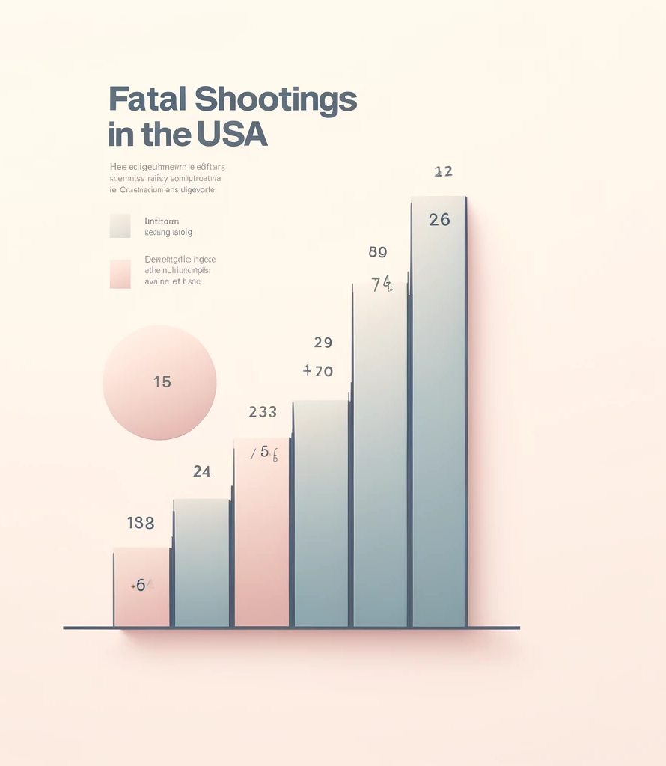
The Washington post : Analyzing Patterns of Police Shooting Data
Santhoshi Priya Sunchu
Meghana Thota
Srividya Srinivasula
Ashvitha Banala

Slide 2

Visualizing the Impact: A Closer Look at Fatal Police Shootings Through Data
Overview of the Dataset: This dataset provides records of fatal police shootings in the United States, capturing the date, location, and outcomes of these critical interactions, includes variables like demographic details, armed status, and mental illness presence.
Significance of the Data: Analyzing the data reveals patterns and trends in fatal police encounters, providing crucial insights for policymakers, law enforcement, and researchers to evaluate and improve practices to reduce unnecessary violence.
Source and Credibility: The Washington Post, is known for its reliability and thorough methodology in tracking every fatal shooting nationwide.

Slide 3
What, Why, How ?
What: Analyzing patterns in fatal police shootings, focusing on aspects like racial demographics, armed status, and geographic distribution.
Why: To uncover insights that might help in understanding the dynamics of police encounters and possibly guide policies.
How: Using JavaScript and D3.js to create interactive visualizations that allow users to explore the data dynamically.

Slide 4
Video Presentation
Video Link: https://drive.google.com/file/d/18RVCori7pXFgcd2Pv-JlD5plvw_4UXnV/view?usp=sharing

Slide 5
Possible Improvements :
Enhancing Data Collection: Include non-fatal incidents and data on body cameras and legal outcomes. Add qualitative insights from body cameras and bystander videos.
Longitudinal Study Recommendations: Set up ongoing data tracking to measure policy and training effectiveness. Support long-term studies to evaluate the impacts of policy and training changes.
Explore the adoption of advanced predictive analytics to forecast trends and preemptively address factors contributing to fatal police shootings.

Slide 6
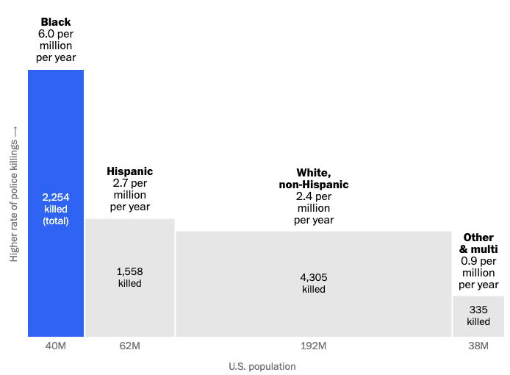
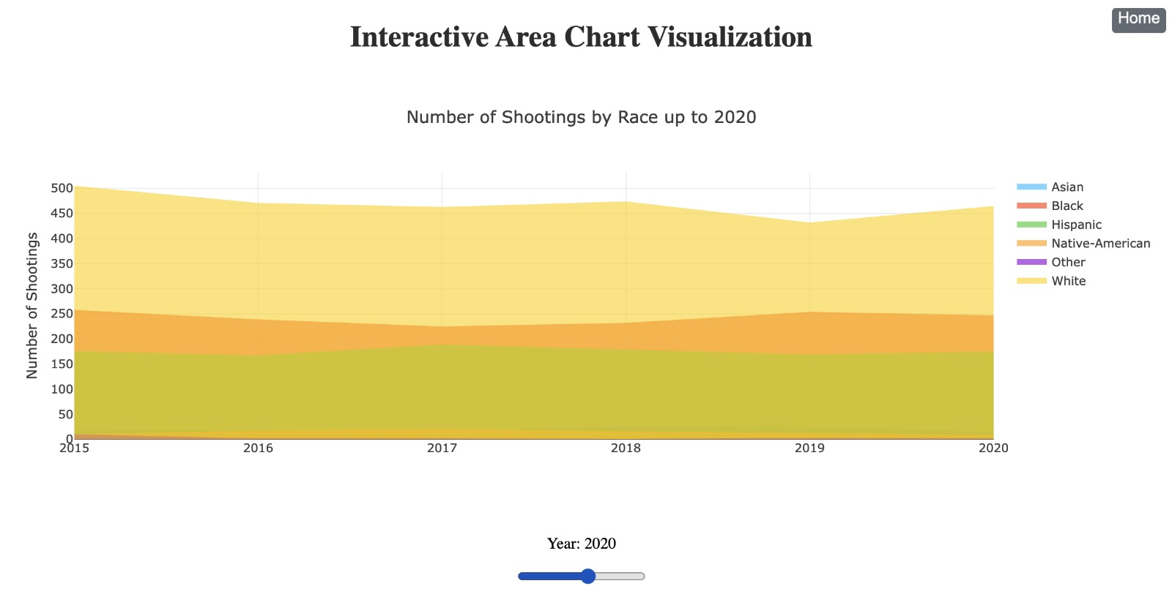
Comparison with Other Visualizations :
Our data representation provides a dynamic multi-year view that illustrates trends over time, enhancing the understanding of changes in racial disparities in police shootings.
The static representation in the Washington Post's Fatal Force database, our graph offers an interactive breakdown by race, allowing viewers to see detailed shifts annually.
Image from The Washington Police
Our statistical display

Slide 7
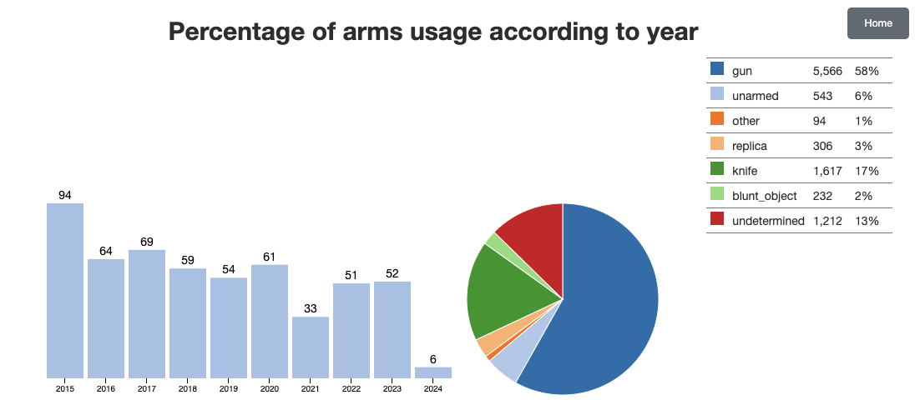
Comparison with Other Visualizations :
By integrating both bar and pie chart elements, our visualization offers a comprehensive overview of the data, showing yearly trends alongside the distribution of different types of arms used.
This multi-dimensional approach provides insights that are not as easily accessible with single-format graphs as one shown :

Slide 8
Conclusion :
Racial Disparities: Analysis of over 9,000 total incidents, African Americans(B) who, at 13% of the population, face the highest fatality rate of 6.0 per million per year. In contrast, White(W),Hispanics(H) 60% of the population, have a rate of 2.4, while Hispanics, 18% of the population, have a rate of 2.70.
Geographic Concentrations: About 37% of all recorded incidents are concentrated in just five states, highlighting regional variations that may reflect differing law enforcement practices or local demographic factors.
Correlation with Mental Health: Data reveals that individuals with reported mental health issues account for 19.93% of the cases, with these encounters resulting in fatal outcomes 99% more often than those without reported mental health issues.
Most Victims are Young: Over half of the individuals fatally shot by police fall within the age range of 20 to 40 years.
4, while Hispanics, 18% of the population, have a rate Key insights:

Slide 9
Links and References
The Washington Post : https://www.washingtonpost.com/graphics/investigations/police-shootings-database/.
Code to generate key statistics for the conclusion slide : https://colab.research.google.com/drive/1pMdVEirUZQeQ2arKmYK4HN4Mubo15V_1?usp=sharing.

