Slide 1
AI-Powered Credit Risk Intelligence Platform
• Dataset: Home Credit Default Risk (Kaggle)
• Stack: Python 3.11, LightGBM, SHAP, Streamlit, SQLite, Docker
• LLM: Multi-provider (OpenAI / Groq / Gemini) + deterministic fallback
• Author: Ashwani Dhayal
NeoStats AI Engineer Assignment — Submission

Slide 2
Business Problem
Banks must make faster, more accurate, and explainable credit decisions.
Identify high-risk applicants early and automate risk scoring.
Provide auditable, regulator-friendly reasons for every decision.
Let business analysts explore the portfolio in plain English.
Bridge ML insights and credit policy through readable rules.

Slide 3
Solution at a Glance
End-to-end platform: EDA → ML → Explainability → Rules → Chatbot.
Single Streamlit UI with 6 sections; one Docker command to run.
ML model returns probability + Low/Medium/High band + Decision.
SHAP TreeExplainer attributes every score to ranked feature drivers.
Talk-to-Data agent translates English to safe, read-only SQLite SQL.
Decision-tree rules give credit officers an audit-ready policy view.

Slide 4
Architecture (logical view)
Streamlit UI (app/streamlit_app.py) — multi-section navigation.
src/ml: LightGBM training / inference / SHAP TreeExplainer.
src/rules: depth-4 decision tree → human-readable IF-THEN rules.
src/data: schema, sample generator, CSV → SQLite ingestion.
src/llm: OpenAI / Groq / Gemini auto-detect + safe NL→SQL agent.
src/utils/sql_safety: read-only SELECT guardrails (no DDL/DML).
Single SQLite DB is the source of truth for ML and the chatbot.

Slide 5
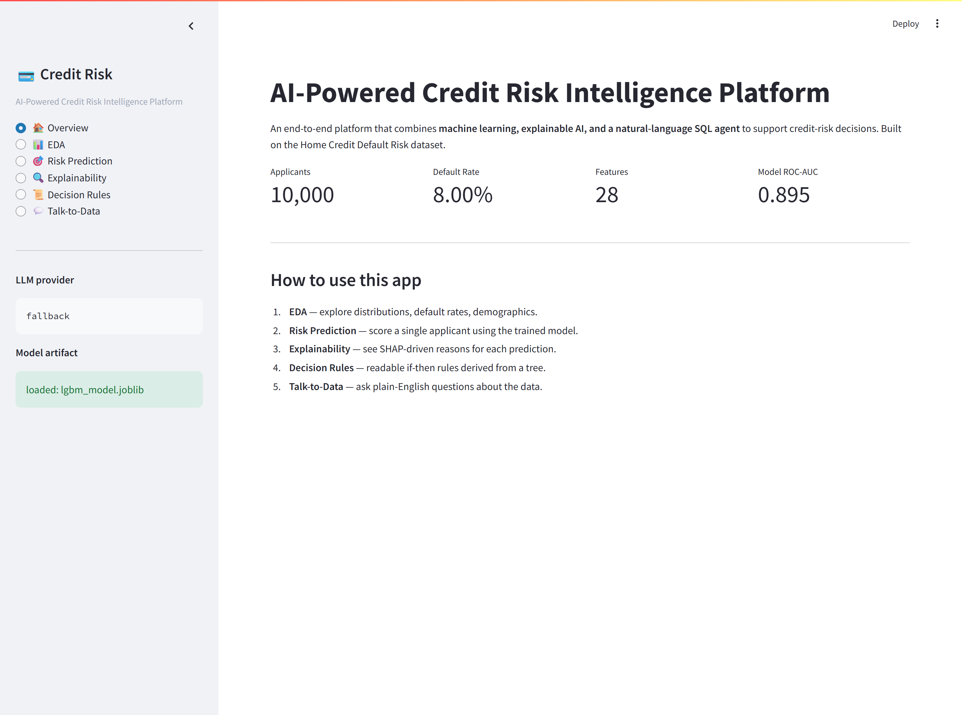
UI · Overview Section
Live KPIs of the platform: 10,000 applicants, 8% default rate, 28 features after engineering, model ROC-AUC 0.895. The sidebar shows the active LLM provider and the loaded model artifact.

Slide 6
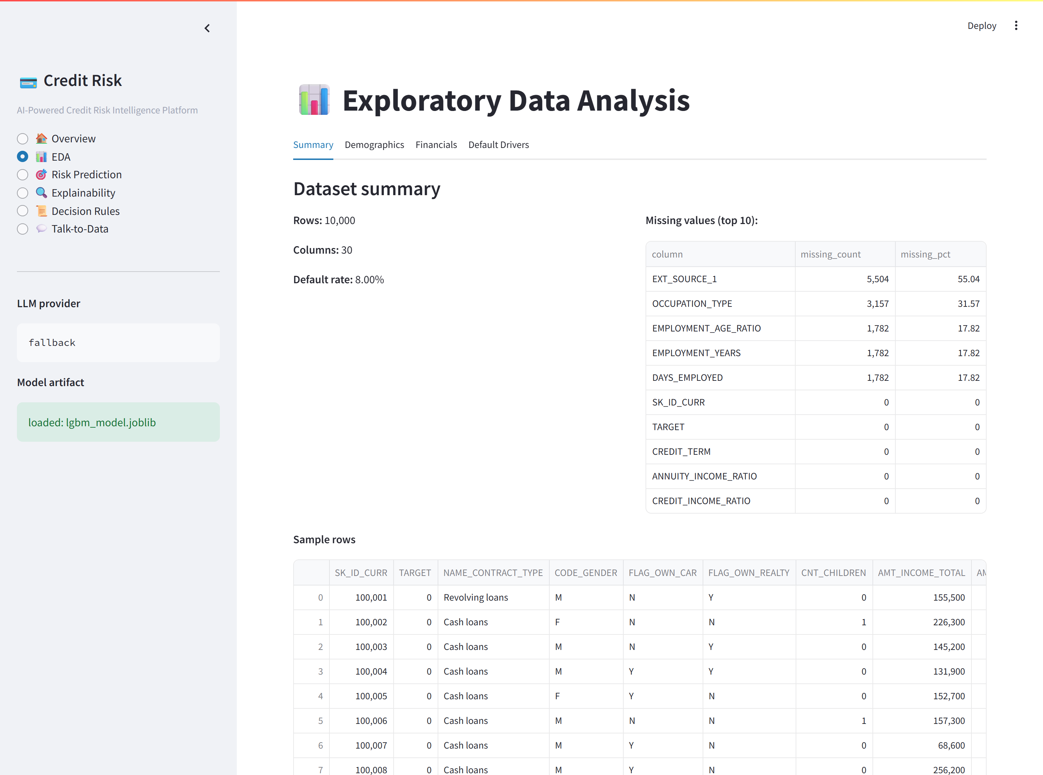
UI · Exploratory Data Analysis
Four EDA tabs: Summary, Demographics, Financials, Default Drivers. Distributions are split by default status; the table on the right shows missingness for the most-affected columns.

Slide 7
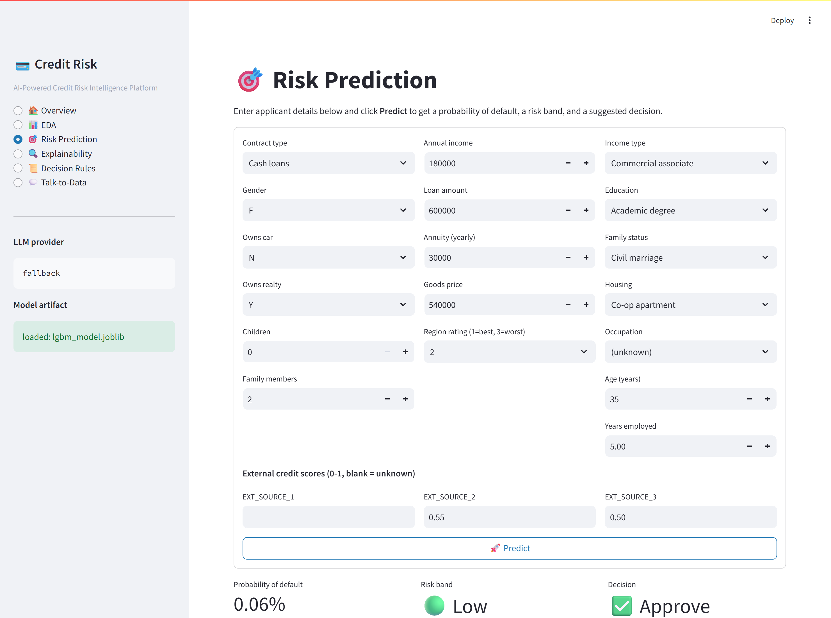
UI · Risk Prediction
Form-driven applicant scoring. Output: probability of default + risk band (Low / Medium / High) + suggested decision (Approve / Review / Reject). Sample shown: P(default)=0.06% → Low → Approve.

Slide 8
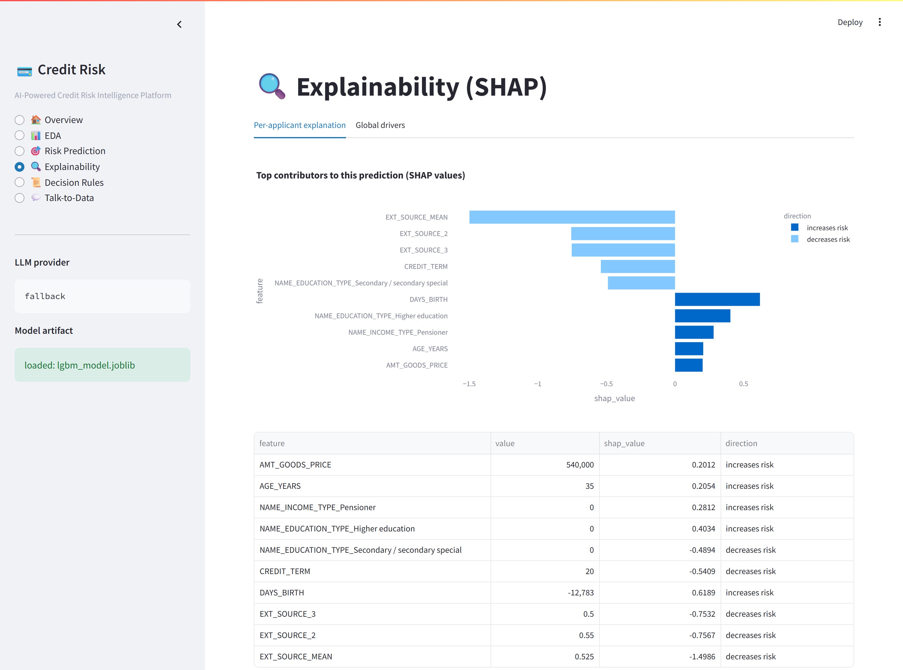
UI · Explainability (SHAP)
Per-applicant top SHAP contributors. Bars going right increase predicted default probability; bars going left decrease it. The table below shows the exact feature values and SHAP magnitudes.

Slide 9
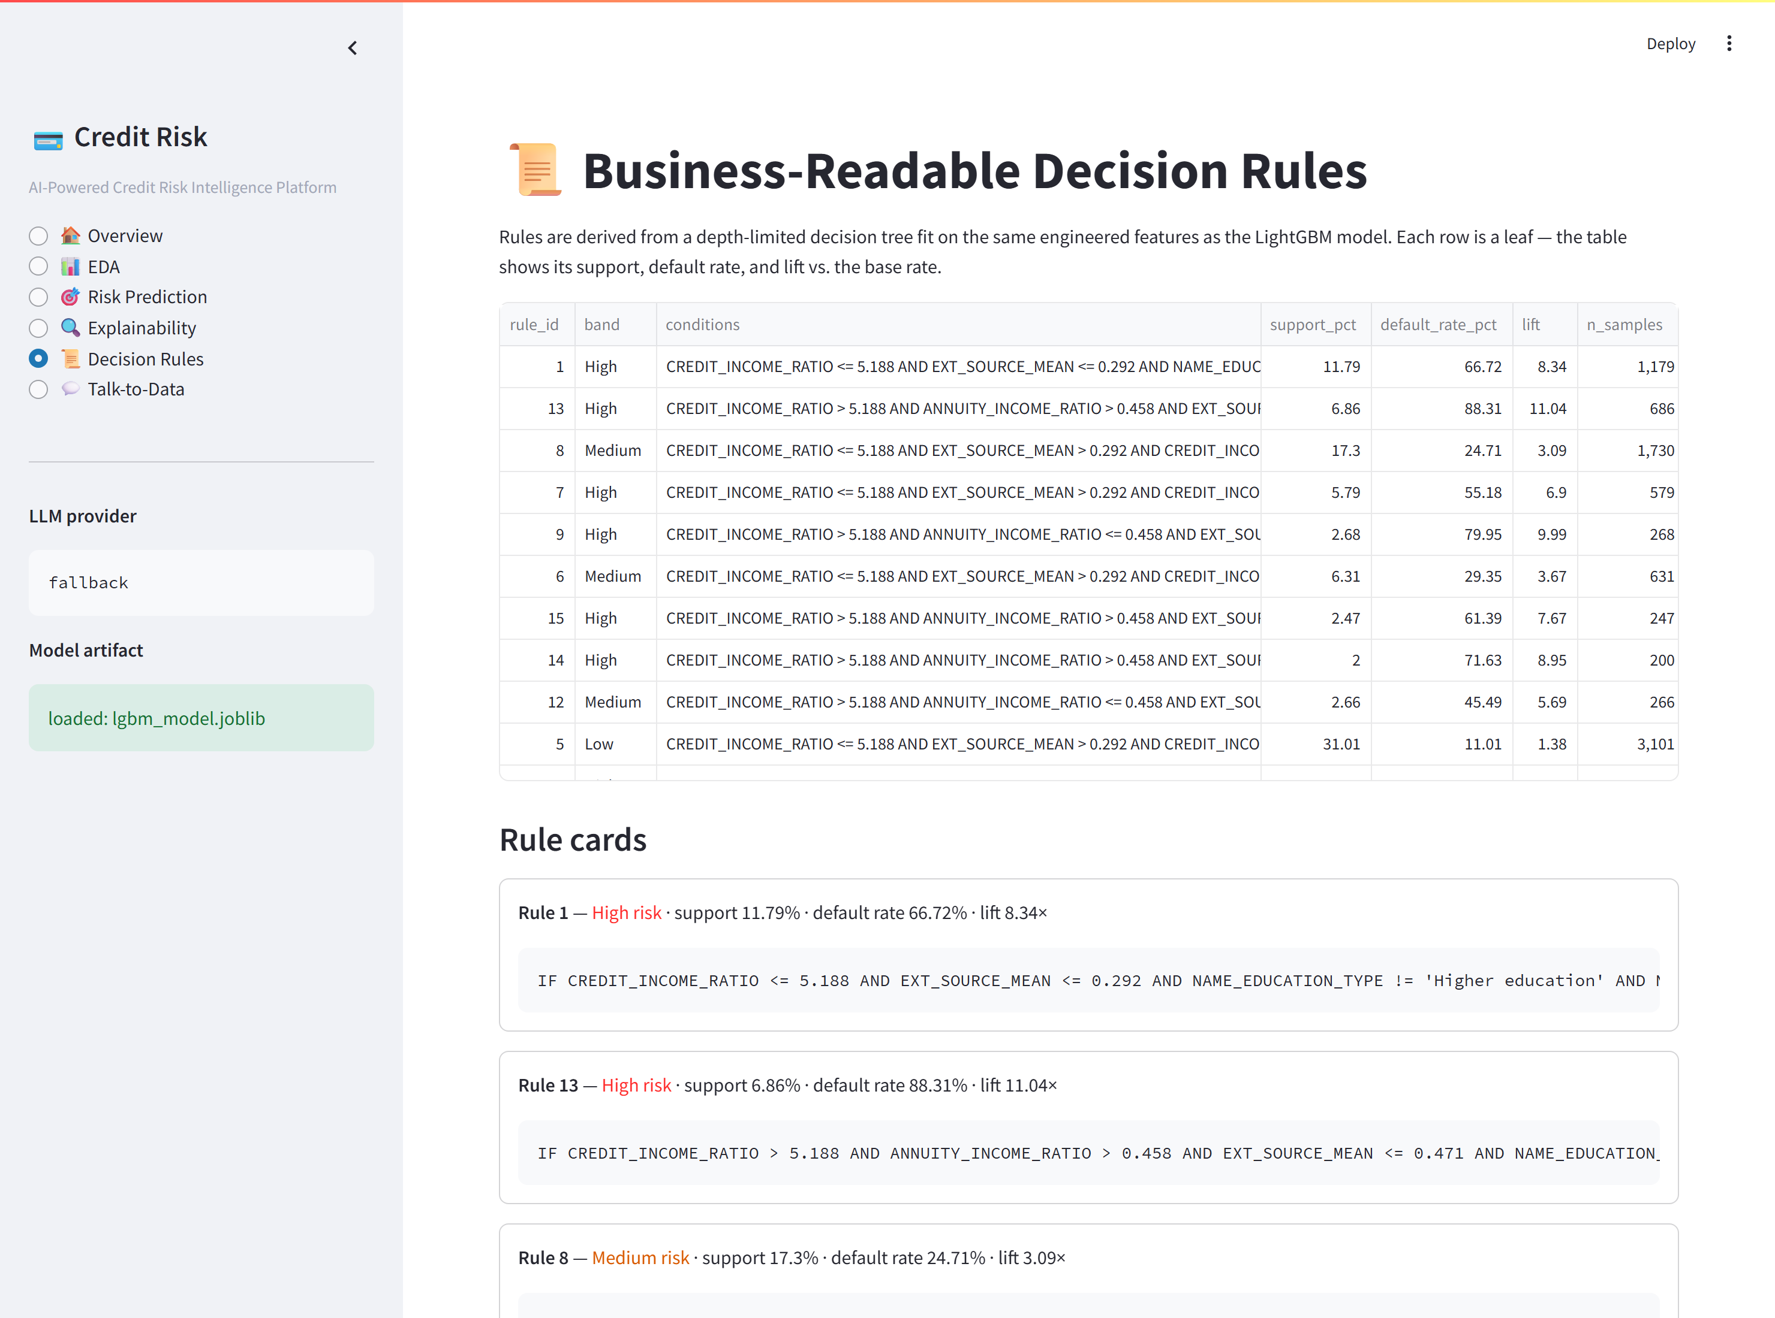
UI · Decision Rules
Business-readable IF-THEN rules derived from a depth-4 decision tree. Each row reports support (% of population), default rate inside the leaf, and lift vs. the 8% base rate.

Slide 10
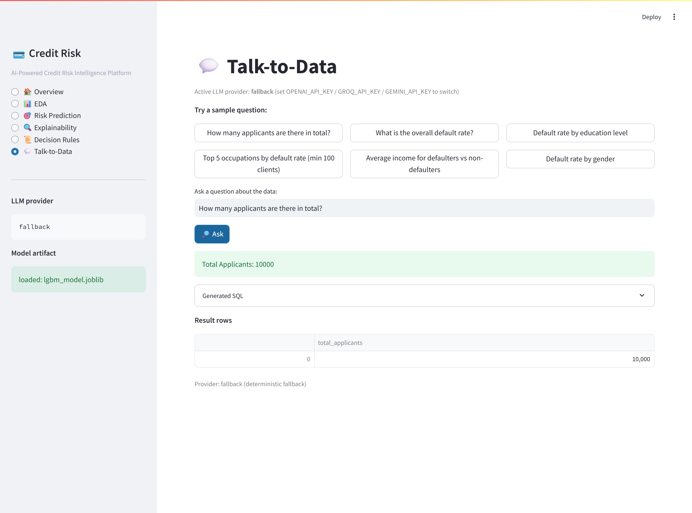
UI · Talk-to-Data Chatbot
User asks a plain-English question; the agent emits a safe SELECT, runs it on SQLite, and summarises the rows. The generated SQL is exposed for full transparency. Falls back to a deterministic intent parser when no LLM key is set.

Slide 11
Backend · ML Training (src/ml/train.py)
LightGBM with scale_pos_weight for class imbalance, threshold chosen by Youden's J on the validation set.
pos_weight = float((y_train == 0).sum() / max((y_train == 1).sum(), 1))
lgbm = LGBMClassifier(
n_estimators=400,
learning_rate=0.05,
num_leaves=31,
max_depth=-1,
min_child_samples=40,
reg_alpha=0.1,
reg_lambda=0.1,
subsample=0.85,
colsample_bytree=0.85,
scale_pos_weight=pos_weight,
random_state=random_state,
n_jobs=-1,
verbose=-1,
)
pipeline = Pipeline(steps=[
("preprocessor", preprocessor),
("classifier", lgbm),
])
pipeline.fit(X_train, y_train)
proba_val = pipeline.predict_proba(X_val)[:, 1]
auc = float(roc_auc_score(y_val, proba_val))
pr_auc = float(average_precision_score(y_val, proba_val))
ks = _ks_statistic(y_val, proba_val)
# Pick the threshold that maximises Youden's J on the validation set.
fpr, tpr, thresholds = roc_curve(y_val, proba_val)
j = tpr - fpr
best_idx = int(np.argmax(j))
best_threshold = float(thresholds[best_idx])
preds = (proba_val >= best_threshold).astype(int)
f1 = float(f1_score(y_val, preds))
cm = confusion_matrix(y_val, preds).tolist()
feat_names = get_feature_names_out(pipeline.named_steps["preprocessor"])
importances_arr = pipeline.named_steps["classifier"].feature_importances_
importances = dict(

Slide 12
Backend · NL → SQL Agent (src/llm/nl_to_sql.py)
Pipeline: prompt LLM → parse JSON → static safety check → read-only execute → second LLM call grounds the summary in rows.
sql_raw = _fallback_sql(question) or (
"SELECT 'unanswerable_with_fallback_parser' AS note"
)
else:
try:
client = get_client()
llm_text = client.chat(build_messages(schema, question))
sql_raw = _extract_json_sql(llm_text)
except (LLMUnavailable, Exception):
# LLM died -- use the deterministic parser instead of giving up.
used_fallback = True
provider = "fallback"
sql_raw = _fallback_sql(question) or (
"SELECT 'llm_failed_and_no_fallback_match' AS note"
)
validation = validate_and_harden(sql_raw)
if not validation.ok:
return AgentAnswer(
question=question,
sql=sql_raw,
rows=[],
answer=f"I rejected the generated SQL: {validation.reason}",
provider=provider,
used_fallback=used_fallback,
error=validation.reason,
)
try:
with open_connection() as conn:
df = pd.read_sql_query(validation.sql, conn)
except sqlite3.Error as e:
return AgentAnswer(
question=question,
sql=validation.sql,
rows=[],
answer=f"SQL execution failed: {e}",
provider=provider,
used_fallback=used_fallback,
error=str(e),
)
summary = _summarise(question, validation.sql, df, provider)
return AgentAnswer(
question=question,
sql=validation.sql,
rows=df.to_dict(orient="records"),
answer=summary,
provider=provider,
used_fallback=used_fallback,
)

Slide 13
Backend · SQL Safety (src/utils/sql_safety.py)
Single SELECT, table allowlist, blocked keyword list, automatic LIMIT cap. The chatbot cannot mutate data even if the LLM goes off-script.
r"\bpragma\b",
r"\bvacuum\b",
r"\bload_extension\b",
r"\b\.shell\b",
r"\b\.system\b",
]
MAX_ROWS = 200
@dataclass
class SqlValidation:
ok: bool
sql: str
reason: str = ""
def validate_and_harden(sql):
raw = sql.strip().rstrip(";").strip()
if not raw:
return SqlValidation(False, "", "Empty SQL.")
if ";" in raw:
return SqlValidation(False, raw, "Multiple statements are not allowed.")
lowered = raw.lower()
for pat in FORBIDDEN_PATTERNS:
if re.search(pat, lowered):
return SqlValidation(False, raw, f"Forbidden keyword detected ({pat}).")
parsed = sqlparse.parse(raw)
if len(parsed) != 1:
return SqlValidation(False, raw, "Exactly one statement is required.")
first_token = parsed[0].token_first(skip_ws=True, skip_cm=True)
if first_token is None:
return SqlValidation(False, raw, "Could not parse SQL.")
head = first_token.normalized.upper()
if head not in {"SELECT", "WITH"}:
return SqlValidation(False, raw, "Only SELECT/WITH queries are permitted.")
# Recognise CTE aliases so `WITH t AS (...) SELECT * FROM t` works.
cte_aliases = set(
re.findall(r"\b([a-zA-Z_][a-zA-Z0-9_]*)\s+as\s*\(", lowered)
)
table_refs = set(re.findall(r"\bfrom\s+([a-zA-Z_][a-zA-Z0-9_]*)", lowered))
table_refs |= set(re.findall(r"\bjoin\s+([a-zA-Z_][a-zA-Z0-9_]*)", lowered))
unknown = table_refs - ALLOWED_TABLES - cte_aliases
if unknown:
return SqlValidation(
False, raw, f"Reference to disallowed table(s): {sorted(unknown)}"
)

Slide 14
Backend · Multi-Provider LLM Client (src/llm/client.py)
Auto-detects OpenAI / Groq / Gemini based on whichever API key is set; gracefully falls back to a deterministic parser.
from openai import OpenAI
self._client = OpenAI(
api_key=SETTINGS.openai_api_key,
timeout=SETTINGS.llm_timeout_seconds,
)
@retry(stop=stop_after_attempt(2), wait=wait_exponential_jitter(initial=1, max=4))
def chat(self, messages):
resp = self._client.chat.completions.create(
model=SETTINGS.openai_model,
messages=messages,
temperature=SETTINGS.llm_temperature,
max_tokens=SETTINGS.llm_max_tokens,
)
return (resp.choices[0].message.content or "").strip()
class _GroqClient(_BaseClient):
name = "groq"
def __init__(self):
from groq import Groq
self._client = Groq(
api_key=SETTINGS.groq_api_key,
timeout=SETTINGS.llm_timeout_seconds,
)
@retry(stop=stop_after_attempt(2), wait=wait_exponential_jitter(initial=1, max=4))
def chat(self, messages):
resp = self._client.chat.completions.create(
model=SETTINGS.groq_model,
messages=messages,
temperature=SETTINGS.llm_temperature,
max_tokens=SETTINGS.llm_max_tokens,
)
return (resp.choices[0].message.content or "").strip()
class _GeminiClient(_BaseClient):
name = "gemini"
def __init__(self):
import google.generativeai as genai
genai.configure(api_key=SETTINGS.gemini_api_key)
self._model = genai.GenerativeModel(SETTINGS.gemini_model)
@retry(stop=stop_after_attempt(2), wait=wait_exponential_jitter(initial=1, max=4))
def chat(self, messages):
# Gemini has no system role - merge into the user prompt.
sys_parts = [m["content"] for m in messages if m["role"] == "system"]
usr_parts = [m["content"] for m in messages if m["role"] != "system"]
prompt = ("\n\n".join(sys_parts) + "\n\n" + "\n\n".join(usr_parts)).strip()
resp = self._model.generate_content(
prompt,
generation_config={
"temperature": SETTINGS.llm_temperature,
"max_output_tokens": SETTINGS.llm_max_tokens,
},
)

Slide 15
Prompt Engineering & Token Optimisation
JSON-only output contract — model emits {"sql": "..."}; deterministic parsing.
Pinned schema (~25 cols, 1-line descriptions) → no DB introspection round-trip.
Few-shot kept tiny (4 examples) to anchor style without bloating context.
Temperature 0; max 256 output tokens — SQL doesn't need prose.
Static SQL safety: SELECT/WITH only, table allowlist, LIMIT cap, blocked keywords.
Result-grounded summary prompt explicitly forbids invented numbers.
Hard fallback: deterministic regex parser keeps the demo working offline.

Slide 16
Evaluation Results (bundled 10k sample)
Metric | Value
ROC-AUC | 0.8952
PR-AUC | 0.5109
KS Statistic | 0.6571
F1 @ optimal threshold | 0.3994
Optimal threshold | 0.0631
Default rate | 0.08
Train rows / Val rows | 8000 / 2000

Slide 17
Top Derived Decision Rules
R1 · High · support 11.79% · default rate 66.72% · lift 8.34×
R13 · High · support 6.86% · default rate 88.31% · lift 11.04×
R8 · Medium · support 17.3% · default rate 24.71% · lift 3.09×
R7 · High · support 5.79% · default rate 55.18% · lift 6.9×
R9 · High · support 2.68% · default rate 79.95% · lift 9.99×

Slide 18
How To Run
git clone https://github.com/ashwani-dhayal/credit-risk-platform.git
cd credit-risk-platform
cp .env.example .env # add ONE LLM key (optional)
docker compose up --build
→ open http://localhost:8501
Local: python -m venv .venv ; pip install -r requirements.txt ; python scripts/train_model.py ; streamlit run app/streamlit_app.py

Slide 19
Limitations & Next Steps
Adding bureau / previous_application aggregates would lift AUC ~+0.03.
No data-drift monitoring yet (Evidently / WhyLogs are obvious next steps).
Single-tenant SQLite — switch to Postgres for multi-user concurrency.
No UI auth — deploy behind a reverse proxy with auth in production.
LLM cost cap is per-call only; daily quotas would need Redis-based limiting.

Slide 20
Thank You
Repo: https://github.com/ashwani-dhayal/credit-risk-platform
Author: Ashwani Dhayal
Submission: NeoStats AI Engineer assignment.

