Slide 1
Human-System Interface (HSI)

Slide 2
Definition
The human-system interface (HSI) is defined as the technology through which personnel interact with plant systems to perform their functions and tasks. The major types of HSIs include alarms, information systems, and control systems.

Slide 3
Human-Computer Interaction (HCI)
Human
the end-user of a software
the others in the organization
Computer
the machine the software runs on
Interaction
the user tells the computer what they want
the computer communicates results

Slide 4
Problems Caused by Inadequate HSI
Wasted Personnel Time
Employee Frustration
Poor Communication and Shift Handovers
Increased Risk
Reduced Team Responsibility and Accountability
Inconsistent Data Entry
Information Holes
Laboured Reporting and Real-Time Analysis
Scattered and Unconnected Data

Slide 5
Types of Interfaces
Between software components
Between software and external (non-human) entities
Between humans and software

Slide 6
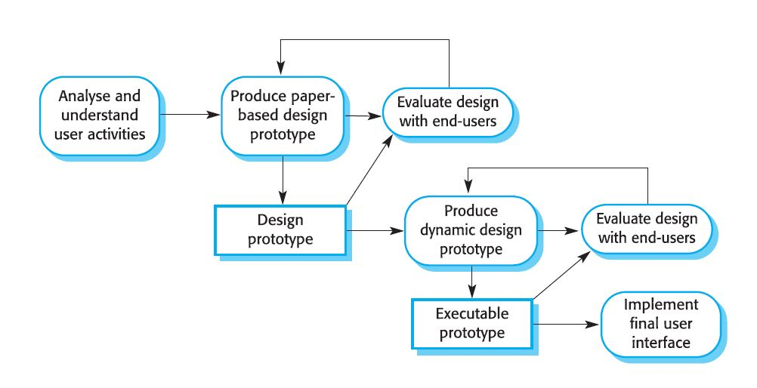
The design process

Slide 7
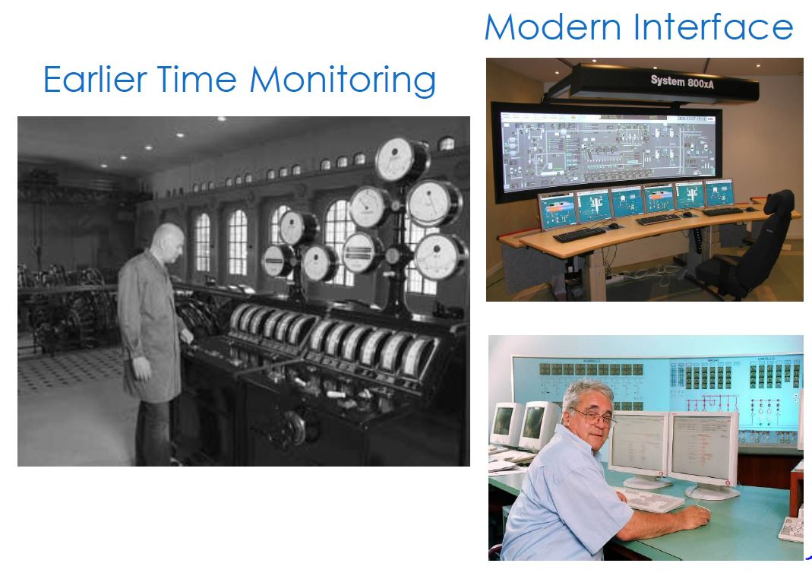
Example of effective HSI implementation

Slide 8
THANK YOU
Submitted By : Ashwani Sekhar
1501051045
IT-A

