Slide 1
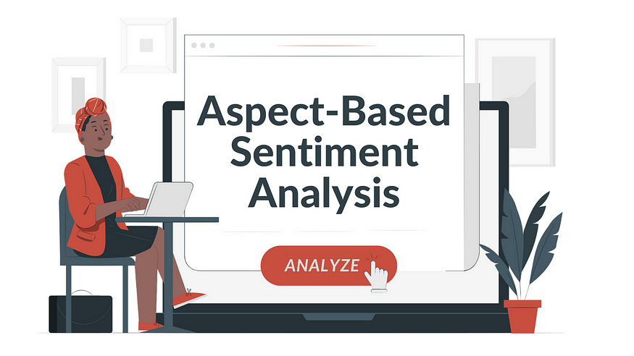
Restaurant Reviews
Ashwani Bindroo
Ashwani Bindroo
26th July 2024
26th July 2024

Slide 2
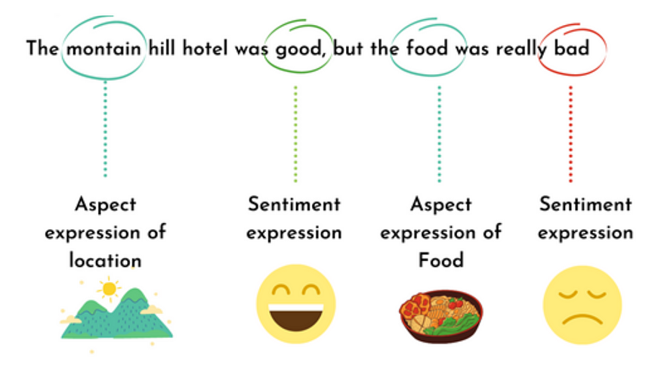
Scenario
You are a data scientist who has been tasked with developing a versatile ABSA model for extracting aspects, determining aspect polarity, and detecting aspect categories from textual data. The goal is to create a robust model/pipeline ensuring flexibility and accuracy across different contexts.

Slide 3
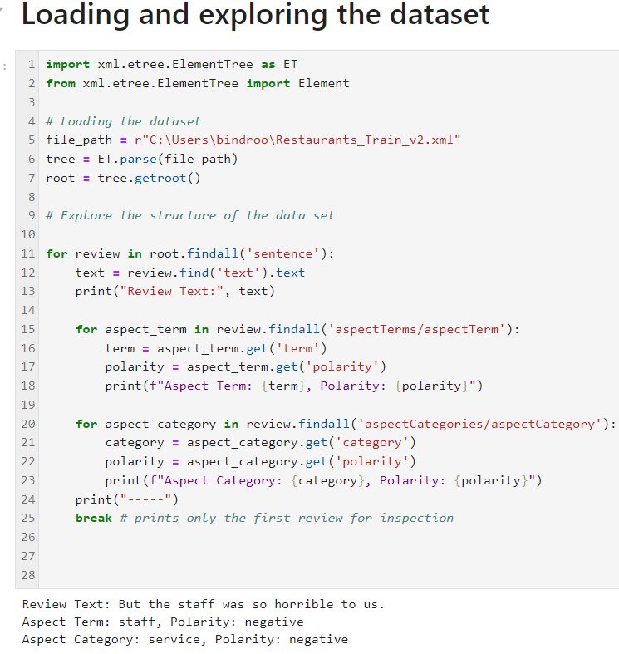
Know the Dataset
The toolkit includes dataset comprising of 3000 customer reviews for a restaurant, all in English, enriched with human-authored annotations. These annotations contain the mentioned aspects of the target entities and the sentiment polarity of each aspect.

Slide 4

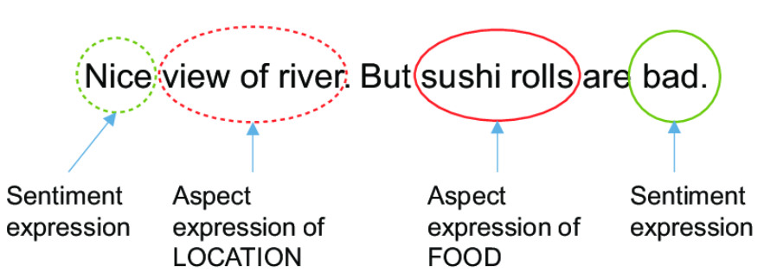
Introduction
To
ABSA
Aspect-based sentiment analysis is a text analysis technique that divides data into aspects and helps determine the sentiment associated with each component.
When we talk about aspects, we’re making reference to the features or elements of a product or service, such as “the customer experience,” “the time it takes to give a response to a complaint,” or “the convenience with which new software can be consolidated.”
Aspect-based sentiment analysis is a crucial component for all businesses, as it necessitates them to listen to their consumers, understand their feelings, analyze their feedback, and focus on improving their experiences, in addition to their expectations for your products and services.
Insights
Pros & Cons
Architecture
Approach
ABSA

Slide 5
Extraction of the review/text
1
2
Aspect term extraction
3
Aspect term polarity detection
4
Aspect category detection
5
Model development
Approach
Insights
Pros & Cons
Architecture
Approach
6
ABSA
Category wise sentiment distribution
7
Negative sentiment analysis (80/20 rule)
8
Inferences from negative reviews
9
10
Pros and cons of the approach
Recommendations towards restaurant for improvements

Slide 6
Aspect term extraction
05
Successfully extracted aspect terms like "food", "service", "staff", etc., from the reviews.
The use of POS tagging helped identify relevant nouns and compound nouns as aspect terms.
Some reviews contained multiple aspect terms, reflecting diverse customer experiences.
Aspect Category Detection
Top 10 Most Negative Reviews
Successfully mapped aspect terms to predefined categories (food, service, price, ambience, anecdotes/miscellaneous).
Extracted the most negative reviews to understand customer pain points better.
Common issues included slow service, poor food quality, and high prices.
03
01
Pros & Cons
Architecture
Insights
Approach
ABSA
02
04
Negative Sentiment Analysis (80/20 rule)
Aspect Term Polarity Detection
Identified that a small number of aspect terms accounted for a large portion of negative sentiments.
Focused on the top aspect terms contributing to 80% of the negative feedback, providing targeted areas for improvement.
The model classified the sentiment polarity (positive, negative, neutral, conflict) for each aspect term with reasonable accuracy.

Slide 7
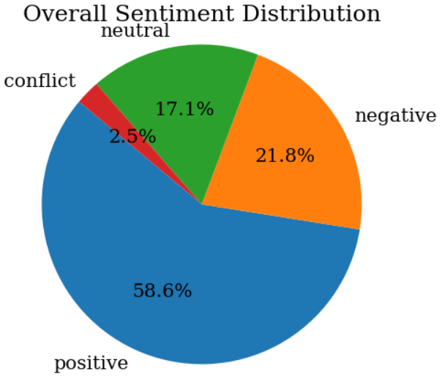
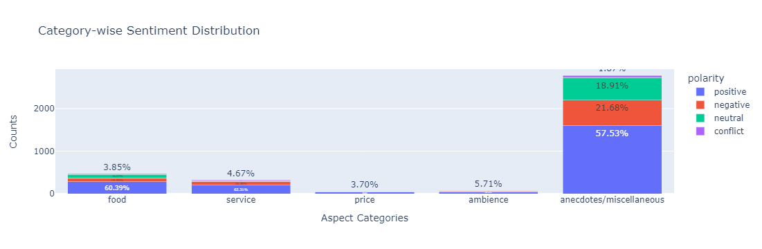
The restaurant has received ~59% of positive reviews.
However, ~22% comprises of negative reviews, which is substantial
Food, Service, Price and Ambience are the Aspect categories worth consideration.
Pros & Cons
Architecture
Insights
Approach
ABSA

Slide 8
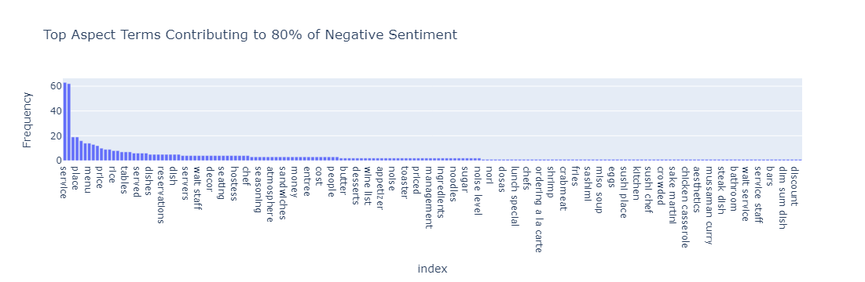
Pros & Cons
Architecture
Insights
Approach
ABSA
Service, Place, Menu and Price are highest contributors of negative sentiment.

Slide 9
Pros
Accuracy
The LinearSVC classifier provided reasonable accuracy for both aspect term polarity detection and aspect category detection.
Manual annotations helped in creating a robust training dataset
02
Pros & Cons
Architecture
01
03
Insights
ABSA
Flexibility
Actionable insights
The model provided actionable insights into customer feedback, highlighting specific areas for improvement.
The sentiment distribution chart and negative sentiment analysis offered a clear understanding of customer sentiments.
The model is designed to be generic and adaptable to different domains beyond restaurant reviews.
The use of standard NLP techniques (POS tagging, vectorization) makes it applicable to various text data.

Slide 10
cons
Reliance on annotated data
Simplistic aspect term extraction
The model's accuracy heavily depends on the quality and quantity of human-annotated data.
Annotating data is time-consuming and may not always be feasible for large datasets.
The use of POS tagging for aspect term extraction is simplistic and may miss out on more complex terms or phrases.
Advanced techniques like dependency parsing or deep learning models could improve extraction accuracy.
03
01
Architecture
Pros & Cons
Insights
ABSA
02
04
Domain specific challenges
Potential for misclassification
The model may need adjustments when applied to different domains, especially in mapping aspect terms to categories.
Certain domain-specific terms may not be accurately captured without additional customization.
LinearSVC, while effective, may not handle highly imbalanced classes or subtle differences in sentiment well.
More advanced models (e.g., transformers) could offer better performance in such scenarios.

Slide 11
For Model Improvement
Advanced Models:
Consider using more advanced models like BERT or other transformer-based models for aspect term extraction and sentiment analysis.
These models can capture more context and nuances in the text, improving accuracy.
Expand Dataset:
Increasing the size and diversity of the annotated dataset can enhance model performance.
Include more diverse reviews from different sources to capture a broader range of customer feedback.
Architecture
Recommendations
Insights
ABSA
Domain Adaptation:
Implement domain adaptation techniques to make the model more robust across different domains.
Customize aspect term-category mappings for specific domains.
Fine-Tuning:
Fine-tune the model parameters and experiment with different classifiers to optimize performance.
Consider techniques like oversampling or class weighting to handle class imbalances.

Slide 12
For Restaurant
Improve Food Quality:
Conduct menu reviews and quality checks.
Gather customer feedback on dishes.
Retrain kitchen staff or hire experienced chefs.
Enhance Service Efficiency:
Provide staff training for better efficiency.
Optimize table turnaround times.
Increase staffing during peak hours.
Implement customer service best practices.
Revise Pricing Strategy:
Analyze and compare pricing with competitors.
Offer promotions and loyalty programs.
Balance portion sizes and ingredient costs.
Highlight value propositions.
Enhance Ambience and Cleanliness:
Invest in cleaning and maintenance.
Update decor and interior design.
Adjust music selection and volume.
Solicit customer feedback on ambience.
Architecture
Recommendations
Insights
ABSA
Focus on Specific Feedback:
Address individual customer complaints.
Make targeted improvements based on feedback.
Provide staff with specific feedback.
Increase Customer Engagement:
Train staff for personalized recommendations.
Implement a CRM system.
Engage with customers through social media.
Encourage customer reviews and feedback.

Slide 13

Business Objectives
Stakeholders:
Product Managers
SMEs
Data Acquisition
Data Engineers
Feature Engineering
EDA
Data Prep and processing
Model Training/Experimentation
Data Scientists
Model Analysis and Evaluation
Architecture
Insights
ABSA
Runtime Env
Autoscaling
Logging/Scheduling
ML Architects + Data Engineers
Risk Assessment
Containerization (Docker/Kubernetes)
Performance degradation checker
DevOps + Data Scientists
Final Model performance analysis
CI/CD Pipelines
Online Monitoring
Data Engineers + DevOps

Slide 14

THANK YOU

