Slide 1
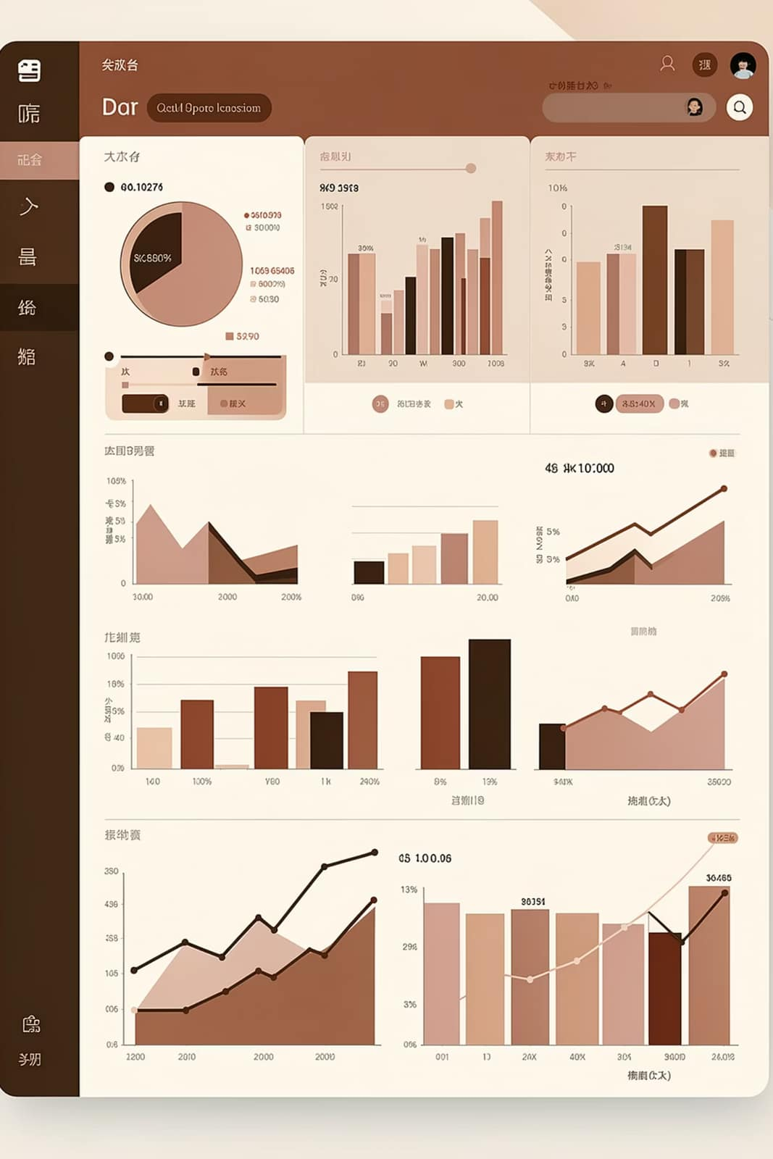
Customer Shopping Behavior Analysis
Uncovering insights from 3,900 purchases to guide strategic business decisions

Slide 2


Project Overview
Dataset Size
Key Goals
3,900 purchases across 18 features
Spending patterns, customer segments, product preferences
Business Impact
Strategic decisions on subscriptions and promotions

Slide 3

Data Preparation Process
Python Workflow
Data loading with pandas
Initial exploration and summary statistics
Missing data imputation
Column standardization
Feature engineering
PostgreSQL integration

Slide 4

Key Data Insights
3,900
Total Purchases
Transactional records analyzed
18
Data Features
Customer demographics and purchase details
$59.76
Average Spend
Mean purchase amount (USD)
44
Average Age
Median customer age in years

Slide 5
Revenue by Gender
Male customers generated 2.1x more revenue than female customers

Slide 6

Top 3 Products
1
2
Pants
Blouse
171 purchases
171 purchases
3
Jewelry
171 purchases

Slide 7

Shipping Type Comparison
Standard Shipping
Express Shipping
Average purchase: $58.46
Average purchase: $60.48
Most common option
Higher-value orders

Slide 8



Subscription Impact
1053
2847
Subscribers
Non-Subscribers
$62,645 total revenue
$170,436 total revenue
$59.49
$59.87
Subscriber Avg
Non-Subscriber Avg
Per purchase amount
Per purchase amount

Slide 9

High-Value Discount Users
Discount Strategy
Identified customers using discounts while spending above average
Revenue Opportunity
High-spending customers responsive to promotional offers

Slide 10




Top-Rated Products
Gloves
Sandals
Boots
Hat
3.86 average rating
3.84 average rating
3.82 average rating
3.80 average rating

